Slide 1
Learning
Outcome: I can understand the theory and practice of learning in this class.

Slide 2
Learning IN a Mr. Petlak class - Summarized
You can expect a combination of personalized learning (pursuing knowledge of your choice within a certain guideline/goal) and traditional learning (making sense of notes, study cards, reading strategies).
Personalized learning prepares you for life and problem solving.
Traditional learning prepares you for post-secondary.

Slide 3
Questions to ask yourself when learning
Why is this important?
What do I want to know more about?
How can I learn more about it?
Do I trust the information I found from a particular source?
How does this connect to other people I know?
Where am I at with understanding this (self-assess)?

Slide 4
Learning Styles and Needs
Ideally, I (Mr. Petlak), can meet the needs of all learners.
You can expect baseline knowledge and then have to apply and create with the baseline knowledge by the end.
It should be delivered in a variety of ways… lecture, hands-on, independent research, discussion, etc. You should learn how you learn best…
I learn best by watching, listening, and reading all together. Simply reading can take me more time, but if I write about my thoughts (reading strategies) while I do it, it makes the content more meaningful to me.

Slide 5
Digital Citizenship
Outcome: I can utilize the internet and social media and be a connected Learner.

Slide 6
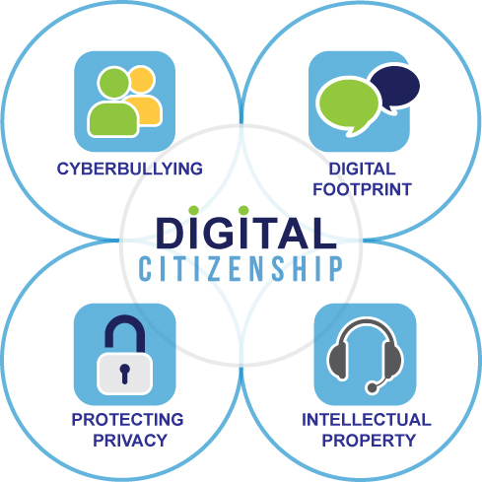
What is digital citizenship?
Being a good “citizen” online.
Cyberbullying – what is it? What does it involve? Don’t hide behind anonymity.
Digital footprint – make one, be aware of what it shows about you – five years from now do you think you will be happy to stumble onto this? – Example = if you make a post about an Ex or breaking up… is it the right venue? Do you need everyone to know in that way?
Protecting privacy – be aware of your privacy settings, and the privacy of others… ANYTHING you share can become public (pictures, opinions, etc.)
Intellectual property – give credit wherever you receive information from if you are re-using it for your own writings.

Slide 7
Pro-Tip
You need a hint of paranoia. EVERYTHING YOU DO CAN BE TRACKED… SO MAYBE AVOID DOING BAD THINGS?
My thoughts on “invasion of privacy” is… if I’m not doing anything wrong… I’ve got nothing to worry about.
Case in point – Ashley Madison hacking several years ago.
Share your learning and reflect on it! Blogs/reflections are great! Find a blog you like, what did they do well? How can you emulate that? What would you do differently?

Slide 8

Social Media (YouTube, Twitter, Instagram, Snapchat)
Follow people that you are interested in – they add to your personal (learning) network. More people with similar interests allows you to be more likely to find more posts that you are interested in.
Think of someone you follow (friend, celeb, etc.), why do you follow them? They post interesting things… So see who they follow or who they are similar to and follow them as well because you’ll probably find even more interesting things!
Apply this to science, health, history, pictures of the world and school! If you connect with people or groups that do this and share your interests, you will have more access to it! Try it now!

Slide 9
Wikipedia. (2016, February 25). Vegetarianism. Retrieved February 25, 2016, from https://en.wikipedia.org/wiki/Vegetarianism

Slide 10
Learning
Knowledge is everywhere online.
YOU can find it everywhere online.
Most simple questions, YOU can find out. This is knowledge.
Learning is knowing how to utilize that knowledge – apply or create with that knowledge.
Reading strategies, discussions with peers and teachers, and asking more questions, helps you enhance that learning.
Networking online, helps you extend people you can learn from WORLDWIDE

Slide 11
In the real world…
Exams aren’t “real life”… but many jobs and education have them as a baseline to confirm what you know.
UNLESS you’re in university… then exams consume your life.
University knowledge is awesome, but a lot of the information you can find yourself online. The class can, however, ask questions to broaden your understanding of some content… and many jobs only recognize university credentials. But textbooks are expensive, and for a lot of first year courses you can avoid textbooks entirely.
It’s best to learn how to get and critique a real answer… is Wikipedia trustworthy? If it sounds ridiculous when you read something, it probably is.
Open Education → Flexible learning (learning what YOU want).
Open Education Database, Coursera

Slide 12
Credibility of websites
We have previous questions on slide three of the presentation that help address this.
Who wrote it? What are their credentials? Is it subject to personal bias? Does it sound biased?
Remember opinion is only that.
When was it written? Is it recent or is it old news?
Play devil’s advocate, try to pick it apart and not just buy into it.

Slide 13
Application
Note that this applies to anything you wish to learn… I am trying to learn how to play piano… I am following piano teachers on twitter, I search for tips and videos on YouTube, I talk to Mr. McCorriston for help, and I connect to music I know and like in order to practice and learn more… and I share my learning of it… for others… AND for myself. Loganpetlak.ca
Writing about it helps me observe my thoughts, and critique my thoughts on it.

