Slide 1
Life Science: Reproduction and Human Development
Examine the process of and influences on the transfer of genetic information and the impact of that understanding on society past and present. [CP, DM]

Slide 2
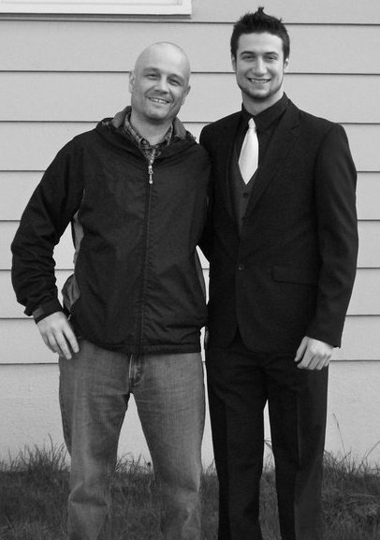
Genetics – Questions to investigate about it
Identify questions to investigate related to genetics.
What is Genetics?
What do I know about it?
What do I want to know about it?
How can I learn about it?

Slide 3
Genetics – Questions to investigate about it
What is Genetics?
“Genetics is the study of genes, genetic variation, and heredity in living organisms. – Griffiths et al”
A gene is the basic physical and functional unit of heredity.
What do I know about it?
What do I want to know about it?
Come up with five questions about genetics
How can I learn about it?

Slide 4
Q’s

Slide 5
Genetics Coin flip.
There are an estimated 20,000-25,000 human protein-coding genes. Wikipedia – The Human Genome.
That’s 25,000 coin flips from mom… and 25,000 coin flips from dad to make you.

Slide 6
Where do we find genetics/genes in our bodies?

Slide 7
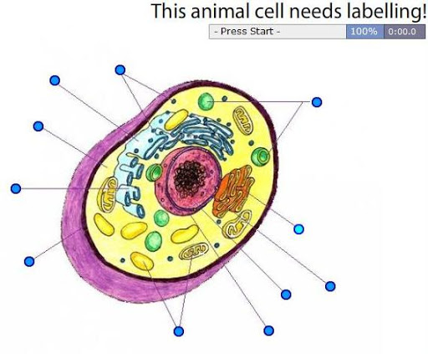
BUT WHERE?!?!?!?!

Slide 8
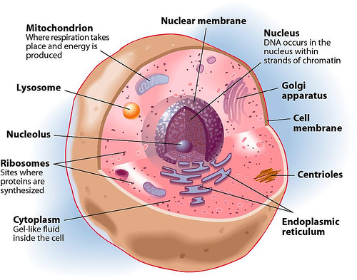
What do we find our genetics in our bodies?
IN EVERY CELL IN OUR BODY!
IN THE NUCLEUS
BLOOD CELLS, BRAIN CELLS, SKIN CELLS – ALL OF THEM HAVE DNA (our genes!)

Slide 9
Nucleus and DNA
Recognize that the nucleus of a cell contains genetic information and identify the relationship among chromosomes, genes, and DNA in transmitting genetic information
Nucleus contains DNA, which is made up of chromosomes, which has genes on them!
When cells

Slide 10
Dominant and Recessive Traits
Identify examples of dominant and recessive traits in humans and other living things.
What is a dominant trait? Dominant traits will be expressed if you receive one from a parent.
What is a recessive trait? Is a trait that will only be expressed if you have two of the same recessive traits from a parent.
AA + aa → Aa
Codominant, sex-linked

Slide 11
Inheritable traits from parents
Observe, collect, and analyze class and/or family data of human traits that may be inherited from parents.
What are traits that we inherit from our parents?
5 minutes – list as many as you can.

Slide 12
Inheritable traits from parents
Observe, collect, and analyze class and/or family data of human traits that may be inherited from parents (e.g., eye colour, chin shape, ear lobes, and tongue rolling).
What are traits that we inherit from our parents? Resource!
Eye colour
Chin shape
Ear lobes
Tongue rolling
Handedness
Hairline
Chin/cheeks
Nose
Thumb
Blood type

Slide 13
Backtracking!
AA is the combination of two alleles (or types of a gene - one from mom, one from dad). These two alleles together represent information for a gene and are an individual’s genotype. Depending on the dominant/recessive nature of the alleles – tells us what will be expressed or seen: phenotype.

Slide 14
From Parent to Child – The Ugly Baby Activity
Observe, collect, and analyze class and/or family data of human traits that may be inherited from parents (e.g., eye colour, chin shape, ear lobes, and tongue rolling).
Work with a partner (table partner). Complete the activity!

Slide 15
Changing our Genetics
Discuss environmental factors and personal choices that may lead to changes in a cell’s genetic information
Can our cells genetic information change? How?
Exposure to things that may damage it. Some genes only activate or become visible at certain ages.
Brainstorm a list of things that may change our cells genetic information.
What is a word to describe this change?
What are the potential effects of this change?

Slide 16
Changing our Genetics
Discuss environmental factors and personal choices that may lead to changes in a cell’s genetic information (e.g., toxins, carcinogens, pesticides, smoking, overexposure to sunlight, and alcohol abuse).
Other factors that can change our genetics:

Slide 17
Changing our Genetics
Discuss environmental factors and personal choices that may lead to changes in a cell’s genetic information (e.g., toxins, carcinogens, pesticides, smoking, overexposure to sunlight, and alcohol abuse).
Other factors that can change our genetics:
Toxins – types of poison
pesticides – substances meant for the destruction of “pests”
carcinogens - a substance capable of causing cancer in living tissue.

Slide 18
Genetic Conditions
Provide examples of genetic conditions whose causes and cures are not understood according to current scientific and technological knowledge.
What are some genetic conditions (diseases/afflictions)?
Come up with a list of five yourself to share (use your phones or background knowledge)
Down’s Syndrome – additional chromosome
Cri-du-chat –
Crohn’s disease – bowel issues
Progeria – premature aging
Scoliosis – abnormal spine curvature
Hemophilia – difficulty with blood clotting
Parkinson’s disease – Tremors and shakes - https://www.youtube.com/watch?v=WiVQcgmIi08
Autism spectrum disorder – difficulty forming relationships
Cystic fibrosis – build-up of mucus
Type 1 diabetes – your pancreas stops producing insulin
Some of these conditions have treatments but not cures because we’d need to fix the genes of every cell in our body!

Slide 19
CELL REPRODUCTION!
https://www.youtube.com/watch?v=L0k-enzoeOM
Crash Course Biology - Mitosis

Slide 20
Cellular Reproductive Processes
RE9.2 Observe and describe the significance of cellular reproductive processes, including mitosis and meiosis.
We know humans reproduce.
But how do cells reproduce?
Many of the cells you are at the moment will soon die, but you’ll still be here!

Slide 21
Gene Therapy and Genetic Engineering
Select and synthesize information from various sources to illustrate how developments in genetics, including gene therapy and genetic engineering, have had an impact on global and local food production, populations, the spread of disease, and the environment.
Canadian Contributions to Genetics
Provide examples of Saskatchewan and Canadian contributions to the science and technology of genetics and reproductive biology in plants and animals.
Careers in Genetics
Describe careers in Saskatchewan or Canada that require an understanding of genetics or reproductive biology

Slide 22
How has gene therapy and engineering affected plants and animals?
Any ideas?

Slide 23
Vocabulary Review
Chromosome
Chromatin
DNA
Chromatid
Centromere
Prophase
Metaphase
Anaphase
Telophase
Cytokinesis
Haploid
Diploid

Slide 24
Vocabulary Review
Chromosome - a threadlike structure of nucleic acids and protein found in the nucleus of most living cells, carrying genetic information in the form of genes.
Chromatin - is a complex of DNA and proteins that forms chromosomes within the nucleus of eukaryotic cells.
DNA - is a molecule that carries the genetic instructions used in the growth, development, functioning and reproduction of all known living organisms and many viruses.
Chromatid - each of the two threadlike strands into which a chromosome divides longitudinally during cell division.
Centromere - the point on a chromosome by which it is attached to a spindle fiber during cell division.

Slide 25
Haploid versus Diploid
having a single set of unpaired chromosomes. (23 chromosomes or n)
Diploid is a single set of paired chromosomes (one from mom and one form dad dad) – 46 chromosomes or 2n
Mitosis is diploid to diploid.
Meiosis is diploid to haploid.

Slide 26
SEX CELL (Gametes) REPRODUCTION!
https://www.youtube.com/watch?v=L0k-enzoeOM
Crash Course Biology – Meiosis
Three or more important points that stood out!

