Slide 1
Science 9: Physical Science
Atoms and Elements

Slide 2
Atoms
AE 9.2 Analyze historical explanations of the structure of matter up to and including:
ººDalton model
ººThomson model
ººRutherford model
ººBohr model of the atom

Slide 3
What makes up…
A pencil.
WOOD! – around the outside
Graphite or Lead – to write
Metal (Aluminum) – eraser holder
Synthetic rubber – Eraser
Paint/plastic cover -

Slide 4
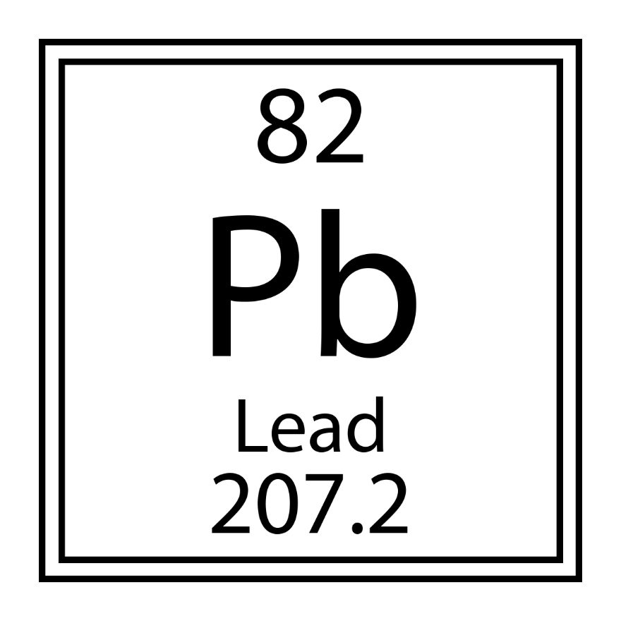
What makes up…
Lead - Pb
Cellulose (wood) – C₆H₁₀O₅ (n)
Aluminum – Al

Slide 5
Vocabulary
Mass
Charge
Electron
Proton
Neutron
Nucleus
Atom
Molecule
Element
Compound
Neutral
Positive
Negative
Ion
Isotope
Periodic table

Slide 6
What is an atom?
An atom is
It has a ________ (center) composed of protons (_), neutrons, and electrons (_).
Protons and electrons have a __________.
Some atoms lose/gain electrons giving them a particular charge.
+ = _______
- = _______
A molecule is

Slide 7
What is an atom?
An atom is the smallest constituent unit of ordinary matter that has the properties of a chemical element.
It has a nucleus (center) composed of protons (+), neutrons, and electrons (-).
Protons and electrons have a charge
Some atoms lose/gain electrons giving them a particular charge.
+ = cation
- = anion
A molecule is the smallest particle in a chemical element or compound that has the chemical properties of that element or compound – held together by chemical bonds.

Slide 8
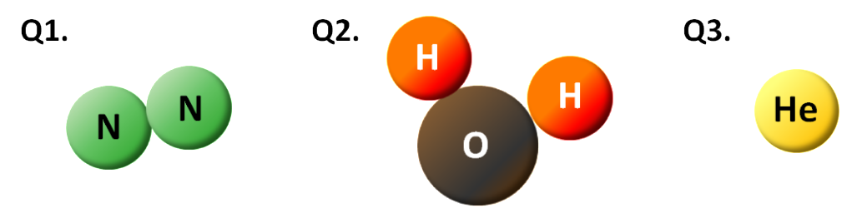
Elements vs Compounds
Element is a
Compound is

Slide 9
Elements vs Compounds
Element is a particular type of atom.
Compound is a combination of two or more different atoms to form a molecule.

Slide 10
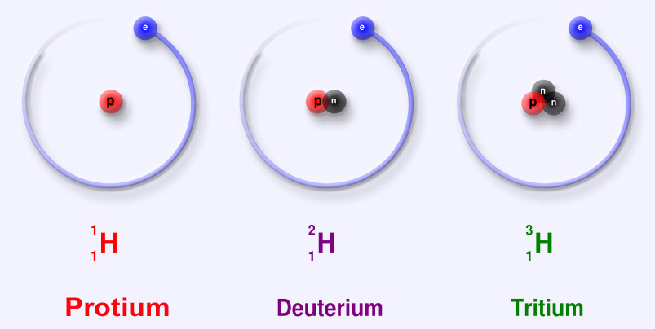
Isotopes
Isotopes
Carbon 12, __, __

Slide 11
Isotopes
Isotopes are versions of an atom or an element that have the same number of protons, but different numbers of neutrons.
Carbon 12, 13, 14

Slide 12
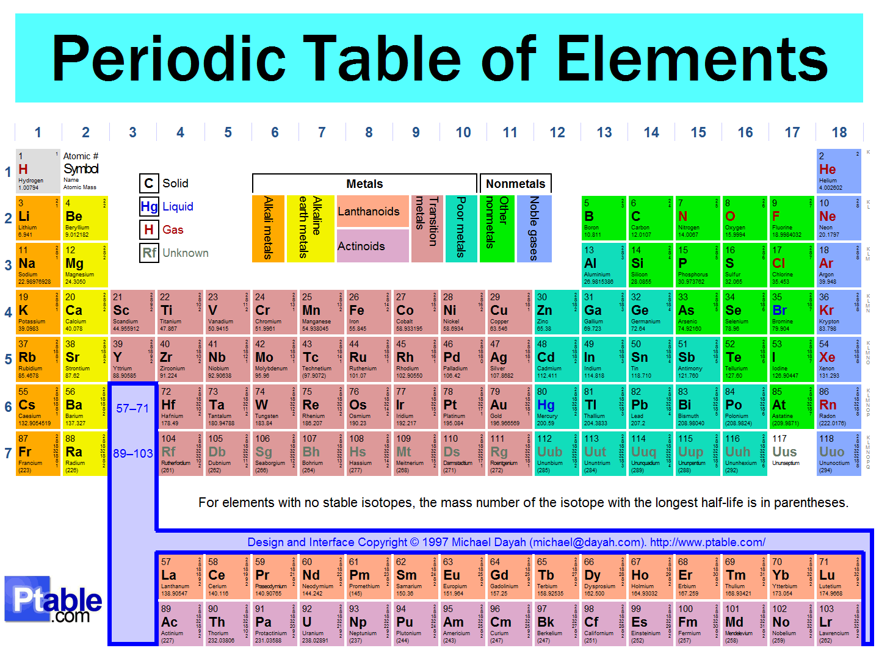

Slide 13
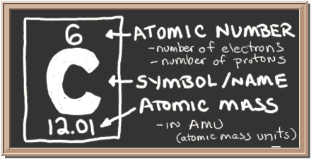
How is it organized?
Atomic number
Atomic mass number
Number of electrons/protons
Valence electrons
Natural state – metals and gases

Slide 14

Dalton Model
Dalton's model of the atom. John Dalton proposed that all matter is composed of very small things which he called atoms.
He knew nothing of atoms and electrons!

Slide 15
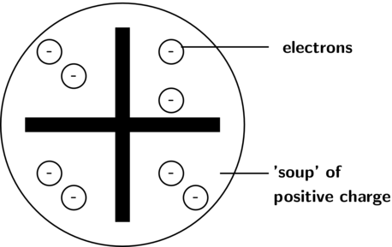
Thomson Model
JJ Thomson discovered the electron!
SO THERE WAS SOMETHING SMALLER THAN AN ATOM?!
Plum pudding model.

Slide 16
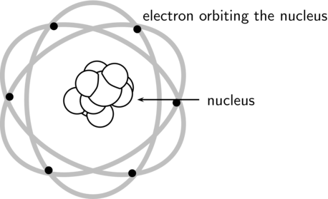
Rutherford Model
X Rays and Radiation appears on the scene!
Dense positively charged core
surrounded by negatively charged particles.

Slide 17
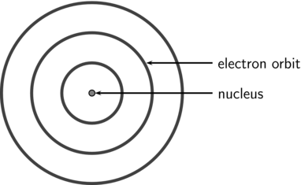
Bohr Model
Electrons orbit the nucleus
in rings called valence.
James Chadwick came up with the theory of neutrons that would hold the atom together.

Slide 18
Atom-Observing Technology
Microscope
Cathode ray tube
Mass spectrometer
Hadron collider (CERN, Saskatoon)

Slide 19
Questions Arising form Studying Atoms
Why do different molecules containing the same elements behave differently?
How do atoms stick together in a molecule?
Are there smaller particles than electrons, protons, and neutrons?

Slide 20
Quarks and Dark Matter/Energy
Quarks combine to form hadrons – most stable of which are called protons and neutrons.
Dark matter (26.8%) is unobservable matter in our universe (doesn’t respond to light).
Dark energy (68.3%) accounts for universal expansion…
MORE OF OUR UNIVERSE IS COMPOSED OF THINGS WE CAN’T OBSERVE

Slide 21
Substances and the Periodic Table
AE9.3 - Demonstrate an understanding of the classification of pure substances (elements and compounds), including the development and nature of the Periodic Table.

Slide 22
WHMIS and Classifying Substances
AE9.1 Distinguish between physical and chemical properties of common substances, including those found in household, commercial, industrial, and agricultural applications.

Slide 23


WHMIS
What is it?

Slide 24
WHMIS
→Have you seen any of these before? → What do you think they mean?
→ Name them!
Workplace Hazardous Materials Information System
It is a means of classifying substances found at home and in the workplace based on their potential hazards and health risks.

Slide 25
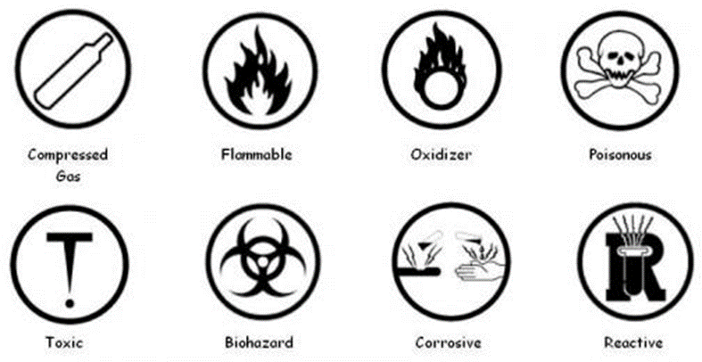
WHMIS Categories and Symbols – Useful Link
Category | Description
Compressed Gas
Flammable
Oxidizer
Poisonous
Toxic
Biohazard
Corrosive
Reactive

Slide 26
Matching – Substances to Categories

Slide 27
Matter
Substances have matter.
Matter is…
What is mass?
There are ________ and _________ properties of matter.

Slide 28
Matter
What are atoms, elements and compounds?
Substances have matter.
Matter is… anything that has mass and takes up space – composed of combinations of atoms and elements.
What is mass? Amount of matter in an object (measured in kg).
There are physical and chemical properties of matter.

Slide 29
Identifying Common Materials
What are some ways we can classify or describe materials?
WE DO NOT TASTE IN A LAB!
What types of properties of matter are these?

Slide 30
Identifying Common Materials
What are some ways we can classify or describe materials?
WE DO NOT TASTE IN A LAB!
What types of properties of matter are these?
smell, colour, melting point, boiling point, density, solubility, ductility, | crystal shape, conductivity, hardness, lustre, texture malleability.

Slide 31
Physical Properties of Matter
What is it?
Any characteristic of matter that can be observed without changing the substances chemical identity.
Examples?
Colour, density, volume, mass, freezing point, melting point, odour,

Slide 32
Physical Properties of Matter
Physical properties can be observed or measured without changing the composition of matter.
Examples include: appearance, texture, colour, odour, melting point, boiling point, density, solubility, polarity, and many others.

Slide 33
Chemical Properties of Matter
What is it?
Characteristics of a material that become evident when it undergoes a chemical reaction or change.
Examples?
Changing of molecular composition, flammability, half-life (radioactivity), toxicity,

Slide 34
Chemical Properties of Matter
are characteristics of a material that become evident when the material undergoes a chemical reaction or chemical change.
Examples include: Flammability, Heat of Combustion, Toxicity, Ability to oxidize, Radioactivity, Chemical stability
When a chemical change occurs we observe a new substance.

Slide 35
Mixtures and solutions
A mixture is two molecules of a particular compound or element together.
A solution is a particular molecule of a compound or element

Slide 36
Evidence of chemical change
How can we tell a chemical change occurred and it’s not just a mixture?

Slide 37
Evidence of chemical change
change in colour,
change in odour,
formation of a gas or precipitate,
or the release or absorption of thermal energy (heat).

Slide 38
Classification Lab
Provide examples of how society’s needs for new products can lead to scientific research and technological developments based on understanding of physical and chemical properties of matter.
g. Investigate changes in the properties of materials and identify those that are indicators of chemical changes (e.g., change in colour, change in odour, formation of a gas or precipitate, or the release or absorption of thermal energy).
h. Use equipment, tools, and materials appropriately and safely when conducting investigations into physical and chemical properties of substances.
i. State a conclusion, based on experimental data, which supports or refutes an initial idea related to personal understanding of physical and chemical properties of matter.
j. Differentiate between physical and chemical properties of matter and physical and chemical changes in matter, based on observable evidence.
k. Provide examples to illustrate that scientific and technological activity related to chemistry takes place in a variety of individual and group settings within Saskatchewan.

