Slide 1
Exploring Our Universe
Inquire into the motion and characteristics of astronomical bodies in our solar system and the universe.

Slide 2
Opening Thought and Reflection /5
What does the quote mean?
How does it apply to studying the universe?
Do you agree/disagree, why?

Slide 3
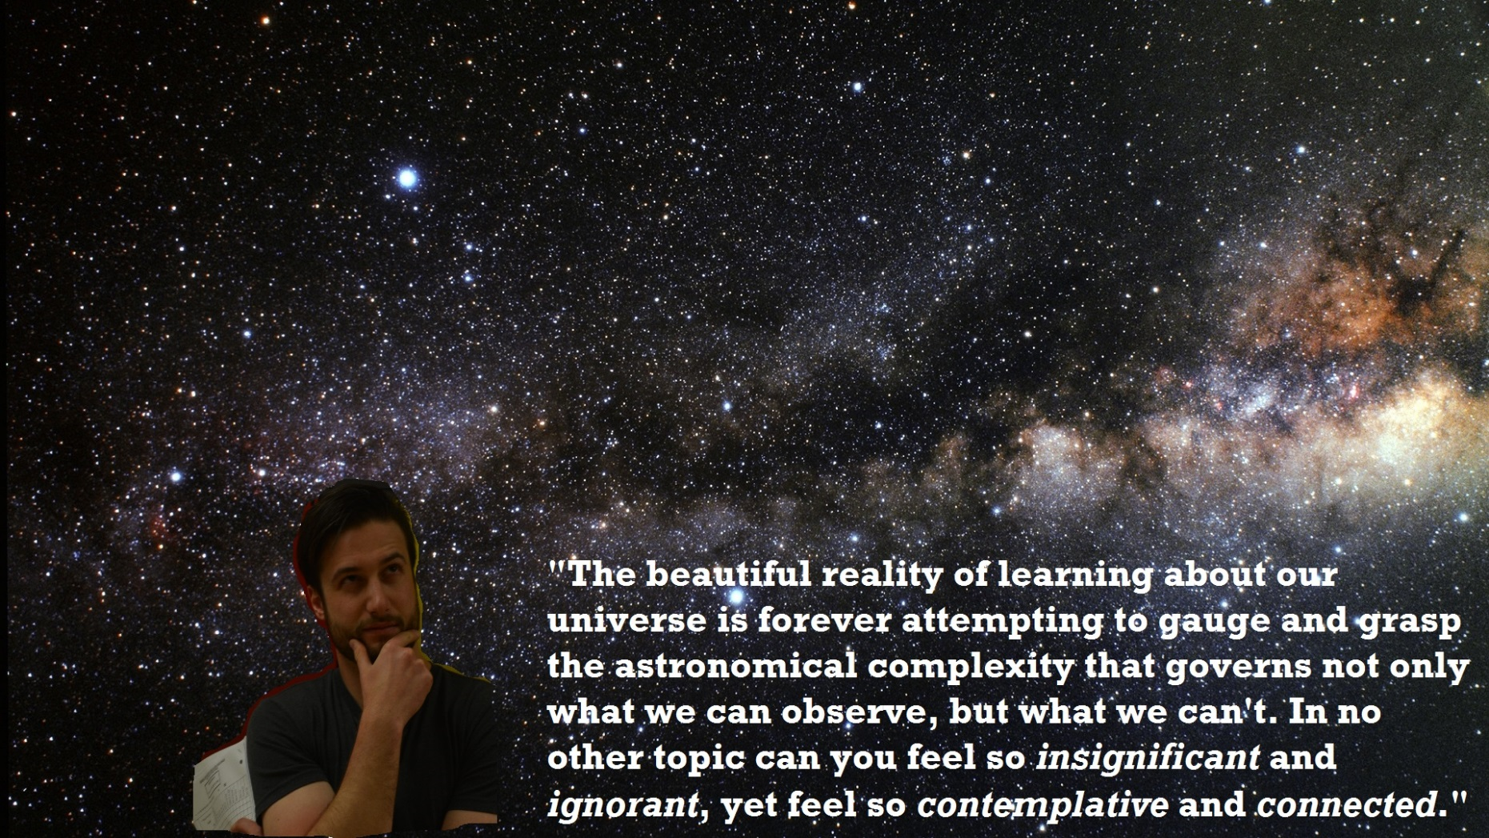

Slide 4
Indicators
Pose questions about the characteristics of and relationships between astronomical bodies.
b. Observe and identify movement patterns of the major visible bodies in the night sky.
c. Compare historical and modern explanations for the real and apparent motion, including real and apparent retrograde motion, of celestial bodies (e.g., sun, moon, planets, comets, and asteroids) and artificial satellites.
d. Create a physical and/or visual representation of the apparent motion of astronomical bodies, including retrograde motion, as seen from various locations within our solar system.
e. Compare the efficacy of various historical and contemporary models of planetary motion, including geocentric and heliocentric models, for explaining observed astronomical phenomena.
f. Describe and explain the role of experimentation, collecting evidence, finding relationships, proposing explanations, and imagination in the development of scientific knowledge of the solar system and universe (e.g., explain how data provided by astronomy, radio astronomy, satellite-based astronomy, and satellite exploration of the sun, planets, moons, and asteroids contribute to our knowledge of the solar system).
g. Conduct an experiment, simulation, or demonstration to investigate the motion and/or characteristics of one or more astronomical bodies.
h. Compare the composition and physical characteristics of astronomical bodies within the solar system, including the planets, comets, asteroids, and meteors, using appropriate scientific terminology and units (e.g., light years, astronomical units).
i. Describe the effects of solar phenomena, including sunspots, solar flares, and solar radiation, on Earth.
j. Classify the major components of the universe, including stars, quasars, black holes, nebulae, and galaxies, according to their distinguishing physical characteristics.
k. Organize data about the characteristics of the major components of the solar system or universe using tables, spreadsheets, charts, and/or diagrams and draw conclusions about those characteristics specifically and the solar system and universe generally.
l. State a prediction and a hypothesis about astronomical phenomenon based on background information or an observed pattern of events (e.g., predict the next visit of a comet based on past observations, predict the location of Venus or Mars over a period of days).

Slide 5
Questions about the universe (stars, planets, comets, asteroids, nebulae, black holes… anything)
Why are most planets closer to the sun rocky?
Why are some more gaseous further away from the sun?

Slide 6
Questions about the universe (stars, planets, comets, asteroids, nebulae, black holes… anything)
What is a __________?
What are __________ made of?
How do they interact?
How far is a light year?
Is FTL possible?
Why is time relative?

Slide 7
Definitions
Astronomical (celestial) body –
Planet –
Moon –
Star –
Nebula –

Slide 8
Definitions
Astronomical (celestial) body – is any natural body outside of the Earth's atmosphere.
Planet – A planet is an astronomical body orbiting a star or stellar remnant that
is massive enough to be rounded by its own gravity,
is not massive enough to cause thermonuclear fusion, and
has cleared its neighbouring region of planetesimals.
Moon - A natural satellite of a planet; an object that revolves around a planet.
Star – A star is a luminous sphere of plasma held together by its own gravity.
Nebula – a cloud of gas and dust in outer space, visible in the night sky either as an indistinct bright patch or as a dark silhouette against other luminous matter.

Slide 9
Definitions
Black hole –
Supernova/Nova -
Gravity -

Slide 10
Definitions
Black hole – a region of spacetime exhibiting such strong gravitational effects that nothing—not even particles and electromagnetic radiation such as light—can escape from inside it
Supernova/Nova - is a cataclysmic stellar nuclear explosion, which causes a sudden brightening of the star.
Gravity - is a natural phenomenon by which all things with mass are brought toward (or gravitate toward) one another, including planets, stars and galaxies. Since energy and mass are equivalent, all forms of energy, including light, also cause gravitation and are under the influence of it.

Slide 11
Movement of Astronomical Bodies
Does our planet move? How? (Does THAT move, how?)
How do things move in our universe?

Slide 12
Movement of Astronomical Bodies
Does our planet move? How? (Does THAT move, how?)
Revolves around the sun in an elliptical orbit (takes 365.265 days to do it).
Sun revolves around center of Milky Way Galaxy (Sagitarius A – supermassive black hole)
How do things move in our universe?
Gravity pulls them into an orbit as they pass through.
(Some moons may have been asteroids)!

Slide 13
Create A Visual or Research /5
Note: Every piece requires a short five sentence explanation /5
Create a visual scale of the distance between significant astronomical bodies in our solar system.
OR
Create a means to show how objects orbit other things in our universe.
OR
Composition of a planet of your choice, provide an explanation for why, and how we know or make that inference?
OR
Construct a visual of the life cycle of stars

Slide 14
What we used to think.
The universe revolved around us (Geocentric) – why?
The sun was the center of the universe (Heliocentric) – why (not necessarily wrong)?

Slide 15
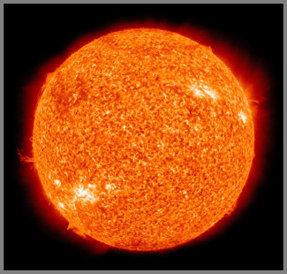
Solar Phenomena
Sunspots,
Solar flares,
Solar radiation

Slide 16
Solar Phenomena
Sunspots - Sunspots are temporary phenomena on the photosphere of the Sun that appear as dark spots compared to surrounding regions. They are areas of reduced surface temperature caused by concentrations of magnetic field flux that inhibit convection.
Solar flares - a brief eruption of intense high-energy radiation from the sun's surface, associated with sunspots and causing electromagnetic disturbances on the earth, as with radio frequency communications and power line transmissions.
Solar radiation - radiant energy emitted by the sun, particularly electromagnetic energy.

Slide 17
Sky Map or Star Chart
Download the free app on your phone!
Socrative quiz! SOC-25236145

Slide 18
Space
Analyze scientific explanations of the formation and evolution of our solar system and the universe.

Slide 19
Indicators
a. Describe First Nations and Métis perspectives on the origin of the solar system and the universe.
b. Identify how worldviews related to astronomical phenomenon are expressed through First Nations and Métis stories and oral traditions.
c. Explain the importance many individuals and cultures place or have placed on the summer and winter solstices and vernal and autumnal equinoxes.
d. Identify common characteristics of stories, past and present, describing the origin of the world from various cultures and those in fantasy literature.

Slide 20
How did our solar system form?
How did our planet form?
How did our moon form?
How do asteroids form?
How did our universe form?

Slide 21
How did others view that it formed?
Religious?
Cultural?

Slide 22
Space
Examine how various cultures, past and present, including First Nations and Métis, understand and represent astronomical phenomenon.

Slide 23
Indicators
a. Describe scientific theories on the formation of the solar system, including planets, moons, asteroids, and comets.
b. Describe scientific theories and models of the origin and evolution of the universe and the observational evidence that supports those theories (e.g., red shift of galaxies, cosmic microwave background radiation, and abundance of light elements).
c. Construct and critique a visual representation of the life cycle of stars using appropriate scientific terminology and identify strengths and weaknesses of the representation.
d. Explain the need for new evidence in order to continually test existing theories in science (e.g., explain the need for new evidence obtained from space-based telescopes and close-up observations by satellites, which can reinforce, adjust, or reject existing inferences based on observations from Earth).
e. Identify new questions and problems that arise from what was learned about the origins of the universe (e.g., “What are the limits of space travel?”, “How old is the Universe?”, and “Is Earth the only suitable home for humans?”).

Slide 24
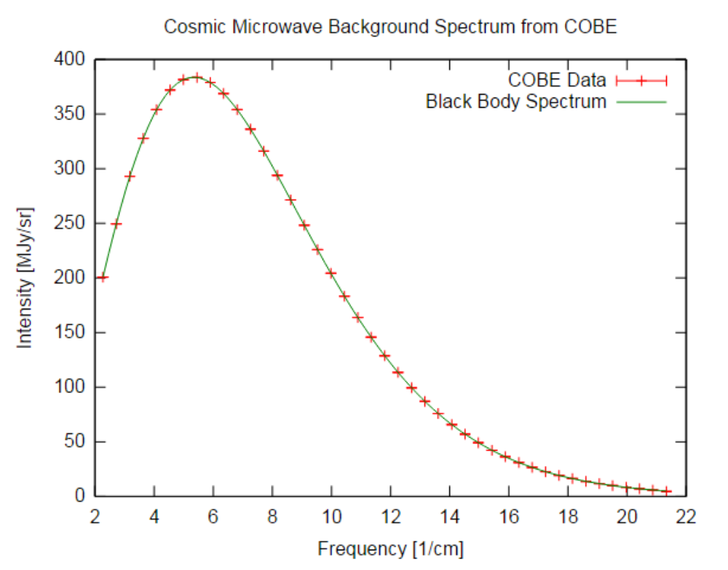
Scientific Theory and the Universe
Learning is ongoing. There’s a lot we don’t understand. A lot is accomplished through repeatable testing. (Like testing gravity).
Big Bang Theory Evidence
red shift of galaxies (change in wavelengths of light – can alter development of organisms and elements)
cosmic microwave background radiation – radiation leftover from the big bang (remnants of light that have no celestial source!
abundance of light elements - before any stars formed, made up of about 75% Hydrogen and 25% Helium, and much less than 1% of all other elements combined. (Simplest atoms to create)

Slide 25
Space Technology
Analyze human capabilities for exploring and understanding the universe, including technologies and programs that support such exploration.

Slide 26
Indicators
a. Identify the major advances of the Canadian, North American, and other space programs that have enabled space probes and human spaceflight exploration of the solar system and universe.
b. Use a technological problem-solving process to design and evaluate a prototype of a habitable space vehicle that could support human exploration beyond our solar system to a student-selected destination.
c. Identify potential physical and psychological barriers to exploring and/or living in the universe beyond the inner solar system.
d. Calculate theoretical values of the time for light or spacecraft at a given speed to travel to a distant star or other astronomical object.
e. Conduct appropriate research and defend a given position on the economic and societal benefits of space exploration.
f. Describe particular technologies designed to explore natural phenomena, extend human capabilities, or solve practical problems related to exploring and understanding the universe (e.g., quadrant, astrolabe, cross-staff, optical telescope, star chart, radio telescope, satellite, space-based telescope, unmanned probe, and robotics).
g. Describe and apply techniques for determining the position of objects in space using the horizontal (e.g., azimuth and altitude) and equatorial coordinate systems (e.g., declination and right ascension).
h. Provide examples of how Canadian research projects in space science and technology are supported by governments, universities, and private agencies.
i. Research space science careers in Canada (e.g., astronauts, astrophysicists, materials technologists, pilots, and computer programmers).
j. Describe possible positive and negative effects of a particular scientific or technological development related to space exploration, and explain why a practical solution requires a compromise between competing priorities (e.g., describe effects such as the spinoffs from space technologies to everyday usage and the potential military use of space exploration, and recognize the need to evaluate these effects).

Slide 27
Closing Project (look on indicator page for more ideas)
Research a significant contribution by Canadians to the/a Space Program (NASA)
Determine a means for us to colonize or travel to a planet with a hypothetical space vehicle. Include how long it would take to get there, how, resources required.
Study particular technologies that help us explore space (telescopes in orbit or on our planet)
Calculate estimated time to travel to several locations in the universe (make a universe brochure)
Do a short essay 1.5 pages double-spaced on… funding of space projects, value of space programs, or space-related careers
How do satellites, telescopes, unmanned probes, robotics, or 3D printing relate to space exploration?
Can and should we leave our planet? What are the physical and psychological limitations to this?

Slide 28
Marking Criteria /25
Information /15 – You should find at least fifteen points of information on your topic. Translate into your own words. Provide evidence of your research.
Images /5 – should include at least three images (referenced) that enhance your project.
Bibliography /5 – resources are cited.

