Slide 1
Electricity
Demonstrate and analyze characteristics of static electric charge and current electricity, including historical and cultural understanding. [CP, SI, TPS]

Slide 2
Indicators!
Pose questions to investigate related to static electric charge and current electricity.
Gather evidence for the transfer of static electric charges, including charging by friction, charging by conduction, charging by induction, and electrostatic discharge and create written, visual, and/or dramatic representations of those processes.
State the properties of static electrical charges.
Examine how the importance of lightning in First Nations and Métis culture is conveyed through stories and legends.
Use a technological problem-solving process to design, construct, and evaluate the reliability of a device to detect static electrical charges, such as an electroscope.
Explain, with reference to electron transfer, the production of static electrical charges in some common materials such as flannel, fur, wood, plastic, rubber, and metal.
Describe the operation of technologies that have been developed based on scientific understanding of static electric charge and discharge (e.g., air filters, fabric softeners, lightning rods, automotive painting, plastic wrap, grounding straps, Van de Graaff generator, and photocopiers).

Slide 3
Static Charge
What is it?
Stationary electric charge typically produced by friction that causes sparks, cracking, and attraction of dust or hair.
It is created by an imbalance of electric charges within or on the surface of a material.
Why is it static?
Because it can be stored or stopped at a location (on a material).
Why does our hair get static-y?

Slide 4
Static Charge
What is it?
Movement of electrons between materials in contact with one another.
More apparent when an insulator (resistant to electric current) takes on electrons – then releases them upon contact with a conductor (electrostatic discharge)
Why is it static?
Because it remains locked in place till it contacts something and is able to move – current electricity flows through wires.
Why does our hair get static-y?
Our hair gets positively charged, repelling itself!

Slide 5
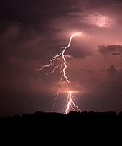

Lightning –
What is it? What was it thought to be?
Guesses?

Slide 6
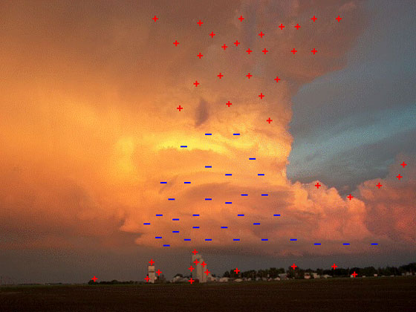
Lightning –
What is it? What was it thought to be?
Was thought of as divine weaponry!
Difference in charge of a cloud (heat/humidity can help cause this)! Evaporating fast moving particles!
Negative charges come crashing to the ground!
Lightning Strike Video
https://www.weathervideohd.tv/wvhd.php?mod=detail&asset=1091

Slide 7
Are there any other places we see lightning?
What other events that may cause lightning naturally in our world?
Why does it happen in these cases?

Slide 8
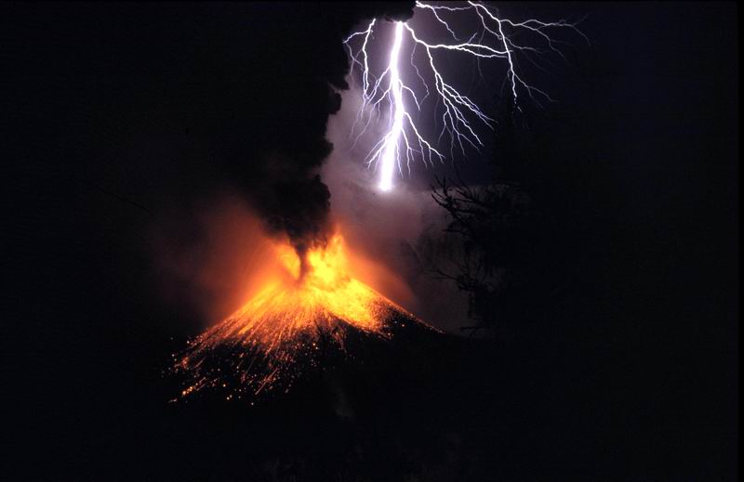
When do lightning storms happen then? Why?
Volcanic activity
Sandstorms
Forest fires
Tornadoes*
Charging of particles – many of these have heat to excite electrons, evaporation, or charged particles from hitting each other!

Slide 9
Properties of Static Electricity
Electric charge is a _________ property of matter created by an __________ in the number of _________ and ________ in a substance.
Charge can be ________ or _________. However, any creation or elimination of charge occurs at a ratio of _:_ between positive and negative charges. (Something loses, another gains)
Static electricity is

Slide 10
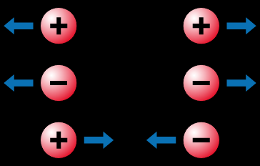
Properties of Static Electricity
Electric charge is a physical property of matter created by an imbalance in the number of protons and electrons in a substance.
Charge can be created or destroyed. However, any creation or elimination of charge occurs at a ratio of 1:1 between positive and negative charges. (Something loses, another gains)
Static electricity is when an excess of electric charge collects on an object's surface… typically this involves a buildup in the imbalance.

Slide 11
Types of Charge - Activity
Create a visual, written or demonstration of one of the following.
Charging by friction.
charging by conduction.
charging by induction.
electrostatic discharge.
/5

Slide 12
Questions to Answer
What is your demonstration (describe what happens and what you need for it) - /5
How do we know that there is a transfer of electricity? /2
What happens with particles in your demonstrations? /2
Share your demonstration (Aurasma – use a trigger image, present to the class, share a short video – SnapChat?) /2
Define each of the terms from the previous page and why it involves or doesn’t involve the terms. /4

Slide 13
Crash Course: Electric Charge
→ Free electrons reside in an atom’s outer shell as valence electrons and are easily plucked off and carried around, when acted upon by an outside force.
→ conductors are types of substances that allow electrons to move freely and easily throughout it (copper).
→ insulators take and hold onto electrons tightly not allowing them to flow (wood).
→ Conservation of electric charge – it says that you can never create a net electric charge. Instead, charge can only move from one place to another.
→An imbalance of charge in an object is called polarization.

Slide 14
Transfer of Electrons in…
flannel, fur, wood, plastic, rubber, and metal.
Why do these charge well/poorly? Electrons flow better! They are polar.
Charges well: Flannel, metal
Charges poorly: Rubber, wood, plastic

Slide 15
How do the following work as it relates to static electricity?
air filters – electrostatic-charged fabrics, attracts particles in the air – stores them on the fabric
fabric softeners – provides charged ions to remove the static charge from clothing.
lightning rods – attracts lightning - conductor
automotive painting – charged spray paint attaches to an opposite charge found on the exterior of the vehicle.
plastic wrap – carries a charge that attracts to the object it is meant to attract and attach to.
grounding straps – prevents build up of static electricity by giving somewhere else for the electricity to go rather than the body (used by electrical workers).
Van de Graaff generator – rubber bands strip electrons from felt and stores electricity in the metal ball – electrons run to your hair.
and photocopiers – negative charged particles are attracted to the positive charged regions on the machine – a blank sheet is made positive and the negatively charged particles are “copied” to a similar location.

Slide 16
Indicators
Outline the contributions of people from various cultures to modern understanding of static electric charge and current electricity (e.g., Thales, Robert Boyle, Benjamin Franklin, Michael Faraday, Nikola Tesla, Georg Ohm, Alessandro Volta, André-Marie Ampère, James Wimshurst, and Robert Van de Graaff), and past and present careers that require an understanding of static electric charge and current electricity.
Identify dangers to the human body associated with static electric charge and discharge, and current electricity, and discuss how technologies such as grounding straps, lightning rods, grounded plugs, fuses, and circuit breakers are designed to minimize such dangers.
Design and safely conduct an investigation to determine the resistance of various materials such as copper wire, Nichrome wire, graphite, rubber tubing, wood, glass, distilled water, and ionic solutions to electric current.
Differentiate between conductors, insulators, and superconductors in electric circuits.
Differentiate between a complete circuit, a closed circuit, an open circuit, and a short circuit.
Describe the flow of charge in an electrical circuit based on the particle theory of matter and electron transfer

Slide 17
Contributions and Safety
Contributions to Electricity Assignment
Safety and Effects/Harm of Electricity Assignment

Slide 18
How fast will electrons flow in the following? (fast or slow and why?)
copper wire – Fast - copper normally exists as a +2 ion, this means it will attract electrons and allow them to flow through easily when put together.
Nichrome wire – Slower - limits the amount of electrical current – slows the flow.
Graphite – faster – a type of carbon molecule that has ample spaces between parts that allow electrons to move freely through it.
rubber tubing – very slowly if at all – it doesn’t allow electrons to flow through it easily.
Wood – slow - it doesn’t allow electrons to flow through it easily. Not polar (has a neutral charge).
glass – slow - it doesn’t allow electrons to flow through it easily. Not polar.
distilled water – slow, if at all - distilled water doesn’t have a charge – no charge, no easy electron flow.
ionic solutions – fast - able to conduct electricity – example: Gatorade!

Slide 19
New Terms
Current -
Conductor –
Insulator –
Superconductor –
Resistance -
Voltage
Amps
Circuit
- short circuit
- open circuit
- complete circuit
- closed circuit

Slide 20
Current – flow of electric charge (often carried by moving electrons through and in a wire or through ions/electrolytes)
Conductor – allows for flow of electrical current in one direction.
Insulator – does not allow electricity to easily pass through it.
Superconductor – can transport electrons from one place to another with no resistance
Resistance - an electrical quantity that measures how the device or material reduces the electric current flow through it.
Voltage – greater the voltage, greater the flow of electrical current.
Amps – unit of electric current (higher means more).
Circuit
- short circuit - simply a low resistance connection between the two conductors supplying electrical power to any circuit.
- open circuit - an electrical circuit that is not complete.
- complete circuit - Electrons flow from the source to the load and then back to the source.
- closed circuit - complete electrical connection around which current flows or circulates.

Slide 21
Voltage Current
Analyze the relationships that exist among voltage, current, and resistance in series and parallel circuits.

Slide 22
Indicators!
Demonstrate the importance of using precise language in science and technology by formulating operational definitions for voltage, resistance, and current.
Demonstrate the role of switches and variable resistors in series and parallel circuits, and identify practical examples of switches and variable resistors in daily life.
Model the characteristics of series and parallel circuits using analogies or visual and/or physical representations.
Use an ammeter, voltmeter, and/or multimeter safely and accurately to measure current and voltage of a variety of student-constructed series and parallel circuits, and identify potential sources of error in instrument readings.
Display data from the investigation of voltage, current, and resistance in series and parallel circuits in tabular form and graphically.
Calculate values of unknown quantities in electric circuits using Ohm’s Law (I = V/R).
Model, using appropriate standard circuit diagram symbols, series and parallel circuits that include an energy source, one or more switches, and various loads designed to accomplish specific tasks (e.g., household lighting, flashlight, electric fan, blender, coffee maker, toy vehicle, and automotive lighting).
Rephrase questions related to electric circuits in a testable form (e.g., rephrase a question such as “Why do we use parallel circuits in household wiring?” to “How do the voltage and current in a series circuit compare with those in a parallel circuit?”).

Slide 23
Series and Parallel Circuit Lab!
It’s a virtual lab – yay!

Slide 24
What did we learn about Series and Parallel Circuits?
Complete Series and Parallel Circuits Virtual Lab prior.
What’s the difference? (Visually and performance-wise)
Series circuits have one path for the electrons to go!
Parallel circuits have more than one path for the electrons to go (electricity).
Function-wise, parallel allows for multiple ways to shut off electrical flow at different locations without stopping the total flow.
Series circuits

Slide 25
I’m an electrician, why is it important to…
Demonstrate the importance of using precise language in science and technology by formulating operational definitions for voltage, resistance, and current.
Demonstrate the role of switches and variable resistors in series and parallel circuits, and identify practical examples of switches and variable resistors in daily life.
Know the difference between voltage and amps?
Voltage – tells us how much electricity/power we have to work with.
Amps – tell us how strong the electrons are flowing
(certain appliances need certain amounts of power and flow)
Why is knowing about current important?
So you understand the direction of electrical flow and don’t do anything to corrupt or interrupt it (this could harm you!)
Know about resistors?
Having an idea of how much certain appliances will slow flow while still providing electricity.
Know about switches?
It is beneficial to be able to kill/stop power to a particular spot while still providing it to other similar locations on the same line.

Slide 26
Electrical Panel and Plug ins
How does electricity in our houses work?
Why are parallel circuits useful in our house?
How do plug ins work?

Slide 27
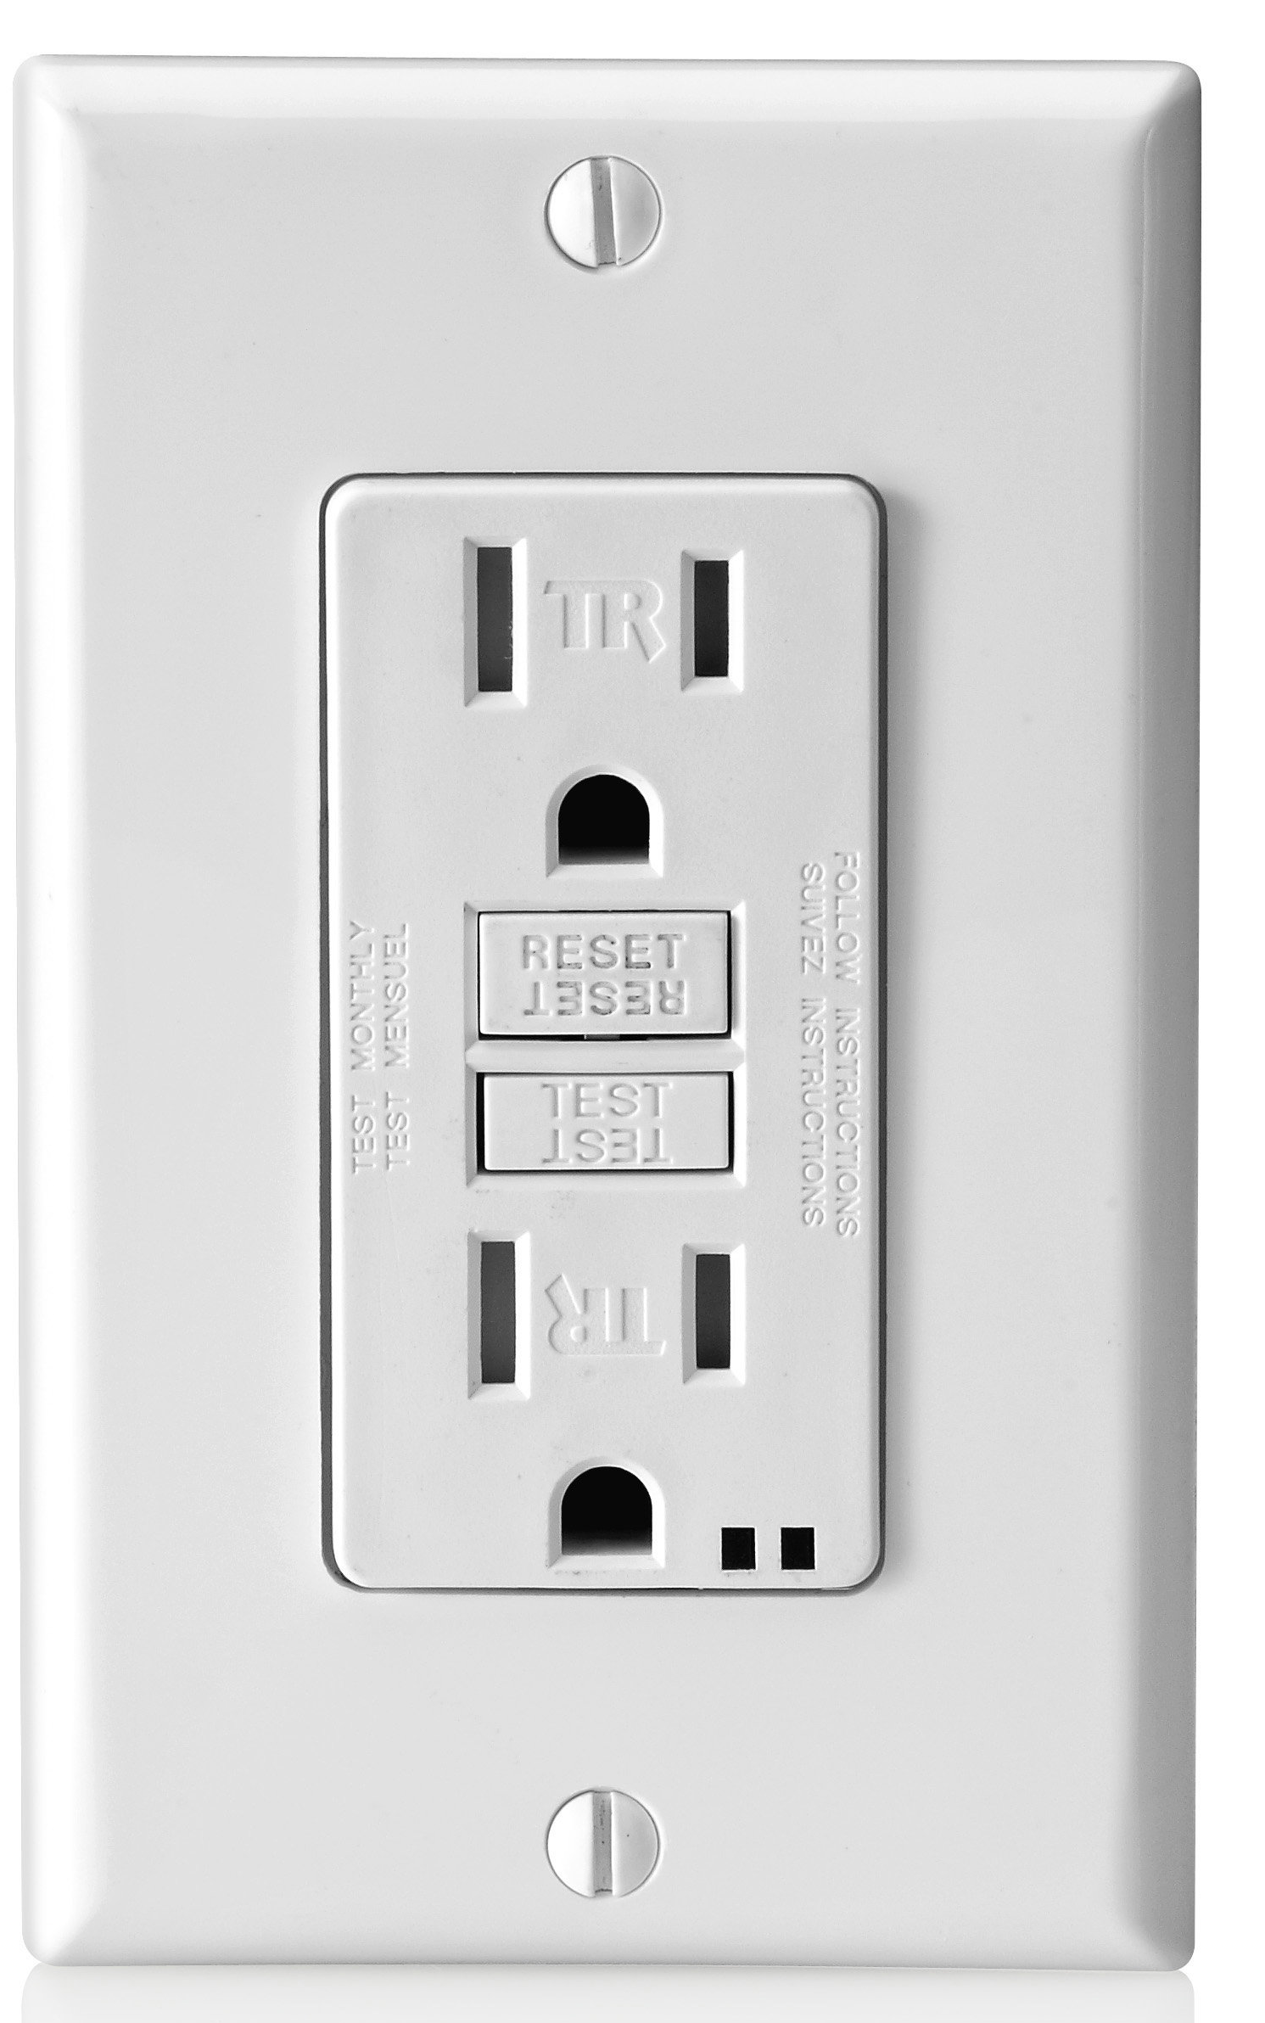
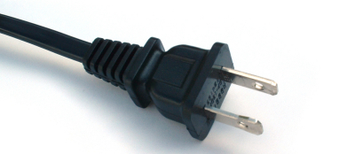
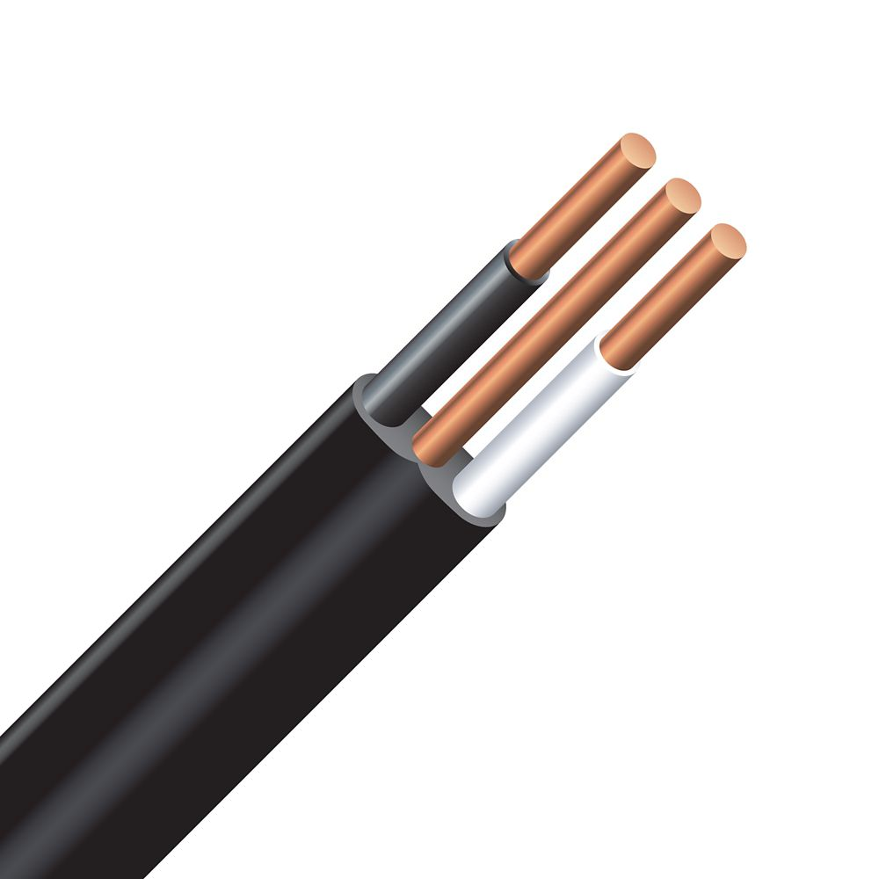
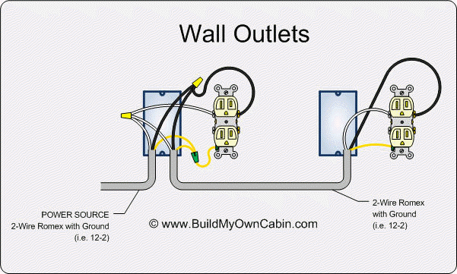
Plug ins

Slide 28
Ohm’s Law - http://www.ohmslawcalculator.com/ohms-law-calculator
Calculate values of unknown quantities in electric circuits using Ohm’s Law (I = V/R).
Ohm's Law deals with the relationship between voltage and current in an ideal conductor. This relationship states that:
The potential difference (voltage) across an ideal conductor is proportional to the current through it.
Easy-way: The amount of voltage you have affects how much current you have.
I = V/R or V = I x R V/I = R
I = current through a conductor (amps)
V = voltage (volts)
R = resistance (Ohm’s)
How does this connect to the Law of Conservation of Energy?

Slide 29
Ohm’s Problems
An electric heater draws 3.5 A from a 110 V source. The resistance of the heating element is approximately…
385 Ohm’s
38.5 Ohm’s
3.1 Ohm’s
31 Ohm’s
A lightbulb draws .9 amps from a 9 V source. The resistance of the lightbulb is approximately…
10 Ohm’s

Slide 30
Ohm’s Problems
A washing machine uses 500 V and has a resistance of 100 Ohm’s. How many amps does it need/have?
A dryer has a resistance of 233 Ohm’s and it generates 10 amps. What is it’s voltage required?
A stove uses 110 V but has a resistance of 35 Ohm’s. What is it’s amps?

Slide 31
Devices that use Electrical Energy
Assess operating principles, costs, and efficiencies of devices that produce or use electrical energy.

Slide 32
Explain the energy transformations involved in devices that use or produce light, heat, sound, motion, and magnetic effects (e.g., toaster, light bulb, thermocouple, oven, refrigerator, television, hair dryer, kettle, fan, electric blanket, and remote-controlled toy vehicle).
Use a technological problem-solving process to collaboratively design, construct, and evaluate a prototype of an electric motor that meets student-identified criteria or solves a student-identified problem.
Calculate the efficiency of common energy-converting devices and suggest reasons why the efficiency is always less than 100%.
Interpret the energy efficiency rating of household electrical appliances and calculate their costs of operation in Saskatchewan over a given time by identifying the power rating and using the formula Cost = Power x time x rate.
Evaluate the design of a household electrical appliance on the basis of criteria such as function, cost, and impact on daily life and the environment, and suggest alternative designs that are more sustainable.
Identify, and suggest explanations for, discrepancies in variations in the monthly costs of electrical energy for a household or business.
Make informed decisions about personal use of devices that use electrical energy, taking into account environmental and social advantages and disadvantages.
Propose a course of action to reduce the consumption of electrical energy in Saskatchewan, taking into account personal, societal, and environmental needs.

Slide 33
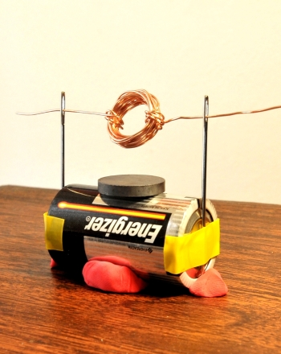
Making a simple electric motor

Slide 34
Electrical Energy Production
Critique impacts of past, current, and possible future methods of small and large scale electrical energy production and distribution in Saskatchewan.

Slide 35
Provide examples of how technological developments related to the production and distribution of electrical energy have affected and continue to affect self and community, including electricity use on reserves, traditional lands, and traditional life in Saskatchewan.
Compare the operating principles, efficiency, lifespan, and safety, of past and current technologies developed to produce and store electrical energy, (e.g., electrochemical cells, wet cells, dry cells, and batteries) in the home, business, and industry.
Discuss the merits of primary and secondary cells and explain why secondary cells are not always appropriate to meet certain needs for electrical energy.
Illustrate and describe the transfer and conversion of energy from a typical generating station to a home in Saskatchewan, including the role of transformers.
Assess the efficiency and impact of large scale versus small scale electrical energy distribution systems for home, business, agricultural, and industrial applications.
Describe scientific, technological, societal, and environmental perspectives related to past, current, and proposed large-scale methods of electrical energy generation in Saskatchewan (e.g., hydroelectric dams, coal and natural gas-fired plants, wind turbines, solar energy, geothermal, biomass, and nuclear plants).
Evaluate evidence and sources of information created by different stakeholders related to various methods of electrical energy production in Saskatchewan, including alternative energy sources such as geothermal, biomass, clean coal, and co-generation.

Slide 36
How do we/they get energy in…
Moose Jaw
Reserves
Germany
Vancouver
Traditional Practices

Slide 37
Producing and Storing Electricity
 | Description | Efficiency | Lifespan | Safety | Typical Use
Dry cell
Wet cell
Electrochemical cell
Batteries

Slide 38
Producing and Storing Electricity
 | Description | Efficiency | Lifespan | Safety | Typical Use
Dry cell | Container storing electricity as a solid. | Can be efficient in certain settings. | Typically more short term. 18 months – 2 years. Lose months in shipping. | More difficult to leak or spill and come into contact with | Finite supply, lighter and compact
Wet cell | Container storing electricity as a liquid. | Wider array of efficient settings | Longer term. 48 months (not all meet this standard) | Leakage or spillage! | Rechargeable, bulky
Electrochemical cell | a device capable of either generating electrical energy from chemical reactions or facilitating chemical reactions through the introduction of electrical energy. | N/A | N/A | N/A | N/A
Batteries | Device containing one or more electrochemical cells. | N/A | N/A | N/A | N/A

Slide 39
Primary and Secondary Cells
Primary cells – provides energy through an irreversible chemical reaction
Secondary cells – rechargeable batteries. (Li-ion).
Why are secondary cells not consistently useful?
What are their benefits? Less waste, more expensive to create, but less expensive to consumer in ownership.

Slide 40
Generators to Home
How does it happen?

Slide 41
Home Electricity Generation
Solar panels – are these plausible?
Tesla panels
Tesla wall batteries

Slide 42
Ways to Produce Energy
Renewable | Non-renewable
Hydropower Wind Solar Geothermal Biomass | Nuclear Coal Natural Gas

Slide 43
How should we produce electricity in SK – what’s practical?
“Clean coal” – is it a thing? Carbon capture tech (90% of emissions are taken care of, transported, and stored - pumped underground)
Co-generation?
In the media – pro SK party or against (what are motives and who has a stake in our government’s decisions)?
What is best for our province?

Slide 44
One view of decisions - opposition
Need to transition out of reliance on fossil fuels. World is changing demand.
Carbon tax money would stay in province.
“Saskatchewan has one of the highest greenhouse gas emissions per capita in Canada”
Perception of SK Party
Opposed to Carbon Tax.
Has received donations from out of province coal/non-renewable companies.
Wind Power ($400 million) start-up in SK aborted citing lack of government support as an associated issue.
Saskatchewan is too dependent on coal – transition would lead to a net increase of jobs.
Capture facility is paid for by SK, tax may forces companies to shoulder some of this cost.

Slide 45
One view of decisions – pro SK Party
Carbon capture facility offsets carbon released ($1.4 billion investment).
Saskatchewan doesn’t produce a lot of carbon emissions – not responsible for global issues.
Saskatchewan has lots of coal, easy-use – transition would lead to a net decrease of jobs.
In deficit, can’t afford to make energy transition.
Carbon tax will further cripple economy. Opposed to Carbon Tax.
World demand still is on fossil fuels. Trump win will mean greater market for fossil fuels.

