Slide 1
Big Idea 1
The process of evolution drives the diversity and unity of life.

Slide 2
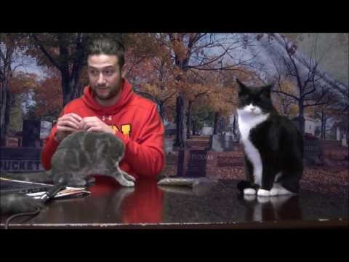
Misconceptions of Evolution
List some off from the video!

Slide 3
Misconceptions of Evolution
Individuals evolve.
Evolution explains how life first came into being.
Evolution is just a theory.
Evolution is random.

Slide 4
1.A: Change in the genetic makeup of a population over time is evolution.
What does this mean?

Slide 5
Natural selection is a major mechanism of evolution
What is natural selection?
What was the activity in the video?

Slide 6
Natural selection is a major mechanism of evolution
What is natural selection?
Individuals with more favourable phenotypes are more likely to survive and produce offspring – passing genetic traits to the next generation.
What was the activity in the video?
Cats! Selective pressures were introduced and affected the population!
What do the bold terms mean?

Slide 7
Survival of the fittest
What’s wrong with this phrase?
What does “fit” mean in this context?
How does this apply to humanity? Who is the most fit? Are we evolving? Or devolving?

Slide 8
Survival of the fittest
What’s wrong with this phrase?
Fitness means ability to reproduce.
What does “fit” mean in this context?
Fitness means ability to reproduce.
How does this apply to humanity? Who is the most fit? Are we evolving? Or devolving?
More kids? More “fit”. Most reproductive success. Educated people tend to have less children, why? Is my thought of it devolving an example of eugenics?

Slide 9
Eugenics Discussion
Tommy Douglas believed in Eugenics (and he was a Christian man).
Should only certain individuals be allowed to reproduce in the human population?
All types of diversity have value.
But what about the infrastructural strain that individuals that reproduce that may be unprepared to do so put on our governments and by extensions us and our tax dollars?
Do we sacrifice freedom for a subjective idea of “perfection”?

Slide 10
New Law
Starting January 1st, 2018, all children will be sterilized upon birth (the procedure is completely safe and reversible) and will be allowed to procreate upon coming of age assuming their application for being a parent is accepted through a competency exam.
Do you vote for or against it? Provide one point as to why.

Slide 11
Genetics and mutation
What are our genetics, where is our “code” found? What does genotype, phenotype and allele mean?
What is a mutation?
How might the gene pool be affected by evolution?

Slide 12
Genetics and mutation
What are our genetics, where is our “code” found? What does gene, genotype, phenotype and allele mean?
Our genetic make-up, found based on combinations of A,T,C, and G. A series of these combinations make up a gene (a location that codes for a specific protein/trait), which can be composed of alleles (a copy of a type of this trait). When we look at the alleles that make us up, this is our genetype, and what we actually see on the organism is our phenotype.
What is a mutation?
An alteration in our genetic makeup.
How might the gene pool be affected by evolution? How does allelic frequency apply?
The frequency of certain alleles changes over time as selective pressures are introduced!

Slide 13
Environment and Adaptation
Environments can be _______ or __________. What does this mean? How is this affected by climate change?
Hurricane Irma, Harvey.
Adaptations –

Slide 14
Environment and Adaptation
Environments can be stable or fluctuate. What does this mean? How is this affected by climate change?
Hurricane Irma, Harvey (people staying in their homes).
Adaptations – are genetic variations that is favoured by selection and is a trait that provides an advantage to an organism in a specific environment.

Slide 15
Read 18.1 of OpenStax
Expect a quiz next day.

Slide 16
Random events and evolution
Chance (meteors, volcanic activities), can influence the evolutionary process. Also called genetic drift – right place, right time. Bottleneck effect – population is thinned in a large event (disease)?
Would this more readily affect a large population or a small population?
Banff Snails

Slide 17
Peppered Moth – Selection at Work
Complete the Peppered Moth Activity
Environments change and act as a selective pressure on populations of organisms. However these phenotypic variations are present due to mutations in genetic code causing new gene combinations (these combinations may lead to increased/decreased production of certain proteins).

Slide 18
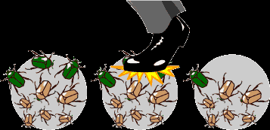
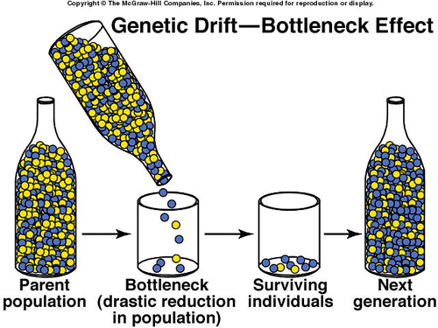
Genetic Drift and The Bottleneck Effect
Genetic Drift
Bottleneck effect

Slide 19
Genetic Drift and The Bottleneck Effect
Genetic Drift involves the chance disappearance of alleles in a population due to an external event. A nonselective process.
Bottleneck effect causes a random thinning (decrease) of the population that may lead to the disappearance of certain traits in a population.
Smaller populations are at a greater risk of losing diversity!

Slide 20
Population Genetics and Hardy-Weinberg
“a population’s allele and genotype frequencies are inherently stable unless some kind of evolutionary force is acting upon the population, neither the allele nor the genotypic frequencies would change”
Recommended Reading: OpenStax Chapter 19.1

Slide 21
Hardy-Weinberg Principle of Equilibrium
Hardy-Weinberg is a means to assess allele frequency in a population, assuming no evolution is occurring means that the distribution or frequency of alleles should remain the same (evolution obviously is occurring, but we can still use it as a snapshot). In order to use it, the following needs to occur
Flaws in all of this?

Slide 22
Hardy-Weinberg Principle of Equilibrium
Hardy-Weinberg is a means to assess allele frequency in a population, assuming no evolution is occurring means that the distribution or frequency of alleles should remain the same (evolution obviously is occurring, but we can still use it as a snapshot). In order to use it, the following needs to occur
No mutations must occur so that new alleles do not enter the population.
No gene flow can occur (i.e. no migration of individuals into, or out of, the population).
Random mating must occur (i.e. individuals must pair by chance)
The population must be large so that no genetic drift (random chance) can cause the allele frequencies to change.
No selection can occur so that certain alleles are not selected for, or against.
Flaws in all of this?

Slide 23
Hardy-Weinberg Equation
p² + 2pq + q² = 1 and p + q = 1
p =
q =
p² =
q² =
2pq =
Math helps in observing evolution by measuring allelic frequencies!

Slide 24
Hardy-Weinberg Equation
p² + 2pq + q² = 1 and p + q = 1
p = frequency of the dominant allele in the population
q = frequency of the recessive allele in the population
p² = percentage of homozygous dominant individuals
q² = percentage of homozygous recessive individuals
2pq = percentage of heterozygous individuals
Math helps in observing evolution by measuring allelic frequencies!

Slide 25
Example Problem
You have sampled a population in which you know that the percentage of the homozygous recessive genotype (aa) is 36%. Using that 36%, calculate the following:
  The frequency of the "aa" genotype.
  The frequency of the "a" allele.
  The frequency of the "A" allele.
  The frequencies of the genotypes "AA" and "Aa."
  The frequencies of the two possible phenotypes if "A" is completely dominant over "a."

Slide 26
Example Problem #2
There are 100 students in a class. Ninety-six did well in the course whereas four blew it totally and received a grade of F. Sorry. In the highly unlikely event that these traits are genetic rather than environmental, if these traits involve dominant and recessive alleles, and if the four (4%) represent the frequency of the homozygous recessive condition, please calculate the following:
  The frequency of the recessive allele.
  The frequency of the dominant allele.
  The frequency of heterozygous individuals

Slide 27
Example Problem #3
In a large, but isolated population of Moose Jaw cats, we observe that it is 67% long haired cats. Long hair is caused by the double recessive genotype “hh”. Calculate the allelic and genotypic frequencies for this population. Five generations later, we observe that the population is 80% long haired cats. Calculate the allelic and genotypic frequencies of this population. Then compare the two and provide and explanation for the potential differences in frequencies, if any.

Slide 28
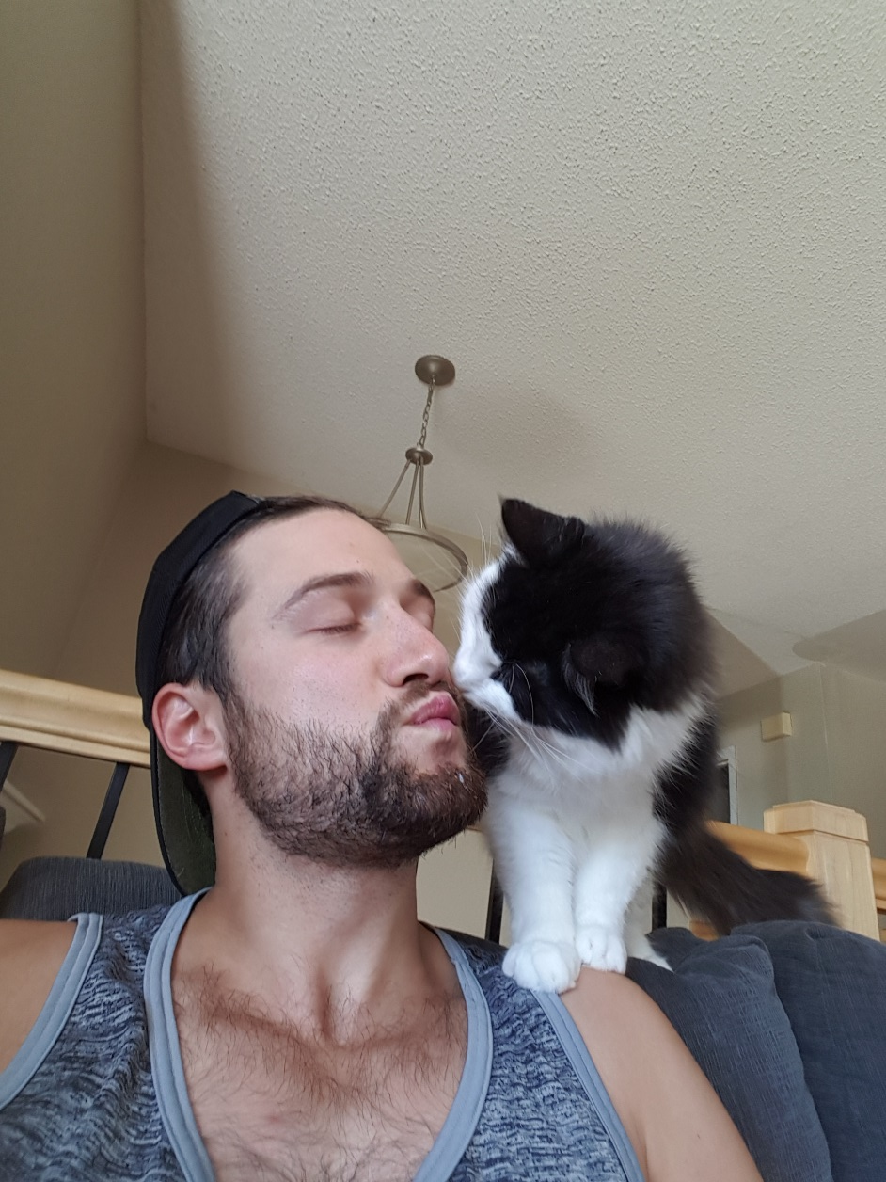
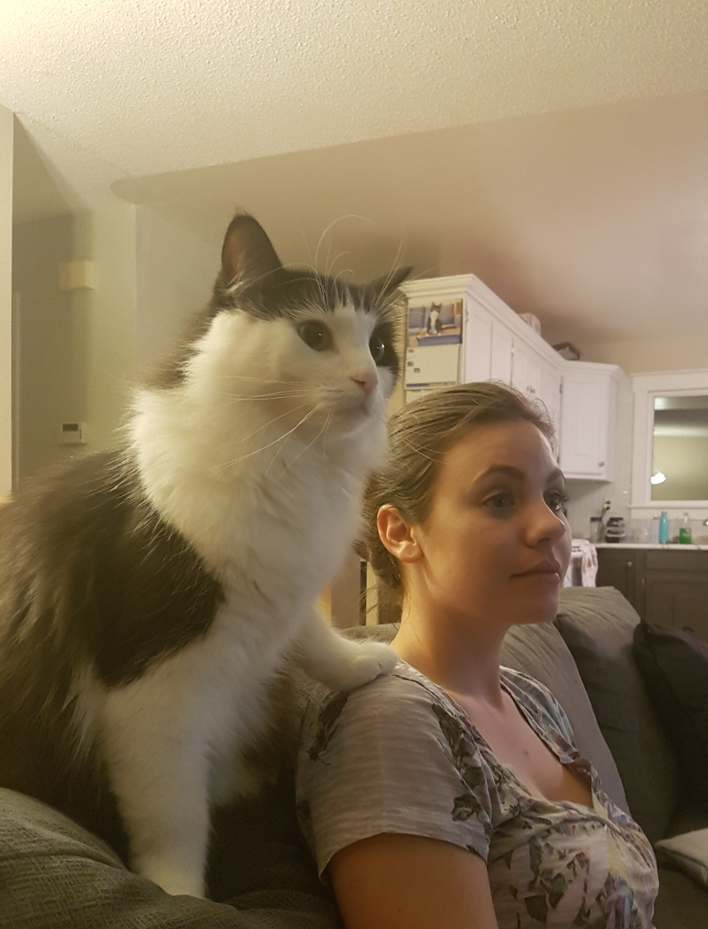
Long-haired cat example

Slide 29
Hardy-Weinberg Lab Tutorial
I will do my whole lab as a class/share my screen in a video so you have a good idea of what I would like to see.

Slide 30
Hardy-Weinberg Lab
Create a hypothetical trait and population to measure the allele frequencies for. Impose a random chance event and measure the results. It should be something physical you can actually do (some people throw a ball at LEGO people, some people go to a class and say pick a number between 1 and 6, roll a dice, and the number rolled all die).

Slide 31
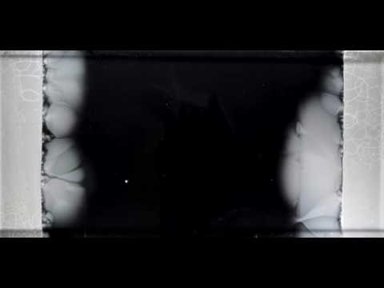
How do humans affect evolution/variation in species?
Pesticide resistance?
Antibiotic resistance?
Is sickle cell anemia a bad thing?
- what is it?
- why is it bad?
- how can it be good?

Slide 32
How do humans affect evolution/variation in species?
Pesticide resistance?
Leaves behind resistant bugs!
Less crop diversity can make them an easy target for disease - monocultures
Antibiotic resistance?
Leaves behind all these resources for the resistant/mutant bacteria.
Is sickle cell anemia a bad thing?
- what is it? Mishapen blood cells
- why is it bad? Poor functioning of the body on occasion.
- how can it be good? Malaria can’t infect sickle cells – individual is immune.

Slide 33
Evidence for Evolution
Organisms share core processes and features widely distributed throughout species today.

Slide 34
Evidence for evolution
What is geographic evidence for evolution?
What is geological evidence for evolution?
What is physical (anatomical) evidence for evolution?
What is chemical evidence for evolution?
Genetic evidence for evolution?

Slide 35
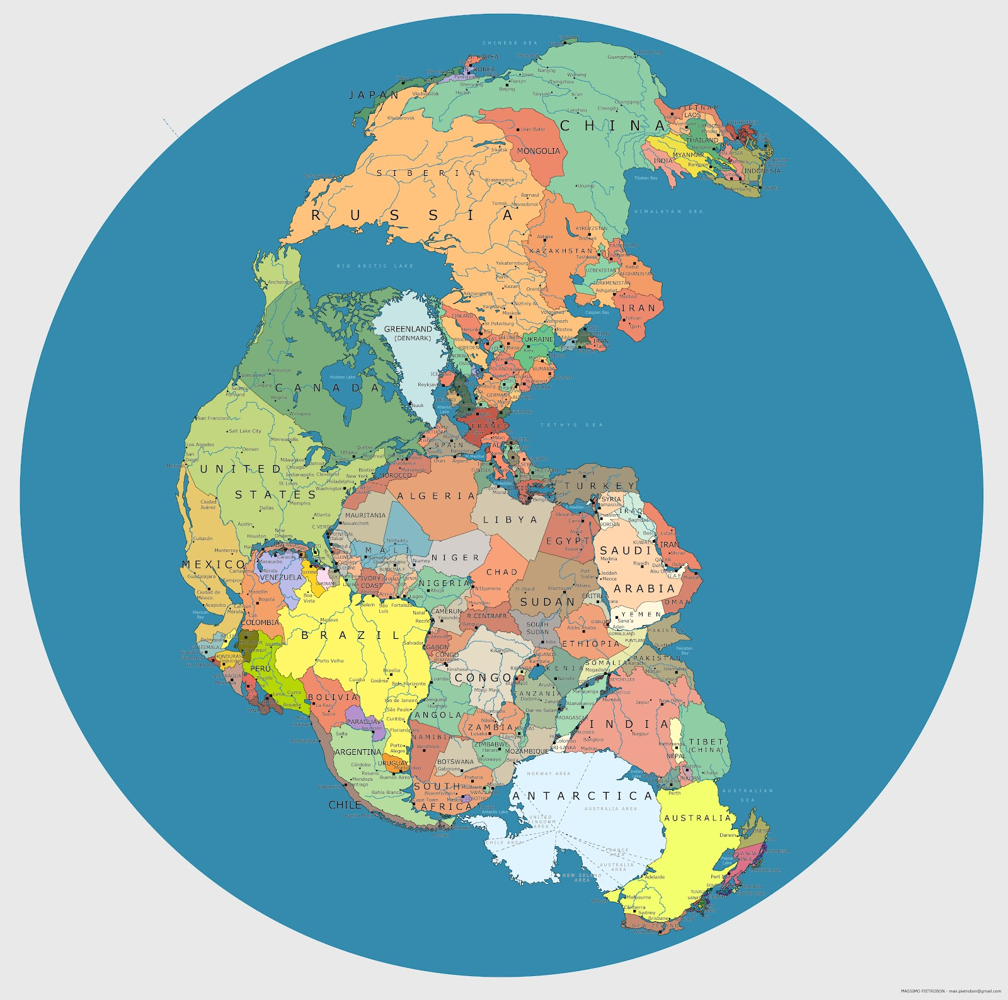
Biogeography – Geographic Evidence
Locations of plants and animals. Similar locations → similar adaptations required → similar organisms.
Pangaea – marine fossils at the top of the Rockies
Old glaciers – Quaternary period of glaciations can explain movement of some soil as well..

Slide 36
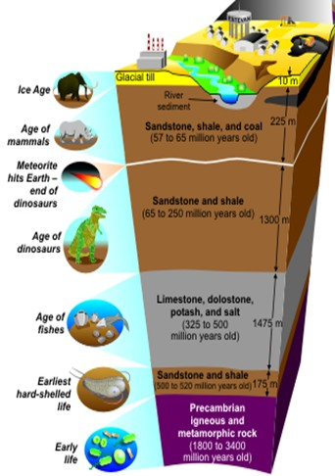
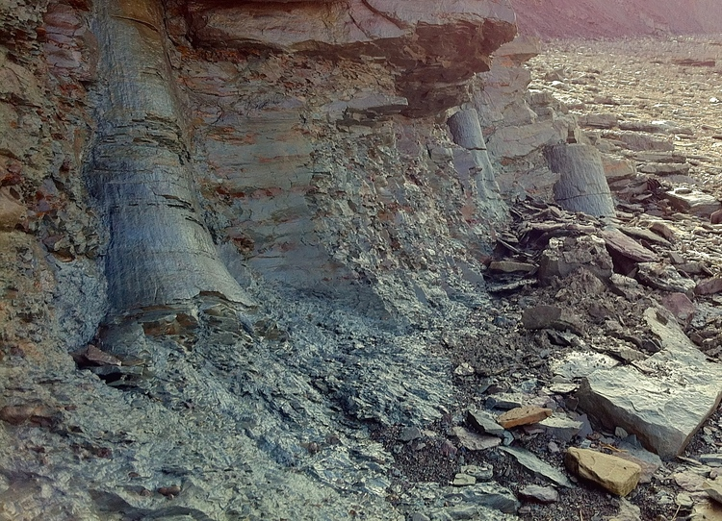
Geological Evidence
Age of rocks/sediment where a fossil is found
Different depths infer different “age”

Slide 37
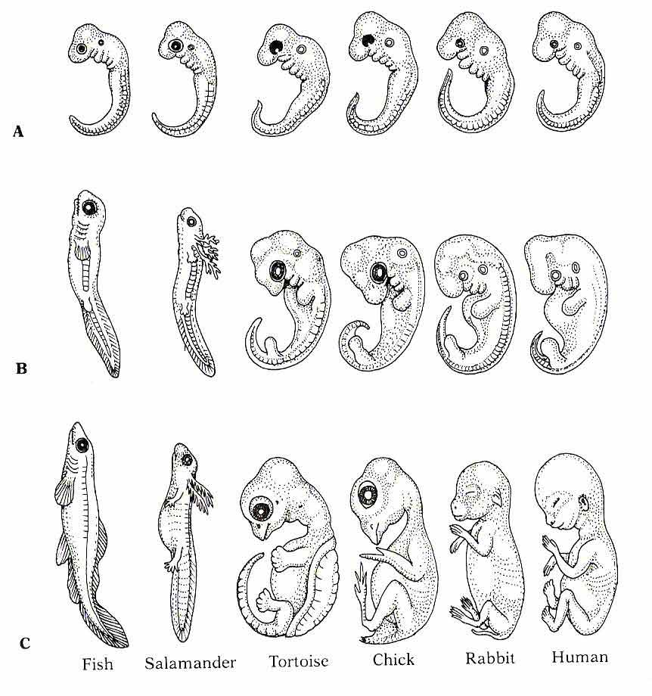
Physical (Anatomical) Evidence for Evolution
Molecular -
Morphological (homologous, vestigial and analogous structures) –
Genetic Information (comparison of genomes) -

Slide 38
Physical (Anatomical) Evidence for Evolution
Molecular – similar molecules found in different organisms.
Morphological (homologous, vestigial and analogous structures) –
Homologous – same structure, different function.
Analogous – same function, different structure.
Vestigial – “useless” leftover organs, parts.
Genetic Information (comparison of genomes) –
Biochemical and genetic similarities, DNA and nucleotide and protein sequences, provide evidence.

Slide 39
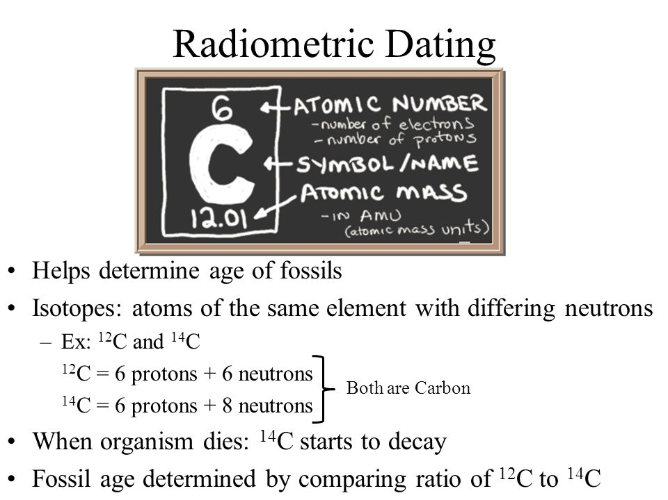
Chemical/Genetic Evidence
Certain organisms share common proteins, amino acids and segments of DNA… observing similarities between these in organisms help us define how closely related they are.
Taxonomists use comparisons of macromolecules such as DNA, RNA, and proteins as a kind of “molecular clock”.
Rate of decay of isotopes (Carbon-14). <see left>. Good up to ~50,000 years.
Similar chemical properties with geographic data

Slide 40
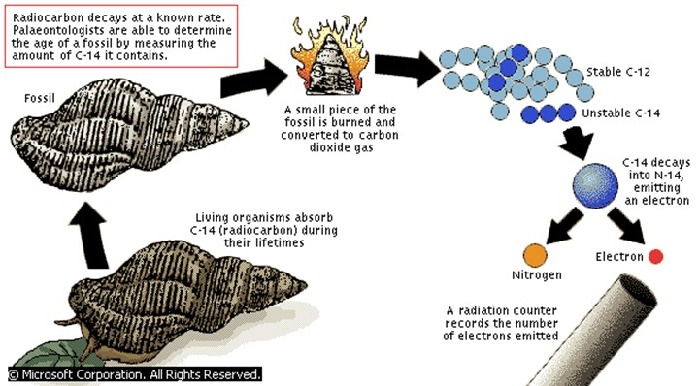
Radiometric Dating
Compares a naturally occurring radioactive isotope to the abundance of its decay products (rate of decay is known) so depending on the amount of decay that’s occurred that tells us the time of the organisms existence). With C-14, the less found in an organism, the older it is.

Slide 41
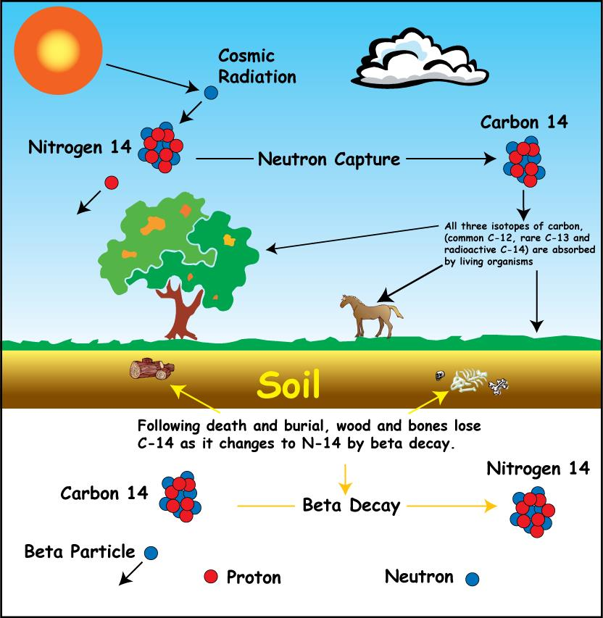

Slide 42
Evidence for Evolution
Applications of (how do we apply these together):
Geographical/Geological -
Geological (Fossils)/Physical (Anatomical) -
Chemical -
Mathematical/Genetic -

Slide 43
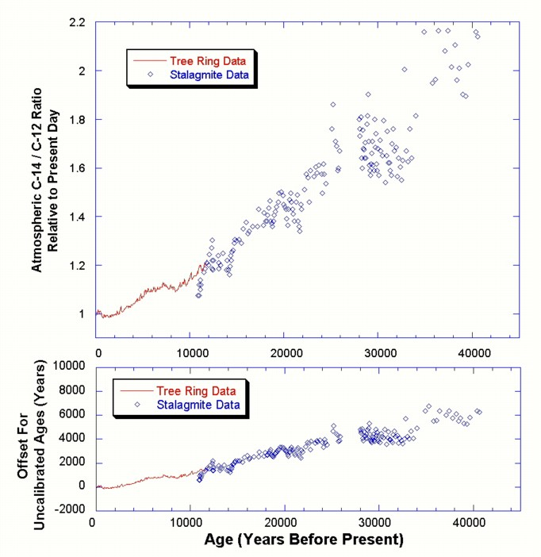
What does this chart tell us?
What does tree ring and stalagmite refer to?

Slide 44
Many different sciences inform existence of species over time.
What are some specifics to organismal structures and functions?

Slide 45
Evidence for evolution
____________ and ____________ evidence supports the connectedness and lineage of living things. (Health science connection!)
Shared genetic code for certain traits exists between organisms.
___ and ___ carry genetic information through transcription, translation, and replication and these processes and particular sequences are shared by all modern living systems.
Similar _____________ _____________ exist between all species (ie. Respiration).

Slide 46
Evidence for evolution
Structural and functional evidence supports the connectedness and lineage of living things.
Shared genetic code for certain traits exists between organisms:
- Genome-wide variation from one human being to another can be up to 0.5% (99.5% similarity)
- Cats have 90% of homologous genes with humans, 82% with dogs, 80% with cows, 79% with chimpanzees, 69% with rats and 67% with mice. (source)
- The fruit fly (Drosophila) shares about 60% of its DNA with humans (source).
DNA and RNA carry genetic information through transcription, translation, and replication and these processes and particular sequences are shared by all modern living systems.
Similar metabolic pathways exist between all species (ie. Respiration).

Slide 47
Eukaryotes
What is a eukaryote?
Which kingdoms are composed of eukaryotes?
What are similar components of all eukaryotic cells?

Slide 48
Eukaryotes
What is a eukaryotic organism?
An organism that has cells that have membrane-bound organelles and a nucleus.
Which kingdoms are composed of eukaryotes?
Plant, Animal, Fungi, Protista
What are similar components of all eukaryotic cells?
Mitochondria/chloroplast, cytoskeleton, linear chromosomes, endo-membrane systems
Why is this significant?
Major domains and kingdoms of life are classified thusly.

Slide 49
Kingdoms of Life
What are the kingdoms of life?
What are defining traits of each kingdom (at least three)?
Suggestions:
Prokaryotic/Eukaryotic
Cellularity (single/multi)
Energy processing (auto or hetero)

Slide 50
Defining Traits of Kingdoms
Plantae – eukaryotic, multicellular, autotrophic
Animalia – eukaryotic, multicellular, heterotrophic
Fungi – eukaryotic, multicellular, heterotrophic
Eubacteria – prokaryotic, unicellular, heterotrophic, autotrophic
Archaebacteria - prokaryotic, unicellular, heterotrophic, autotrophic
Protist – eukaryotic, unicellular (mostly), hetero/auto-trophs

Slide 51
Organisms are linked by common lines of descent
OpenStax Chapter 20
The Kingdoms of Life represent these common lines of descent.

Slide 52
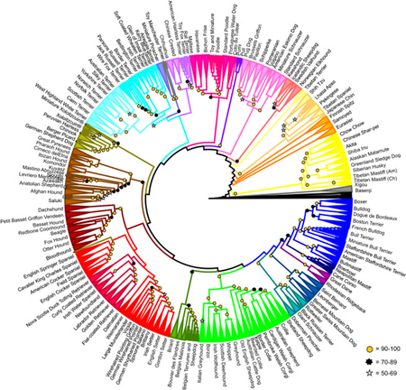
Phylogenetic Trees and Cladograms
Biology 30 review: Create a cladogram using a table of six phenotypic traits and five organisms.
On the dog breed tree, is a Jack Russell Terrier more closely related to a Poodle or a Great Pyrenese, and why? What about a Chihuahua?
JRT – closer to a sheep dog or blood hound?
https://3c1703fe8d.site.internapcdn.net/newman/gfx/news/hires/2017/12-researchersm.jpg

Slide 53
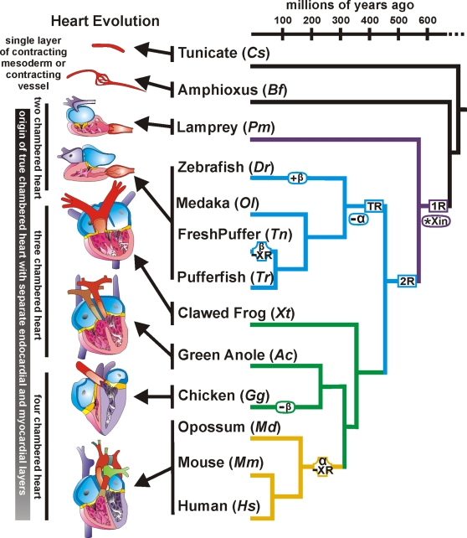
Cladograms
We can also identify traits that are either derived or lost through evolution.
Chambers of hearts.
How many does a human have?
A mouse?
A crocodile?
A perch?

Slide 54
Shared Structural Components ex. Limbs, body systems, heart chambers, organs, metabolic processes?
What are some structural features that all Chordates (vertebrates) share?
What are some structural features that all mammals share?
What are some structural features that all fish share?
What are some structural features that all eukaryotes share?
What does this help tell us evolutionarily?

Slide 55
Shared Structural Components ex. Limbs, body systems, heart chambers, organs, metabolic processes?
What are some structural features that all Chordates (vertebrates) share? Notochord (spinal chord – “cartilaginous nerve line”)
What are some structural features that all mammals share?
Mammary glands, warm-blooded (can regulate temp), more advanced diaphragm
What are some structural features that all fish share?
Cold-blooded (can’t regulate body temp), fins/air bladder
What are some structural features that all eukaryotes share?
Nucleus, membrane-bound organelles, cytoskeleton, linear chromosomes
What does this help tell us evolutionarily?
Certain traits have emerged or disappeared over time within specific groups of organisms.

Slide 56
Phylogenetic Trees
Are __________. They are
They illustrate that ______________ has occurred.

Slide 57
Phylogenetic Trees
Are dynamic. They are constantly changing as new evidence emerges.
They illustrate that speciation has occurred.
Speciation is the emergence of a species – in which two members of a group are capable of reproducing with viable offspring.

Slide 58
Speciation
OpenStax Chapter 18.2, 18.3

Slide 59
Speciation
Dispersal -
Vicariance -
Species -
What is it?
Allopatric -
Sympatric –
What does it include?
Why is it important?

Slide 60
Speciation
Dispersal – organisms “disperse” to new locations
Vicariance - organisms are separated “river divides the group”
Involves the formation of new and distinct species in the course of evolution. Two types: Allopatric (geographic separation of parents and the creation of new species – dispersal and vicariance) and sympatric (parent species is in same location but changes within population eventually lead to new separate species – ploidy {problems in cell division})
Species – organisms able to mate with their own and have viable, fertile offspring.
It includes natural selection and isolation (reproductive barriers).
It is important because these differences and changes give rise to new species and maintain the differences between others.

Slide 61
Selective Pressures
Selective Pressures are
OR
Types of Pressures

Slide 62
Selective Pressures
Selective Pressures are any phenomena which alters the behavior and fitness of living organisms within a given environment.(1)
OR
Anything that can impact the life of organisms. Puts “pressure” on organisms and will cause selection to take place.
Types of Pressures
Competition
Predation
Changes in climate
Parasitism
Pollution

Slide 63
Example of Selective Pressure
Create an example of each selective pressure on a particular species and what trait may help one get past this versus others in the species.
  Competition –
  Predator –
  Change in climate –
  Parasitism –
  Pollution –

Slide 64
Example of Selective Pressure
Create an example of each selective pressure on a particular species and what trait may help one get past this versus others in the species.
  Competition – Two tigers, fightin’ over bread, stronger one lives and eats and then can reproduce!
  Predator – Eagles are attacking rodents, porcupines who have sharper spikes live – eagles don’t like sharp spikes.
  Change in climate – drought – Gazelle with better internal compass live.
  Parasitism – caterpillar with thicker skin – wasp can’t inject parasitic larvae
  Pollution – mammal with hairier nostrils filters out air pollutants on the way in.

Slide 65
Example of Selective Pressure
In a cold climate, animals need certain characteristics to survive, like a warm furry coat, the ability to make burrows to live in and the ability to collect and store food for the winter. The selective pressure of cold weather means that animals that don't have these characteristics and are less likely to survive and reproduce. In a hot, dry climate, plants will have an advantage if they have phenotypes such as the ability to store water, large root systems to absorb what little water is in the soil, and perhaps ways to prevent water loss even at high temperatures.
Source: Study.com

Slide 66
Human Evolution
What human “social creations” or mental constructs affect evolution (religion, love, marriage)?
What are selective pressures in our society?

Slide 67
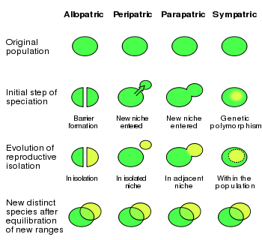
Visual for Sympatric vs Allopatric Speciation

Slide 68
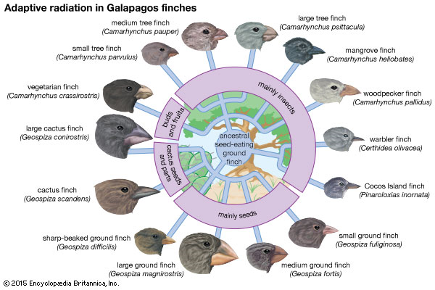
Speciation Rates
Rates of speciation can vary. Especially when adaptive radiation occurs.
Adaptive radiation is
However, when/if they spread out, this is when we observe similar species in different locations that may now be separated by natural or man-made boundaries.

Slide 69
Speciation Rates
Rates of speciation can vary. Especially when adaptive radiation occurs.
Adaptive radiation is the tendency of beneficial traits in a particular species to radiate out from and to a particular location/ecological niche.
However, when/if they spread out, this is when we observe similar species in different locations that may now be separated by natural or man-made boundaries.

Slide 70
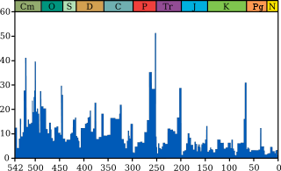
Mass Extinction
An _______________ event (also known as a mass ____________ or biotic crisis) is a widespread and rapid decrease in the biodiversity on Earth.
last such extinction was __ _________ ____ ____–three quarters of plant and animal species were wiped out. (Clay from this time period has lots of iridium – uncommon on earth but common on asteroids. With some exceptions many organisms (tetrapods) exceeding 55 pounds did not survive.
P-Tr Extinction event. Cause – _______, _______, _____________?

Slide 71
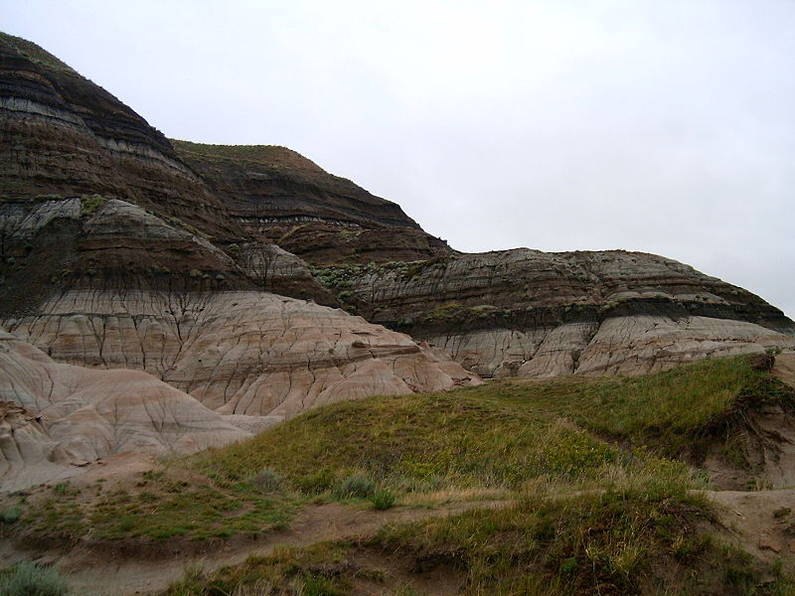
Mass Extinction
An extinction event (also known as a mass extinction or biotic crisis) is a widespread and rapid decrease in the biodiversity on Earth.
last such extinction (K-Pg) was 65 million years ago –three quarters of plant and animal species were wiped out. (Clay from this time period has lots of iridium – uncommon on earth but common on asteroids. With some exceptions many organisms (tetrapods) exceeding 55 pounds did not survive.
P-Tr Extinction event. Cause – Anoxia, Meteor, Volcanoes?

Slide 72
Speciation Rates
Species extinction rates are rapid at times of ecological stress.
Mass extinctions contribute to this.
What are five major extinctions that have occurred in history? What were the causes, and how much biodiversity was lost?
Inquiry: Are we in a mass extinction event now?

Slide 73
Isolation/Barriers to Reproduction
Isolation leads to ____________.
Two types of reproductive barriers prezygotic and postzygotic.
Prezygotic –
Postzygotic –
Different barriers.
Behavioural
Temporal
Geographic

Slide 74
Isolation/Barriers to Reproduction
Isolation leads to Speciation. Isolation means “reproductive isolation of the species” – what makes that species mate with itself and only itself... There are barriers to reproduction that help this occur.
Two types of reproductive barriers prezygotic and postzygotic.
Prezygotic - are those that prevent mating between different species. (Gametic barriers/structural barriers).
Postzygotic - are those that reduce the likelihood that an offspring will survive after mating has occurred, but before the offspring is actually born (can also include sterile offspring)

Slide 75
Behavioural Isolation
What is it?
What does it involve?
Example:

Slide 76
Behavioural Isolation
Evolutionary mechanism of identifying members of same species as proper mates.
It involves a reproductive barrier based on behavior, usually in the form of mating rituals and signals. Signals that attract mates to each other may be one of the most important factors in determining whether closely related species mate with each other or not.
Fireflies – males flash a particular light pattern. Females only recognize that of the same species.
Puffer Fish -

Slide 77
Temporal Isolation
What is it?
What does it involve?
Example:

Slide 78
Temporal Isolation
Evolutionary mechanism that prevents species from mating because they breed at different times. These differences can be time of day, season, or even different years.
It involves organisms that only mate at certain times – if the times don’t sync up – no mating!
Example – two similar species of frogs, but they mate at different times of the year.

Slide 79
Geographic/Habitat Isolation
What is it?
What does it involve?
Example:

Slide 80
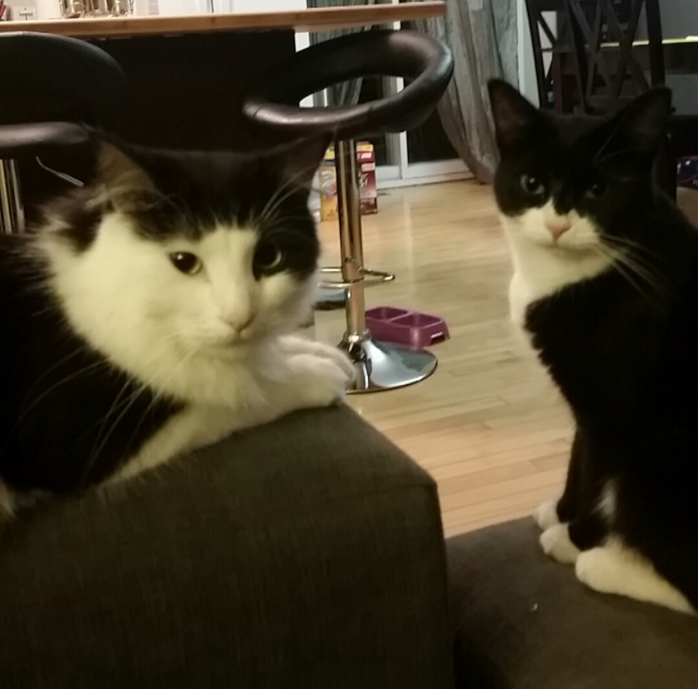
Geographic/Habitat Isolation
Evolutionary mechanism that refers to a population of animals, plants, or other organisms that are separated from exchanging genetic material with other organisms of the same species.
It involves the physical separation of the species – once isolated they begin to evolve independently.
Example – black cats and white cats are separated by a new river that formed after a flood. No more mixes… ☹

Slide 81
Evolution over Generations
Gradualism versus punctuated equilibrium
Divergent/convergent evolution
Coevolution
Adaptive radiation
Mass extinction
Evolutionary arms race

Slide 82
Gradualism
Evolution occurs
This can happen from ___________ _________. The species may not officially change, but subtle changes/trends occur over time. (Humans are getting taller).

Slide 83
Gradualism
Evolution occurs over a long period of time in small steps.
This can happen from environmental changes. The species may not officially change, but subtle changes/trends occur over time. (Humans are getting taller).

Slide 84
Punctuated Equilibrium
A particular species
This can happen from environmental changes.
Stasis, change and reintroduction (snail example)
http://evolution.berkeley.edu/evolibrary/article/side_0_0/punctuated_01

Slide 85
Punctuated Equilibrium
A particular species undergoes change very quickly from the parent species and then may remain largely unchanged for an extended period of time.
This can happen from environmental changes.
Stasis, change and reintroduction (snail example)
http://evolution.berkeley.edu/evolibrary/article/side_0_0/punctuated_01

Slide 86
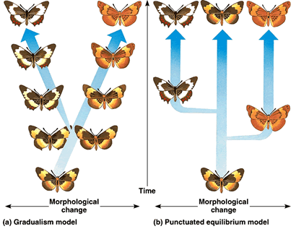
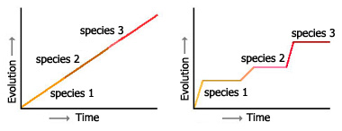
Gradualism vs Punctuated Evolution

Slide 87
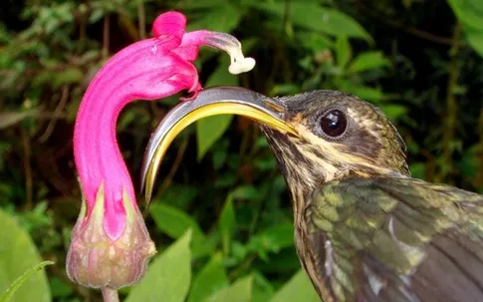
Coevolution
occurs when
Can lead to exclusivity of certain plants/animals becoming dependent on one another for survival. Evolved to live with one another.

Slide 88
Coevolution
occurs when changes in species' genetic compositions reciprocally affect each other's evolution.
Can lead to exclusivity of certain plants/animals becoming dependent on one another for survival. Evolved to live with one another.

Slide 89
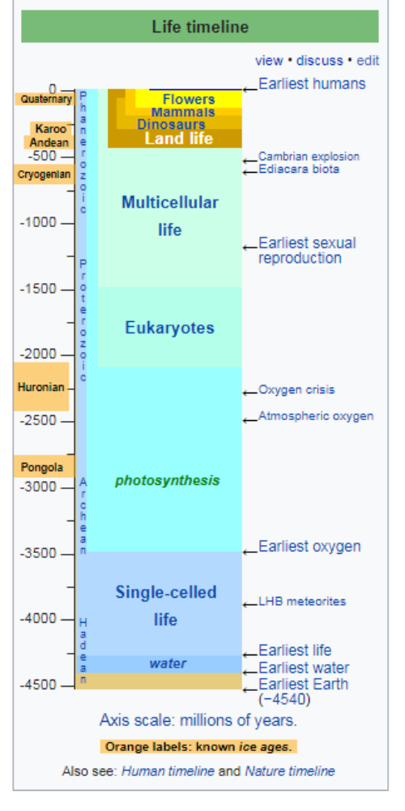
How did the dinosaurs die?
When did they exist?
Did we exist with them?
Cambrian Explosion (541 million years ago)

Slide 90
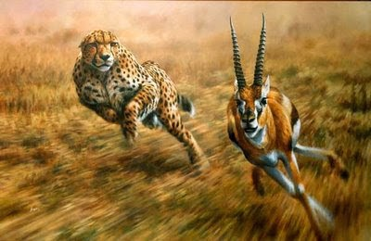
Evolutionary Arms Race
an evolutionary arms race is
Resembles an arms race, which could be, and often are, described as examples of positive feedback (environmental science connection).
Host-parasite – virulence vs resistance.
Adaptations and counter-adaptions (selective pressures). ____________ – direct competition. _____________ – counter competition (right)

Slide 91
Evolutionary Arms Race
Human society example?
Animal example?
an evolutionary arms race is an evolutionary struggle between competing sets of co-evolving genes, traits, or species, that develop adaptations and counter-adaptations against each other.
Resembles an arms race, which could be, and often are, described as examples of positive feedback (environmental science connection).
Host-parasite – virulence vs resistance.
Adaptations and counter-adaptions (selective pressures). Symmetrical – direct competition. Asymmetrical – counter competition (right)

Slide 93
Chi Squared Simplified
http://stattrek.com/online-calculator/chi-square.aspx

Slide 94
Chi Squared
Degrees of freedom (number of observations minus 1).
2 for us, typically.
Chi-squared critical value (CV) -
Cumulative probability P(X² < CV)

