Slide 1
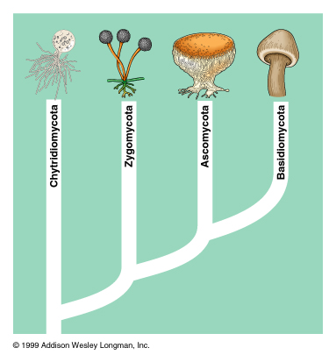

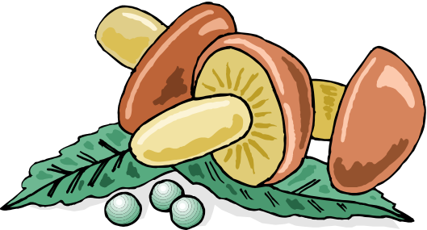
Kingdom Fungi
Outcome: Describe and observe the Kingdom Fungi

Slide 2
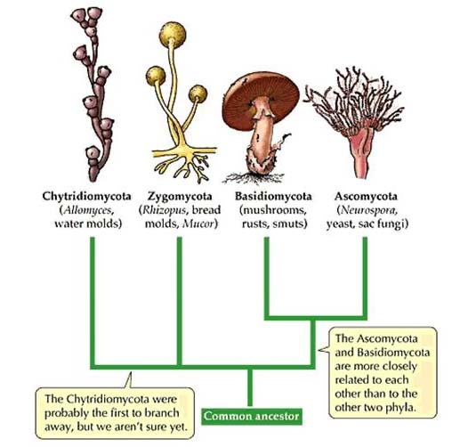
Overview of fungi - Characteristics
Fungi are :
  Eukaryotic
  Nonphotosynthetic
  Multicellular - most
  Heterotrophs
Fungi are microscopic molds or yeast

Slide 3
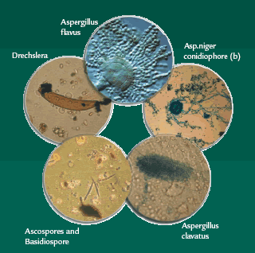
Characteristics
Molds are fungus that grow on bread and oranges and are tangled masses of filaments of cells

Slide 4
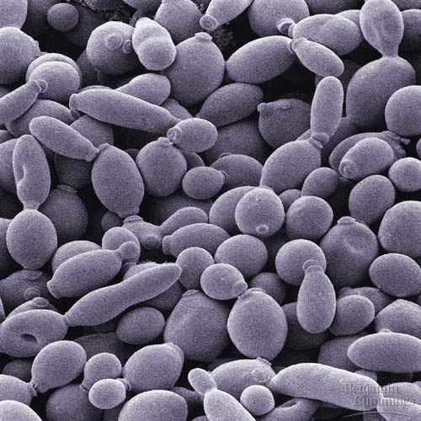
Characteristics
Yeasts are unicellular organism whose colonies that resemble bacteria.
Yeasts are best known as the microorganism that makes bread rise.

Slide 5
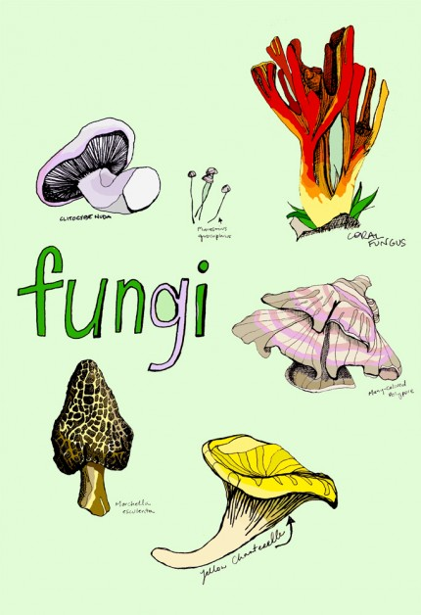
Characteristics
Fungi resemble plants in that they can not move, they have cell walls and some are edible to provide food for heterotrophs.

Slide 6
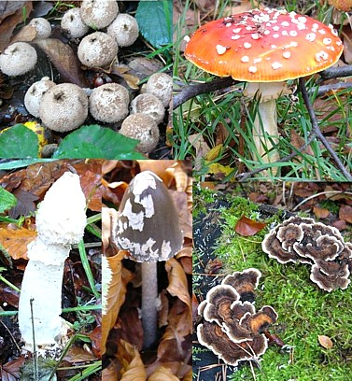
Characteristics
Fungi differ from plants
  Lack chlorophyll
  Not photosynthetic
  Never produce seeds
  Cells wall are made of chitin NOT cellulose

Slide 7
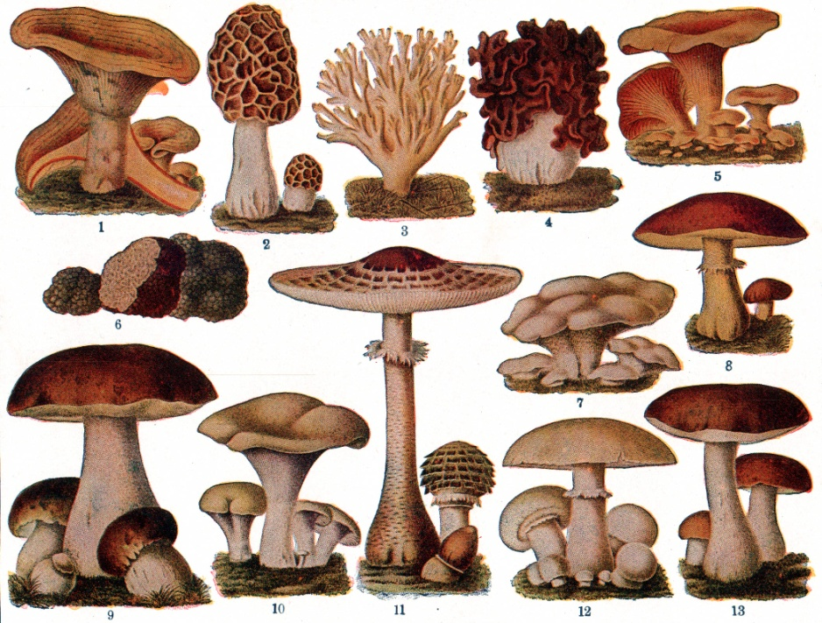
Characteristics
All FUNGI:
  Have nuclei and mitochondria, so they are eukaryotic
  Depend on other organisms for their nutrition, so heterotrophs
  Cannot move by themselves

Slide 8
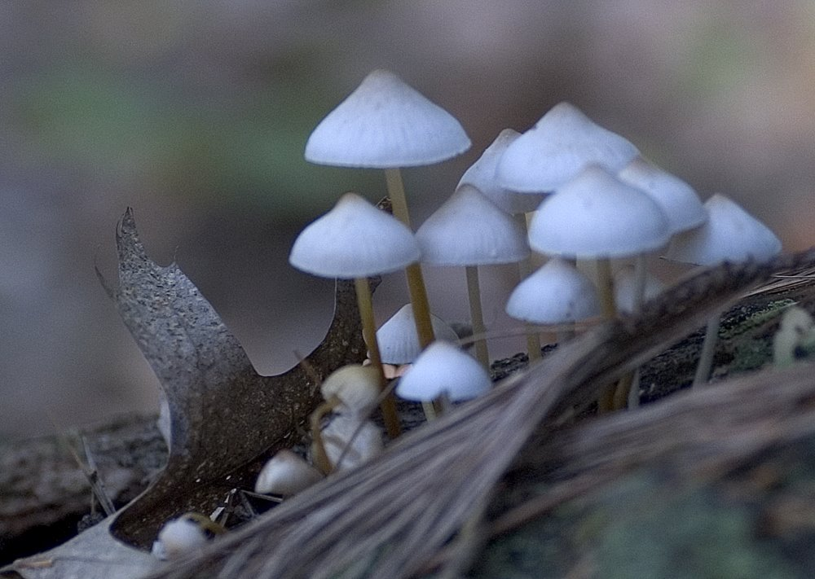
Nutrition of fungi
All fungi are heterotrophs, so obtain their nutrition from other organisms.
Most fungi are saprophytes, they obtain their nutrients by digesting and absorbing nutrients from dead organisms.

Slide 9
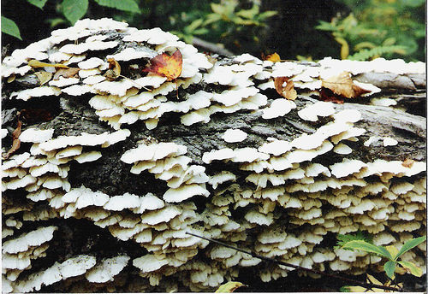
Nutrition of Fungi
Most fungi are decomposers or recyclers.
Some fungi are parasites and obtain their nutrients from living hosts.
Few fungi are predators, having the ability to trap their food.

Slide 10
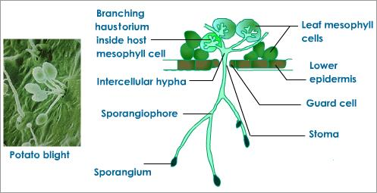
Nutrition of fungi
Fungi digest their food outside of their bodies by secreting enzymes that break down organic material.
The fungi then absorbs food through their cell walls.
Fungi store their energy in the form of glycogen.

Slide 11
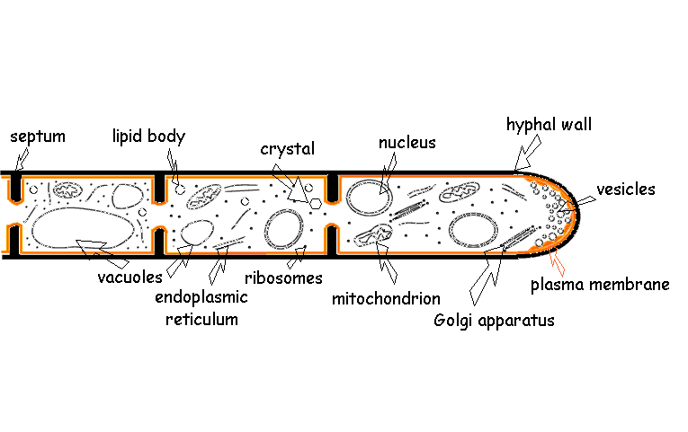
Structure of fungi
The study of fungi is called mycology
The body of a fungus consists of tiny filaments called hyphae
Hyphae are tiny tubes filled with cytoplasm and nuclei.
The cell walls of hyphae contain chitin.

Slide 12
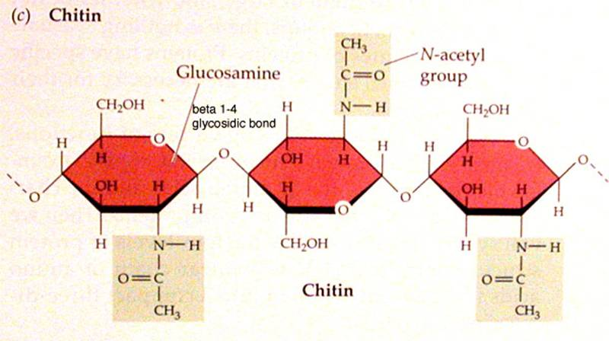
Structure of fungi
Chitin is found in the cell walls of fungi
Chitin is a complex polysaccharide not found in bacteria, protists or other microorganisms but found in insects.

Slide 13
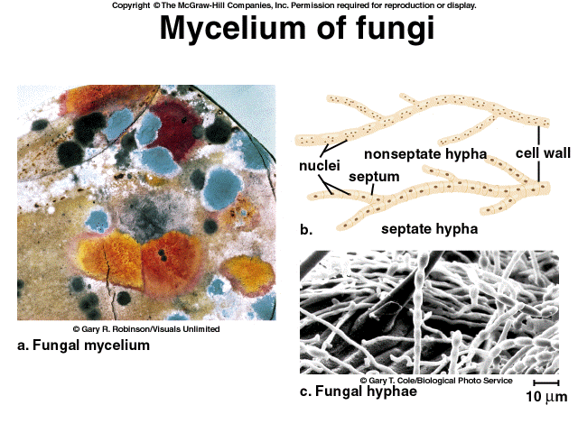
Structure of fungi
Hyphae are the living, growing part of multicellular fungi
A mass of hyphae visible to the unaided eye is a mycelium

Slide 14
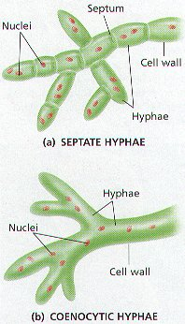
Structure of fungi
Some hyphae are divided by cross section segments called septa
Septa have holes through which cytoplasm and organelles can move from segment to segment.

Slide 15
Structure of hyphae
Hyphae whose cells are divided by septa are called septate hyphae
Hyphae that do not have septa are called coenocytic

Slide 16
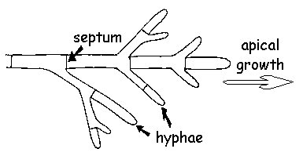
Growth of fungi
Hyphae increase length by cellular growth and division at the TIP.
As the hyphae grow, the size of the mycelium increase

Slide 17
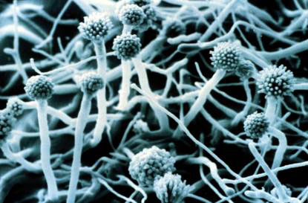
Growth of fungi
Because materials from the whole mycelium are available to the growing hyphae, fungi can grow rapidly
http://129.215.156.68/Movies/hypha.htm

Slide 18
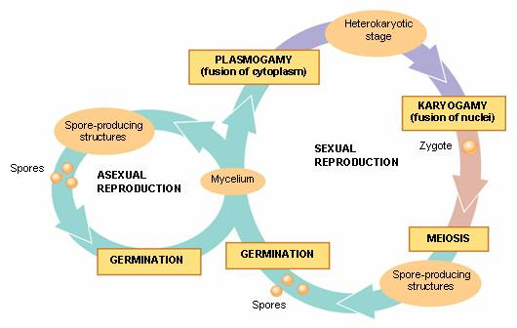
Reproduction in fungi
Many fungi can reproduce both asexually and sexually
Sexual reproduction usually occurs when nutrients or water become scarce.

Slide 19
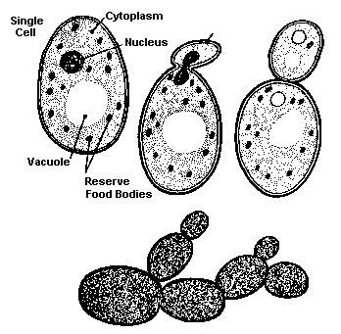
Asexual reproduction in fungi
Some unicellular fungi can reproduce by mitosis
Yeast cells reproduce by a process of budding, a process in which part of the cell pinches itself off to produce small offspring.

Slide 20
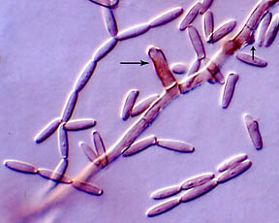
Asexual reproduction in fungi
Most fungi can grow from a small piece of mycelium called fragmentation.

Slide 21
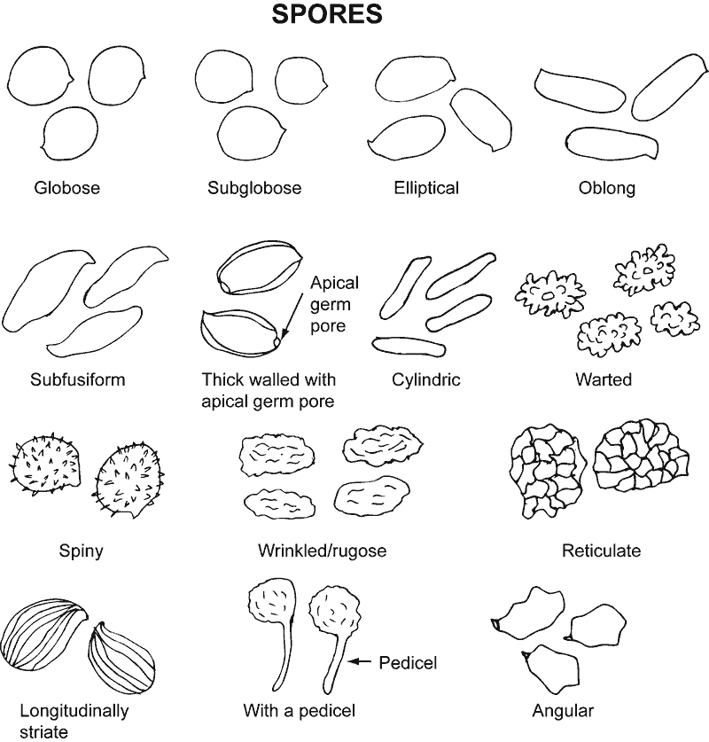
Asexual reproduction in fungi
Most fungi can reproduce asexually by spores.
Spores are the means by which fungi are dispersed.
Each spore contains a nucleus and dehydrated cytoplasm surrounded by a protected coat.

Slide 22
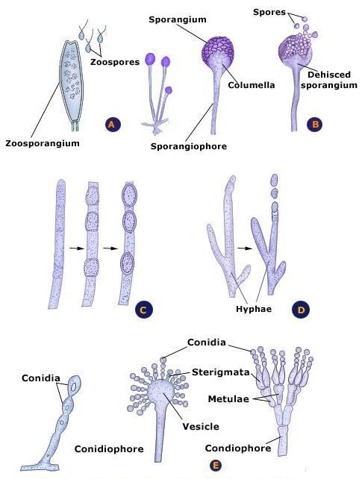
Asexual reproduction in fungi
The reproductive structures of fungi that produce spores are called fruiting bodies.
A fruiting body consists typically of a stalk and a sac in which spores are produced.

Slide 23
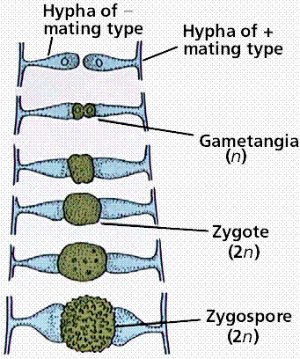
Sexual reproduction in fungi
There are no male and female fungi
The two mating types are called PLUS mating type and MINUS mating type.
Fertilization occurs when the hyphae from a plus and minus fuse

Slide 24
Section 28-1
Complete Reading Guide and Review

Slide 25
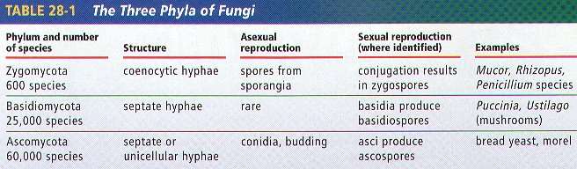
Classification of fungi
There are approximately 100 000 species of fungi classified into three phyla
Traditionally fungi are classified according to their structures and form of sexual reproduction.
For your cards you will add Deuteromycota to this table

Slide 26
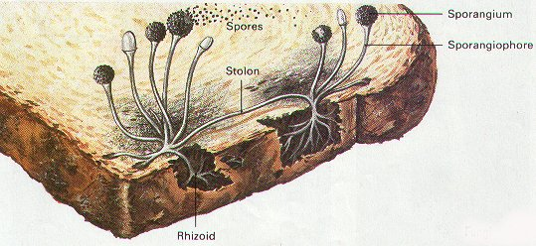
Phylum zygomycota – common molds
Most species are terrestrial organisms found primarily in soil that is rich in organic matter.
The hyphae are coenocytic
Common bread mold is an example

Slide 27
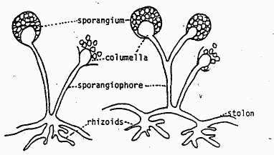
Phylum zygomycota
The hyphae of common molds show some specialization of function:
  Rhizoids – the part of the hyphae used by the fungus to anchor to its source of food.
  Stolons – hyphae that connect one group of rhizoids to another.

Slide 28
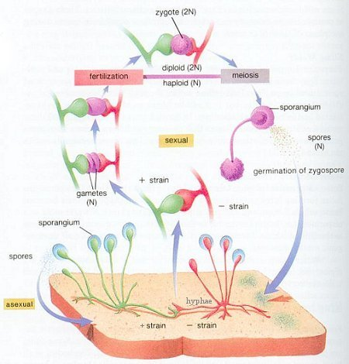
Phylum zygomycota
Common mold life cycles include both asexual and sexual but most often they are in asexual mode.
When hyphae of different mating type grow close to each other the mold may reproduce sexually by conjugation

Slide 29
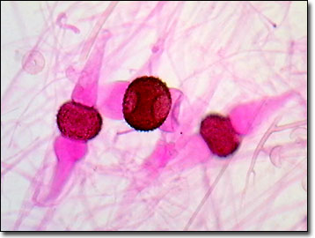
Phylum zygomycota
The mold develops special extensions for mating called gamatangium.
The gamatangia from two type grow together and fuse
Nuclei from the two types mix and form a zygosporangium which is a resting stage of fungi.

Slide 30
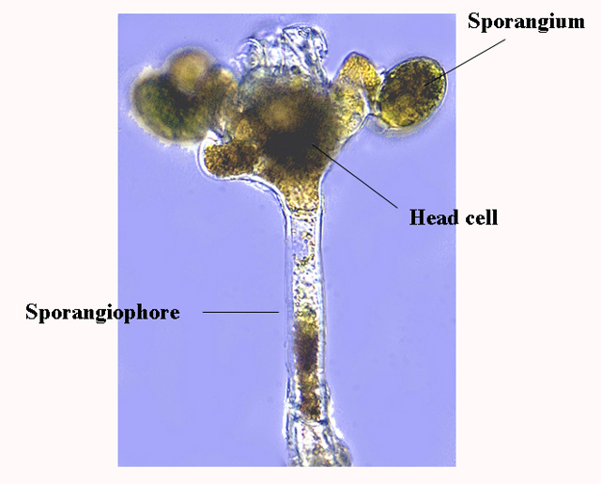
Phylum Zygomycota
A zygosporangium can survive hostile environmental conditions.
When conditions improve, the diploid zygosporangium cracks open and a sporangiophore grows and forms a sporangium
The sporangium releases thousands of haploid spores.

Slide 31
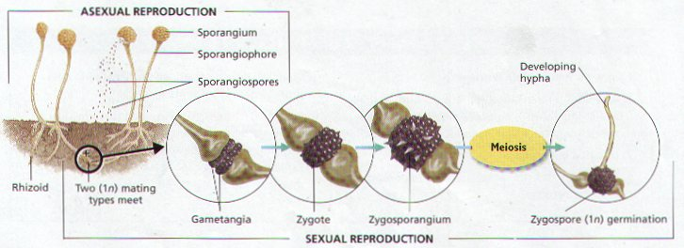
Phylum zygomycota

Slide 32
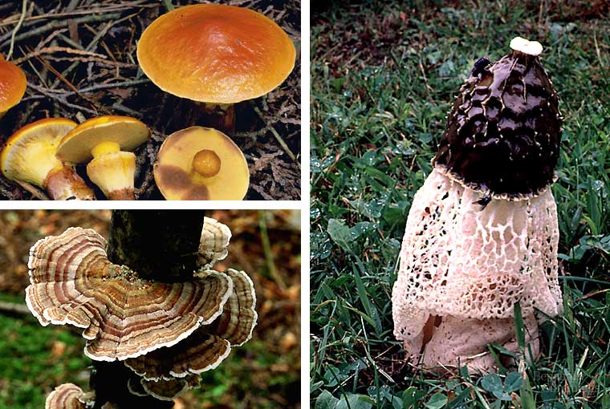
Phylum basidiomycota
Often called ‘club fungi’ because they produce small club-like reproductive structures called basidia during sexual reproduction.
This phylum includes mushrooms, bracket fungi, shelf fungi, puffballs.

Slide 33
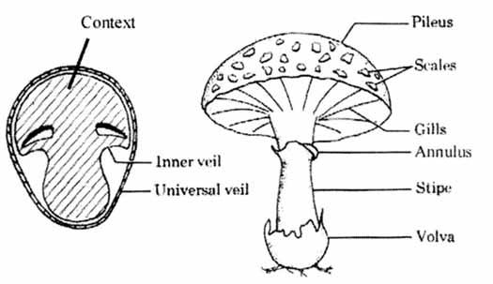
Phylum basidiomycota
Club fungi seldom reproduce asexually
Club fungi reproduce sexually by forming spores in a structure called a basidium which can be found lining gills inside the basidiocarp.

Slide 34
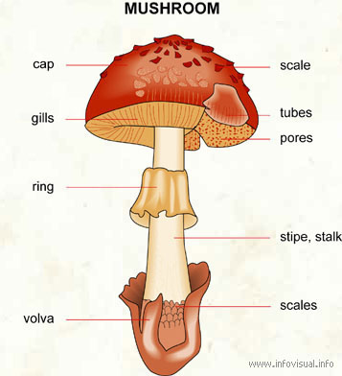
Phylum basidiomycota
Basidiocarp consists of a stem called a stalk and a flattened structure known as a cap.
Each gill is lined with thousands of dikaryotic basidia – cells containing two nuclei

Slide 35
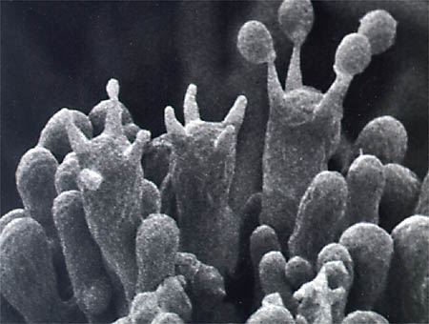
Phylum basidiomycota
In each basidium, two nuclei fuse to form a zygote.
The zygote undergoes meiosis to form four haploid nuclei, that develop into four basidiospores which are released into the air
Under favorable conditions the basidiospores germinate and grow new hyphae and mycelia

Slide 36
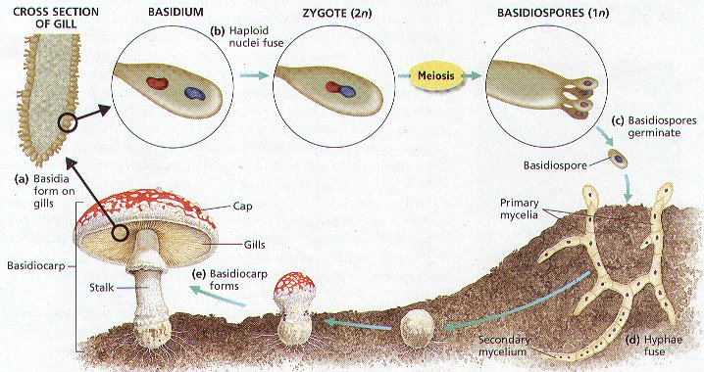
Phylum basidiomycota

Slide 37
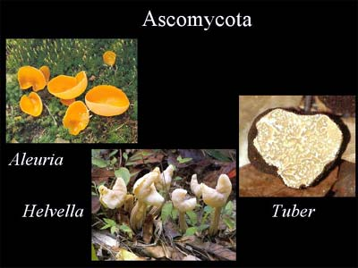
Phylum ascomycota
Ascomycetes are distinguished by the presence of saclike compartments where sexual production of spores occurs
Includes unicellular yeasts, cup fungi, truffles, morels and mildews

Slide 38
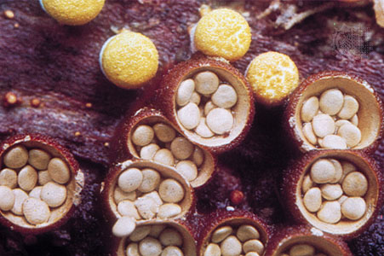
Phylum ascomycota
Sac fungi can reproduce both sexually and asexually
They reproduce asexually by forming spores at the tips of their hyphae

Slide 39
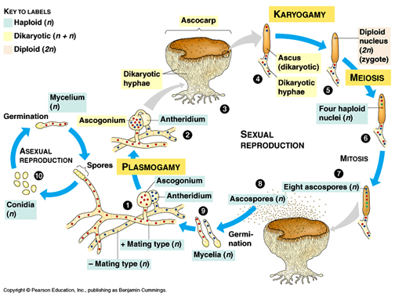
Phylum ascomycota
Sac fungi reproduce sexually by forming an ascus – a sac structure in which spores are formed.
Sexual reproduction takes place when the hyphae of two compatible mating types form male and female haploid gametangia
The female gametangia is called an ascogonium
The male gametangia is called an antheridium.

Slide 40
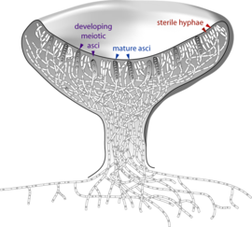
Phylum ascomycota
The parent fungi form a visible cup-like structure called the ascocarp
Within the ascocarp the sacs called asci develop at the tips of the hyphae and form ascospores, which are released.

Slide 41
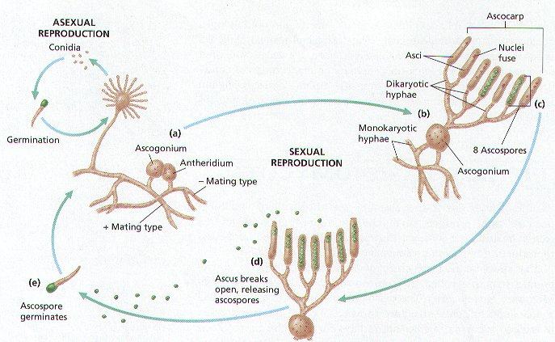
Phylum ascomycota

Slide 42
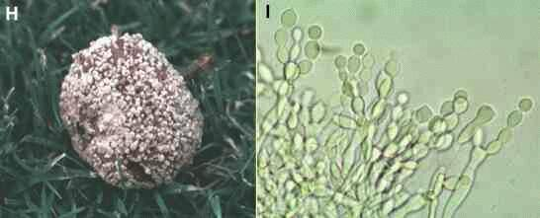
Phylum deuteromycota
These are known as the imperfect fungi because there is no sexual reproductive phase in their life cycle

Slide 43
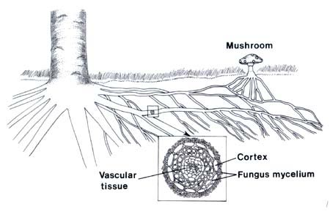
fungal Relationships - mycorrhizae
A mycorrhiza is a symbiotic association between a fungus and plant roots
Mycorrhizae are mutualistic associations

Slide 44
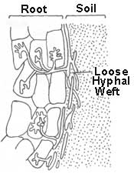
fungal relationships - mycorrhizae
The fungus benefits because it can absorb nutrients (sugars) made by the plant
The plant benefits in two ways
  The hyphae act a root extensions so increases the plants ability to absorb water
  The digestive enzymes help breakdown organic matter in the soil that the plants are able to absorb

Slide 45
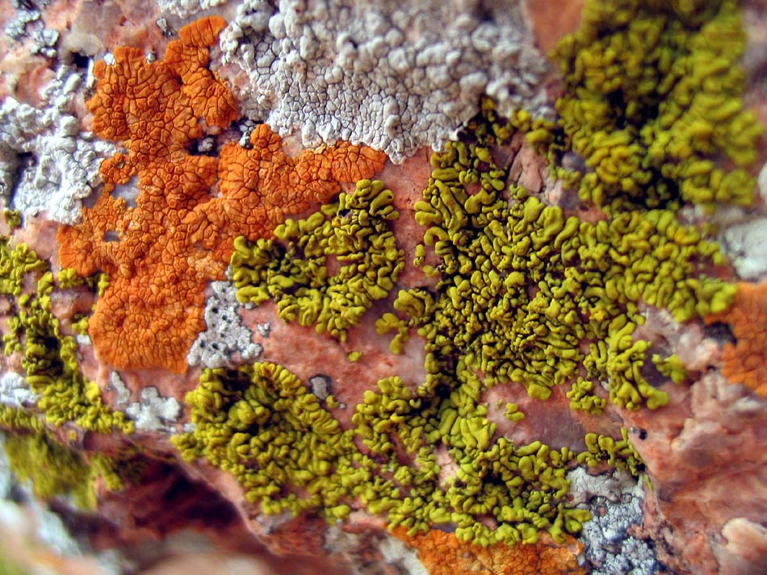
Fungal relationships - lichen
A lichen is a mutualistic association between a fungus and a photosynthetic organism.
The fungus is usually an ascomycetes and the photosynthetic organism is usually an alga or cyanobacterium

Slide 46
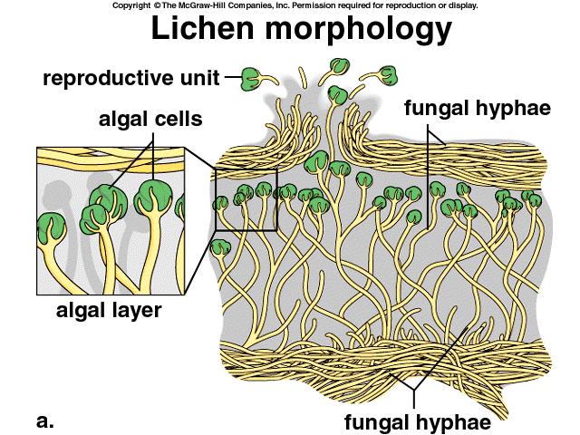
Fungal relationships - lichen
Many lichens absorb chemical nutrients from the air and provide them to the photosynthetic partner which provides the sugars for the fungus.
The fungus also provides moisture, shelter and anchorage for the photosynthesizer.

Slide 47
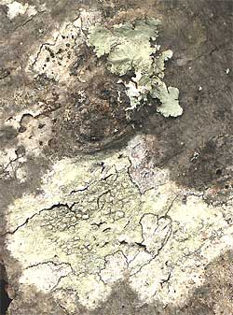
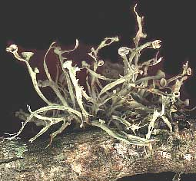
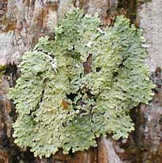
Fungal relationships - lichen
Lichens are identified according to their distribution and structure
  Crustose – grow as a layer on the surfaces of rocks and trees
  Fruiticose – shrub-like and grow up to 1.5 m
  Foliose – live on soil surfaces and form mat-like growths with tangled bodies
crustose
fruiticose
foliose

Slide 48
Section 28-2
Complete Reading Guide & Review

Slide 49
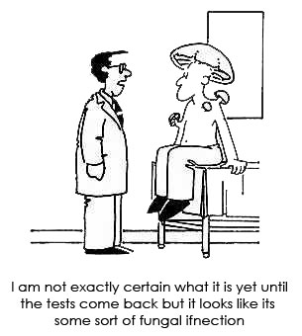
Fungi & human disease
Fungi can sometimes attach the tissues of living plants and animals which is known as a disease
Fungal disease is a major concern for humans because fungi attack not only us, but our food source

Slide 50
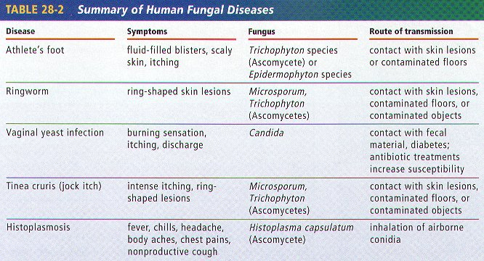
Fungi & human disease

Slide 51




Fungi in industry
Many fungi are valuable food sources, such as yeast, mushrooms, morels and truffles
Many fungi are plant pathogens that attack grain and fruit
Fungi are also used to produce chemical compounds that are then used in the food processing industry

Slide 52

Fungi and the environment
Most fungi are either saprophytes or decomposers that break down and feed on decaying organic material or dead organisms
When fungi secrete digestive enzymes into a food source, the nutrients are released to be used by the fungus and other organisms

Slide 53
Section 28-3
Complete Reading Guide & Review

