Slide 1
Biological Systems Pt. 2
Supplemental Reading (not required): Chapter 9

Slide 2
Positive and Negative Feedback Loops
Did we discuss this?

Slide 3
Negative feedback loop
Temperature regulation (how do we cool or warm up?)
Feedback can be a bad thing – negative feedback loops negate more feedback.
Negative feedback loops help us maintain homeostasis.
We sweat to cool ourselves off back to an optimal functioning temperature.

Slide 4
Positive feedback loop
Amplification of a signal or response by the response.
Ripening of fruit – how does this happen?
Ethlyene is released by ripening fruit which triggers the ripening process (causing yellowing-browning of bananas or “redding” of apples), this triggers the release of even more ethylene
Lactation in mammals is a positive feedback loop – how does this happen?
When mammals breastfeed, it triggers the release of prolactin which stimulates the production of milk, which is further stimulated as their offspring breastfeed

Slide 5
Consequences of feedback alteration
Diabetes mellitus in response to decreased insulin. (how does this relate to feedback loops getting altered?)
Graves’ disease (hyperthyroidism) - (how does this relate to feedback loops getting altered?)
Blood clotting (why is it good, why is it bad)

Slide 6
Innate behaviour vs learned behaviour
Innate – born with
Learned – observed
NATURE VS NURTURE
Is migration learned or innate?

Slide 7
Organismal Response (why and how?)
Photoperiodism (why do flowers open at certain times?)
Phototropism (how do plants grow towards light?)
Hibernation and migration (how do organisms “know” where to migrate?)
Taxis and kinesis - Chemotaxis in bacteria
Nocturnal and diurnal activity: circadian rhythms (internal clocks)
Shivering/sweating (why, and how?)

Slide 8
Environment Influences Homeostasis - Cell
Certain cell activities are affected by the interaction between biotic and abiotic factors.
Photosynthesis – what abiotic factor(s) might influence cell activity –sunlight!
Anyone remember what biofilm is? (Look it up, how might it relate – what factors trigger its growth?)
How might sunlight trigger cell activity?

Slide 9
Environment Influences Homeostasis - Organism
Organismal activities are affected by the interaction between biotic and abiotic factors.
Symbiotic relationships are relationships between organisms in which there is some form of benefit/deficit or effects borne of their interactions
Come up with an example of these symbiotic relationships:
Mutualistic,
Commensalistic; and
Parasitic

Slide 10
Environment Influences Homeostasis - Community
The community of organisms in an ecosystem are affected by the interaction between biotic and abiotic factors.
Much like we observed in our labs – there is an ebb and flow based on increased/decreased abiotic/biotic factors in a population.

Slide 11
Inquiry Questioning – Mechanisms for Nutrient Uptake and Waste Elimination
We’re doing another FlipGrid! (A visual would be smart to include in this one)
Choose one of the ideas and compare two organisms
What is the difference in gas exchange between aquatic and terrestrial plants?
How do the respiratory systems of aquatic and terrestrial animals differ?
Waste production and removal in aquatic vs terrestrial animals?
What is the difference between two animals gastrovascular cavities for nutrient absorption (are there any that ingest the same way they eliminate)?

Slide 12
Homeostasis in Microbes/Fish
To maintain homeostasis, some organisms use osmoregulation to maintain their osmotic pressure inside their cells.
This can be done by adjusting their salt concentrations in their cells!
Why are some fish only freshwater fish (or saltwater fish)? How can some fish be freshwater and saltwater?

Slide 13
Zebra Mussels in SK
What are zebra mussels?
https://www.saskatchewan.ca/residents/environment-public-health-and-safety/wildlife-issues/invasive-species/clean-drain-and-dry-your-boat
Any fishers? Do you ever read the guide?
http://bcinvasives.ca/news-events/recent-highlights/zebra-mussels-pose-threat-to-saskatchewan-waters/
Invasive species can disrupt homeostasis in ecosystems – how so (consider our lab)?

Slide 14
Disruptions to homeostasis affects health
What does our body do when we get sick?
Why?
Are there certain things our bodies do that are “non-specific” immune responses or our first line of defence (not long term immunity)?

Slide 15
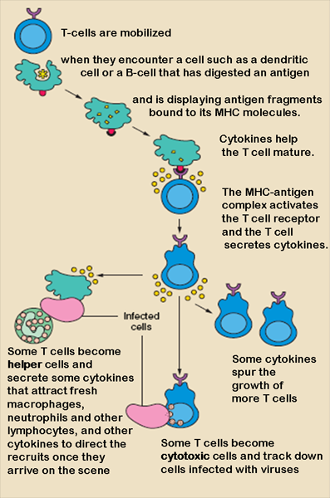
Mammalian Immune Response
Cell mediated - is an immune response that does not involve antibodies, but rather involves the activation of phagocytes, antigen-specific cytotoxic T-lymphocytes, and the release of various cytokines in response to an antigen. (1)
Humoral - is the aspect of immunity that is mediated by macromolecules found in extracellular fluids such as secreted antibodies, complement proteins, and certain antimicrobial peptides. (2)

Slide 16
Comparing Immunity
Cell-mediated - Cytotoxic T-Cells, a lymphocytic white blood cell, “target” intracellular pathogens when antigens are displayed on the outside of cells.
Humoral response – B Cells – a type of lymphocytic white blood cell.
Antigens are recognized by antibodies specific to the antigen. Antibodies are proteins created by B cells. Second exposure to a similar antigen promotes a quicker immune response.

Slide 17
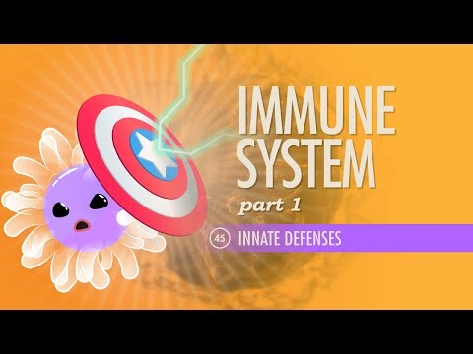
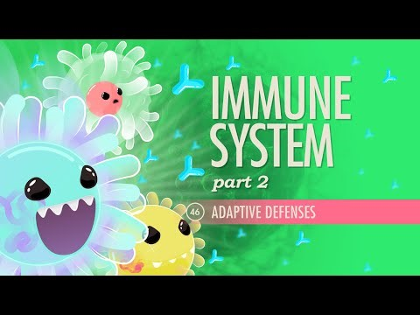
Crash Courses

Slide 18
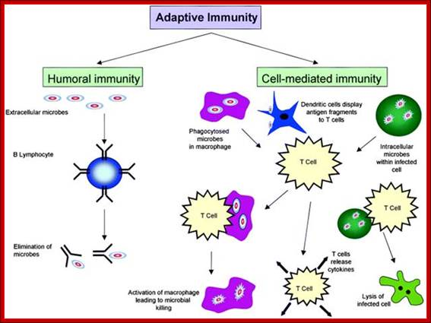
Comparison of Adaptive Immunity

Slide 19
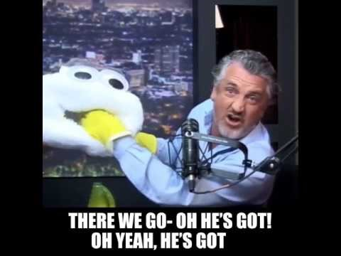
Flu Shots and Vaccinations
How do they work?
Do they work?
Herd Immunity

Slide 20
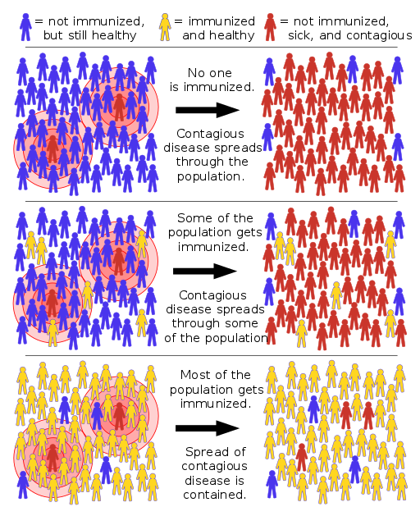
Herd Immunity and Bill Nye
Scope out – we can see these immunities on an organismal scale – but how does this affect the population?
Netflix: Bill Nye Saves the World – Anti-Vaxxers

