Slide 1
Biological Systems Pt. 2
Supplemental Reading (not required): Chapter 9

Slide 2
Positive and Negative Feedback Loops
Did we discuss this?

Slide 3
Negative feedback loop
Temperature regulation (how do we cool or warm up?)
Feedback can be a bad thing – negative feedback loops negate more feedback.
Negative feedback loops help us maintain homeostasis.
We sweat to cool ourselves off back to an optimal functioning temperature.

Slide 4
Positive feedback loop
Amplification of a signal or response by the response.
Ripening of fruit – how does this happen?
Ethlyene is released by ripening fruit which triggers the ripening process (causing yellowing-browning of bananas or “redding” of apples), this triggers the release of even more ethylene
Lactation in mammals is a positive feedback loop – how does this happen?
When mammals breastfeed, it triggers the release of prolactin which stimulates the production of milk, which is further stimulated as their offspring breastfeed

Slide 5
Consequences of feedback alteration
Diabetes mellitus in response to decreased insulin. (how does this relate to feedback loops getting altered?)
Graves’ disease (hyperthyroidism) - (how does this relate to feedback loops getting altered?)
Blood clotting (why is it good, why is it bad)

Slide 6
Innate behaviour vs learned behaviour
Innate – born with
Learned – observed
NATURE VS NURTURE
Is migration learned or innate?

Slide 7
Organismal Response (why and how?)
Photoperiodism (why do flowers open at certain times?)
Phototropism (how do plants grow towards light?)
Hibernation and migration (how do organisms “know” where to migrate?)
Taxis and kinesis - Chemotaxis in bacteria
Nocturnal and diurnal activity: circadian rhythms (internal clocks)
Shivering/sweating (why, and how?)

Slide 8
Environment Influences Homeostasis - Cell
Certain cell activities are affected by the interaction between biotic and abiotic factors.
Photosynthesis – what abiotic factor(s) might influence cell activity –sunlight!
Anyone remember what biofilm is? (Look it up, how might it relate – what factors trigger its growth?)
How might sunlight trigger cell activity?

Slide 9
Environment Influences Homeostasis - Organism
Organismal activities are affected by the interaction between biotic and abiotic factors.
Symbiotic relationships are relationships between organisms in which there is some form of benefit/deficit or effects borne of their interactions
Come up with an example of these symbiotic relationships:
Mutualistic,
Commensalistic; and
Parasitic

Slide 10
Environment Influences Homeostasis - Community
The community of organisms in an ecosystem are affected by the interaction between biotic and abiotic factors.
Much like we observed in our labs – there is an ebb and flow based on increased/decreased abiotic/biotic factors in a population.

Slide 11
Inquiry Questioning – Mechanisms for Nutrient Uptake and Waste Elimination
We’re doing another FlipGrid! (A visual would be smart to include in this one)
Choose one of the ideas and compare two organisms
What is the difference in gas exchange between aquatic and terrestrial plants?
How do the respiratory systems of aquatic and terrestrial animals differ?
Waste production and removal in aquatic vs terrestrial animals?
What is the difference between two animals gastrovascular cavities for nutrient absorption (are there any that ingest the same way they eliminate)?

Slide 12
Homeostasis in Microbes/Fish
To maintain homeostasis, some organisms use osmoregulation to maintain their osmotic pressure inside their cells. Osmoregulation is the adjustment of the concentration of solute within cells.
This can be done by adjusting their salt concentrations in their cells!
Why are some fish only freshwater fish (or saltwater fish)? How can some fish be freshwater and saltwater?

Slide 13
Homeostasis in Microbes/Fish
To maintain homeostasis, some organisms use osmoregulation to maintain their osmotic pressure inside their cells. Osmoregulation is the adjustment of the concentration of solute within cells.
This can be done by adjusting their salt concentrations in their cells!
Why are some fish only freshwater fish (or saltwater fish)? How can some fish be freshwater and saltwater?
Fish need to maintain certain concentrations of solute to maintain homeostasis with their environment so that their cells do not shrink or inflate

Slide 14
Zebra Mussels in SK
What are zebra mussels?
https://www.saskatchewan.ca/residents/environment-public-health-and-safety/wildlife-issues/invasive-species/clean-drain-and-dry-your-boat
Any fishers? Do you ever read the guide?
http://bcinvasives.ca/news-events/recent-highlights/zebra-mussels-pose-threat-to-saskatchewan-waters/
Invasive species can disrupt homeostasis in ecosystems – how so (consider our lab)?

Slide 15
Disruptions to homeostasis affects health
What does our body do when we get sick?
Why?
Are there certain things our bodies do that are “non-specific” immune responses or our first line of defence (not long term immunity)?

Slide 16
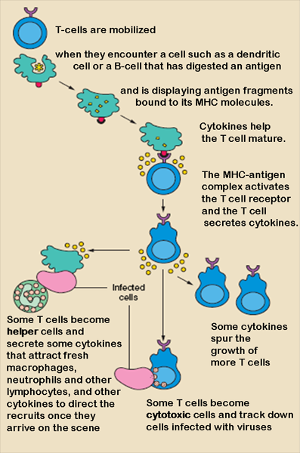
Mammalian Immune Response
Cell mediated - is an immune response that does not involve antibodies, but rather involves the activation of phagocytes, antigen-specific cytotoxic T-lymphocytes, and the release of various cytokines in response to an antigen. (1)
Humoral - is the aspect of immunity that is mediated by macromolecules found in extracellular fluids such as secreted antibodies, complement proteins, and certain antimicrobial peptides. (2)

Slide 17
Comparing Immunity
Cell-mediated - Cytotoxic T-Cells, a lymphocytic white blood cell, “target” intracellular pathogens when antigens are displayed on the outside of cells.
Humoral response – B Cells – a type of lymphocytic white blood cell.
Antigens are recognized by antibodies specific to the antigen. Antibodies are proteins created by B cells. Second exposure to a similar antigen promotes a quicker immune response.

Slide 18
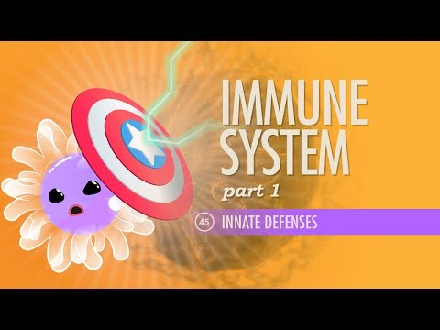
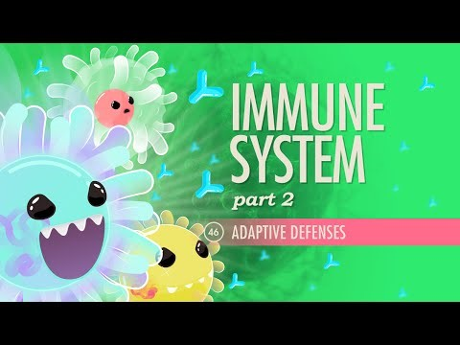
Crash Courses

Slide 19
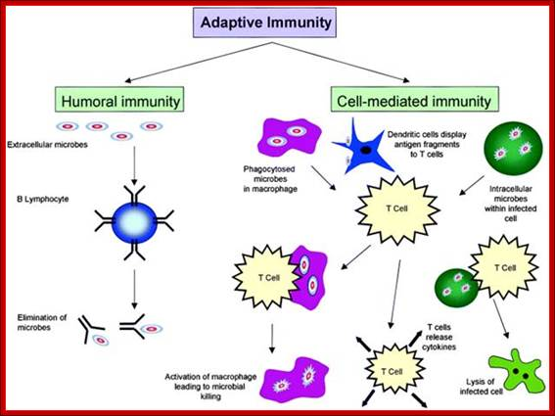
Comparison of Adaptive Immunity

Slide 20
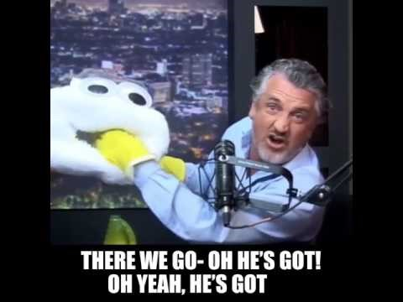
Flu Shots and Vaccinations
How do they work?
Do they work?
Herd Immunity
https://www.youtube.com/watch?v=IMC9auZGnZk

Slide 21
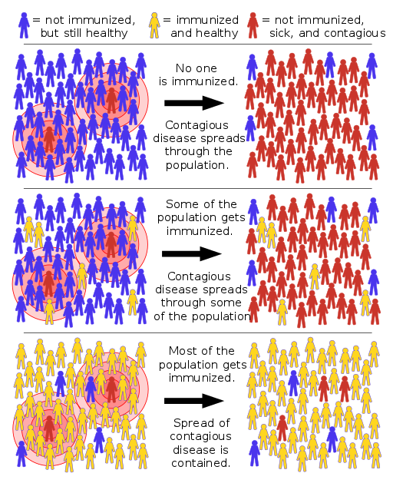
Herd Immunity and Bill Nye
Scope out – we can see these immunities on an organismal scale – but how does this affect the population?
Netflix: Bill Nye Saves the World – Anti-Vaxxers

Slide 22
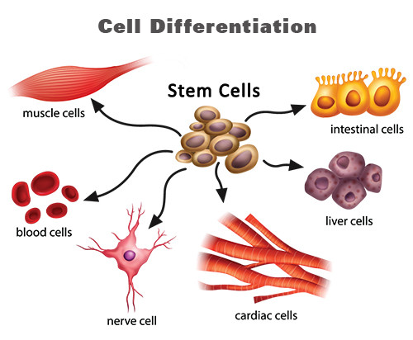
Cell Differentiation
For Immunity – how do our cells become different from one another then?
Why do we have muscle cells, brain cells, skin cells?
Do all our cells have the same DNA?

Slide 23
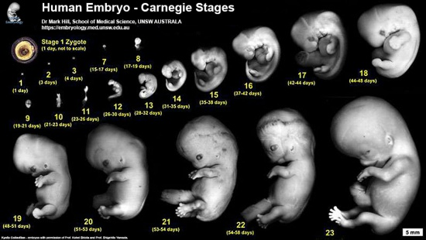
Growth of an embryo
What happens in each stage of an embryo growing into a fetus/child?
What causes each change to occur?

Slide 24
Genetic Expression
Different triggers exist that cause development to occur in sequences.
These triggers cause transcription (creation of specific proteins) to occur, causing different anatomical structures to form. (This is similar in plants when seeds germinate in certain temps and moisture).
Specific genes that regulate this are called homeotic.
For proper embryonic development, specific homeotic genes need to activate in a certain order.
If mutated, we may see drastic changes in the phenotype of the organism.
Part of what helps this is microRNAs
More on the italicized terms in our genetics unit.

Slide 25
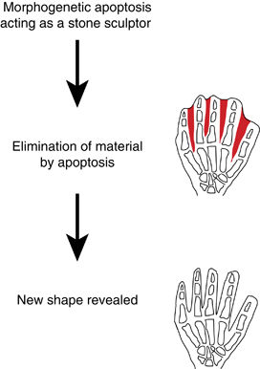
Apoptosis
Programmed cell death also helps in our development!
Additional, “unnecessary” growth gets stopped or countered.
Fingers don’t extend out when connected early on, the cells between the digits die.
It might seem wasteful to kill cells our body made, but the macromolecules are recycled.

Slide 26
Multiple Mechanisms Regulate These Processes
The environment triggers molecular signals in plants
- Phototropism -
- Photoperiodism -
Internal and external signals regulate and cause certain physiological responses.
Is working night shifts good for our health?
Is jet lag a thing? How does it work?

Slide 27
Health effects of shift work and extended hours of work
Give this article a read – highlight or write out at least five points that stood out from the post to share in small group discussion.
WHAT IS THE EVIDENCE TO SUPPORT/GO AGAINST SHIFT WORK?

Slide 28
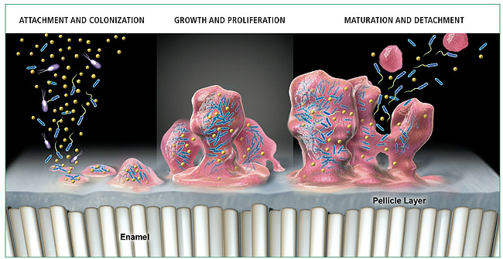
Environmental triggers
Just like sunlight and time of day, different environmental triggers exist for bacteria, fungi, and protists (different types of organisms – mostly unicellular)!
Some bacteria practice quorum sensing.
Quorum sensing involves this environmental triggering that we’ve talked about, except they release molecules that also trigger responses in nearby bacteria potentially leading to vast increases in population density, like biofilm!

Slide 29
Coordination amongst organisms and mechanisms
Organismal communication allows organism’s to respond and act on different environment triggers (which can be biotic or abiotic) molecularly and behaviourally.
Innate responses are ones we inherit genetically, learning occurs through the interactions organisms have with the environment and organisms - do you think biofilm would be innate or learned?
What are some examples of innate responses/behaviours vs learned responses/behaviours? (5 each)

Slide 30
How do these responses and behaviours connect to evolution?
Which of the previous traits we listed may see a variety of outcomes that may be vital in terms of natural selection?
Phototropism = the plants ability to respond to light maximizes its exposure to leaves.
Photoperiodism = amount of light helps regulate flowering and preparation for winter (less light, lower temp = prep for winter).

Slide 31
Environmental cues and selection - organism
An organism’s ability to respond to environmental cues are vital to their reproduction, survival, and natural selection.
What happens if…
Frogs don’t hibernate?
Turtles don’t estivate?
Canadian Geese don’t migrate?
Humans don’t “court” one another?

Slide 32
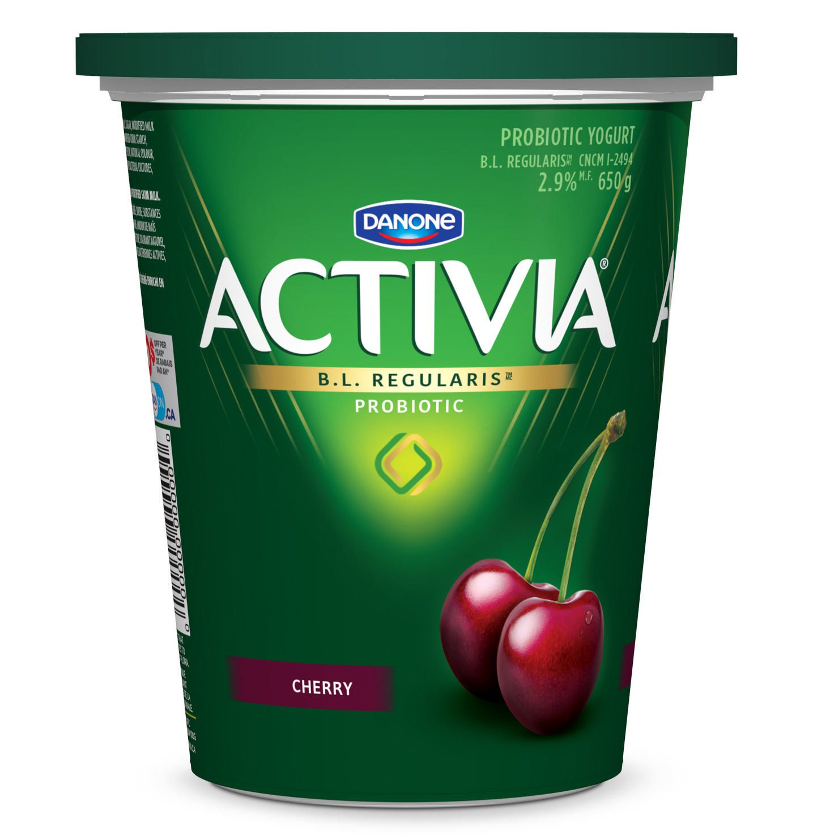
Environmental cues and selection - community
An organism’s ability to cooperate with other organisms can be vital to their reproduction, survival, and natural selection.
What happens if…
Bees don’t pollinate?
Probiotics don’t help us digest?

