Slide 1
3.A Mendelian Genetics
Recommended Reading: Chapter 12 of OpenStax

Slide 2
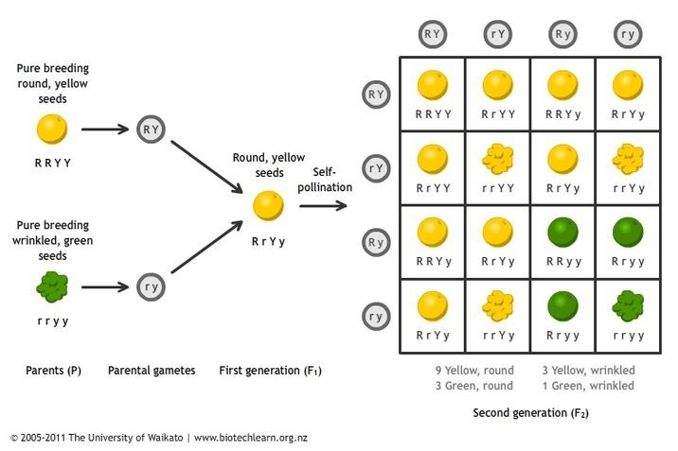
Mendel’s Process

Slide 3
Mendel’s Laws
Law of segregation –
Law of independent assortment –
Law of dominance –

Slide 4
Mendel’s Laws
Law of segregation - states that allele pairs separate or segregate during gamete formation, and randomly unite at fertilization.
Law of independent assortment - when two or more characteristics are inherited, individual hereditary factors assort independently during gamete production, giving different traits an equal opportunity of occurring together.
Law of dominance - one of the factors for a pair of inherited traits will be dominant and the other recessive, unless both factors are recessive.

Slide 5
Probability and Statistical Analysis
Is the fundamental ideas behind this. Possibility and chance abound and account for genetic diversity.
Analyzing the statistics leads to an overlap of math and science! Use math and likelihood of events to occur to make inferences about organisms!
However, why might this not always be accurate?
Genetics isn’t just “one gene codes for one trait”, multiple genes can code for one trait.

Slide 6
Vocabulary
Heterozygous =
Homozygous =
Allele =
A =
a =
Gene loci =
Genotype =
Phenotype =

Slide 7
Vocabulary
Heterozygous = has a genotype composed of two different alleles.
Homozygous = has a genotype composed of two of the same allele.
Allele = a copy of coding for a particular trait or gene loci (one letter).
A = capital letter means dominant.
a = lower case letter means recessive.
Gene loci = location of coding for an organism’s genetics (DNA), typically for a specific characteristic – however, some phenotypes are coded by multiple loci.
Genotype = combination of alleles an individual possesses.
Phenotype = the visible expression of the genotype (the code means we see ________).

Slide 8
Vocabulary
Monohybrid Crosses (A monohybrid cross is a mating between two individuals with different alleles at one genetic locus of interest.)
Dihybrid Crosses (A dihybrid cross is a mating between two individuals with different alleles at two genetic loci of interest.)
Codominance –
Sex-linked –
Autosomes –

Slide 9
Vocabulary
Monohybrid Crosses (A monohybrid cross is a mating between two individuals with different alleles at one genetic locus of interest.)
Dihybrid Crosses (A dihybrid cross is a mating between two individuals with different alleles at two genetic loci of interest.)
Codominance – when two alleles are both represented in a phenotype.
Sex-linked – chromosomes/genes that are located on X or Y chromosome.
Autosomes – non-sex-linked chromosomes.

Slide 10
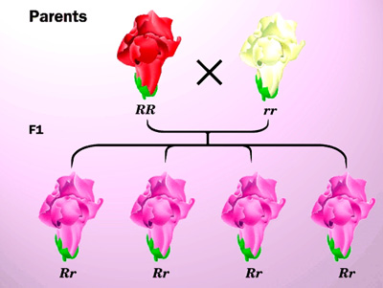
Vocabulary
Incomplete dominance –
Multiple alleles –
Polygenic inheritance -

Slide 11
Vocabulary
Incomplete dominance – one trait isn’t completely dominant over the other so you get a mixed phenotype.
Multiple alleles - we end up with two alleles for every trait in our phenotype
Polygenic inheritance - occurs when one characteristic is controlled by two or more genes.

Slide 12
Importance
Why is it important to know about inheritance?
Why might knowing about dominant and recessive genes be important when considering offspring?
Performing a test cross and looking at offspring can help us determine genotypes, how?

Slide 13
Importance
Why is it important to know about inheritance?
To get an understanding of potential health problems you have to deal with (some conditions are inherited)
Why might knowing about dominant and recessive genes be important when considering offspring?
Knowing about your partner’s genetic make-up could help you avoid the occurrence of genetic conditions that may be recessive.
Performing a test cross and looking at offspring can help us determine genotypes, how?
If you don’t know an organism’s genotype, but breed it with a completely recessive organism – their offspring should tell you what they have.

Slide 14
Monohybrid/Dihybrid Crosses - Punnett’s Squares
P Male(Aa) x Female (Aa) | A (gamete -allele) | a (gamete -allele)
A (gamete -allele)
a (gamete -allele)
Include potential combinations of parental genotypes to determine probability of offspring.
P =
F1 =
F2 =

Slide 15
Monohybrid/Dihybrid Crosses - Punnett’s Squares
P Male(Aa) x Female (Aa) | A (gamete -allele) | a (gamete -allele)
A (gamete -allele) | AA | Aa
a (gamete -allele) | Aa | aa
Include potential combinations of parental genotypes to determine probability of offspring.
P = parental generation
F1 = first generation of offspring
F2 = second generation of offspring (using offspring from F1)

Slide 16
Sample Diybrid
White hair colour in horses is recessive (w), and brown hair is dominant (W). Long mane length is a dominant trait (M), and short mane length is a recessive trait (m). If a heterozygous male (for both traits), mates with a heterozygous brown-haired, homozygous long maned female, what is the phenotypic and genotypic ratios of offspring? What is the percent chance for the different phenotypes of offspring?

Slide 17
Sample Diybrid
White hair colour in horses is recessive (w), and brown hair is dominant (W). Long mane length is a dominant trait (M), and short mane length is a recessive trait (m). If a heterozygous male (for both traits), mates with a heterozygous brown-haired, homozygous long maned female, what is the phenotypic and genotypic ratios of offspring? What is the percent chance for the different phenotypes of offspring?
25% white, long 75% brown, long

Slide 18
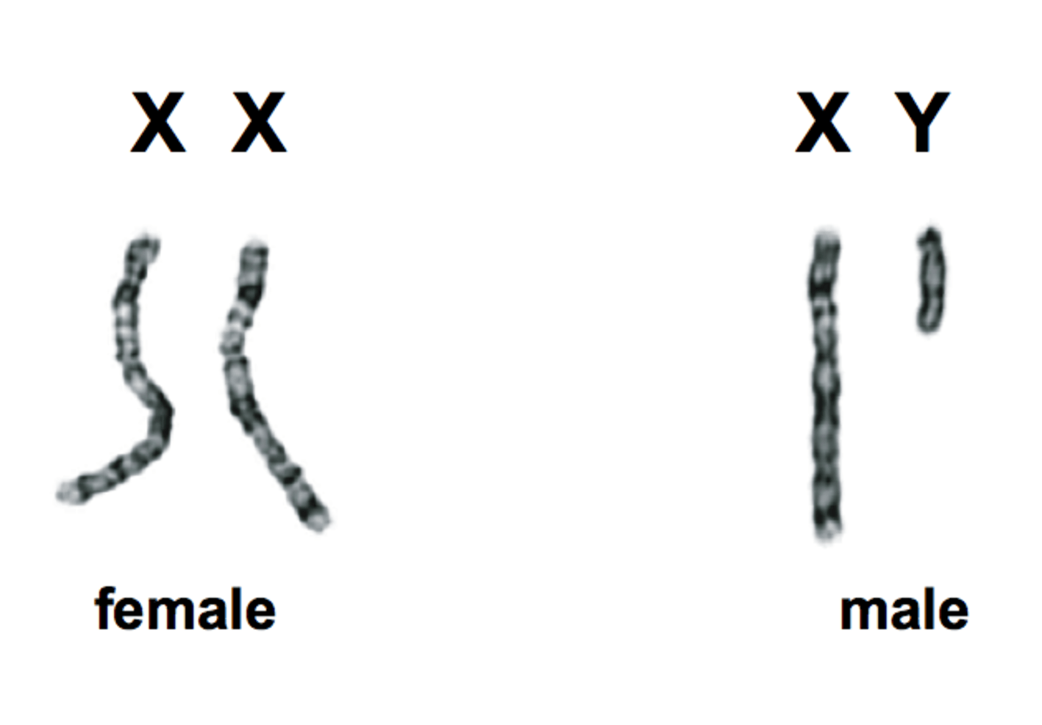
Sex-linked traits
Sex-linked traits are found on ___ Chromosomes in Humans.
___ Chromosome determines “maleness” – it’s small!
So if something was X-linked and recessive, would it be expressed in males?
Some traits are also ___________. Some sex-specific genes only activate in the presence of other sex-specific genes (baldness, milk production).

Slide 19
Sex-linked traits
Sex-linked traits are found on X Chromosomes in Humans.
Y Chromosome determines “maleness” – it’s small!
So if something was X-linked and recessive, would it be expressed in males?
Some traits are also sex-limited. Some sex-specific genes only activate in the presence of other sex-specific genes.

Slide 20
Nonnuclear inheritance
All of this inheritance is based on mitosis and meiosis of DNA in the nucleus of eukaryotic cells. Mitochondria and chloroplast aren’t in the nucleus. They have their own DNA. They replicate in their own ways.
All of us animals have our mother’s DNA. The egg actually maintains a mitochondria, the sperm does not!
Mitochondria is a big part of our cellular function, what disorders are mitochondrially-based?

Slide 21
Application of these Crosses
When chromosomes separate, these traits that make up our phenotypes can be found close to other traits on chromosomes and they tend to cross over or transfer together.
But many traits found on a particular chromosome are more likely to transfer together.
And many traits aren’t just coded by one gene. So… Mendelian Genetics is flawed-ish. What is predicted, commonly isn’t what we see.
What are three things we are pretty sure chromosome 1 codes for?
What are three disorders normally attributed to chromosome 1?
Are these things related?

Slide 22
Genetic Disorders
What are some genetic disorders (some of you wrote about schizophrenia, autism, etc.)?
What causes Down Syndrome?
Why would this be problematic?
How does this connect to the idea of the complexity of biological processes?

Slide 23
Sociocultural Issues with Genetics
Designer Babies – what were some considerations or issues?

Slide 24
Sociocultural Issues with Genetics
Designer Babies – what were some considerations or issues?
Genetic ownership
Wealth Gap
Elite division of society
“Natural” process of human life

