Slide 1
Nature of Environmental Science (Studies)
Outcome: ES20-ES1
Examine the methods, mindsets and purposes of environmental science.

Slide 2
Connecting to the Environment
Reflect upon how one's connection with the environment is influenced by personal experiences and cultural understandings. ((K, STSE, A)
How many of you would consider yourselves outdoors-enthusiasts?
Do/should you “care” about the environment?
Are we dependent on nature?
What are some of your best memories growing up? What was the setting?
What is the Western perspective on environment?

Slide 3
Connecting to the Environment
Reflect upon how one's connection with the environment is influenced by personal experiences and cultural understandings. ((K, STSE, A)
Inherent hypocrisy in discussing and making decisions based on the environment.
Are there alternatives? What is the cost of the alternative, environmentally speaking?
How does our society – government (democracy vs despotism), ideologies (capitalism vs communism) – influence environment?
These notes are printed on paper, is that okay? Should we use an alternative? My first set of presentation notes for this semester probably would’ve been about 6% of a tree. That’s for one teacher in this school, of which there are how many in MJ, SK, Canada, World?

Slide 4
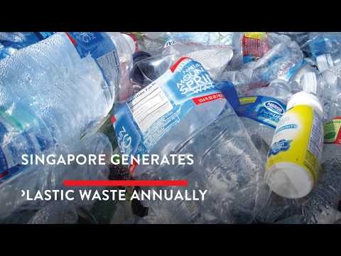
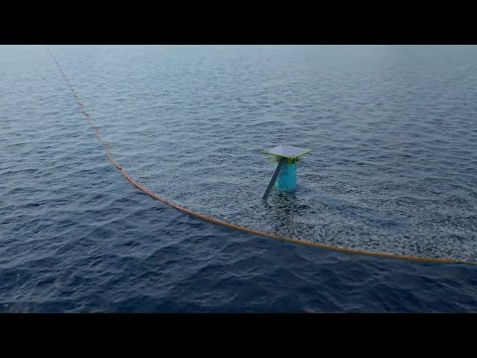
Connecting to the Environment
Reflect upon how one's connection with the environment is influenced by personal experiences and cultural understandings. ((K, STSE, A)
Even now we’re learning about the environment in a classroom – not outdoors in nature. Is this good or bad?
How does developing technology influence the environment for the better or the worse?
We all have differing views about environment influenced by our experiences and this impacts our decision-making.
Thoughts like these about how we learn about the environment has led to the desire or need for place-based learning.
Annual Plastic Waste

Slide 5
Place-Based Learning, Environmental Stewardship, and Sustainability
_________________________________ ‘promotes learning that is rooted in what is local—the unique history, environment, culture, economy, literature, and art of a particular place—that is, in students' own "place" or immediate community.’(Wikipedia)
Simplified:
_________________________________ refers to responsible use and protection of the natural environment through conservation and sustainable practices. (Wikipedia)
Mindset:

Slide 6
Place-Based Learning, Environmental Stewardship, and Sustainability
Place-Based Learning ‘promotes learning that is rooted in what is local—the unique history, environment, culture, economy, literature, and art of a particular place—that is, in students' own "place" or immediate community.’(Wikipedia)
Simplified: We learn better when the learning is relevant to the setting in question. Ex. Learn about ocean while at the ocean.
Environmental stewardship refers to responsible use and protection of the natural environment through conservation and sustainable practices. (Wikipedia)
Mindset: Those with the power to make decisions that support the environment are morally obligated to

Slide 7
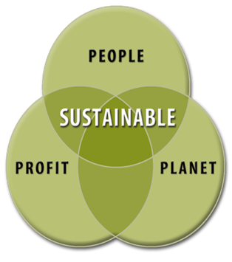
Place-Based Learning, Environmental Stewardship, and Sustainability
_______________ - (from sustain and ability) is the property of biological systems to remain diverse and productive indefinitely. (Wikipedia)
Meaning:

Slide 8
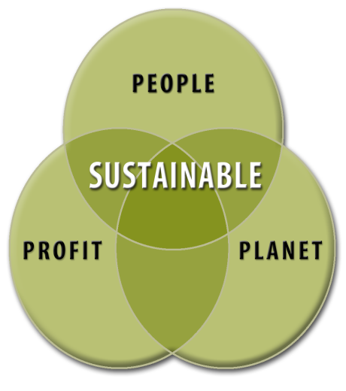
Place-Based Learning, Environmental Stewardship, and Sustainability
Sustainability - (from sustain and ability) is the property of biological systems to remain diverse and productive indefinitely. (Wikipedia)
Meaning: We want to approach our use of the environment in a means that minimizes impact and be continuously used forever.

Slide 9
Place-Based Learning Activity
Engage in place-based learning to gain a deeper understanding and appreciation of the environment. ((S, STSE)
Think about a particular location on the school grounds (one that you will be able to go to that is not here, ideally not one you go to often). Write at least ten expected observations you’ll have there (include all your senses).
You have seven minutes to go to that location. Write at least ten expected observations you’ll have there (use all your senses).

Slide 10
Place-Based Learning Activity
Engage in place-based learning to gain a deeper understanding and appreciation of the environment. ((S, STSE)
Compare what you wrote before to what you wrote after, was there any difference?
I would expect you to have better info there than from here.
We are able to go to certain locations on school grounds, but what about if I asked about McClennan Lake, SK? What are barriers to us having place-based learning about there?

Slide 11
Place-Based Learning, Environmental Stewardship, and Sustainability
Place-based Learning barriers:
Financially - How do we do it?
Weather-wise what is problematic of our setting in SK to be outdoors?
What is most relevant to us in our setting?
What “places” can we learn about or go to locally?

Slide 12
Place-Based Learning, Environmental Stewardship, and Sustainability
Place-based Learning barriers:
Could we use a VR Headset to
- learn about oceans?
- take field trips?
But is this authentic? What would we be missing? Does it need to be authentic?
Where do you fit about this versus others in the classroom?

Slide 13
Environmental Worldviews and Policy
What environmental worldview of the following do you most identify with?
Ecocentric/Biocentric –
Technocentric -
Anthropocentric -
Ecofeminist -

Slide 14
Environmental Worldviews and Policy
What environmental worldview of the following do you most identify with?
Ecocentric/Biocentric – organisms and enviro important regardless of their usefulness. Considering all forms of life having intrinsic value.
Technocentric - is a value system that is centered on technology and its ability to control and protect the environment.
Anthropocentric - is the belief that human beings are the most significant entity of the universe. Anthropocentrism interprets or regards the world in terms of human values and experiences
Ecofeminist - a term that links feminism with ecology. Its advocates say that paternalistic/capitalistic society has led to a harmful split between nature and culture.

Slide 15
Environmental Worldviews and Policy
Analyze how different worldviews (e.g. anthropocentric, biocentric and ecocentric) are expressed through various environmental action plans or environmental policies developed by individuals, industry, government and non- governmental organizations and First Nations, Métis and Inuit groups. ((STSE, K)
How might your background influence you into thinking this way or influence government decision-making and policies (any recent big environmental decisions you can think of)?

Slide 16
Environmental Worldviews and Policy
Analyze how different worldviews (e.g. anthropocentric, biocentric and ecocentric) are expressed through various environmental action plans or environmental policies developed by individuals, industry, government and non- governmental organizations and First Nations, Métis and Inuit groups. ((STSE, K)
How might your background influence you into thinking this way or influence government decision-making and policies (any recent ones you can think of)?
End of the EPA in the United States
Keystone Pipeline in Canada
Dakota Pipeline in States
Carbon Tax in SK

Slide 17
Dakota Access Pipeline in the States
What’s the story (remember to critique your source)?
Pros and cons of each side (3 pros, 3 cons)?
What value do we place on First Nations’ perspectives in making decisions in these cases?
Although we may not hold the same values, what is at stake in this decision-making? What do these decisions “say” about policy-maker worldview?

Slide 18
First Nations’ Perspective
Recognize essential characteristics of First Nations and Métis worldviews regarding the environment, including the importance of the four elements (i.e., earth, water, wind and fire), a sense of interconnectedness with the environment and respect for Mother Earth. ((STSE, K)
Different Indigenous peoples hold varying beliefs on environment!
Interconnectedness was a large part of many of their core beliefs with nature (arguably, ecocentric). This interconnectedness was a result of balance between the four elements (earth, wind, water and fire)
We can draw parallels from these elements to our understandings of environment now as our units are terrestrial, atmospheric, aquatic, and energy – all major components of environment.
Difference of perspective: First Nations’ worldview of feeling “one” with nature – rather than the Western - “owning” of nature.
When you fundamentally believe you are not better than the environment and are instead a part of it, it is easier to respect life.
This is where we see the clash in worldview for the Dakota Access Pipeline.

Slide 19
What is Environmental Science?
What are Environmental Studies?
Differentiate between environmental science and environmental studies, including the types of questions asked, methods used to address those questions and the types of data collected. ((STSE)
Environment involves surroundings and conditions (biotic and abiotic) that influence an organism’s life cycle and activity.
Environmental science involves
This is very broad and literal, involving many different fields of science to inform our understanding (much like in climate change, research from many different fields of science inform our understanding of it)
Environmental studies involves

Slide 20
What is Environmental Science?
What are Environmental Studies?
Differentiate between environmental science and environmental studies, including the types of questions asked, methods used to address those questions and the types of data collected. ((STSE)
Environment involves surroundings and conditions (biotic and abiotic) that influence an organism’s life cycle and activity.
Environmental science involves the study of how environments work, how our environment affects us, and how we affect our environment.
This is very broad and literal, involving many different fields of science to inform our understanding (much like in climate change, research from many different fields of science inform our understanding of it)
Environmental studies involves the social, political, and historical elements of the environment and its connectedness with law and policy.

Slide 21
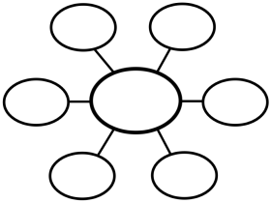
Disciplines of Environmental Science
Recognize environmental science as a newly developing field that integrates knowledge, theories, models and processes from other scientific disciplines such as ecology, atmospheric science, biology, chemistry, physics, oceanography, geology and human geography to investigate human impacts on the environment. ((K, STSE)
Many different disciplines of science contribute to environmental science! Brainstorm a list of branches of science that you know of (list 7, use phones if necessary) – (7 marks).
Summarize/define each of these branches (7 marks).
Justify how they may be connected to environmental science and another science they are similar to
(14 marks).
Environmental Science
Make one of these, fill it in (12 marks)

Slide 22
Environmental Science Connections
Recognize environmental science as a newly developing field that integrates knowledge, theories, models and processes from other scientific disciplines such as ecology, atmospheric science, biology, chemistry, physics, oceanography, geology and human geography to investigate human impacts on the environment. ((K, STSE)
Sample branches of science:
Ecology (organisms and environment),
Biotechnology,
Botany (plants),
Zoology (animals),
Microbiology (bacteria, viruses, etc),
Soil Biology (soil composition),
Computer Science,
Mycology (fungi),
Chemistry (characteristics of matter),
Physics (energy, motion, space and time),
Geology (of solid earth),
Mineralogy (chemistry and structure of minerals),
Agriculture (farming),
Oceanography (marine ecosystems and inhabitants), and Geography (earth’s land, features, and inhabitants).
ALL OF THESE WORK TOGETHER!
WE SEPARATE THEM IN SCHOOL, BUT THEY ARE ALL CONNECTED AND INFORM OUR OVERALL UNDERSTANDING OF THE ENVIRONMENT

Slide 23
History of Environmental Science
What do these involve? What did it lead to (societally)?
Agricultural Revolution
Industrial Revolution
Medical Revolution
Green Revolution
Environmental Revolution and Sustainability
How are these tied to the world’s economy at different times?

Slide 24
History of Environmental Science
Agricultural Revolution
In approximately 8,000 BC, humans began to settle into specific regions and areas, actively shaping and utilizing the land in contrast to their nomadic ancestors who simply foraged and hunted. People began to grow crops, domesticate animals and as food become more plentiful the populations could grow (since there was more food to support more people). This in time led to specialization of jobs and led to the creation of new roles and tasks in communities (building, farming, defense, parenting, etc.).
Industrial Revolution
In the early 1700s, humanity shifted from rural life that utilized animal-powered agriculture and handmade manufacturing, to an urban society powered by nonrenewable energy sources (which include fossil fuels such as oil, coal, and natural gas – named fossil fuels due to the fact it is created from condensed organic matter over thousands of years). This event led to advances in sanitation (cleanliness), increased agricultural production, and medical technology.

Slide 25
History of Environmental Science
Medical Revolution
As industry and technology advanced, this allowed for the mass production of medical instruments, antibiotics, and vaccines. Antibiotics combat bacterial infections and vaccines help to prevent or reduce the severity of both viral and bacterial infections. Scientists began determining causes for many diseases being attributed to organism’s (bacteria) that spread from person to person. Waste management became a greater concern as did personal hygiene and cleanliness (washing hands, etc.).
Green Revolution (Agriculture)
The creation of vehicles that contributed to greater food production combined with fertilizers and pesticides also increased crop yields. With greater increases in food production and people living cleaner, healthier, and longer, the population continued to grow rapidly. Higher natality rates. Lower mortality rates.

Slide 26
History of Environmental Science
Environmental Revolution & Sustainability
In recent history, evidence has arose that assessed the devastating impact of human growth on the surrounding environment. Climate change, ozone layer depletion, and concerns regarding the use of chemicals and pesticides on our well-being have become more prominent. Analyzing our ecological footprint, which calculates how much land and water is required to support a specific individual or population, can aid in observing our impact on the environment. Most practices associated with minimizing your footprint involve the pursuit of sustainability. Sustainability involves resources that can have continued use at the same rate for the foreseeable future (solar power, organic farming), but overuse of resources may affect its ability to be reused (fresh water depletion, excessive deforestation).
Over time we can see a progression of utilizing the environment to aid in survival and improving human quality of life.
Increasing Survival --> Become Superior to and Manipulate --> Stewardship (protect it)
This progression outlines how environmental science's use and goals continue to evolve over time adapting to humanity's needs.

Slide 27
Environments as Systems
A ___________ is a network of relationships among parts, elements, or components that interact with and influence one another through the exchange of energy, matter or information.
How might systems be relative?
What are examples of natural systems?

Slide 28
Environments as Systems
A system is a network of relationships among parts, elements, or components that interact with and influence one another through the exchange of energy, matter or information.
How might systems be relative?
What are examples of natural systems?

Slide 29
Environments as Systems
A system is a network of relationships among parts, elements, or components that interact with and influence one another through the exchange of energy, matter or information.
How might systems be relative?
The boundaries of systems are subject to interpretation. Do you include the internet and all of its information as part of a computer system? Do you include the energy source that powers the computer?
What are examples of natural systems?
Carbon cycle, food chain, nitrogen cycle

Slide 30
Other systems at work in Environmental Science/Studies
What are some human systems at work influencing the environment and how?
- Governments – through policies
- Currency/Economy – exchange of goods and their value is connected to environment
- Law – enforcement of government policies – order over behaviour that impacts environments
- Education system – what perspectives and ideas are perpetuated by the school system?

Slide 31
Components of systems
Boundaries – limits or containing of a system in question.
Input –
Output –
Inputs and outputs exist in a
In nature we can observe _________ ______. Feedback is like a response, typically related to another response in some way.

Slide 32
Components of systems
Boundaries – limits or containing of a system in question.
Input – something introduced to a system, could be elements, energy, anything.
Output – something that exits or comes out of a system
Inputs and outputs exist in a cause and effect relationship.
In nature we can observe feedback loops. Feedback is like a response, typically related to another response in some way.

Slide 33
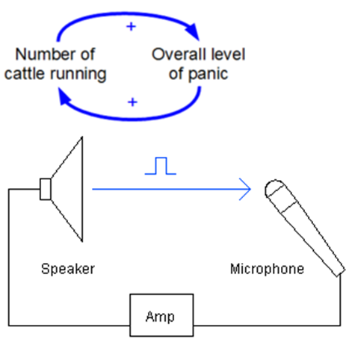
Systems Theory
Positive Feedback Loops –
Natural example?
Negative Feedback Loops –

Slide 34
Systems Theory
Positive Feedback Loops – AMP/Mic
A produces more of B which in turn makes more A. (think: one action, adds to more of another, which adds to more of another – exponential growth)
Natural example?
Negative Feedback Loops – Sweating!
A leads to B which helps stabilize/cancel out A. (think: one action, negates another)
These types of loops are of great importance when considering environmental issues like overpopulation or climate change.

Slide 35
Systems Theory
Energy flows – following our understandings of energy, we know that it flows through different forms (chemical and kinetic) and this exists through organismal interactions with nature.
Matter transfers in a similar way through the carbon, nitrogen, water, phosphorus cycle.
Understanding the connectedness of systems allows us to make informed, ethical decisions influencing Environmental Sustainability.

Slide 36
Environmental Sustainability
Examine how principles of sustainability (i.e., environmental, economic and social justice) are integral to environmental science. ((STSE)
Principles of sustainability are a big part of environmental science:
Environmental Principles of Sustainability
Biodiversity –
Renewable Energy (Solar) –
Nutrient Recycling –
*Population Control* -
These are also constantly connected to economic and social justice pieces.

Slide 37
Environmental Sustainability
Examine how principles of sustainability (i.e., environmental, economic and social justice) are integral to environmental science. ((STSE)
Principles of sustainability are a big part of environmental science:
Environmental Principles of Sustainability
Biodiversity – variety of different levels of “life” in the world or certain environments. Includes species, environmental, and genetic diversity.
Renewable Energy (Solar) – renewable means energy harnessing and transfer to minimize impact on biodiversity and natural systems.
Nutrient Recycling – nutrients cycle through different systems – how can we harness this at minimal impact to biodiversity?
*Population Control* - can humanity reach a sustainable growth ethically that doesn’t exceed our planet’s carrying capacity?
These are also constantly connected to economic and social justice pieces.

Slide 38
Environmental Social Justice
Examine how principles of sustainability (i.e., environmental, economic and social justice) are integral to environmental science. ((STSE)
Social Justice – what is it?
“justice in terms of the distribution of wealth, opportunities, and privileges within a society.”
Environmental Justice - is the fair treatment and meaningful involvement of all people regardless of race, color, national origin, or income with respect to the development, implementation, and enforcement of environmental laws, regulations, and policies.”
Our perspectives on environmental justice determine what policies or actions we’re willing to pursue for the environment as environmental stewards.

Slide 39
Environmental Models
The creation of models meant to represent occurrences in the environment helps us better understand our potential effects on the environment.
Making predictions about climate change through the creation of climate models – how valid are they?
https://www.skepticalscience.com/climate-models.htm
What models exist for climate change? Are they valid? What all informs it?
Average global temperatures
Sea levels
CO2 levels

Slide 40
Environmental Policy
To enforce regulations and restrictions to protect the environment, policies must be created. A policy consists of a formal set of general plans and principles for addressing problems and guiding decision-making. Environmental policy involves general plans and principles that address the interactions between humans and the environment. To enforce these policies, governments typically follow a command-and-control approach in which these rules and regulations are set and punishments are made should these not be followed. However, government's need to do sufficient research so that these regulations and claims are well-supported through valid scientific data.

Slide 41
Environmental Policy
To encourage pro-environmental practices, governments may provide subsidies to individuals, in the form of cash or public resources.
Contrasting this, are green taxes, which tax companies that participate in activities or create products that are harmful to the environment. Building on this includes a cap-and-trade system. Wherein companies are given a limit (or 'cap') to their environmental impact, but are able to sell their additional cap space if they are underneath the limits to other companies (so that these companies can have increased limits).
What are some environmental policies that you know of? Are there ones we should be pursuing or not pursuing? Are there ways around some of these policies?

Slide 42
Want to make a Policy?
Steps for making change and creating policies:
1. Identify the problem
2. Identify causes – research why the problem has arisen.
3. Envision a solution – what can be done to mitigate effects or fix the problem.
4. Get organized – into a group demanding action or change.
5. Gain access – to politicians who can make changes via lobbying – which is the process of influencing an elected official to support a specific interest (money helps).
6. Help a solution become policy – create and introduce a bill.

Slide 43
What would be a policy of interest?
1.
2.
3.
4.
5.
6.

Slide 44
What would be a policy of interest?
1. Greenhouse gas emissions or vehicle usage.
2. Poor public transportation, more individual vehicle usage, cultural causes or indifference to environmental effects.
3. Request City of MJ invest more on public transport.
4. Find individuals who are like-minded (specifically large groups/businesses)
5. Fraser Tolmie (Mayor), Warren Michelson (MLA), Greg Lawrence (MLA)
6. Provide support to parties involved to create and introduce a bill or how to increase spending.

