Slide 1
Gene Expression
3B – Gene regulation results in differential gene expression, leading to cell specialization.

Slide 2
Gene Expression
Recommended Reading: Chapter 16 - OpenStax

Slide 3
What is Gene Regulation?
Gene Regulation (like genetic expression) involves certain sequences of DNA (genes) or some RNAs that interact with _________________ to control transcription.
Some are _________________ (________ transcription).
Some are _________________ (________ transcription).
Some are _________________ (________transcription).
Any _________________ is one that codes for the regulatory proteins in these processes.

Slide 4
What is Gene Regulation?
Gene Regulation (like genetic expression) involves certain sequences of DNA (genes) or some RNAs that interact with regulatory proteins to control transcription.
Some are promoters (start transcription).
Some are terminators (stop transcription).
Some are enhancers (speed up transcription).
These sequences of genes under the control of a specific promoter are called operons.
Any regulatory gene is one that codes for the regulatory proteins in these processes.

Slide 5
What is gene expression?
Process of turning on a gene to produce RNA which in turn produces a protein.
This can happen in the presence of certain regulatory protein molecules (activators, repressors, or inducers) – which cause the unwrapping DNA from histones – promoter transcription, translation, lots of things!
Why is this a thing? Why wouldn’t they just be left on all the time?
It’s not energy-efficient. Specialization of certain cells only need to be active at certain times

Slide 6
What are activators, inducers, and Repressors?
Repressors –
Activators –
Inducers –
Tryptophan -

Slide 7
What are activators, inducers, and Repressors?
Repressors – proteins that suppress transcription of a gene in response to an external stimulus.
Activators – proteins that increases transcription of a gene in response to an external stimulus.
Inducers – activate or repress transcription depending on needs of cell and availability of the substrate.
Tryptophan – a protein-receptor-activator. When tryptophan is present, it activates the gene.

Slide 8
Difference Between…
What is the difference between…
Promoters and Activators – an activator can trigger the promoter on a DNA sequence to start transcripting.
Terminators and Repressors – terminators are the end of a gene sequence, whereas repressors prevent or stop a gene sequence from getting transcripted in the first place.
Inducers and Enhancers – inducers are proteins that can cause transcription to start/stop based on their concentration. Enhancers help cause promoters to transcript.
Some of them deal with the Gene/DNA sequence, some of them are proteins that influence the Gene/DNA sequence

Slide 9
How does the repressor work?
(think of concentration of solutions)
Water balloon analogy (the wall of the water balloon is the DNA for transcription). More tryptophan in the environment forces the repressors to the wall, blocking them from producing more!
Look up in the text either the trp operon or the lac operon – is it a repressor, activator or inducer operon? How does it work? Why is it significant?

Slide 10

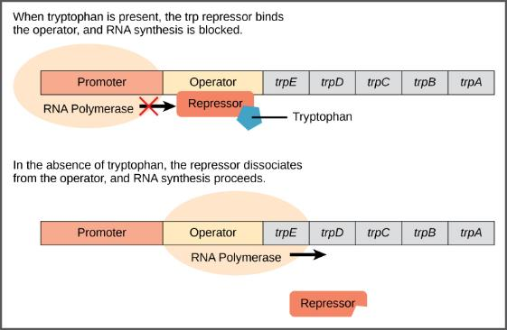
Figure 16.3
What is a promoter?
What is happening here?
The five genes that are needed to synthesize tryptophan in E. coli are located next to each other in the trp operon. When tryptophan is plentiful, two tryptophan molecules bind the repressor protein at the operator sequence. This physically blocks the RNA polymerase from transcribing the tryptophan genes. When tryptophan is absent, the repressor protein does not bind to the operator and the genes are transcribed.
https://www.youtube.com/embed/8aAYtMa3GFU

Slide 11
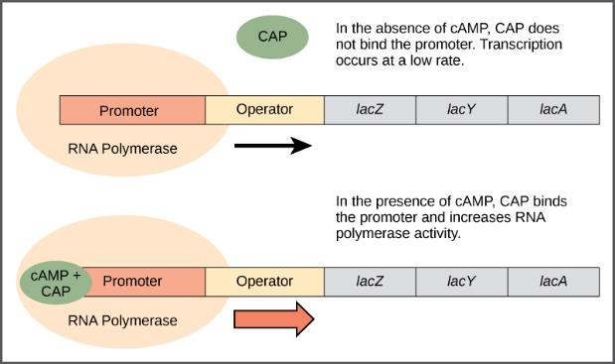
Figure 16.4
When glucose levels fall, E. coli may use other sugars for fuel but must transcribe new genes to do so. As glucose supplies become limited, cAMP levels increase. This cAMP binds to the CAP protein, a positive regulator that binds to an operator region upstream of the genes required to use other sugar sources.
https://www.youtube.com/embed/iPQZXMKZEfw

Slide 12
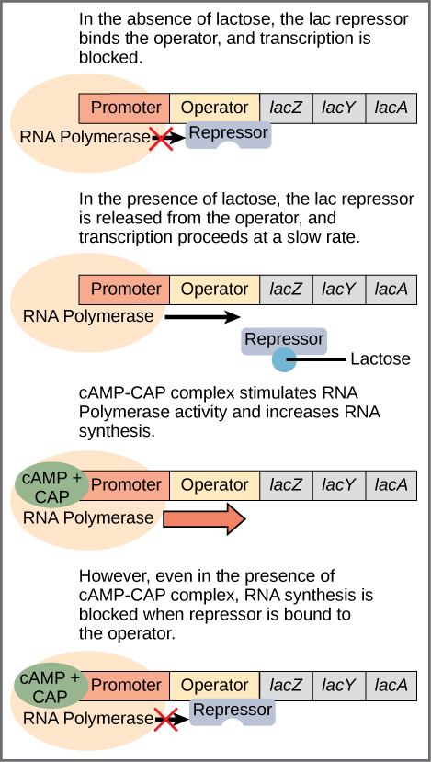
Figure 16.5
Transcription of the lac operon is carefully regulated so that its expression only occurs when glucose is limited and lactose is present to serve as an alternative fuel source.
https://www.youtube.com/embed/iPQZXMKZEfw

Slide 13
Gene Expression as a Bio Process
This connects to feedback mechanisms (loops) from environmental science 20.
How?
Positive feedback in organisms?
Presence or activation leads to more. What are things in our body that upon use or production will need more
Apples! When one apple becomes ripe (or riper), it releases a chemical that causes others to also ripen, which releases more of these chemicals!
Other examples: - Lactose - labour

Slide 14
These mechanisms are therefore important because…
Some things need to be stopped. Some things need to keep going!
If not… Dehydration (due to decreased ADH), hyperthyroidism, blood clotting

Slide 15
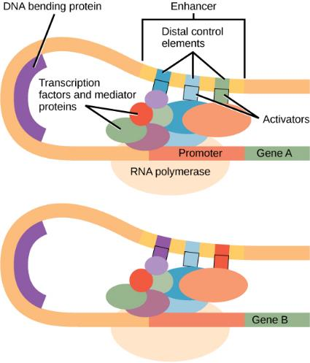
Figure 16.9
An enhancer is a DNA sequence that promotes transcription. Each enhancer is made up of short DNA sequences called distal control elements. Activators bound to the distal control elements interact with mediator proteins and transcription factors. Two different genes may have the same promoter but different distal control elements, enabling differential gene expression.

Slide 16
Reading (16.1 -16.4)
Most of this should make sense

Slide 17
Gene Regulation and Phenotypes
Gene regulation accounts for organisms that may have similar genotypes but different phenotypes.
If certain genes are more active, more of a particular protein may be created and therefore the organism may have a different visual appearance.
Example: Dominant and recessive genes – just because someone has a blonde hair gene, doesn’t necessarily mean their brown hair gene won’t be expressed.

Slide 18
Cell Cycle - Signal Transmission
Remember when we talked about the Cell Cycle and how certain molecules promote different stages of the cell cycle?
Cytokines help regulate the cell cycle much like the regulatory proteins we’ve discussed, and
Mating Pheromones in Yeast – basically,

Slide 19
Cell Cycle - Signal Transmission
Remember when we talked about the Cell Cycle and how certain molecules promote different stages of the cell cycle?
Cytokines help regulate the cell cycle much like the regulatory proteins we’ve discussed, and since they influence cell division, this can also influence gene expression.
Mating Pheromones in Yeast – basically, the presence of pheromones in the yeast’s environment triggers cell specialization and gene expression. So extracellular molecules can influence gene expression and in this case sexual reproduction.

Slide 20
Big Idea 3C: Processes of Genetic Information is Imperfect
We already know this!
Do a not-for-marks socrative quiz to test your knowledge!
98QHCGFW7

Slide 21
Viruses
OpenStax Ch. 21
How big are viruses?
How do viruses replicate/reproduce?
How does their replication allow them to mutate rapidly?
Do they have an RNA error-checking mechanism? What is the significance of this?
Why is HIV so successful as a pathogen within the body and between people? Why can’t we vaccinate for it?
Can viruses alter the DNA of its host? How? What is a potential medical application of this?

Slide 22
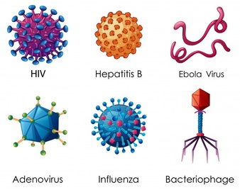
Viruses
Viruses come in different shapes and sizes. However, their size is ridiculously small. They are composed of several parts with an RNA molecule as their molecule of heredity
20-250nm big. Which is about 1/100 the size of many types of cells.

Slide 23
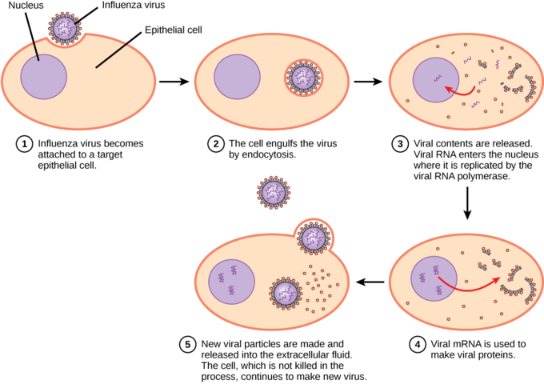
Virus Replication
The virus basically hijacks cells and injects its DNA into them, tricking them to make more of the virus.
When all we do is just have certain parts of our DNA being read and transcripted though, this makes sense and just adds an additional transcript for processing.

Slide 24
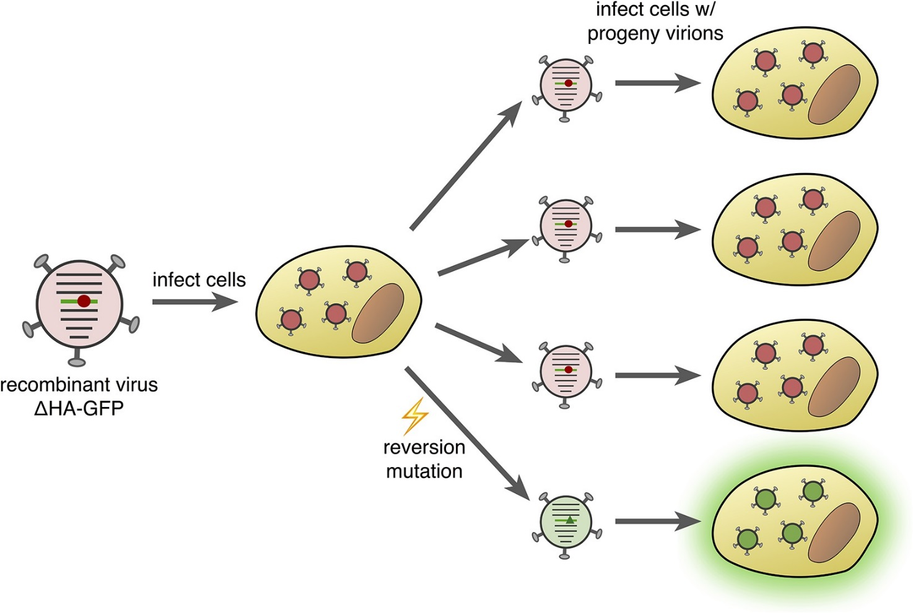
Viral Mutation
Viruses don’t have a error-checking system with their RNA.
Given their size and ability to replicate quickly, this doesn’t matter if you have a bunch of negative mutations, as long as you have a couple able to function and go find other cells to replicate in.
The virus finds new combinations to function quickly (kind of like bacteria and antibiotic resistance). Very evolutionarily advantageous.

Slide 25
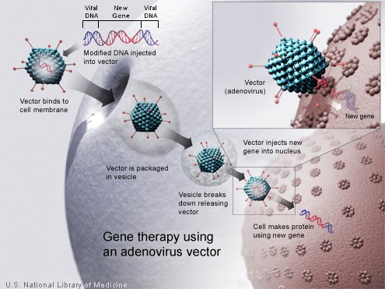
Virus Affects on DNA
Viruses can alter the DNA of host cells.
We can use this (viruses) to potential provide genetic therapy for individuals with genetic conditions.
Some of the human genome we actually find ancestry to viruses (most jawed vertebrates have some “viral DNA”). Endogenous viruses.

Slide 26
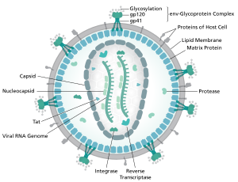
HIV
HIV mutates faster than other viruses.
It also specifically attacks and destroys your immune system.
SIV – it’s primate predecessor is now benign in many primates, perhaps our immune systems will “figure it out”.
Viral “immunoprophylaxis” may be key in treating it as well – use a virus to fight a virus.

