Slide 1
Cell Communication
Big Idea 3 (D, E)
D – Cell-cell and Organism-Organism Communication (Chapter 9,10 of OpenStax Text)
E – Information Processing (nervous system – Ch. 35.1 and 35.2)

Slide 2
Cell Communication and Evolution
Communication involves the transduction (conversion of one signal/trigger to another) of stimulatory or inhibitory signals from cells, other organisms, or the environment.
Correct transduction of signals is a strong selective pressure.
Signal transduction pathways influence how a cell responds to the environment. Ex. How bacteria respond to external signals triggering movement.

Slide 3
Bacterial Movement
Flagella are tail-like structures found on bacteria composed of several different types of proteins.
Bacteria have receptors that recognize or bond with certain attractants (we could consider this similarly to response to light, some processes we know that if we apply energy, it triggers a reaction).
When these receptors bond with certain attractants, it can trigger the flagella to activate.
Not the same process, but think how hunger is a signal that can ultimately get you moving as well, but takes many more steps (imagine all of the different parts of your body involved in that process).

Slide 4
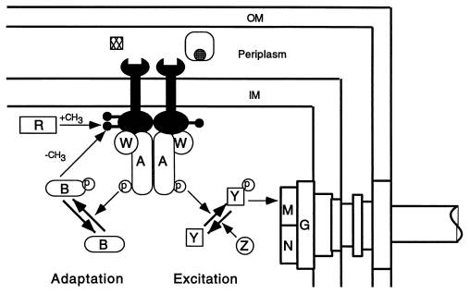
Bacterial Movement
Trying to explain it with a visual – note: this should be hard.
Attractants
Do your best to make sense of this and summarize in 3-5 sentences. If you get it mostly right, I will be impressed.
Avoid getting caught up in names of molecules, trying to just the gist of what is happening.
Flagella Complex

Slide 5
Bacterial Movement
Trying to explain it with a visual – note: this should be hard.
Attractants diffuse through CM (cell membrane – of which there is an Outer-OM and Inner-IM) where they trigger the wrench receptors (they aren’t wrenches, but possess a shape that would “fit” with the attractants).
The wrench receptors are triggered to bond with two molecules (W and A) that ultimately attract and phosphorylate Y (another molecule). The Y induces the flagella motor complex (M) to “activate” movement.
Flagella Complex

Slide 6
Bacterial Movement - Significance
You shouldn’t have to do anything this complex on the final. But consider how many ideas are at work that you should know by now…
Diffusion of molecules across a membrane.
Molecules triggering a response in cells.
Molecules react with each other and new combination changes their properties (can bend, fold, or change ability to bond).
If this makes any sense, recognize how significant and specific an idea in bacteria this is and how this applies to your understanding of Biology and life, what we consider a “simple” organism, and a complex idea like movement in response to a molecule, more or less explained using all these concepts. It is complicated, but understandable.

Slide 7
Signal Transduction – Multicellular Organisms
This transduction of signals occur within a cell to generate certain responses and may also generate transduction of the signal cell-cell (think of the cells releasing attractants that triggers other cells’ activity)
Inputs of energy, like certain molecules, can trigger signal transduction.
Temperature in some ectotherms (reptiles) can actually determine sex (extreme high or low temps in eggs, makes males, thinking of chromosomes and evolution – how can we explain this if we assume that).

Slide 8
Sex Determination in Humans
Can it for humans? – Read the article, critically, what do you think?
What are some other “fabled” factors that influence sex determination? Can we explain them scientifically or related to signal transduction?

Slide 9
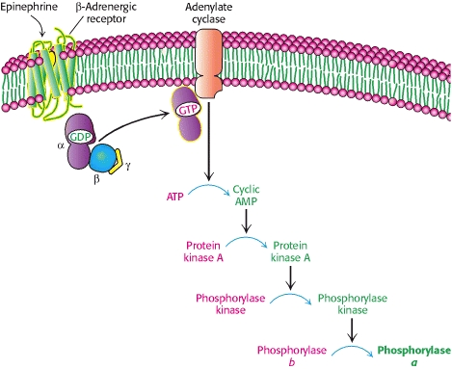
Mammalian Example
Epinephrine – what is it used for in a drug-sense?
What does it actually do?
Epinephrine and Glucagon Signal the Need for Glycogen Breakdown

Slide 10
Mammalian Example
Epinephrine – what is it used for in a drug-sense?
ADRENALINE!
What does it actually do?
MUSCLES BREAKDOWN GLYCOGEN – ENERGY FOR MUSCLES!
Epinephrine and Glucagon Signal the Need for Glycogen Breakdown

Slide 11
Cell Communication: Cell-to-Cell
Cells communicate via cell-cell contact.
Immune cells communicate through this contact – how?

Slide 12
Cell Communication: Short Distances
Cells communicate over short distances.
Neurotransmitters

Slide 13
Cell Communication: Long Distances
Cells communicate over long distances.
Endocrine System releases signalling molecules throughout the body via blood.
What message do these send? What triggers thems?
HGH
Insulin
Estrogen
Testosterone

Slide 14
Signalling Process
Begins with recognition of a chemical messenger (called a ligand) by a receptor protein.
Different receptors recognize different, but specific molecules (like peptides, small chemicals or proteins).
A receptor protein recognizes signal molecules, this changes the shape of the receptor protein, which initiates transduction of the signal.
Ligand-gated ion channels.

Slide 15
Signalling Process: Signal to Response
Signals trigger a cellular response.
These responses behave in the form of a signalling cascade relaying messages (one triggers another which triggers another, etc.)
They also can serve to amplify the message to their “target destination” for an appropriate response by the cell.
Second messengers are an important part of the cascade.
Ligand-gated ion channels, second messenger:
Many of these occur in phosphorylation cascades (one thing gets phosphorylated to the next via protein kinases facilitate this process).

Slide 16
Changes in Pathways
Changing the pathway, can alter the response.
If the signal transduction is blocked or defective, this has consequences that can be deleterious, preventative, or prophylactic.
Examples: neurotoxins, poisons and pesticides.

Slide 17
Organism-to-Organism Communication
Transmission of information results in changes within and between biological systems.

