Slide 1
Cell Communication
Big Idea 3 (D, E)
D – Cell-cell and Organism-Organism Communication (Chapter 9,10 of OpenStax Text)
E – Information Processing (nervous system – Ch. 35.1 and 35.2)

Slide 2
Cell Communication and Evolution
Communication involves the _________________ (conversion of one signal/trigger to another) of stimulatory or inhibitory signals from cells, other organisms, or the environment.
Correct transduction of signals is a strong _________________.
Signal transduction pathways influence how a cell responds to the environment. Ex. How bacteria respond to external signals triggering movement.

Slide 3
Cell Communication and Evolution
Communication involves the transduction (conversion of one signal/trigger to another) of stimulatory or inhibitory signals from cells, other organisms, or the environment.
Correct transduction of signals is a strong selective pressure.
Signal transduction pathways influence how a cell responds to the environment. Ex. How bacteria respond to external signals triggering movement.

Slide 4
Bacterial Movement
_________________ are tail-like structures found on bacteria composed of several different types of proteins.
Bacteria have _________________ that recognize or bond with certain _________________ (we could consider this similarly to response to light, some processes we know that if we apply energy, it triggers a reaction).
When these receptors bond with certain attractants, it can trigger the flagella to activate.
Not the same process, but think how hunger is a signal that can ultimately get you moving as well, but takes many more steps (imagine all of the different parts of your body involved in that process).

Slide 5
Bacterial Movement
Flagella are tail-like structures found on bacteria composed of several different types of proteins.
Bacteria have receptors that recognize or bond with certain attractants (we could consider this similarly to response to light, some processes we know that if we apply energy, it triggers a reaction).
When these receptors bond with certain attractants, it can trigger the flagella to activate.
Not the same process, but think how hunger is a signal that can ultimately get you moving as well, but takes many more steps (imagine all of the different parts of your body involved in that process).

Slide 6
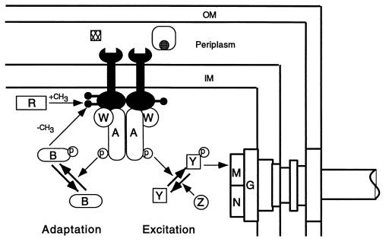
Bacterial Movement
Trying to explain it with a visual – note: this should be hard.
Attractants
Do your best to make sense of this and summarize in 3-5 sentences. If you get it mostly right, I will be impressed.
Avoid getting caught up in names of molecules, trying to just the gist of what is happening.
Flagella Complex

Slide 7
Bacterial Movement
Trying to explain it with a visual – note: this should be hard.
Attractants diffuse through CM (cell membrane – of which there is an Outer-OM and Inner-IM) where they trigger the wrench receptors (they aren’t wrenches, but possess a shape that would “fit” with the attractants).
The wrench receptors are triggered to bond with two molecules (W and A) that ultimately attract and phosphorylate Y (another molecule). The Y induces the flagella motor complex (M) to “activate” movement.
Flagella Complex

Slide 8
Bacterial Movement - Significance
You shouldn’t have to do anything this complex on the final. But consider how many ideas are at work that you should know by now…
If this makes any sense, recognize how significant and specific an idea in bacteria this is and how this applies to your understanding of Biology and life, what we consider a “simple” organism, and a complex idea like movement in response to a molecule, more or less explained using all these concepts. It is complicated, but understandable.

Slide 9
Bacterial Movement - Significance
You shouldn’t have to do anything this complex on the final. But consider how many ideas are at work that you should know by now…
Diffusion of molecules across a membrane.
Molecules triggering a response in cells.
Molecules react with each other and new combination changes their properties (can bend, fold, or change ability to bond).
If this makes any sense, recognize how significant and specific an idea in bacteria this is and how this applies to your understanding of Biology and life, what we consider a “simple” organism, and a complex idea like movement in response to a molecule, more or less explained using all these concepts. It is complicated, but understandable.

Slide 10
Signal Transduction – Multicellular Organisms
This _____________ of signals occur within a cell to generate certain responses and may also generate transduction of the signal cell-cell (think of the cells releasing attractants that triggers other cells’ activity)
Inputs of energy, like certain molecules, can trigger signal transduction.
Temperature in some _______________ (reptiles) can actually determine ____ (extreme high or low temps in eggs, makes males, thinking of chromosomes and evolution – how can we explain this if we assume that).

Slide 11
Signal Transduction – Multicellular Organisms
This transduction of signals occur within a cell to generate certain responses and may also generate transduction of the signal cell-cell (think of the cells releasing attractants that triggers other cells’ activity)
Inputs of energy, like certain molecules, can trigger signal transduction.
Temperature in some ectotherms (reptiles) can actually determine sex (extreme high or low temps in eggs, makes males, thinking of chromosomes and evolution – how can we explain this if we assume that).

Slide 12
Sex Determination in Humans
Can it for humans? – Read the article, critically, what do you think?
What are some other “fabled” factors that influence sex determination? Can we explain them scientifically or related to signal transduction?

Slide 13
Nervous System in Animals
Animals have nervous systems that detect external and internal signals, transmit and integrate information, and produce responses.

Slide 14
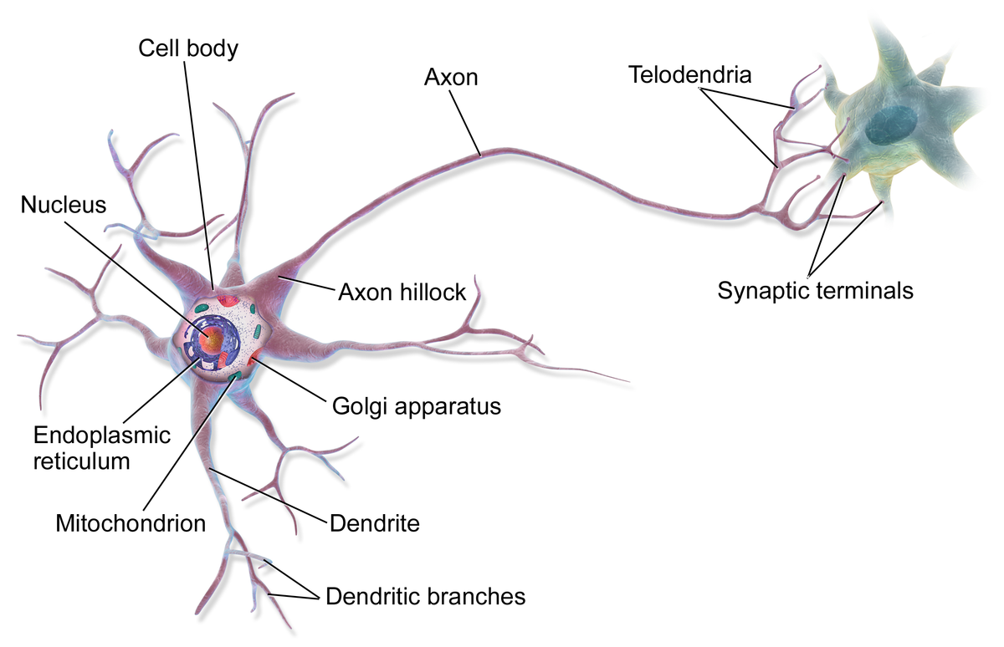
Neurons
Neuron is the basic structure of the nervous system that reflects function.
Neurons are composed of cell bodies, dendrites, and axons.
Their structure allows for detection, generation, transmission, and integration of signal information.

Slide 15
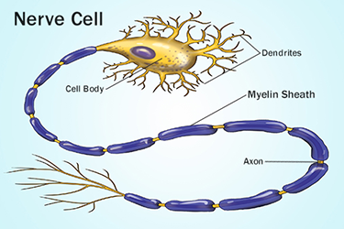
Schwann cells and the myelin sheath
Signals propagate along the neuron, insulated by the myelin sheath (which is like the outside of a wire).
When our nerves are stimulated, this can eventually trigger an action potential which goes neuron-neuron conveying messages throughout our bodies.
Crash Course: Nervous System Part 1, 2, 3

Slide 16
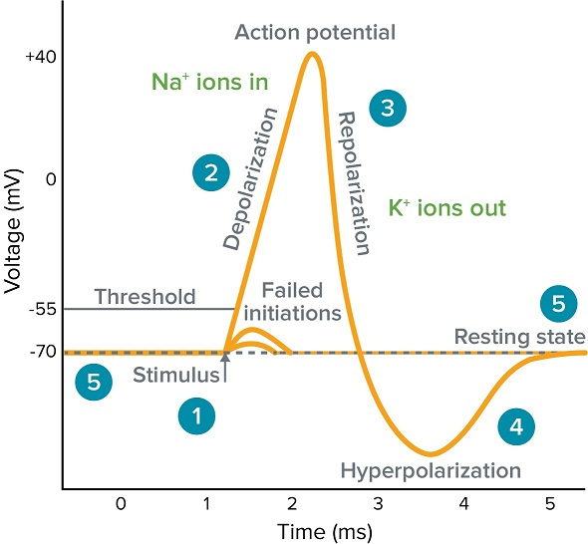
Action potentials propagate impulses along neurons.
Na+/K+ Pumps, powered by ATP, work to maintain membrane potential.
Transmission of information occurs across synapses.
Action potentials (APs) propagate impulses along neurons.
Membranes of neurons are polarized by the establishment of electric potentials across membranes.
In response to stimulus, Na ⁺ and K⁺ gated channels sequentially open and cause the membrane to be locally depolarized.

Slide 17
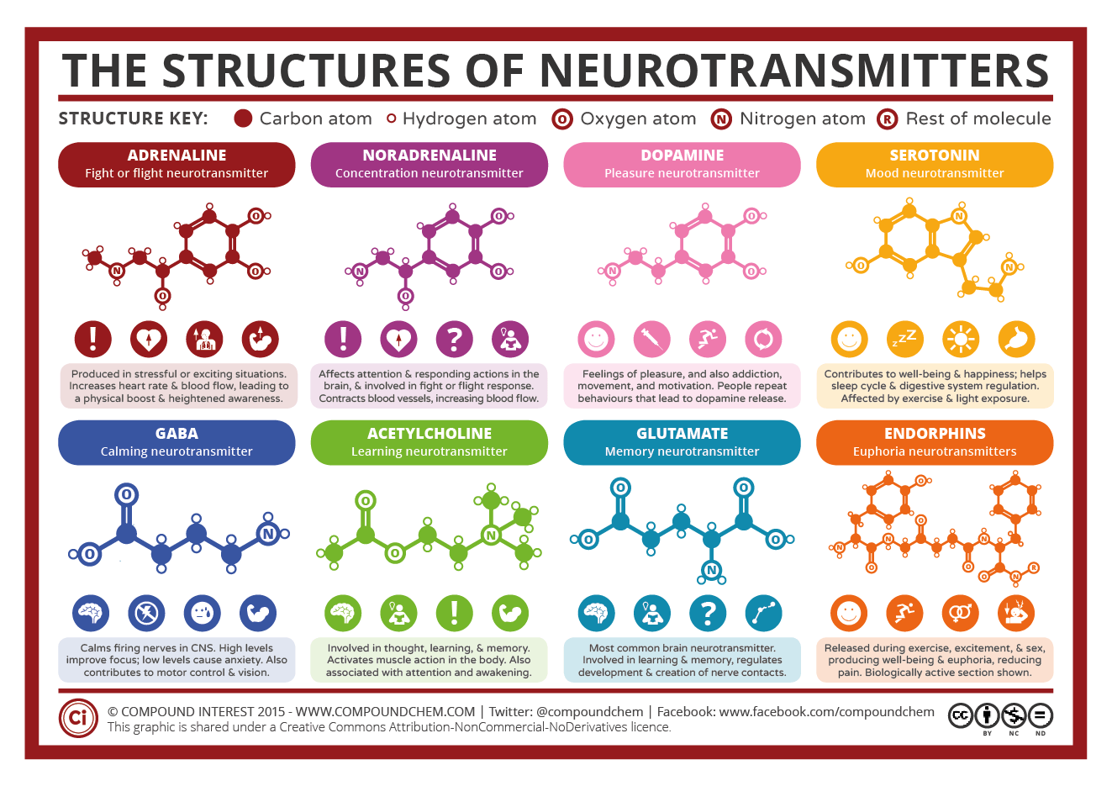
Neurotransmitters
Dopamine, serotonin, epinephrine, norepinephrine all are neurotransmitters.
These all trigger a response as messages move from neuron to synapse to neuron.
The response can be stimulatory (fire off APs) or inhibitory (prevent APs).

Slide 18
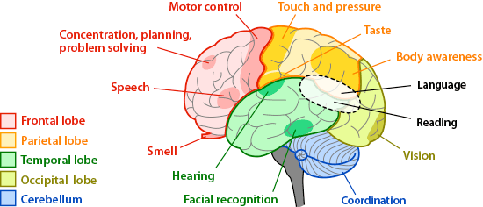
Regions of the Brain
As such, these responses may direct to different regions of the brain which are responsible for different functions.
Vision
Hearing
Muscle movement
Abstract thought

Slide 19
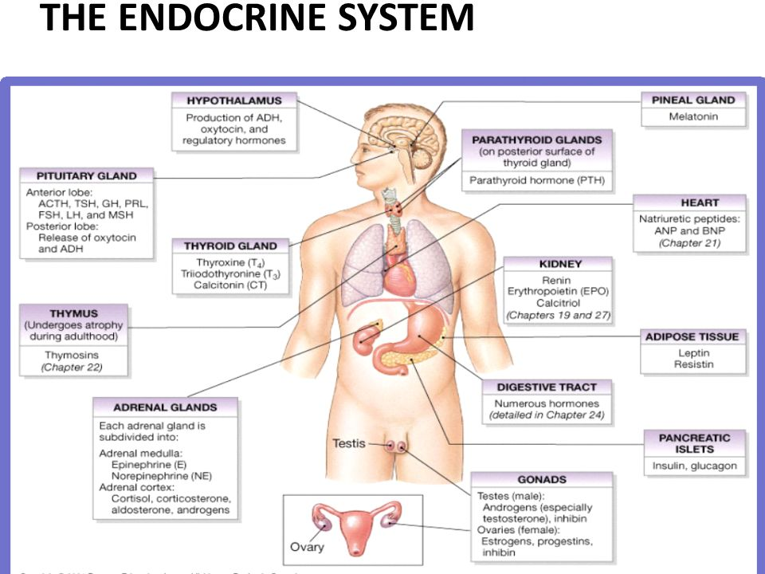
Cell Communication: Long Distances
Cells communicate over long distances.
Endocrine System releases signalling molecules throughout the body via blood.
What message do these send? What triggers them?
HGH
Insulin
Estrogen
Testosterone

Slide 20
Cell Communication: Cell-to-Cell
Cells communicate via cell-cell contact.
Immune cells communicate through this contact – how?

Slide 21
Cell Communication: Cell-to-Cell
Cells communicate via cell-cell contact.
This can occur through the exchange of molecules like proteins.
In bacteria, pili sometimes connect to share molecules or even genetic information.
Immune cells communicate through this contact – how?
Immune cells interact via cell-cell contact. Antigen-presenting cells (APCs) are identified via helper T cell contact and destroyed via contact with killer T cells.

Slide 22
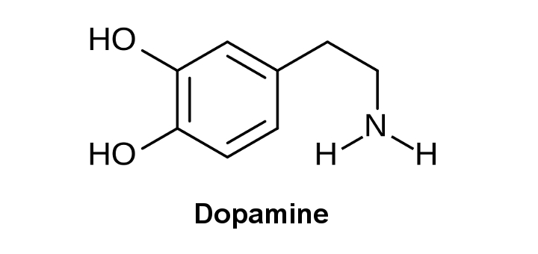
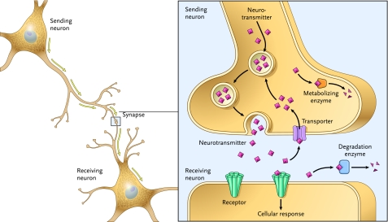
Cell Communication: Short Distances
Crash Course Psychology: The Chemical Mind
Cells communicate over short distances between cells.
________________ are released from neuron-neuron via ________ triggering cellular responses.
__________ is an example of a “feel-good” neurotransmitter.

Slide 23
Cell Communication: Short Distances
Crash Course Psychology: The Chemical Mind
Cells communicate over short distances between cells.
Neurotransmitters are released from neuron-neuron via synapses triggering cellular responses.
Dopamine is an example of a “feel-good” neurotransmitter.

Slide 24
How exactly does the signalling process work?
More molecules triggering molecules!

Slide 25
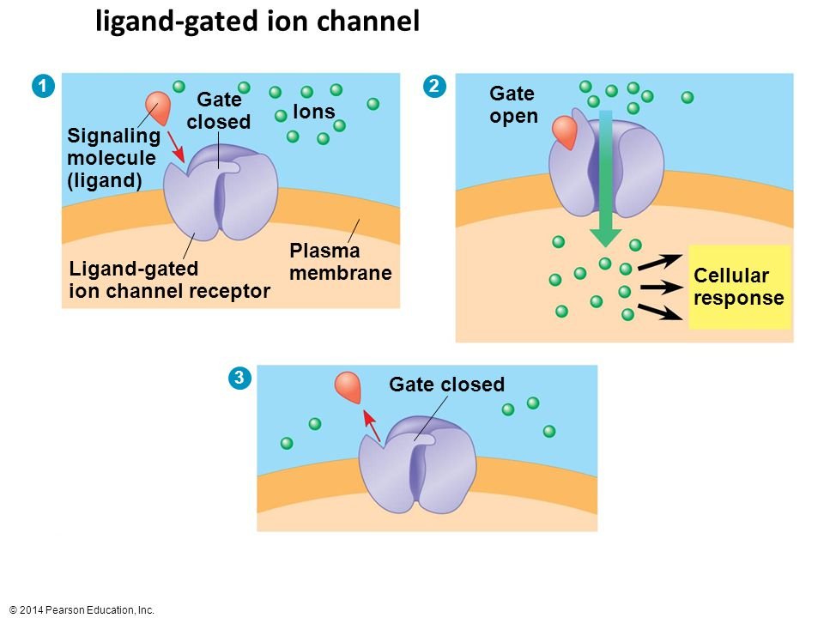
Signalling Process
Very similar to what we’ve already discussed…
Begins with recognition of a ___________________ (called a ligand) by a __________________.
___________________ recognize different, but specific ___________________ (like peptides, small chemicals or proteins).
A receptor protein recognizes signal molecules, this ________ ______ ________ of the receptor protein, which initiates transduction of the signal (allows in certain ions in the case to the right).
Ligand-gated ion channels.

Slide 26
Signalling Process
Very similar to what we’ve already discussed…
Begins with recognition of a chemical messenger (called a ligand) by a receptor protein.
Different receptors recognize different, but specific molecules (like peptides, small chemicals or proteins).
A receptor protein recognizes signal molecules, this changes the shape of the receptor protein, which initiates transduction of the signal (allows in certain ions in the case to the right).
Ligand-gated ion channels.

Slide 27
Signalling Process: Signal to Response
Nitric oxide is an example of this that’s created by the breakdown of arginine.
Certain extracellular signals trigger a cellular response.
These responses are triggered in the form of a signalling cascade relaying messages (one triggers another which triggers another, etc.)
They also can serve to amplify the message to their “target destination” for an appropriate response by the cell – commonly done by secondary messengers.
Ligand-gated ion channels involve second messengers:
Many of these occur in phosphorylation cascades (one thing gets phosphorylated [p] to the next via protein kinases facilitating this process).
So the gates open, allow a molecule (secondary messenger) to enter, and this molecule triggers the cascade.

Slide 28
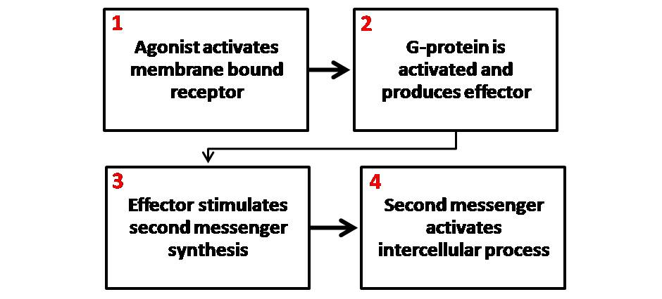
Secondary Messenger System
Using epinephrine as an example (an extracellular first messenger) – it binds with receptors in the cell membrane to open the gate to allow certain secondary messengers to enter the cell causing changes within the cell through a signalling cascade, ultimately triggering the effects of adrenaline – increased heart rate, amongst others.

Slide 29
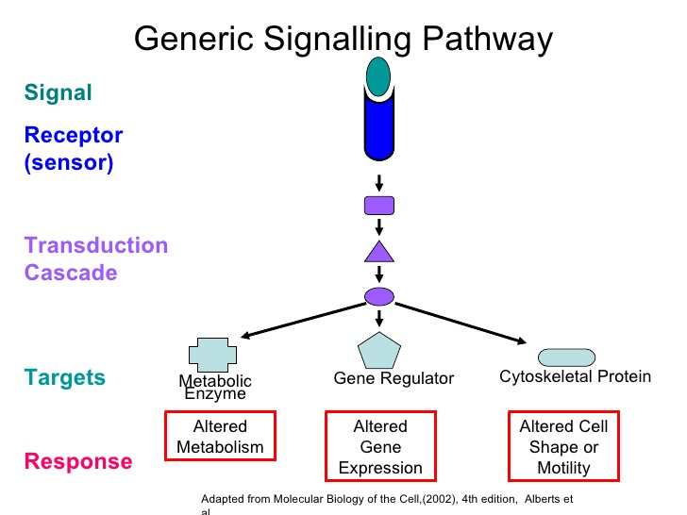
Analogy: Key Card
The school - whose doors are locked (cell).
Key card (signal - neurotransmitter) is inserted into slot (protein receptor) opens the door (cell membrane).
This allows my buddy with a key in (secondary messenger).
This key turns on the lights (beginning of the signalling cascade).
Which allows another person to see.
Who opens a door.
Which lets another person out who opens another door.
Until the whole school is ready for learning (what the cascades function actually serves – altered metabolism)! Yay!

Slide 30
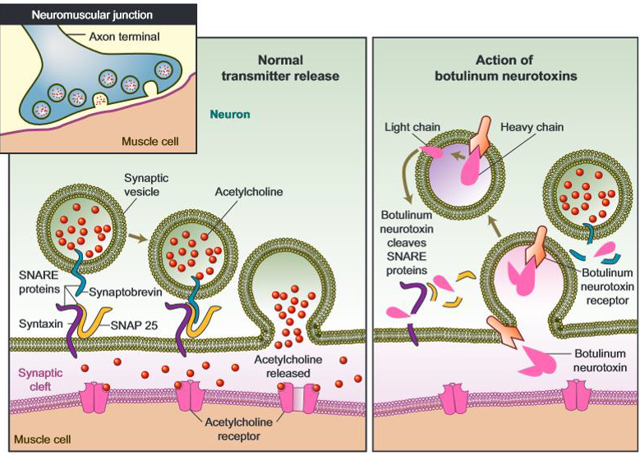
Changes in Pathways
Changing the pathway, can alter the response.
If the signal transduction is blocked or defective, this has consequences that can be deleterious, preventative, or prophylactic.
Examples: neurotoxins, poisons and pesticides.
Ethanol is a neurotoxin that alters the composition of cell membranes – which can inhibit certain receptors for neurotransmitters. (ie. why booze can affect memory).
This can cause abnormalities in fetus development as we know many different triggers and expression of genes occurs in this time.

Slide 31
Birth Control
Progesterone and Estrogen levels basically act as a suppressant to FSH and LH which, when high, trigger the release of mature egg cells.
“Tricking the body into thinking its pregnant” is the simple explanation for basically ingesting molecules that suppress or prevent the release of FSH and LH by suppressing/lowering the activity of GnRH which typically only happens at lower levels of progestin or estrogen.

Slide 32
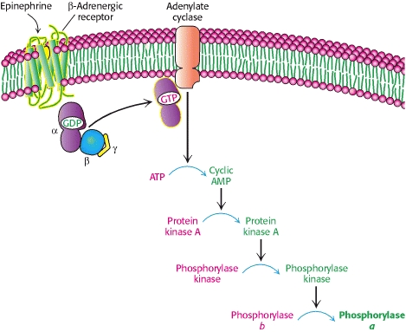
Mammalian Example
Epinephrine – what is it used for in a drug-sense?
What does it actually do?
Epinephrine and Glucagon Signal the Need for Glycogen Breakdown

Slide 33
Mammalian Example
Epinephrine – what is it used for in a drug-sense?
ADRENALINE!
What does it actually do?
MUSCLES BREAKDOWN GLYCOGEN – ENERGY FOR MUSCLES!
Epinephrine and Glucagon Signal the Need for Glycogen Breakdown

Slide 34
Review
We know how genes can be affected (expressed more or less depending on different factors) by molecules.
We know how cells can be affected by molecules (and how certain molecules affect certain cells in a particular way).
We know how cells can affect other cells with molecules (by releasing certain molecules under certain circumstances).
We know that systems in our body represent pathways for these interactions to take place and transport signals throughout it.
What’s next?
Organisms use all of these methods within themselves to communicate and respond to signals sent by one another.

Slide 35
Organism-to-Organism Communication
Transmission of information results in changes within and between biological systems.

Slide 36

Organismal Communicating
Organisms exchange information with each other which triggers internal responses triggering external responses that are reflected in behaviour.
Certain signals or behavioural cues influence other organisms (ie. territory-marking) and ultimately effect reproductive success.

Slide 37
Signals Animals Use
What are some different types of signals animals use (visual, audible, tactile, electrical, chemical)?
What do they use them for?

Slide 38
Signals Animals Use
What are some different types of signals animals use (visual, audible, tactile, electrical, chemical)?
Birds songs
Territory marking
Herd, flock and school behaviour
Chest pounding
What do they use them for?
Establish dominance
Find food
Establish territory
Reproductive success

Slide 39
Learned/Innate and Cooperative Behaviour
Responses to information and communication of information are vital to natural selection and evolution.
Responding to signals and stimuli appropriately improves an organism’s chance to live. This response we call behaviour
Natural selection favours innate and learned behaviours that increase survival and reproductive fitness.
This can include cooperative behaviour or reproductive strategies (parent-offspring relationships).
Cooperative behaviour, in general, tends to increase fitness of the individual and survival of the population.
Pack animals – why is it beneficial for all members?
How is migration/schooling beneficial for the entire group?
Courtship behaviours – what does conveying the right message indicate?

Slide 40
Communication of Information
Our cells have evolved to communicate with one another over direct, short, and long distances.
Organisms have developed systems to respond to external stimuli by manipulating their cellular responses (yet many share similar pathways).
Genetics accounts for different molecules created from our genes that potentially behave differently (more or less successfully) when exposed to different stimuli.
Those with the best proteins in their body as suited to their environments, survive.
Many supplements and health care treatments are centered on manipulating the transmission of information at all levels of life.

