Slide 1
Interactions in Biological Systems
4.A Interactions within systems lead to complex properties.
Supplemented from Open Stax

Slide 2
Macromolecules
Subcomponents of biological molecules and their sequence determine the properties of a molecule.
What are the four types of macromolecules?
Chapter 3 of OpenStax Text
All of these molecules are composed of different combinations of atoms which determine their properties, shapes, and functions.

Slide 3
Macromolecules
Subcomponents of biological molecules and their sequence determine the properties of a molecule.
What are the four types of macromolecules?
Nucleic acids
Proteins
Lipids
Carbohydrates
Chapter 3 of OpenStax Text
All of these molecules are composed of different combinations of atoms which determine their properties, shapes, and functions.

Slide 4
Building Macromolecules Lab (Remember?)
Health Science Review
Build carbohydrates!
What are their monomers and polymers?
Build lipids!
What are their monomers and polymers?
Build proteins!
What are their monomers and polymers?

Slide 5
Building Macromolecules - Answer
Health Science Review
Build carbohydrates!
What are their monomers and polymers?
Monosaccharides and polysaccharides are the polymer.
Build lipids!
What are their monomers and polymers?
Fatty acid chains – triglyceride, steroids
Build proteins!
What are their monomers and polymers?
Amino acids (monomer) – polypeptides (polymer)

Slide 6
Nucleic Acids: DNA and RNA
We already know a lot about DNA and RNA.
Both are involved in biological processes and help form the heritable information of life.
RNA is also found in the mitochondria, ribosomes, and other subcellular components.

Slide 7
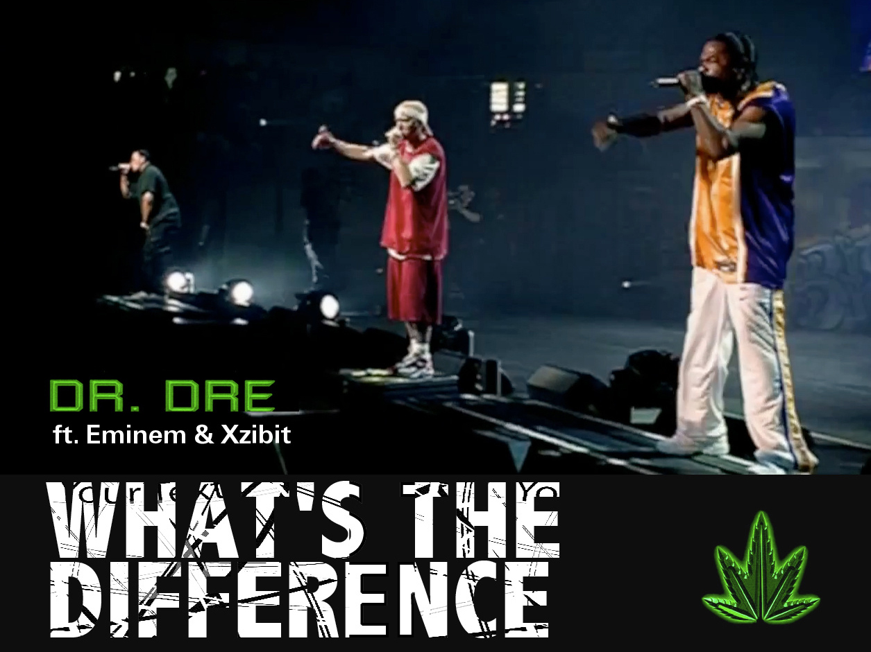
Nucleic Acids
DNA and RNA are two types of nucleic acids.
What’s the difference between each:
Structure:
DNA
RNA
Function(s):
DNA
RNA

Slide 8
Nucleic Acids
DNA and RNA are two types of nucleic acids.
What’s the difference between each:
Structure:
DNA – double-helix, contains deoxyribose (and thymine)
RNA – single-strand, contains ribose (and uracil)
Function(s):
DNA – stable information-carrying molecule
RNA – smaller, better for transports

Slide 9
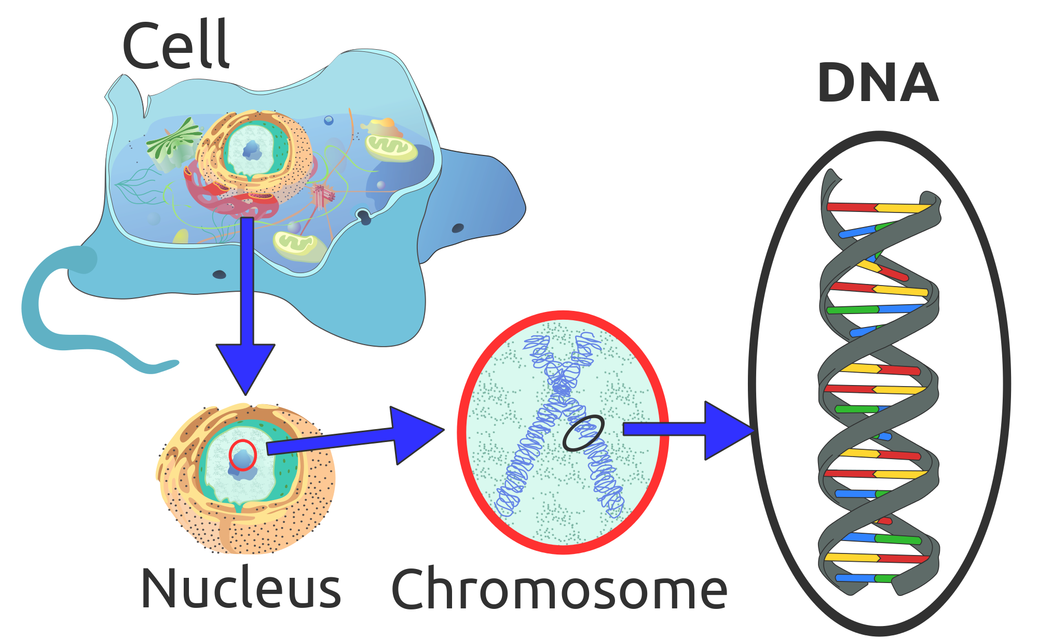
DNA – Deoxyribonucleic acid
is a molecule that carries the genetic instructions used in the growth, development, functioning and reproduction of all known living organisms and many viruses.
Conveys messages transported by RNA through the nuclear envelope to different parts of the cell.

Slide 10
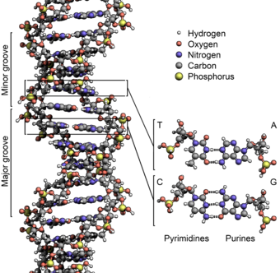
DNA/RNA
Contain a sugar group, a phosphate group, and a nitrogenous base.
Contains nitrogenous base pairs called: cytosine, guanine, adenine, thymine (C, G, T, A)
A and G – purines
C and T - pyrimidines
Complimentary pairs (C pairs with G, A pairs with T)
RNA has uracil (U) instead of T

Slide 11
DNA and RNA help make proteins
What about the complexity of proteins?

Slide 12
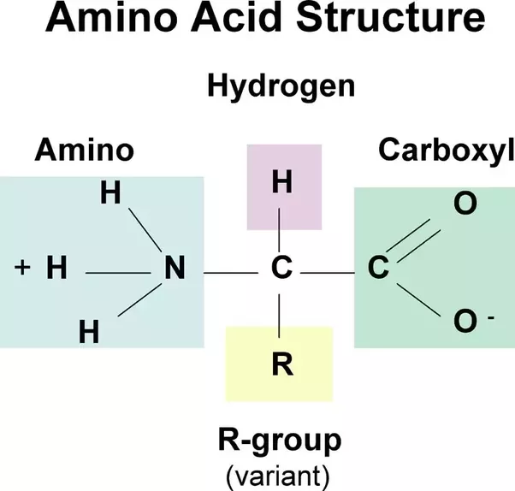
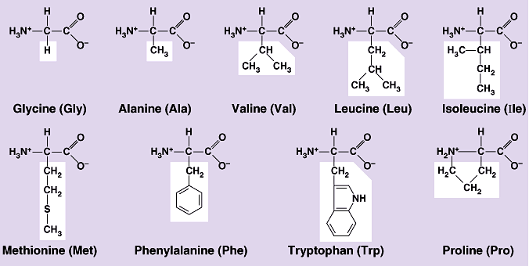
Proteins
Composed of _________ _______(lots of them). The combination of these determine function. How?
R group (different types – hydrophobic/philic, ionic) – variable group determining which amino acid it is – and what properties it has.

Slide 13
Proteins
Composed of amino acids (lots of them). The combination of these determine function. How?
Different molecules react with different specific molecules (enzymes bend and fold a certain way to fit with certain molecules to break them down).
R group (different types – hydrophobic/philic, ionic) – variable group determining which amino acid it is – and what properties it has.

Slide 14
Protein Shape
Proteins are classified given their structures (which are classified accordingly):
Primary – Quarternary Structure of Proteins
Primary structure –
Secondary –
Tertiary –
Quarternary –

Slide 15
Protein Shape
Proteins are classified given their structures (which are classified accordingly):
Primary – Quarternary Structure of Proteins
Primary structure – string of amino acids.
Secondary – two dimensional bending of the protein due to composition (given all of the amino acids). Paper analogy (folding)
Tertiary – three-dimensional bending of the protein due to composition.
Quarternary – three dimensional bending between two proteins.

Slide 16
Directionality → Structure/Function
How might these terms apply to proteins and nucleic acids?
Different structures bend different ways due to varying polarity between molecules. This bending and folding leads to the complexity of biological molecules (enzymes, hormones, etc).
But this idea doesn’t just apply to proteins. All biological molecules display different properties given their configuration.

Slide 17
Directionality → Structure/Function
How might these terms apply to proteins and nucleic acids?
Nucleic acids organize according to 3’ and 5’ carbons in nucleotides.
Different structures bend different ways due to varying polarity between molecules. This bending and folding leads to the complexity of biological molecules (enzymes, hormones, etc).
But this idea doesn’t just apply to proteins. All biological molecules display different properties given their configuration.
Other biological molecules (macromolecules) include:

Slide 18
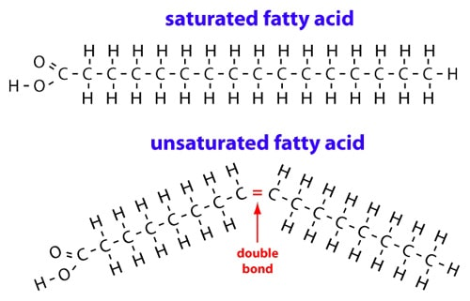
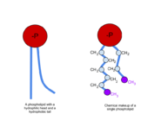
Lipids
Lipids are typically ___________.
Phospholipids display structural properties that have a _____________ and _______ area.
This makes up a large part of the cell membrane of organisms.
Different _________________ lead to _________________.

Slide 19
Lipids
Lipids are typically non-polar.
Phospholipids display structural properties that have a hydrophobic and -philic area.
This makes up a large part of the cell membrane of organisms.
Different atomic components lead to different functions

Slide 20
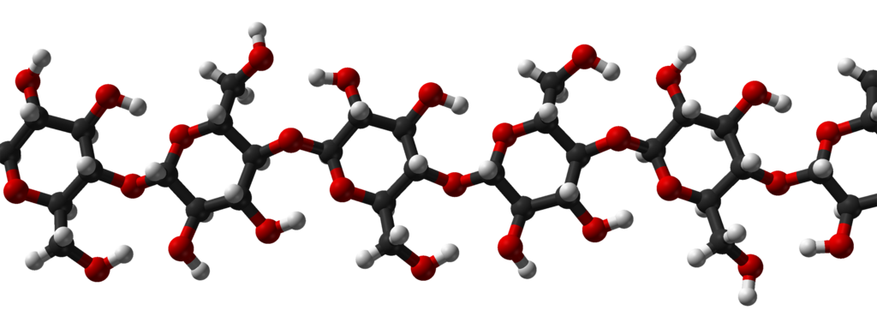
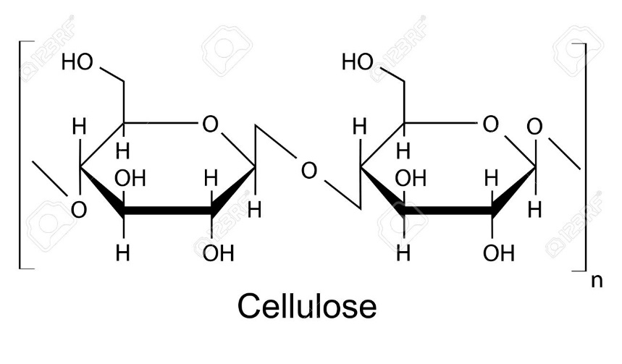
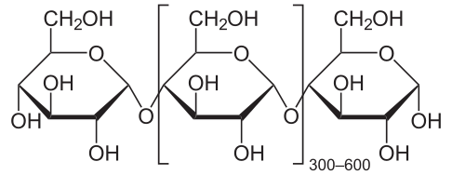
Carbohydrates
Are composed of sugar monomers called __________________.
These structures bond together in __________________.
What’s the difference between cellulose and starch (function, appearance)?

Slide 21
Carbohydrates
Are composed of sugar monomers called monosaccharides.
These structures bond together in dehydration synthesis.
What’s the difference between cellulose and starch (function, appearance)?
Slight differences in structure leads to different functions such as stability of plant cells (cellulose), or energy storage – starch (amylose)

Slide 22
Subcellular Components
These biological molecules comprise the cellular structures like the following!
Ribosomes
Endoplasmic Reticulum (Rough, Smooth)
Golgi Complex
Mitochondria
Lysosomes
Vacuole
Chloroplasts

Slide 23
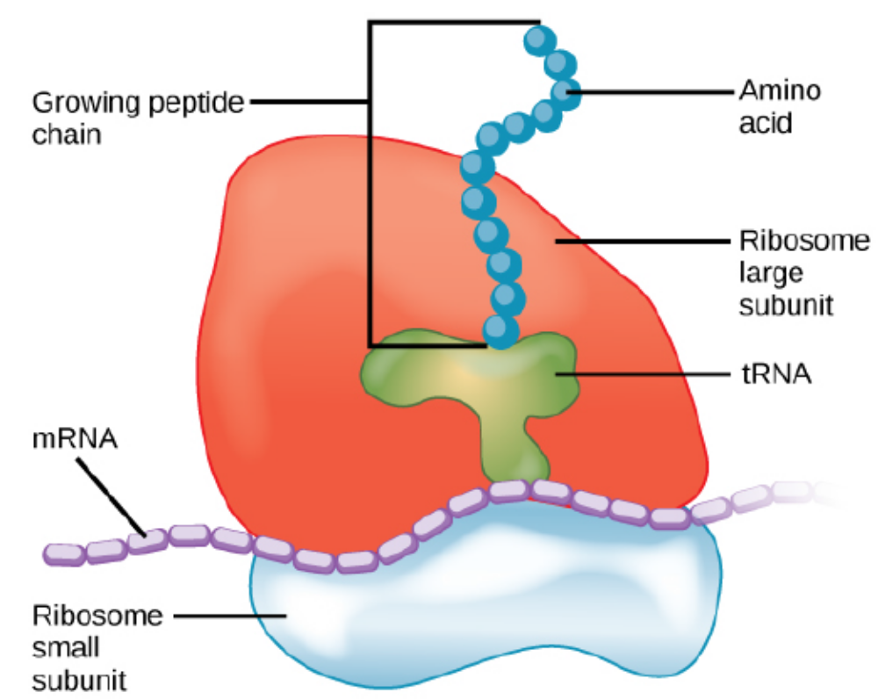
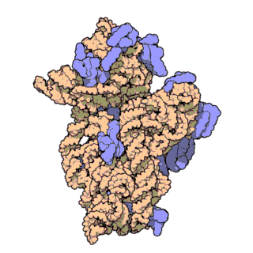
Ribosomes
Composed of _____ and __________.
_____ units that are bound together. Ribosomes are larger in Eukaryotes (60S and 40S = 80S)
Build/synthesize _________.

Slide 24
Ribosomes
Composed of rRNA and protein.
Two units that are bound together. Ribosomes are larger in Eukaryotes (60S and 40S = 80S)
Build/synthesize proteins.
Quaternary protein structure of ribosomes.

Slide 25
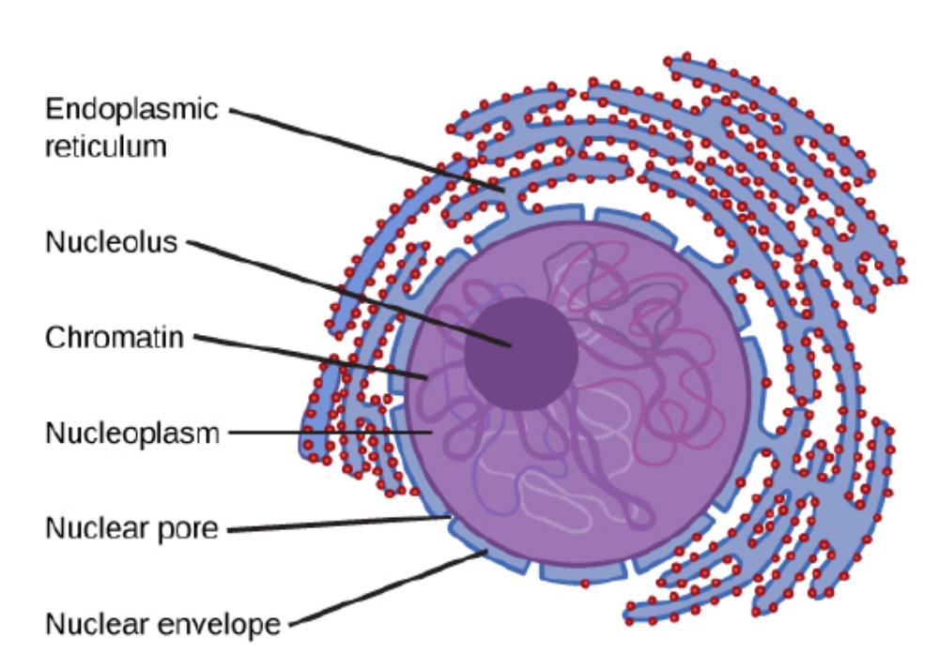
Endoplasmic Reticulum
__________________– has ribosomes on it. Site-specific protein synthesis and transport.
__________________ - (not picture) – lipid synthesis.

Slide 26
Endoplasmic Reticulum
Rough ER – has ribosomes on it. Site-specific protein synthesis and transport.
Smooth ER (not picture) – lipid synthesis.
(There’s no ribosomes on smooth ER, but it doesn’t need them – ribosomes make proteins, not lipids).

Slide 27
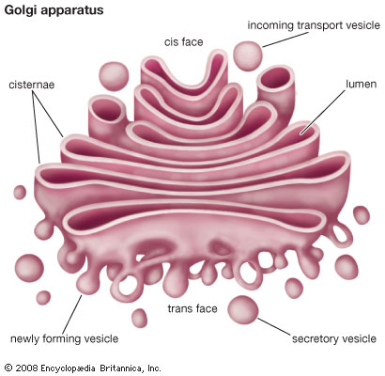
Golgi Complex
“
” – Britannica
Aids in production of ________________.

Slide 28
Golgi Complex
“responsible for transporting, modifying, and packaging proteins and lipids into vesicles for delivery to targeted destinations.” – Britannica
Aids in production of lysosomes.
Note, even this has a membrane separating it from the cytoplasm.

Slide 29
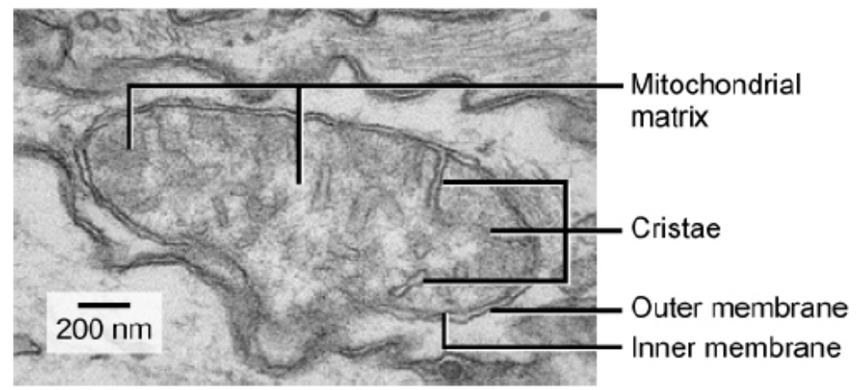
Mitochondria
Produces _____ (site of respiration)
Possesses a _________ membrane.
_______ contain ________ for ATP production.

Slide 30
Mitochondria
Produces ATP (site of respiration)
Double membrane. Molecules need to pass through its membranes.
Cristae contain enzymes for ATP production.
Double-membrane due to ingestion of an aerobic molecule (evolutionarily speaking)

Slide 31
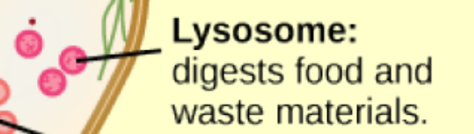
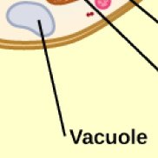
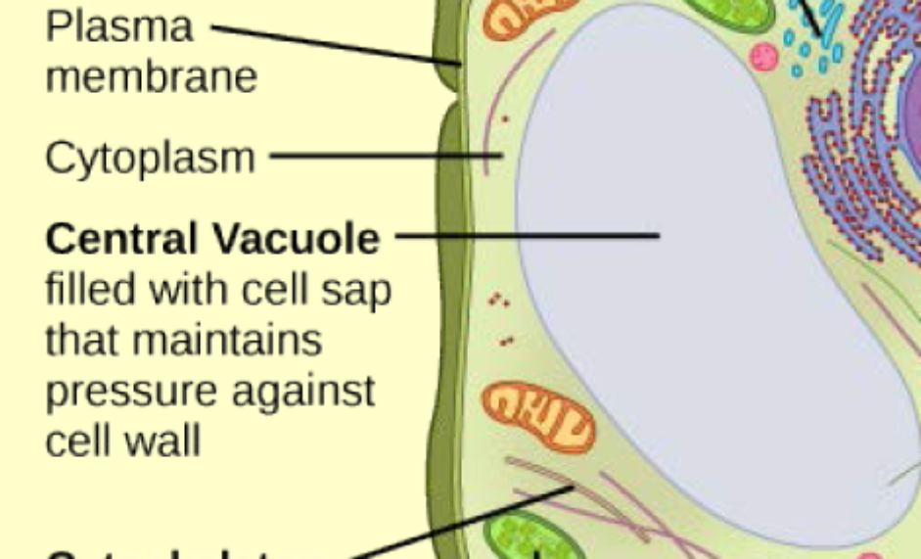
Lysosome (Animal Cell)
________________________ and digestion.
Recycle organic material and a part of ___________ (programmed cell death)
Vacuole
Smaller in ____________ cells.
Function: __________________. Stores water (plants need more water to maintain turgor pressure). Or poisonous substances or pigments!

Slide 32
Lysosome (Animal Cell)
Waste management system and digestion.
Recycle organic material and a part of apoptosis (programmed cell death)
Vacuole
Smaller in animal cells.
Function: Storage and transport. Stores water (plants need more water to maintain turgor pressure). Or poisonous substances or pigments!

Slide 33
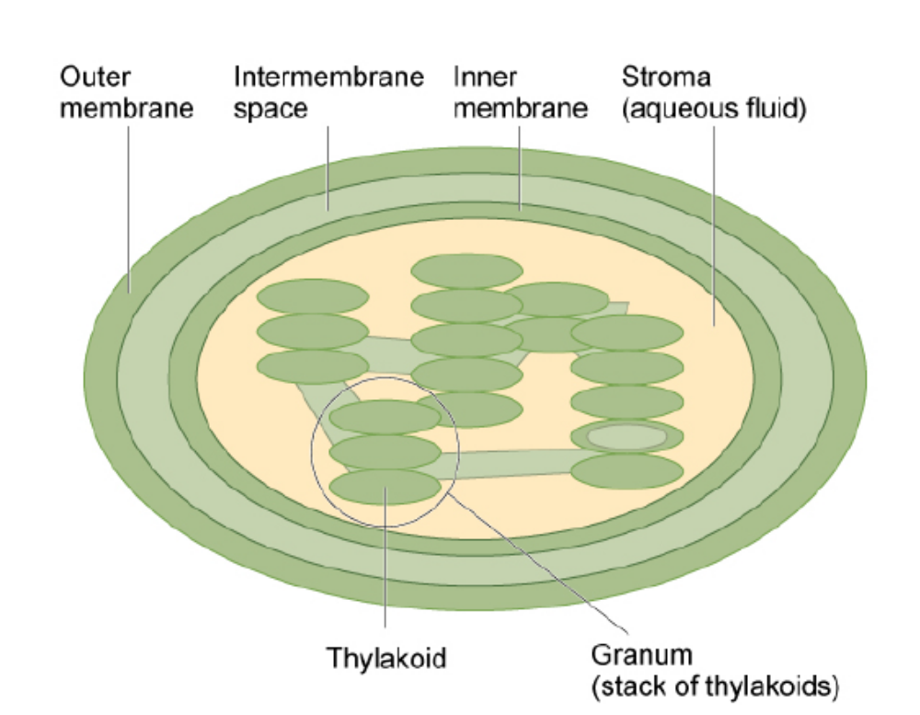
Chloroplast
Site of __________________.
Contains ____________ (why is it green?)
Double-membrane (like mitochondria) – ____________ has chlorophyll in its membrane (light-dependent reactions).
___________ – site of light independent reactions

Slide 34
Chloroplast
Site of photosynthesis
Contains chlorophyll (why is it green?)
Double-membrane (like mitochondria) – thylakoid has chlorophyll in its membrane (light-dependent reactions).
Stroma – site of light independent reactions

Slide 35
How might four of these organelles interact?
How might four of these organelles interact to perform a particular function?
Why might chloroplasts and mitochondria have their own DNA and ribosomes (hint: Endosymbiotic theory)?

Slide 36
Identifying these in Eukaryotic Cells
A little bit of colouring!
Expect a quiz tomorrow in which you will need to illustrate a step-by-step process in which these organelles work together to perform a specific function for the cell – stating what happens at each step in the process..

Slide 37
Coordination of Components
This coordination within cells also exist within organ systems and between organisms (and this coordination can be influenced by the gene expression and regulation we’ve discussed already).
Organ systems are comprised of separate structures (organ) performing a larger particular function such as evidenced by:
Some organ systems even work in cooperation with one another such as:

Slide 38
Coordination of Components
This coordination within cells also exist within organ systems and between organisms (and this coordination can be influenced by the gene expression and regulation we’ve discussed already).
Organ systems are comprised of separate structures (organ) performing a larger particular function such as evidenced by:
Small intestines, large intestines, rectum, esophagus, stomach
Digestive system – extract nutrients – excrete waste.
Some organ systems even work in cooperation with one another such as:
Cardiovascular system (blood circulation) with respiratory system (harnessing airborne O₂)

Slide 39
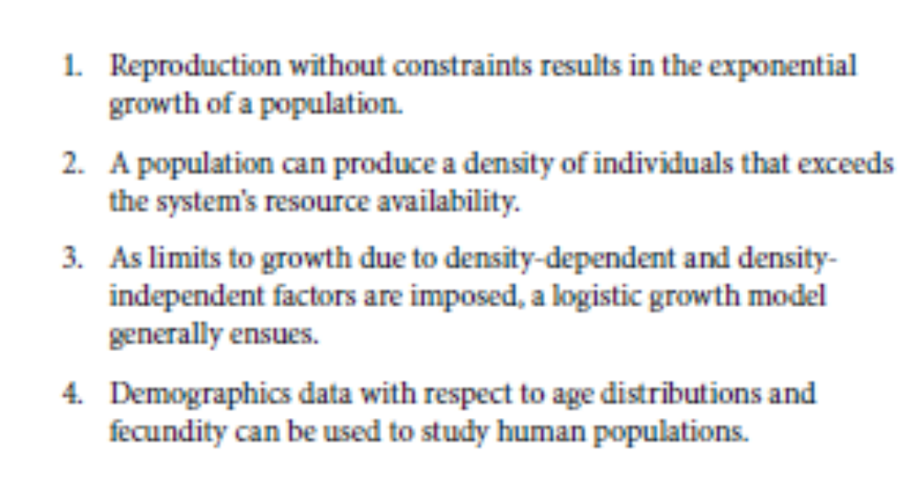
Communities, Populations and Interactions
Communities are composed of populations that interact in certain ways.
You get some reading time to finish class today!
Ch. 45.4, 45.5, 45.6
Expect a quiz tomorrow regarding predator/prey populations and how they fluctuate in a community.
Mathematics allows us to make calculations about communities – much like we did in our lab.

Slide 40
Coordination and Communities
There’s coordination between organs, cells, organelles, and organisms!

Slide 41
Population Growth
What all influences population growth?

Slide 42
Population Growth
What all influences population growth?
Health – nutrition, disease
Predators
Territory – habitat-based, certain organisms adapted to certain environments
Availability of resources
Accumulation of waste

Slide 43
Population Growth
What all influences population growth?
Resources
Territoriality
Health
Predation
Accumulation of Wastes

Slide 44
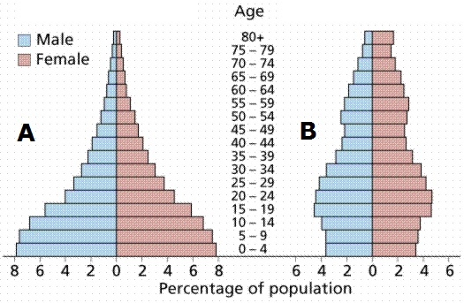
Studying Populations - Age Structures
When we analyze communities of organisms and make observations about their characteristics or demographics, we can make inferences about population growth/decline.
Which to the right is stable?
Which is soon to experience growth?

Slide 45
Studying Populations - Age Structures
When we analyze communities of organisms and make observations about their characteristics or demographics, we can make inferences about population growth/decline.
Which to the right is stable?
Which is soon to experience growth?

Slide 46
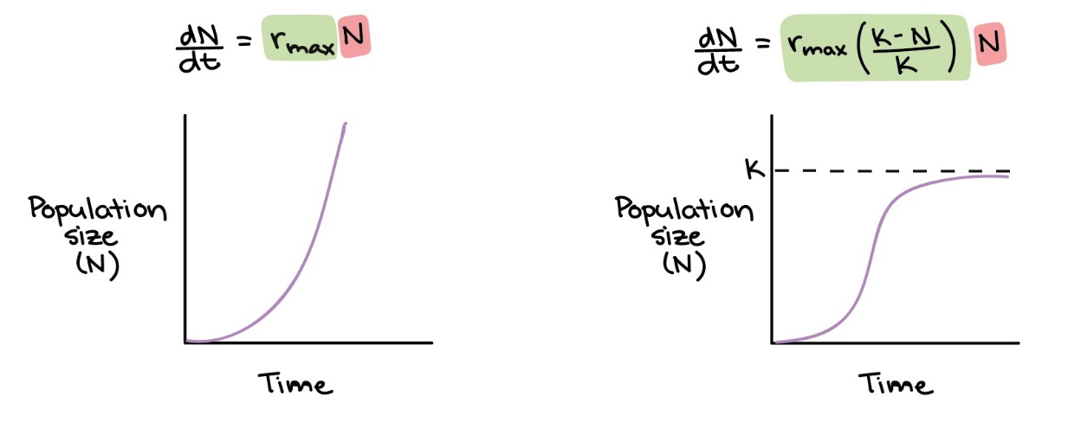
Population Growth
Logistic Growth –
“Balanced” or stable growth in which there is an equilibrium established with available resources – and other population growth factors.
Exponential Growth –

Slide 47
Population Growth
Logistic Growth –
“Balanced” or stable growth in which there is an equilibrium established with available resources – and other population growth factors. Growth rates change based on the size.
Exponential Growth –
Growth rates don’t change regardless of size.

Slide 48
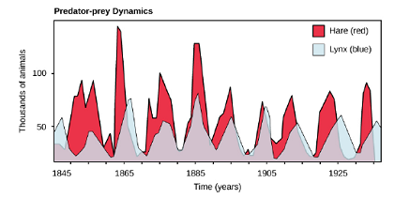
Predator-Prey Dynamics
As we observed in our labs, populations tend to fluctuate based on many different factors.
Predator-prey dynamics tend to keep each other in check or balanced.

Slide 49
Predator-Prey Dynamics
As we observed in our labs, populations tend to fluctuate based on many different factors.
Predator-prey dynamics tend to keep each other in check or balanced.
Predators help maintain the food chain by limiting the growth of other consumers.

Slide 50
Interactions move matter and energy.
How does this apply to communities of organisms?
How is matter recycled?
How does energy flow?

Slide 51
Interactions move matter and energy.
How does this apply to communities of organisms?
Organisms interact and exchange matter/energy in their interactions.
How is matter recycled?
As matter and energy go from organism to organism – eventually the food chain is “refreshed” by decomposers who replenish nutrients for producers.
How does energy flow?
Energy, stored in the molecules in organisms passes from organism to organism – but some heat is “lost” in this process.

Slide 52
Food chains
How are animals connected?
Producers, primary/secondary/tertiary consumers, decomposers
What is at the base of the food chains you made?
Producers (converting inorganic energy into organic molecules.
What limits population growth?
Any of the population growth factors we’ve discussed.

Slide 53
Food chains
How are animals connected?
What is at the base of the food chains you made?
What limits population growth?

Slide 54
Walking Dead Scenario
Let’s create a scenario as a class and determine who would live given these factors.
How does the environment we choose influence who lives and dies?

Slide 55
Interactions in Biological Systems
4.B – Competition and cooperation are important aspects of biological systems.

Slide 56
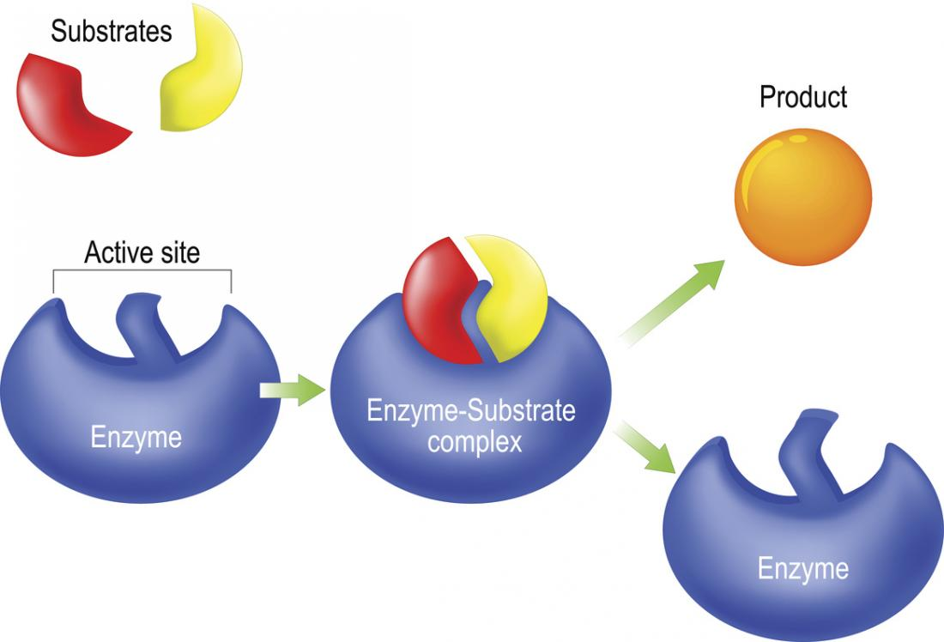
Enzymes
Enzymes are _________ that have a particular shape that fit with certain molecules to catalyze reactions. (This is due to the protein bending and folding we discussed before).
If their shape is damaged, they don’t fit and don’t work.
The substrate is ___________ or “fits” with the substrate(s).

Slide 57
Enzymes
Enzymes can build or take apart molecules.
Ex. Amylase breaks down amylose (starch).
A-Amylase forms amylose (starch).
Enzymes are proteins that have a particular shape that fit with certain molecules to catalyze reactions. (This is due to the protein bending and folding we discussed before).
If their shape is damaged, they don’t fit and don’t work.
The substrate is complementary or “fits” with the substrate(s).

Slide 58
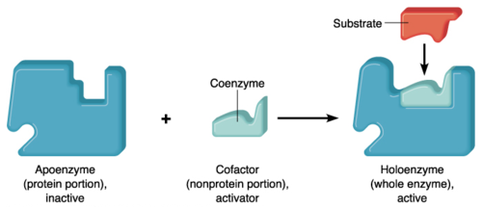
Coenzymes
Coenzymes are
Think of them as ________.
Their presence actually starts the enzymes processes.

Slide 59
Coenzymes
Coenzymes are molecules that bond with an enzyme to cause a structural change which allows enzymatic reactions to occur.
Think of them as activators.
Their presence actually starts the enzymes processes.

Slide 60
Molecules in the Environment
Other molecules in the environment can influence enzyme activity – bonding to either substrate sites or coenzyme sites!
This can increase or decrease enzyme activity!
Some bond temporarily or permanently to these sites.

Slide 61
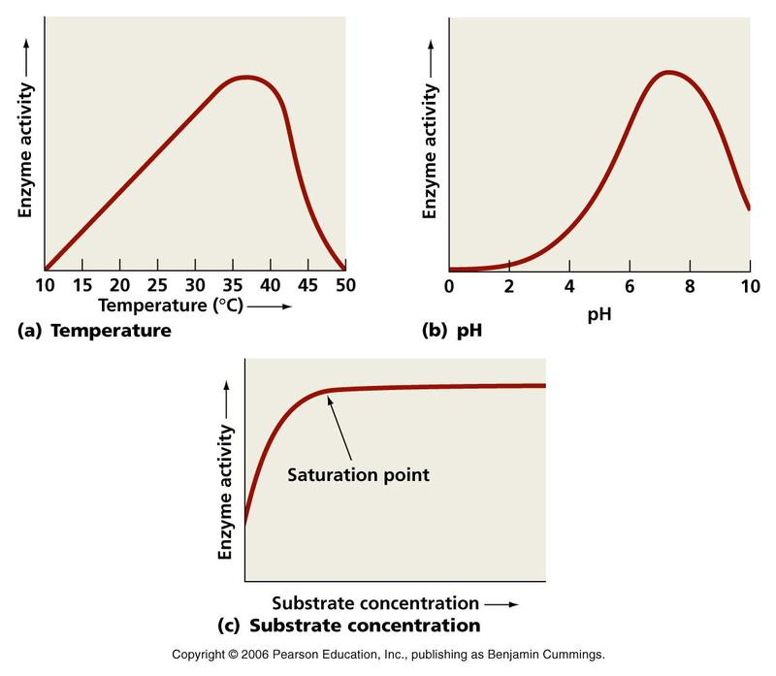
Enzyme activity is influenced by the environment
Certain ____________ and ___________ affect enzyme activity.
Certain enzymes are created or activated in the presence of certain molecules (substrate) but the production of these and the substrate could even act as an inhibitor (reaches a _________________________) to a certain amount of growth.

Slide 62
Enzyme activity is influenced by the environment
Certain temperatures and acidity affects enzyme activity.
Certain enzymes are created or activated in the presence of certain molecules (substrate) but the production of these and the substrate could even act as an inhibitor (reaches a saturation point) to a certain amount of growth.

Slide 63
Parts of Cells and Organisms
Different parts of cells have different substances dissolved into it (like enzymes).
Matter and energy may interact differently given the contents of these parts – or be contained within these parts.
For example:

Slide 64
Parts of Cells and Organisms
Different parts of cells have different substances dissolved into it.
Matter and energy may interact differently given the contents of these parts – or be contained within these parts.
For example:
Cytoplasm of a cell
Stroma of a thylakoid
Matrix of a mitochondria
The contents of each of these compartments need to be kept separate from other parts of the cell/organelle so that reactions don’t interfere with one another.

Slide 65
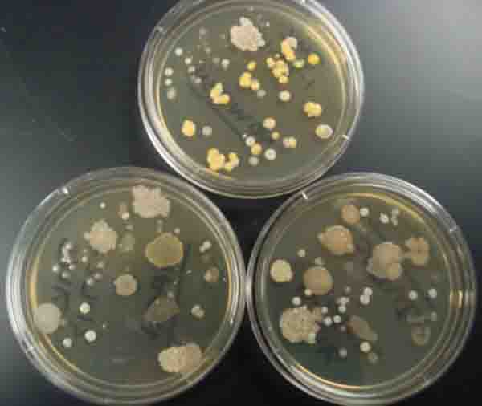
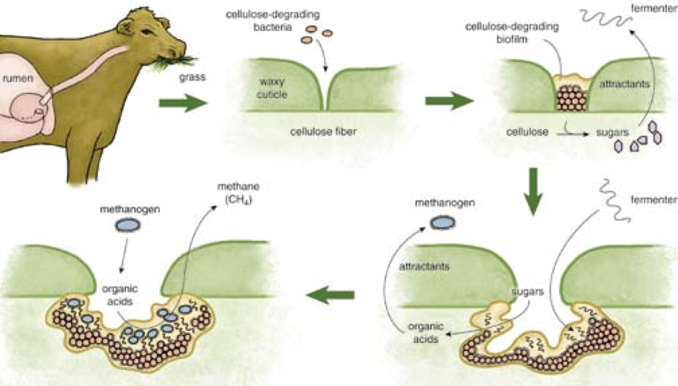
Bacteria – Like Specialized Cells or Organs
Bacteria form colonies and may actually begin to specialize into certain functions.
This makes it look like they behave as multicellular organisms like us!
http://www.cbc.ca/news/canada/saskatoon/vetavision-saskatoon-fistulated-cows-2017-1.4315178

Slide 66
Bozeman Science - Enzymes
Write out three points that stood out from the video:
Competitive and Allosteric inhibition involves either a chemical blocks the active site (competition) or the shape-changing of the enzyme (allosteric)
Cofactors (like heme) are like coenzymes in that they allow enzymes to activate – heme is an essential, inorganic part of hemoglobin, which is in our blood.
Enzymes when not in use may denature or break apart. Certain molecules we ingest can also have this effect on enzymes (like alcohol)

Slide 67
Population Dynamics
Interactions between and within populations influence patterns of species distribution and abundance.

Slide 68
How do populations interact (with one another)?
What does population mean?
Number of individuals in a particular species in a specific area
What does community mean?
The sum of the populations of all species in a specific area.

Slide 69
How do populations interact (with one another)?
What does population mean?
Number of individuals in a particular species in a specific area
What does community mean?
The sum of the populations of all species in a specific area.
Competition
Parasitism (one benefits, other suffers)
Mutualism (both benefit)
Commensalism (one benefit, other no effect)
Predation
Symbiotic (an ongoing interaction between two species).

Slide 70
How do populations interact?
Competition
Parasitism
Predation
Mutualism
Commensalism
Symbiotic

Slide 71
Symbiotic Relationships
There are many symbiotic relationships in a community.
Arguably, every interaction in communities represent a symbiotic relationship.
Example of this at work?

Slide 72
Symbiotic Relationships
There are many symbiotic relationships in a community.
Arguably, every interaction in communities represent a symbiotic relationship.
Example of this at work?
There are direct relationships between species – and indirect relationships between species (like lawn and humans who own the lawn)

Slide 73
Symbiotic Relationships
Remember that individuals may possess specific characteristics in a population (like having brown hair), but a population itself may possess different characteristics we can’t apply to individuals (demographics).
The cooperation and competition between individuals in a population contribute to these different properties.

Slide 74
Events and Populations
Ecosystem - All the biotic and abiotic components of a particular area
What all effects populations?
All affect population sizes (abundance) and distribution in an ecosystem.

Slide 75
Events and Populations
Ecosystem - All the biotic and abiotic components of a particular area
What all effects populations?
Health (disease)
Natural disasters (weather, geological disasters like volcanoes – meteorites)
Human activity
Resources (gain/loss)
Species-specific events
All affect population sizes (abundance) and distribution in an ecosystem.

Slide 76
Events and Populations
What all effects populations?
Species-specific events (disease, competition)
Environmental catastrophes,
geological events,
the sudden influx/depletion of abiotic resource,
Human activity
All affect population sizes (abundance) and distribution in an ecosystem.

Slide 77
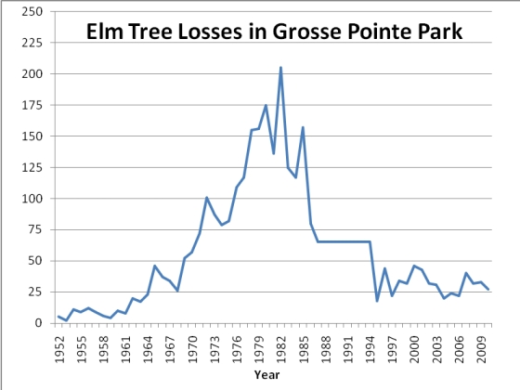

Dutch Elm Disease
Species-Specific Event
Is a ______________ _______ that kills Elm trees in under a year in some cases. It has minimal predators so this helps it spread!
It is spread via _______.
Stop the _______ – stop the _______!
What are ways we prevent this in the least environmentally detrimental way?
What about other pests like this?

Slide 78
Dutch Elm Disease
Species-Specific Event
Is a phytopathogenic fungus that kills Elm trees in under a year in some cases. It has minimal predators so this helps it spread!
It is spread via beetles.
Stop the beetles – stop the disease!
What are ways we prevent this in the least environmentally detrimental way?
What about other pests like this?

Slide 79
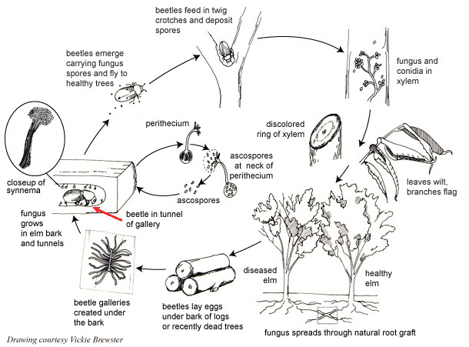
DED Fungus Life Cycle

Slide 80
Humans and Dutch Elm Disease
How do we influence this situation?
What is a solution?

Slide 81
Humans and Dutch Elm Disease
How do we influence this situation?
Through the cutting down of infected elm trees we may spread it via firewood transport.
What is a solution?
Education on the disease.
Plant and tree diversity in cities

Slide 82
Inferences based on Interactions
If we see an increase in beetle populations then we might be concerned about the spread of DED (as the opportunities for disease spread increases).
The same can be said about Lyme disease with ticks in our local animal populations. Be sure to check your outdoor pets frequently in Spring!

Slide 83
Mathematical Models of Populations
Each of these interactions can be inputted into graphs and mathematics to assess how these interactions affect different populations in communities.

Slide 84
Population Dynamics Videos
Crash Course Ecology #2, #3
Bozeman Science – Ecosystem Ecology

Slide 85
Causes of Ecosystem Change
What causes ecosystem change? How does this affect organisms and populations of them?

Slide 86
Effects On Populations (Reprise)
What all effects populations?
Species-specific events (disease, competition)
Environmental catastrophes,
geological events,
the sudden influx/depletion of abiotic resource,
Human activity

Slide 87
Human Activity and Ecosystem Change
Our activity causes ___________________ in ecosystems – more “stress” on organisms in them (___________________ ___________________ ___________________ ___________________ ___________________ are all examples of how this negatively impacts life).
When we have these severe changes the few organisms that survive can ___________________ with less competition for new ___________________ .

Slide 88
Human Activity and Ecosystem Change
Our activity causes accelerated change in ecosystems – more “stress” on organisms in them (logging, agriculture, infrastructure development, and climate change are all examples of how this negatively impacts life).
When we have these severe changes the few organisms that survive can “over-thrive” with less competition for new ecological niches.

Slide 89
Hypothetical Change
Moose Jaw is planning on building a new Potash mine south of town between 15 Wing Moose Jaw and 9th Avenue West portion of Moose Jaw. It will occupy 1200 acres of currently farmland – like the size of Mosaic by Belle Plaine.
What all can be affected by this – ecosystemically-speaking?

Slide 90
Geological Events and Ecosystem Change
Continental Drift – how did this affect ecosystems?
El Nino – how does this affect ecosystems?
Meteor Impact on Dinosaurs – how did this affect ecosystems?

Slide 91
Geological Events and Ecosystem Change
Continental Drift – how did this affect ecosystems?
Would have lead to more speciation as habitats became fragmented – less connected.
El Nino – how does this affect ecosystems?
El Nino involves warming of ocean waters – different organisms may not survive in warmer temperature waters
Meteor Impact on Dinosaurs – how did this affect ecosystems?
Kicks up dust – reduces sunlight – plants die – bacteria/fungi eat dead plants.
OR
Kills large organisms unable to adapt and withstand extreme change – new organisms thrive to take their place – new predators emerge that eat them -

Slide 92
Connecting Interactions in Biological Systems with Course Content
4C. Naturally occurring diversity among and between components within biological systems affects interactions within the environment.
Connecting to other ideas to what we’ve talked about this year.

Slide 93
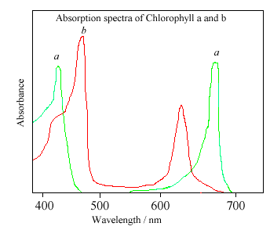
Variation in molecular units provide cells with a wider range of functions.
In photosynthesis, there are different chlorophylls - Why are there different chlorophylls?
This also occurs in different things like phospholipids in cell membranes – different arrangements alter functions – helps with diversity.

Slide 94
Variation in molecular units provide cells with a wider range of functions.
In photosynthesis, there are different chlorophylls - Why are there different chlorophylls?
Both are designed to take in light, but they do different things with that absorbed energy (and absorb different wavelengths of light) - (different shapes allow for different functions)
This also occurs in different things like phospholipids in cell membranes – different arrangements alter functions – helps with diversity.

Slide 95
Environmental factors influence the expression of the genotype in an organism.
What is an environmental factor that influences organisms?
How would they influence traits (of organisms) directly?
How would they influence traits (of organisms) indirectly?
How might height/weight in humans connect to these?
Seasonal fur colour in arctic animals?
Flower colour based on soil pH?
How might dark fur in cooler regions of the body in certain mammals connect to gene expression and the idea of a “flexible genome”?

Slide 96
Environmental factors influence the expression of the genotype in an organism.
What is an environmental factor that influences organisms?
Abiotic (non-living – example heat) and biotic (living – example amount of predators) factors.
How would they influence traits (of an organism) directly?
Different environmental factors could activate certain genes!
How would they influence traits (of organisms in the pop’n) indirectly?
Considering natural selection, the traits present in a population may change over time due to environmental factors.
How might height/weight in humans connect to these?
Seasonal fur colour in arctic animals?
Flower colour based on soil pH?
How might dark fur in cooler regions of the body in certain mammals connect to gene expression and the idea of a “flexible genome”?

Slide 97
The level of variation in a population affects population dynamics.
Genetic diversity is critical to avoiding extinction. Why?
What is the value in being programmed to respond differently (disease)?
Banff Springs Snail – is it worth protecting?
Allelic variation and Hardy-Weinberg – how does this help with populations?

Slide 98
The level of variation in a population affects population dynamics
Genetic diversity is critical to avoiding extinction. Why?
With a wider ranger of genotypes (phenotypes) there is a greater chance for some organisms to resist or survive any environmental changes.
What is the value in being programmed torespond differently (disease)?
Some things can effect the majority of a population but this can be detrimental to survival of organism (stampeding – not all in the herd join).
Banff Springs Snail – is it worth protecting?
Maybe yes? Maybe no. Is protecting this small isolated species, worth $?
Allelic variation and Hardy-Weinberg – how does this help with populations?
Gives us an idea of what alleles (traits) are present in a population.

Slide 99
The diversity of species within an ecosystem may influence the stability of an ecosystem.
Is a more biodiverse ecosystem (natural or artificial) more or less resistant to change?
What is a keystone species and why are they important?

Slide 100
The diversity of species within an ecosystem may influence the stability of an ecosystem.
Is a more biodiverse ecosystem (natural or artificial) more or less resistant to change?
More resistant!
What is a keystone species and why are they important?
Keystone species is a species that is critical to the survival of an ecosystem. Example: Beaver.

