Slide 1
Human Population
Outcome: ES20-HP1 Investigate technologies and processes used for mitigating and managing resource use, waste generation and pollution associated with a growing human population.
OR
Looking at garbage we create and how to clean it up

Slide 2
What contributes to human population growth?
Brainstorm five ideas that contribute to the growth of the human population:
Policy regarding procreation (limit or taxes for more children)

Slide 3
What contributes to human population growth?
Brainstorm five ideas that contribute to the growth of the human population:
Policy regarding procreation (limit or taxes for more children)
Food supply (agricultural increased in ag rev) – more food more people.
Stronger economy – more jobs = more money, better able to support offspring.
Better health care. MORE PEOPLE LIVE (Longer lives, increased chances of birth survival)!
Suitable conditions in the environment for growth (favourable climate) – Advances in housing (plumbing, insulation, waste treatment)
Technology – Globalization - Reproductive
Cultural trends

Slide 4
What contributes to human population growth?
Ideas that contribute to the growth of the human population:
Life expectancy – humans are living longer. Why? How much older will we keep living?
- Nutrition and access to food
- Increased medical care (more treatments for disease or disability).
Cultural values on life – abstract concept – but how we value individual life influence population growth versus other points in human history.
Globalization – does this increase or decrease growth rates?

Slide 5
Current Human Population Growth Trends
What is the current World population?
What was it in the 1800s?
Is the world’s population growth rate increasing or decreasing? Why?

Slide 6
Current Human Population Growth Trends
What is the current World population?
7.4 billion?
What was it in the 1800s?
1 billion?
Is there world’s population growth rate increasing or decreasing? Why?
- It’s actually decreasing!
- People are spending more time on themselves/their careers. Less time for baby-making!
- Contraceptives are becoming much more widely available – sex education is becoming a requirement in more and more places!

Slide 7
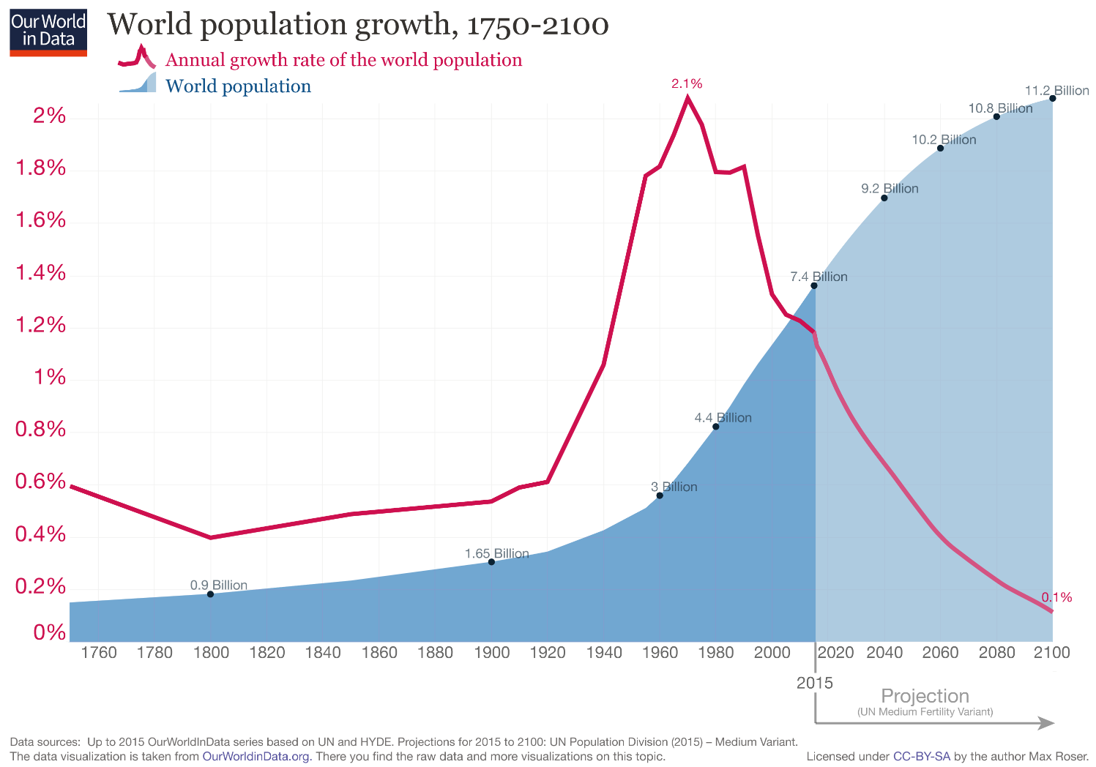

Slide 8
Population
Typically when discussing population growth, certain terms arise:
Mortality rates –
Natality/fertility rates –
Exponential growth –
“First World” and “Third World” countries –
Carrying capacity and population growth -

Slide 9
Population
Typically when discussing population growth, certain terms arise:
Mortality rates –
Amount of deaths in a population over a period of time.
Natality/fertility rates –
Amount of births in a population over a period of time.
Exponential growth –
growth that increases at an increasing rate in proportion to the growth of the total population size (1 → 2 → 4 → 8→ 16)
“First World” and “Third World” countries –
“Developed” and “undeveloped” countries as determined during the Cold War. Typically FW has low birth/death rates. Typically TW has high birth/death rates.
Carrying capacity and population growth -
Environments possess a limit to available resources that allow for the growth of organisms.

Slide 10
Third World Countries
Why would they have high birth/death rates?
How might worldview and political ideologies influence these rates?
Capitalism –
Religion that is anti-contraceptive -

Slide 11
Third World Countries
Why would they have high birth/death rates?
More education → smaller families – Why? More time spent in post-secondary and working? Knowledge of contraceptives?
These are less prevalent in Third World Countries.
- More food security and access to medicine increase birth and decrease death rates
How might worldview and political ideologies influence these rates?
Capitalism – individualism actually contributes to smaller families!
- but the poor who are left behind typically have larger families.
Religion that is anti-contraceptive – families identifying with certain religions tend to have larger family sizes - people who are “secular” may have smaller family sizes as there may be less affiliation with negativity associated with sexual activity for the sake of pleasure.

Slide 12
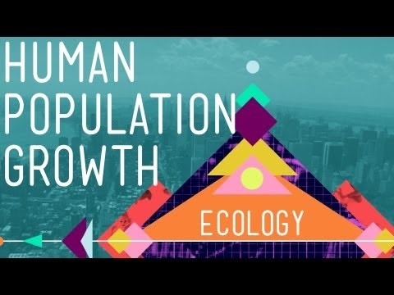
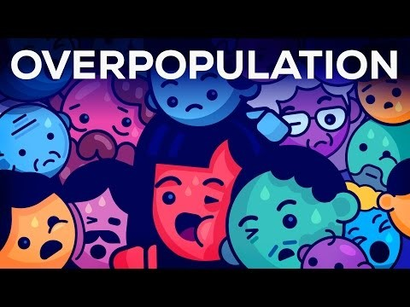
Videos of Human Population Growth
Write down three points that stood out for each.
r/K theory (organisms have different birth rates and this is also reflective of their impact on carrying capacity)
Human population is beginning to have a negative feedback loop – when people have kids, their kids are less likely to have more kids.
Human population growth rate has declined from 1962 from over 2% to close to 1%
Empowerment of women – not viewed solely as a vehicle for childbirth.

Slide 13
How does the human population affect the planet?
Is this good?
Is this bad?
What do we do?

Slide 14
Claims about Human Population
In general, how does an increasing population of humans on Earth affect environments and other species within it?
If humans vanished from the planet, what would change?
Humans individually may directly release pollutants in the devices we use – but what about the creation of pollutants by what we create?

Slide 15
Claims about Human Population
In general, how does an increasing population of humans on Earth affect environments and other species within it?
- Increase population = increased need for resources = increased pollution due to resource production
- Reduced resources
- Loss of habitats due to industrialization – extinction due to habitat fragmentation
If humans vanished from the planet, what would change?
Much of our infrastructure may soon “decompose” and we’d see a reorganization of the food chain.
Humans individually may directly release pollutants in the devices we use – but what about the creation of pollutants by what we create?

Slide 16
Human Impact on a Specific Area
How has the increase in human population affected resource use, waste generation and pollution in…
Canada?
Moose Jaw?
<Insert other part of the world?>

Slide 17
Human Impact on a Specific Area
How has the increase in human population affected resource use, waste generation and pollution in…
Canada?
Moose Jaw?
<Insert other part of the world?>
Ultimately human population growth has an impact on previous environments whether it is in the harvesting of resources or accommodations for individuals.

Slide 18
Optional Viewing
Bill Nye Saves the World: Overpopulation and Empowering Women

Slide 19
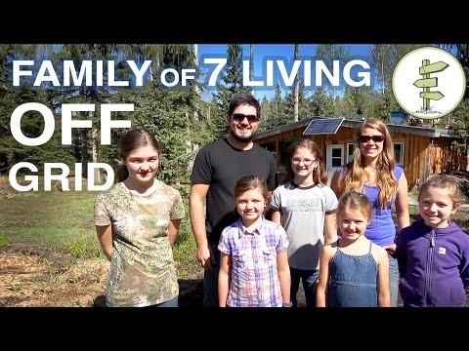
Using resources wisely – Sustainability
Research First Nations and Metis beliefs and practices that demonstrate these perspectives.
Can we be self-sufficient? Live off the grid?
Perspective: What are ideas and principles used by First Nation’s culture in the past we can incorporate – or at the very least critique our current world on?
- Should our diets be more plant-based? Why or why not?
- Do we need over 1000 sq. ft. houses?
- What causes us to answer the way we do?

Slide 20
Analyzing our Impact
Discuss the strengths and limitations of models (like the I=PAT model) that scienctists use to quantify impacts on the environment.
I = (PxAxT)/S
I=impact on environment, P=population, A=affluence, T = technology, S=environmental Stewardship
Work with a partner or two and explain this equation/model.

Slide 21
Analyzing our Impact
Discuss the strengths and limitations of models (like the I=PAT model) that scientists use to quantify impacts on the environment.
I = (PxAxT)/S
I=impact on environment, P=population, A=affluence, T = technology, S=environmental Stewardship
Each of P,A,T individually impact the environment, but when you combine population with affluence you begin to see a greater negative impact on the environment. S (enviro stewardship) is placed on the bottom as the more ideas you have in place to minimize impact on the environment decreases the effect of P,A,T

Slide 22
Analyzing our Impact
I = (PxAxT)/S
The impact on the environment is affected by the total population of humans. If a place is densely populated, there may be more vehicles due to more people, more vehicles may mean greater amounts of waste/pollution. If population is lower, but more affluent (has more money), they can still have many vehicles that can cause a similar effect. More technology can lead to more creations that may hurt/help the environment. All of this can be reduced (divided) by individuals being environmental stewards who takes steps to care for the environment.

Slide 23
Calculating Your Ecological Footprint
Myfootprint.org
Calculate your Footprint.
Complete the booklet!

Slide 24
Waste Management
Investigate waste management practices and technologies

Slide 25
Types of Waste
Municipal Solid Waste -
Industrial Waste -
Harzardous Waste –
E-Waste -

Slide 26
Types of Waste
Municipal solid waste – non-liquid waste from homes and institutions like small businesses.
Industrial Waste – production of goods (metal, agriculture, mining, etc.)
Hazardous – solid or liquid waste that is toxic. Household cleaners, medical waste, industrial solvents.
E-Waste - electronic waste, old electronics that maybe weren’t disposed of properly.
All of these require different types and considerations for disposal.

Slide 27
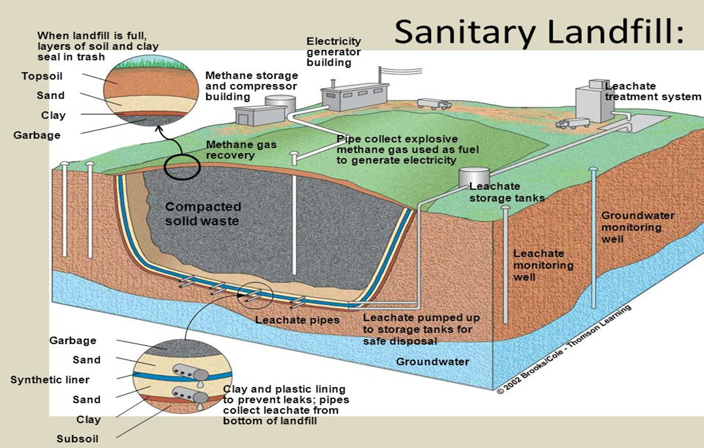
Waste Management Practices
How do they work?
Incineration (Sweden) –
Sanitary Landfills –
Recycling –

Slide 28
Waste Management Practices
How do they work?
Incineration (Sweden) – burning of waste, decreases volume and can actually help produce energy – but it may release more harmful toxins.
Sanitary Landfills – a place to dump waste – isolated from the environment until it is safe.
Recycling – Conversion of waste materials into new materials and objects.
But what all is recyclable?
Should all companies use recyclable products?
Do people know how to recycle?
The recycling industry is beginning to struggle.

Slide 29
Recycling and Waste Disposal in MJ
How do you recycle?
What is okay to recycle in Moose Jaw?
How do you dispose of electronics, paint, and batteries in Moose Jaw?

Slide 30
Recycling and Waste Disposal in MJ
How do you recycle?
What is okay to recycle in Moose Jaw?
How do you dispose of electronics, paint, and batteries in Moose Jaw?

Slide 31
Life Cycle of a Product
What are all the steps of the process involved in us being able to cook a burger on a BBQ at home?
It’s important to consider this when considering alternatives to environmentally-detrimental practices.

Slide 32
Life Cycle of a Product
What are all the steps of the process involved in us being able to cook a burger on a BBQ at home?
It’s important to consider this when considering alternatives to environmentally-detrimental practices.

Slide 33
Research Tech/Policy Project
Local
Topics:
Composting
Renewable Energy Source (Solar, Wind, etc.)
Curbside Recycling
Sewage Treatment Plants
Eco-Friendly Fertilizers and Tech to Increase Agricultural Output (effects on environment).
In this assignment you will be looking into one of the following topics related to the production of waste and a means to reduce it.
Consider the life cycle of these products, how these products work, and how we may implement this in Moose Jaw (or how we already do – can we improve this?)

Slide 34
Field Work: Lab – Collecting Garbage around school
Design and carry out a waste audit, and propose a plan of action for waste reduction and/or diversion based on the findings. (S, A, K)
Count number of separate pieces of garbage _______
Weight of total amount of garbage _______
Pictures of garbage – put on “Global” in “Environmental Science 20”
Location of garbage (we will have a map)
What garbage did we find the most of? How does this particular garbage affect the environment? How is it normally disposed of (landfill, recycle)? What is our best way to dispose of it?
What is the cause/source?
Solution: how do we combat this?

Slide 35
How do we dispose of some of these forms of waste?
Which of these are biodegradable? (Does that matter? Can it still be hazardous?)
How do we reduce the production of this waste directly and indirectly?

Slide 36
Analyzing Data
Making observations and inferences given what we found
Most garbage was found in the bushes before the fence leading to the field! Regardless of whether it was by the teacher parking lot or student parking lot!
There was a greater concentration of cigarette butts in the student parking lot. This implies that more students probably smoke more than teachers and that is the source of the cigarette butts.

Slide 37
Cigarette Butts
How does this particular garbage affect the environment?
How is it normally/properly disposed of (landfill, recycle)?
What is our best way to dispose of/reduce it?

Slide 38
Cigarette Butts
How does this particular garbage affect the environment?
Cigarette butts – air pollutant due to chemicals released into the air. This waste can collect in water bodies. Discarding them can cause fires. Toxins they contain can leach into the soil and leak into the water supply. If it’s in the soil it can damage plant/animal life.
How is it normally/properly disposed of (landfill, recycle)?
“Portable ash tray” – throw in garbage after – sent to land fill
What is our best way to dispose of/reduce it?
“Green butts” – when tossing them they have seeds to help grow.
Have disposal places available nearby individuals who smoke.
Don’t smoke – advocate against smoking.

Slide 39
Fast Food Waste
How does this particular garbage affect the environment?
How is it normally/properly disposed of (landfill, recycle)?
What is our best way to dispose of/reduce it?

Slide 40
Advocacy – making a change
Why is this important? Why should people care?
Facts help!
Providing waste disposal information –
Convey information (announcements, posters, social media)

Slide 41
Advocacy – making a change
Why is this important? Why should people care?
It affects people we care or will potentially care about in the future and now.
Environment takes care of us – all resources from it one way or another so we need to take care of it.
We don’t want animals to get sick.
Facts help! We have some facts to back up our claims.
Waste disposal information – how do we get rid of it?
Placing more waste disposal containers near where people are.
Improve our current waste disposal containers – add lids. Is there a chemical to reduce the volume of the waste in these containers?
TELL PEOPLE TO THROW OUT THEIR GARBAGE.
Convey information (announcements, posters, social media)

Slide 42
Activism Booklets
Consider using social media – it’s what you’re all on… however is there the uncool preachy aspect to this?
Movie Trailer http://greenlivingideas.com/2015/04/24/how-our-trash-affects-the-whole-planet/

Slide 43
Project: Environmental Activism /10
Examples:
- Weekly Energy Saving-Tip Announcement,
- Posters Providing Education and Advocating Pro-Environmental Change,
- Social Media Group Advocating Pro-Environmental Change
- Increase number of trash cans
- Recycling program
What is a perceived problem in our immediate environment?
What causes it?
What can be done to fix it?
Do it.

Slide 44
Rubric
Plan /5
Action /5
Group Contribution – did they contribute fully/fairly (/100%)

