Slide 1
Big Idea 3 – DNA and Genetics: Living things store, retrieve, transmit and respond to information relevant to life’s processes.
Recommended Reading(s): OpenStax: Biology Unit 3: Genetics

Slide 2
Enduring Understanding 3.A: Heritable information provides for continuity of life.
Chapter 14 and 15 of OpenStax Textbook

Slide 3
DNA and RNA
3.A.1: DNA, and in some cases RNA, is the primary source of heritable information.
Genetic traits are inherited from one generation to the next through DNA and, in some cases, RNA.
Different structures inside of cells contain their own DNA or RNA like plasmids (mitochondria and chloroplasts are examples of this).
In Eukaryotes (cells contain membrane-bound organelles) – Multiple, linear chromosomes
In Prokaryotes (cells don’t contain membrane-bound organelles) – Singular, circular chromosomes

Slide 4
Proof of DNA as Heritable Molecule
Look up the experiment – summarize its significance – how do they relate to DNA or heredity?
Watson, Crick, Wilkins, and Franklin on DNA structure.
Discovered double helix structure of DNA.
Avery-Macleod McCarty Experiments
evidence for transfer of DNA between bacteria through infecting mice.
Hershey-Chase Experiment
bacteriophage “laced” with radioactive materials to proteins. Shifted thinking from idea proteins held genetic information, not DNA.

Slide 5
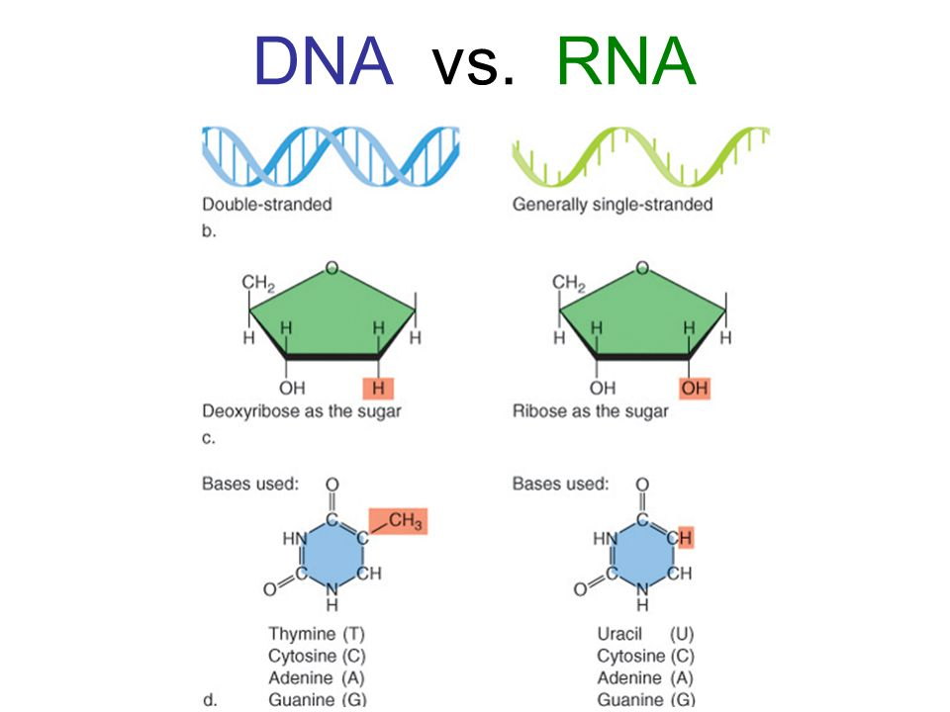
DNA
DNA:
RNA:
Composed of sugar, phosphate
and nitrogenous bases
Four (five) different types of bases:
__________ (__________ for RNA),
__________, __________, __________

Slide 6
DNA
DNA: deoxyribonucleic acid
RNA: ribonucleic acid
Composed of sugar, phosphate
and nitrogenous bases
Four (five) different types of bases:
Thymine (Uracil for RNA),
Cytosine, Adenine, Guanine

Slide 7
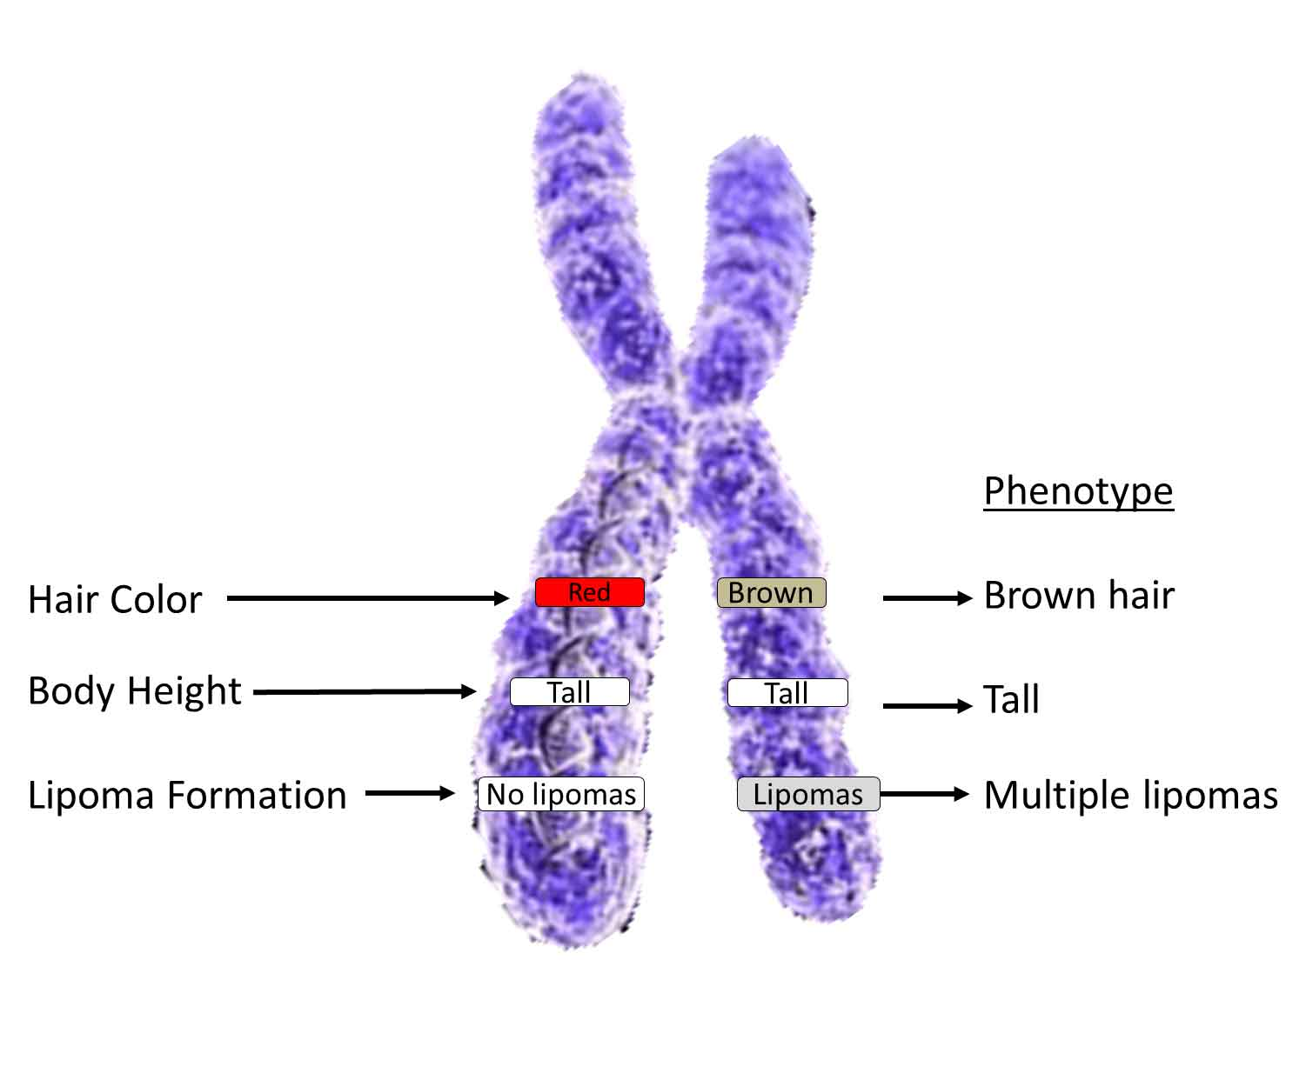
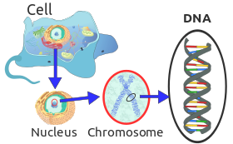
DNA
(In Eukaryotes) Each strand of DNA represents a chromosome!
Double-helix structure of DNA supercoils (bends and winds in many ways). This allows it to condense into a very small area.

Slide 8
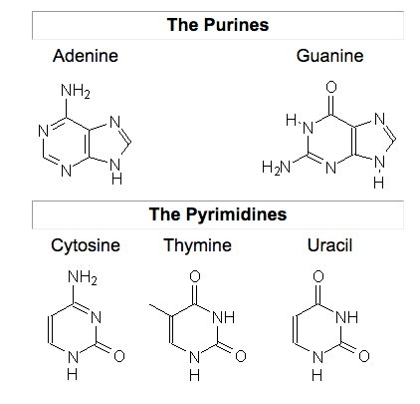
DNA
Build a DNA molecule activity.
Purines: A, G
Pyrimidines: C,T, U
C always goes with G
A always goes with T (Unless it is RNA – in which case A goes with U)

Slide 9
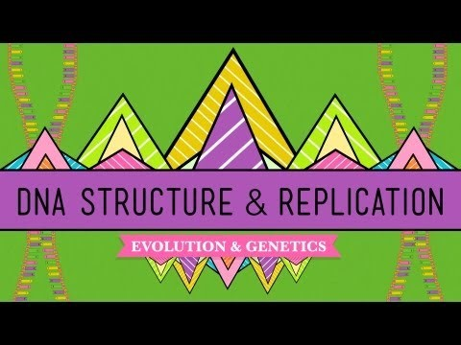
DNA Structure and Replication
DNA replicates itself when new cells are made!
It’s another complicated biological process!

Slide 10
DNA Structure and Replication Crash Course
Primase, Ligase, Helicase, DNA Polymerase
Are a series of enzymes that are coordinated to allow for DNA replication to occur.
When DNA is being replicated there is a leading strand and a lagging strand [which takes longer to make and is done so in “fragments” (okazaki)]
DNA (nucleotides) is made up of a sugar group, a phosphate group, and one of four different nitrogenous bases (A,T,C,G).

Slide 11
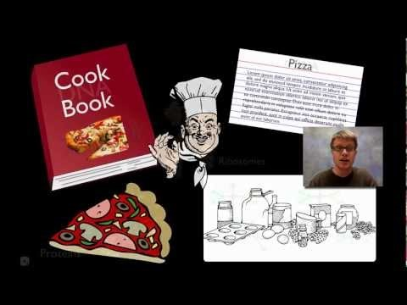
Protein Synthesis
Recommended Reading (s):
15.3, 15.4, 15.5 in OpenStax: AP Biology
Recommended Video:
Crash Course Biology #11;
Bozeman Science: Transcription and Translation

Slide 12
Protein Synthesis from DNA
Vocab
mRNA –
tRNA –
rRNA –
Helicase –
DNA Polymerase –
RNA Polymerase –
Codon –

Slide 13
Protein Synthesis
Vocab
mRNA – messenger RNA (carries messages from nucleus)
tRNA – transfer RNA (transfers amino acids to ribosome)
rRNA – what ribosomes are mostly composed of – allows mRNA to “fit” into it.
Helicase – DNA-splitting enzyme
DNA Polymerase – creates new DNA strands
RNA Polymerase – creates RNA strands (like mRNA)
Codon – three-nucleotide “code” for a particular amino acid.

Slide 14
Protein Synthesis
__________ → ___________ → ___________
Replication creates new copies of DNA (perhaps to create a new cell). DNA Polymerase reads and creates a new strand of DNA from an unzipped DNA.
Transcription takes the information encoded in DNA and encodes it into mRNA, which heads out of the cell's nucleus and into the cytoplasm. During translation, the mRNA works with a ribosome and tRNA to synthesize proteins.

Slide 15
Protein Synthesis
Replication → Transcription → Translation
Replication creates new copies of DNA (perhaps to create a new cell). DNA Polymerase reads and creates a new strand of DNA from an unzipped DNA.
Transcription takes the information encoded in DNA and encodes it into mRNA, which heads out of the cell's nucleus and into the cytoplasm. During translation, the mRNA works with a ribosome and tRNA to synthesize proteins.

Slide 16
Transcription
Transcription (creation of a “transcript” of DNA information)
Helicase (an enzyme), unzips the DNA inside the nucleus. DNA or RNA Polymerase (other enzymes), binds to the DNA and “rides’ along it, adding complementary base pairs until it reaches a stop. This complementary new strand (for RNA Polymerase) is called mRNA or messenger RNA and will exit the nucleus.
Remember: In RNA, Thymine = Uracil (Why? It’s less energy-intensive than Thymine and makes it easier to create)
The mRNA then ventures from the nucleus to a ribosome in the cell’s cytoplasm BUT FIRST!

Slide 17
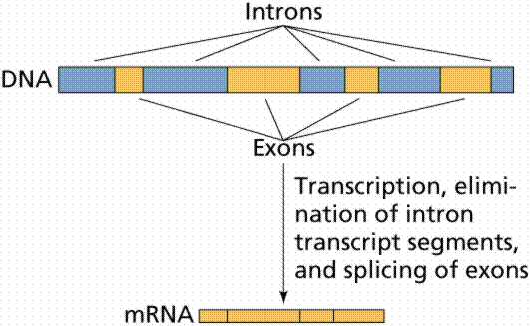
mRNA modification
mRNA is still a molecule, therefore it is able to react with molecules it may encounter on the way to the ribosome – that’s why this occurs, to chemically protect it.
Prior to the mRNA leaving the nucleus – it needs to be ___________and___________ through capping and the addition of a tail.
5’ Capping occurs -
3’ Poly-A Tail -
Pre-mRNA splicing also occurs (or excision of introns). There’s basically “filler” parts of the DNA that get cut out in the transcription process.

Slide 18
mRNA modification
mRNA is still a molecule, therefore it is able to react with molecules it may encounter on the way to the ribosome – that’s why capping/tailing occurs, to chemically protect it.
Prior to the mRNA leaving the nucleus – it needs to be “prepared” and “protected” through capping and the addition of a tail.
5’ Capping occurs - The five prime end gets a 7-methylguanosine cap through phosphorylation. This helps initiate its reading at a ribosome.
3’ Poly-A Tail - an enzyme, poly-A polymerase, adds about 200 adenines that protect the other side of the strand.
Pre-mRNA splicing also occurs (or excision of introns). There’s basically “filler” parts of the DNA that get cut out in the transcription process.

Slide 19
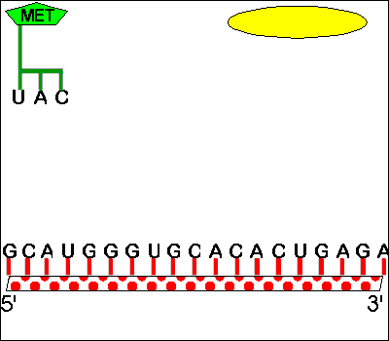
Translation
Translation (translation of mRNA into a combination of amino acids – polypeptide chain):
The mRNA meets with a corresponding ribosome and awaits a tRNA (transfer RNA – which transfers amino acids) to bond with/compliment its code (example: if the mRNA is CAG, the tRNA would be GUC). The code, or codon, is a sequence of three DNA or RNA nucleotides that corresponds with a specific amino acid or stop signal during protein synthesis. When bonded with the mRNA in the ribosome, it allows a certain amino acid to be added to the chain (the amino acid provided corresponds to the code).
Note: certain amino acids are considered “start codons” amino acids which will start the amino acid, and some are called “stop codons” which will end the amino acid chain.

Slide 20
(1) The DNA transcribes its message into mRNA in the nucleus
(2) mRNA leaves the nucleus
A U G U A U C G A U C G U
DNA
mRNA
(3) The mRNA moves to find the appropriate ribosome.
nucleus
(8) The released amino acids bond together to form a protein.
(7) The exposed codon of the tRNA matches with exposed bases of the template, which causes the tRNA to release the amino acid. The free tRNA returns to get another amino acid
cytoplasm
AA₁
AA₂
AA₄
(5) The tRNA found in the cytoplasm finds its specific amino acid (AA)
AA₂
(6) The tRNA carries the amino acid over to the ribosome
AA₁
C A U
A U G U A U C G A U C G U
tRNA
A U C
AA₁
G A C
AA₂
ribosome
AA₃
(9) When the protein is finished the mRNA and ribosome disassemble so that the ribosome is free to be a protein synthesis site again. The mRNA may return to the nucleus to be broken apart to form more mRNA
(4) The mRNA attaches to the ribosome to make a template
A U G

Slide 21
Protein Sequencing Practice
What codes for what?
Each three-letter codon codes for an amino acid. These amino acids are assembled at a ribosome to make a protein.
mRNA = the type of amino acids combined to make a protein.

Slide 22
Different types of codons
Different amino acids may be start or stop codons. Therefore, if damage happened to the DNA (or mRNA), the wrong amino acid may be brought, the wrong protein made, and a large, useless organic molecule may be created.
DNA has a proofreading system to cope with this in addition to the complimentary base pairing!

Slide 23
Differences in translation and transcription in Prokaryotes versus Eukaryotes
Create a chart including three major differences between each (I’d recommend using your OpenStax textbook).
Eukaryote (cell has a membrane-bound nucleus) | Prokaryote (cell doesn’t have a membrane-bound nucleus)

Slide 24
Differences in translation and transcription in Prokaryotes versus Eukaryotes
Create a chart including three major differences between each (I’d recommend using your OpenStax textbook).
Eukaryote (cell has a membrane-bound nucleus) | Prokaryote (cell doesn’t have a membrane-bound nucleus)
3 Types of RNA Polymerase | Only has one type of RNA Polymerase
Transcript (Nucleus) Translation (Cytoplasm) | Transcription and Translation occur simultaneously in the cytoplasm.
Rate of replication is 50 nucleotides/second | Rate of replication is 500 nucleotides/second

Slide 25
Differences in translation and transcription in Prokaryotes versus Eukaryotes
Create a chart including three major differences between each (I’d recommend using your OpenStax textbook).
Eukaryote (cell has a membrane-bound nucleus) | Prokaryote (cell doesn’t have a membrane-bound nucleus)
Have linear DNA in the form of chromosomes | Have circular DNA (like plastids)
Eukaryotes mRNA codes for one protein at a time. | Prokaryotes are smaller than eukaryotes and their DNA is similarly smaller.
Transcription occurs inside nucleus, translation occurs in cytoplasm | Transcription and translation occur simultaneously.

Slide 26
Proteins and Gene Expression
The proteins that are created in translation ultimately reflect what we see in the phenotype (visible, observable traits or content) of organisms.
Translation can ultimately
-
-
Translation can be triggered by the presence of molecules in organisms or cells – this is called gene expression (we’ll come back to this).

Slide 27
Proteins and Gene Expression
The proteins that are created in translation ultimately reflect what we see in the phenotype (visible, observable traits or content) of organisms.
Translation can ultimately
- code for enzymes associated with digestion or catalyzing of biological processes/reactions.
- synthesize proteins that are structural components in the body (melanin, keratin).
Translation can be triggered by the presence of molecules in organisms or cells – this is called gene expression (we’ll come back to this).

Slide 28
Biotechnologies – applying this knowledge
Genetic Engineering can modify DNA or RNA in organisms.
-
-
-
-
-
-

Slide 29
Biotechnologies – applying this knowledge
Genetic Engineering can modify DNA or RNA in organisms.
- CRISPR
- PCR (Polymerase Chain Reaction)
- GMOs
- Transgenic organisms
- Cloned animals
- Pharmaceuticals (such as human insulin).

Slide 30
Study/Learning Resource
Feel free to take a notes package that summarizes a big part of this topic thus far.
Expect a quiz next class applying this content.

