Slide 1
Introduction to Biology
Biology: The Study of Life

Slide 2
Nature of Science – Discussion
Fundamental Thoughts to Remember
Question everything (including ourselves and what we value). “Why does __________ happen?”
Nothing is ever “proven”, but things can be very likely to be right given evidence. Uncertainty about some things is a reality, be comfortable with it.
What is the scientific method?
Following it adds validity and consistency to science.
Should be unbiased – what’s wrong with social media and articles about “science”?
Sciences are not independent of one another, chemistry and physics are integral parts of biology.

Slide 3
What you should take away from Biology 30
Appreciate the complexity of life that biology seeks to understand and the delicate balance that holds life together. Everything is connected, the experiences we have dictate the development of our human brain which may lead to further discoveries in biology that affect our ever-evolving society and world. All of this is simply a product of a series of molecular reactions that are part of biological processes encoded in (and translated from) genes that allow you to convert these written words into thoughts. That capacity for thought is only made possible by generations upon generations of our biological ancestors passing on favourable traits to their offspring in a variety of specific environments they managed to survive in. Use this knowledge to critically analyze and learn about the universe and approach all elements of your life with appreciation, curiousity and a sense of responsibility about your impact on life as we know it.

Slide 4
Characteristics of Life
Unit 1
BI30–LE1 Explore how scientific understandings of life and its characteristics change in light of new evidence.

Slide 5
What is life?
Life is immensely complex!
Crash Course Big History (Life Begins):
https://www.youtube.com/watch?v=1WS712DHfmg
Write out three points that stood out from the video:
What is life?
How did life begin?
Theories on how life began.
- Panspermia –
- RNA World Hypothesis –

Slide 6
What is life?
Life is immensely complex!
Crash Course Big History (Life Begins):
https://www.youtube.com/watch?v=1WS712DHfmg
Write out three points that stood out from the video:
What is life?
How did life begin?
Theories on how life began.
- Panspermia – life originated elsewhere and that “seeded” Earth
- RNA World Hypothesis – RNA was the first molecule that could replicate as it is made from molecular components that can be found in the formation of Earth and stars.

Slide 7
What makes something living?
Brainstorm at least five characteristics you think ALL living things share.

Slide 8
What makes something living?
Brainstorm at least five characteristics you think ALL living things share.
“Movement”*
Reproduction – exchange/pass on genetic information typically in the form of DNA
Growth
Energy processing (nutrition/waste)
Response to stimuli
Structure/Order

Slide 9
How might definitions of living be relative?
Are there any arguments about something that is living but defies or challenges what we think makes something living?
Classification of “living” is a man-made concept, isn’t it? Why is that important to acknowledge?
How has our definition/description of life changed over time? Why has this changed? What does this mean for the future?
- Aristotle’s (~350 BCE)
- Linnaeus (~1750 CE)

Slide 10
How might definitions of living be relative?
Are there any arguments about something that is living but defies or challenges what we think makes something living?
Classification of “living” is a man-made concept, isn’t it? Why is that important to acknowledge?
How has our definition/description of life changed over time? Why has this changed? What does this mean for the future?
New evidence emerges that enhance or refine our understanding of what life is.
- Aristotle’s (~350 BCE) -
- Linnaeus (~1750 CE) -

Slide 11
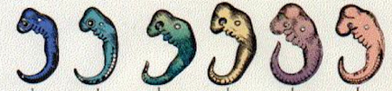
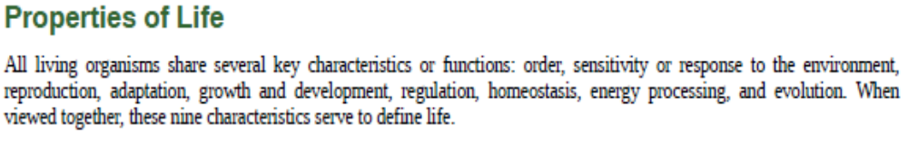
Common Characteristics

Slide 12
Common Characteristics
Order – organisms require some form of order/organization to function
Energy processing – organisms need a means to capture and use energy to perform functions.
Response to stimuli – organisms must possess a means to sense/respond to their environment
Growth and development – organisms typically follow a pattern of growth and development
Reproduction – organisms need some capacity to replicate or generate offspring
Homeostasis/regulation – organisms have processes to maintain balance and optimal functioning
Adaptation – organisms have traits or characteristics that make them successful in certain environments

Slide 13
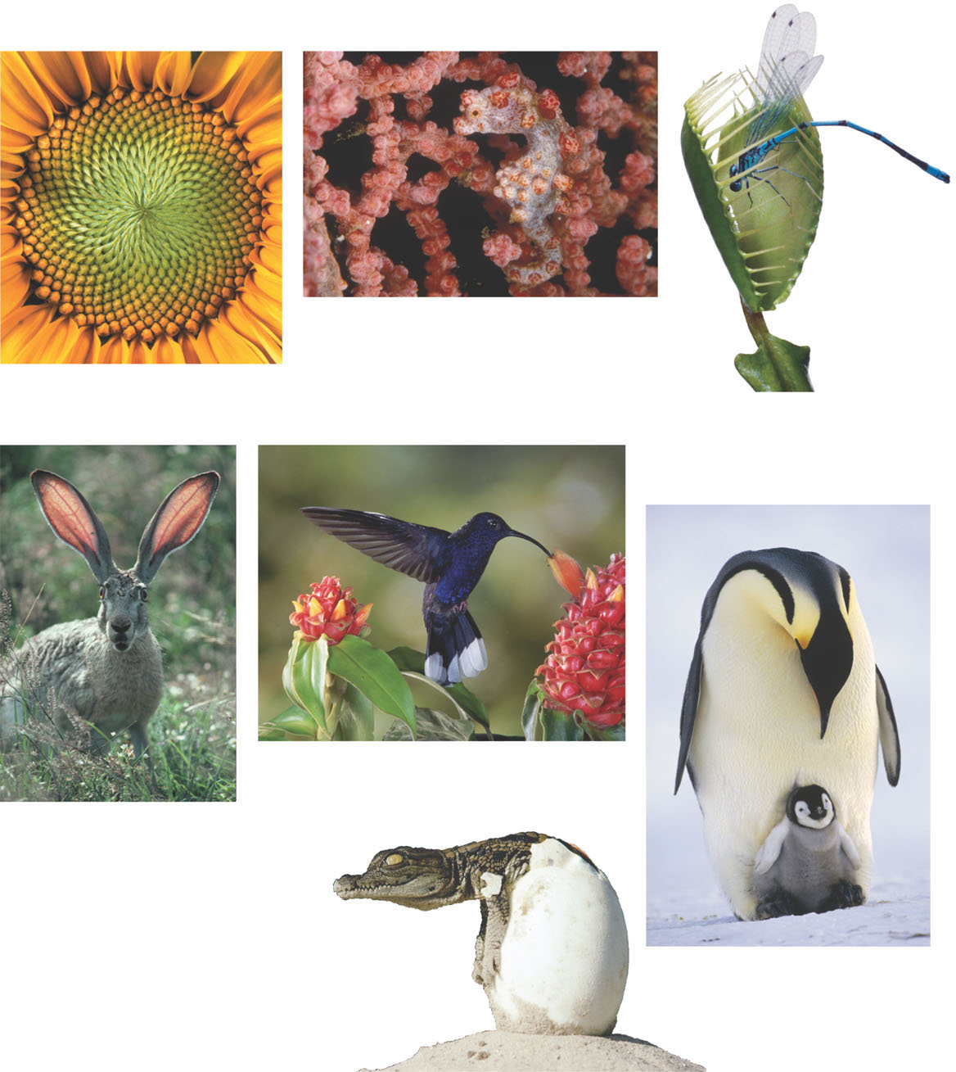
(b)
(a)
(c)
(e)
(d)
(f)
(g)
Figure 1.2

Slide 14
(b) Evolutionary
adaptation
(a) Order
(c) Response to the
environment
(e) Energy
processing
(d) Regulation
(f) Growth and
development
(g) Reproduction
Figure 1.2

Slide 15
Viruses and OpenStax
Debate whether or not entities such as viruses, viroids and prions should be considered alive. (S, STSE)
Using OpenStax Biology Text – Answer the associated questions on the assignment.
Do you consider viruses alive?

Slide 16
Cell Theory
Examine the impact of the cell theory and advances in microscopy on past and current scientific definitions of life. (K, STSE, A)
Importance:

Slide 17
Cell Theory
Examine the impact of the cell theory and advances in microscopy on past and current scientific definitions of life. (K, STSE, A)
All living organisms are composed of one or more cells. (However, this is controversial because non-cellular life such as viruses are disputed as a life form.)^{[1]}
The cell is the basic unit of structure and organization in organisms.
Cells arise from pre-existing cells. From Wikipedia
Importance: As we develop new technologies that increase our ability to observe the microscopic world – our definition of life constantly changes.

Slide 18
What is significant about cell theory?
How could the idea that “organisms are composed of cells” be significant?
Why is defining life important?
Ask a question about cells/life that we can’t answer yet.

Slide 19
Varying Definitions of Life
Distinguish among scientific and cultural perspectives with respect to the question of what constitutes life. (STSE, A)
Explore how scientific definitions of life have changed over time as a result of advances in technologies and scientific understanding. (K, STSE)
Different cultures perceive what constitutes life differently.
Does nature have a spirit?
Do you believe in ghosts?
Do animals have souls?
Just because science doesn’t have the technology to measure it now, does that mean it will never be discovered?

Slide 20
Contributions of Scientists
Recognize the contribution of scientists (e.g., Francesco Redi, Louis Pasteur, Stanley Miller, Harold Urey and Lynn Margulis) whose experiments contributed to a wider understanding of life from a biological perspective. (K, STSE)
Social Media Assignment (see assignment sheet)!
Create a Social Media Account for an individual who contributed to Biology.
Inform your instructor who you’ve selected (we want to avoid doubling up).
Who are you studying? What social media platform will you be using?
Have fun with this assignment but look at the rubric!

Slide 21
Outcome/Big Idea
Remember, this is our learning outcome:
BI30–LE1 Explore how scientific understandings of life and its characteristics change in light of new evidence.
Biology is an evolving science (like all sciences). What we know today, may be different tomorrow.

