Slide 1
Unit 2 -
Atmospheric Systems
Outcomes:
Part 1 – ES20-AH1 – Assess the impact of indoor/outdoor air quality on human and environmental health and the need for regulations and mitigating technologies to minimize risks to human health.
Part 2 – ES20-AH2 – Analyze the production, reliability and uses of geoscience data to investigate the effects of a changing climate on society and the environment.
________________________________
I have a booklet of notes that may help some of you begin thinking about this content available on the website (I didn’t want to print it off).

Slide 2
Questions about “Air”
What is air?
Is CO₂ bad for human health?
Is the air different in certain parts of the world, why or why not (geographic, or atmospherically)?
What is “good, clean” air?

Slide 3
Questions about “Air”
What is air?
Water vapour, Nitrogen gas 78% of our air (N₂), (CO₂) Carbon Dioxide, Oxygen 21% (O₂), other assorted gases (argon).
Is CO₂ bad for human health?
In general, no. (In high enough concentrations, anything can kill you).
Is the air different in certain parts of the world, why or why not (geographic, or atmospherically)?
Altitude-wise, yes. Higher up you are, less oxygen.
Geographically-speaking, yes. Different locations in the world have different concentrations of particles found in it.
What is “good, clean” air?
“Smells clean, fresh, not bad”, “less carbon dioxide”, “unpolluted”,
“not cow-poop, pork-poop, air”.

Slide 4
Part 1 – ES20-AH1 – Assess the impact of indoor/outdoor air quality on human and environmental health and the need for regulations and mitigating technologies to minimize risks to human health.
AIR QUALITY

Slide 5
Humans and air quality
Outcome – pose questions regarding how human activities and technologies have influenced air quality
How do humans influence air quality?
Pollution (emissions due to human activities [agriculture, transportation, factories, production]).
“Clean” air (remove pollutants, “freshen it” with lovely scents).
In homes?
Febreeze, air filters/purified, biological shedding
Outside?
Pollution (see above).
Vegetation (what we elect to plant).
What technologies influence air quality?
See above.
Catalytic converter.

Slide 6
Humans and air quality
Outcome – pose questions regarding how human activities and technologies have influenced air quality
Would we live as successfully or fully without a furnace in Saskatchewan's winters?
With this in mind, we need to ask ourselves what parts of air pollution are necessary or inevitable?
Humans exhale CO2 (a greenhouse gas), and vehicles emit harmful chemicals into the air we breathe, but can we escape this?

Slide 7
Humans and air quality
Outcome – pose questions regarding how human activities and technologies have influenced air quality
What are some of the most polluted places in the world, and why?
What caused the pollution (release of damaging matter or energy into the environment) there?
And what are some of the cleanest places in the world, and why? Is pollution always man-made (molds and airborne pathogens)?
Regulations and Carbon Tax – news article – your thoughts?
http://www.theglobeandmail.com/news/politics/saskatchewan-premier-brad-wall-rejects-ottawas-carbon-pricing-plan/article28808667/
Carbon capture - https://en.wikipedia.org/wiki/Carbon_capture_and_storage

Slide 8
Humans and air quality
Outcome – pose questions regarding how human activities and technologies have influenced air quality
What are some of the most polluted places in the world, and why?
“Singapore?” “China.” “More densely populated places” “India.”
What caused the pollution (release of damaging matter or energy into the environment) there?
Production.
And what are some of the cleanest places in the world, and why? Is pollution always man-made (molds and airborne pathogens)?
Netherlands. “In general, Europe” “Places untouched by humans - Antarctic”
Regulations and Carbon Tax – news article – your thoughts?
http://www.theglobeandmail.com/news/politics/saskatchewan-premier-brad-wall-rejects-ottawas-carbon-pricing-plan/article28808667/
Carbon capture - https://en.wikipedia.org/wiki/Carbon_capture_and_storage

Slide 9
Humans and Air Quality indicators: pose questions regarding how human activities and technologies have influenced air quality (e.g. is air pollution necessary? Where is most polluted and why? What are some local sources of air pollution?
What are some local sources of air pollution?
What are the best ways to combat these?
Who assesses/regulates air quality and how did these come into existence??
Fun fact – Toronto has a “congestion charge”.
Check SK or another location
Canada – www.airhealth.ca/
- http://www.lung.ca/protect-protegez/pollution-pollution/indoor-interieur/school-ecole_e.php
States - http://www.airnow.gov/
- http://www.stateoftheair.org/#

Slide 10
Humans and Air Quality indicators: pose questions regarding how human activities and technologies have influenced air quality (e.g. is air pollution necessary? Where is most polluted and why? What are some local sources of air pollution?
What are some local sources of air pollution?
Sanitary landfill.
Cars/Transportation.
Oil refinery.
Pork plant/stockyards (poo-ey smell).
What are the best ways to combat these?
Carpooling? Composting/Recycling (reduces waste). Eat less pork?
Who assesses/regulates air quality and how did these come into existence?
Government – public demand.
Fun fact – Toronto has a “congestion charge”.
Check SK or another location
Canada – www.airhealth.ca/
- http://www.lung.ca/protect-protegez/pollution-pollution/indoor-interieur/school-ecole_e.php
States - http://www.airnow.gov/
- http://www.stateoftheair.org/#

Slide 11
Qualities of the Atmosphere (Read the notes)
Outcome – understand the layers of the atmosphere, the composition of air within the troposphere, and investigate the role of ozone layer depletion on human health.
Atmosphere – thin layer of gases surrounding Earth (apple analogy).
Layers of the atmosphere:
Troposphere _______-_______ km
Stratosphere (ozone layer – O₃) – _______-_______km
Ozone is not good in the troposphere? Free radical good or bad?
Bottle of water anyone?
Mesosphere – _______-_______km
Thermosphere – _______-_______km
Atmosphere is ~78% __________________ (N₂) and 21% _______________(O₂). Also contains water vapour. These are the three most important. Remaining 1% are other assorted gases.

Slide 12
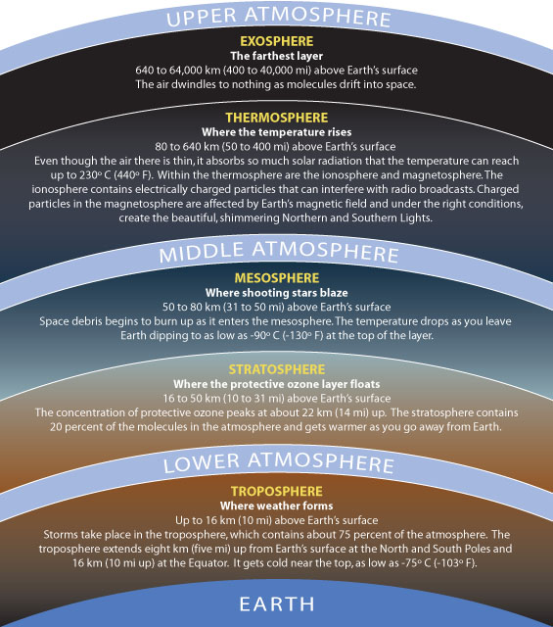
Ozone Depletion indicators: investigate the role of the stratospheric ozone layer depletion as a contributor towards human health issues such as cancers and cataracts
What is the ozone layer? Where is the ozone layer? Where is the stratosphere?
http://ozonewatch.gsfc.nasa.gov/
How did it get depleted? What does it do for us?
How would this affect human health?

Slide 13
Layers of Atmosphere and Ozone Layer
It’s important to note the components of the atmosphere at different layers form our surface.
Many pollutants/contaminants can react and adjust the conditions existing in these spheres and that can in turn impact human health and the environment.
After identifying some of the pollutants/contaminants, we can begin to create policies and legislation to minimize emissions.

Slide 14
Indoor/Outdoor Contaminants
Find four primary pollutants in air, describe them and their negative impact on health. (Do you think it is found more dominantly indoors or outdoors)?
Find one secondary pollutant in air.

Slide 15
Indoor Air Quality indicators: examine how contaminants such as radon, carbon monoxide, mold, volatile organic compounds, allergens, and particulates affect indoor air quality
Air Pollutant/contaminant – release of damaging materials into the atmosphere or air.
- radon –
- carbon monoxide –
- mold/allergens –
- volatile organic compounds –
- particulate matter (PM) –
- Lead –
Are you at risk?
http://www.lung.ca/protect-protegez/pollution-pollution/indoor-interieur/home-chezvous_e.php

Slide 16
Indoor Air Quality indicators: examine how contaminants such as radon, carbon monoxide, mold, volatile organic compounds, allergens, and particulates affect indoor air quality
Air Pollutant/contaminant – release of damaging materials into the atmosphere or air.
- radon – floor level gas causing lung cancer. Can seep in foundation of houses from radioactive rock.
- carbon monoxide – odourless gas that deprives cells of oxygen by binding with hemoglobin in the blood. Comes from vehicle emissions or other burning of fossil fuels.
- mold/allergens – dander, pollen, and allergens made possible by moisture indoors (keep humidity below 50%) – Can cause cough, sneezing, congestion, respiratory, eye irritation
- volatile organic compounds – carbon-containing chemicals fumes such as methane, propane, benzene, and butane found in cleaning products – can cause cancer and can react to produce ozone in the troposphere.
- particulate matter (PM) – soot, dust, tiny bits of metals, damage lungs and affect breathing
- Lead – can last for a long time and travel through air and get into groundwater – causes neurological problems dominantly in children.
Are you at risk?
http://www.lung.ca/protect-protegez/pollution-pollution/indoor-interieur/home-chezvous_e.php

Slide 17
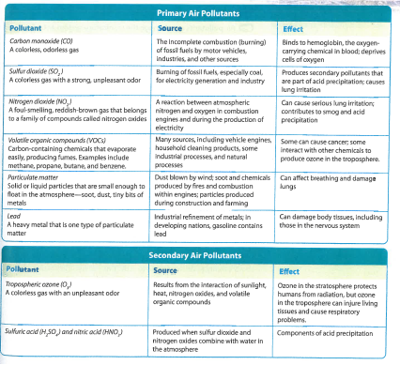
Outdoor Air Quality indicators: identify how contaminants in the troposhere such as ozone, particulates, carbon monoxide, nitrogen oxides, lead, and sulphur dioxide can affect human health and impact the environment.

Slide 18
Quiz
List 3 common indoor air contaminants, 3 common outdoor air contaminants, describe them and their effects on humans. Format below.
Contaminant | Description | Effect on Human/Organism Health

Slide 19
Assessing Air Quality indicators: design and carry out a process for collecting and analyzing data to assess air quality.
How can we create a process to find out our air quality?
Using white paper squares and Vaseline (very primitive, but it works!)
Lab – Air Quality - Reporting Data (Making a Graph) – observe squares under a microscope? 2016 Data

Slide 20
Air Quality Webquest
See assignment sheet for more details!
In a nutshell:
Background Research on Outdoor Contaminants (we should have this mostly in our notes).
Indicators map – search SK for facilities that release emissions. Find the higher ones in the SK area – record where it is, how much it emits, and the industry it’s associated with. Put top emitters on your map on the next page (use letters to code for locations).
Track current wind patterns by Moose Jaw and Regina, include on map.
Answer questions – you should be able to given our background.

Slide 21
Government Regulations indicators: recognize the impact of government regulations such as the Air Quality Health Index (AQHI) and the National Ambient Air Quality Objectives ( NAAQOs), on minimizing risks to environmental and human health.
Air Quality Health Index (Canada-Local) - www.airhealth.ca/ - Means of measuring our Air Quality – is it safe to do activities outside?
Air Quality Index - THE WORLD - http://aqicn.org/map/world/#@g/1.5195/20.2697/2z - Measures PM in the troposphere. Green = good.
NAAQO – National Ambient Air Quality Objectives - http://www.ec.gc.ca/default.asp?lang=En&n=56D4043B-1&news=A4B2C28A-2DFB-4BF4-8777-ADF29B4360BD – goals for PM in the air – should not exceed certain amounts.
Clean Air Act in SK - Outlines protocol and rules for companies and individuals in SK
Canadian Environmental Protection Act (1999) – Contains details on requirements for products and management pertaining to environmental protection (waste, vehicles, toxic)
What is the importance of all of these? What purpose do they serve, how did they come into being?

Slide 22
Smog
Investigate the sources and production of industrial and photochemical smog and identify measures that can be undertaken to mitigate their effects to human health. (K, STSE, A)
Smog –
Photochemical smog -
Where do these come from? How do we minimize their impact on human health?

Slide 23
Smog
Investigate the sources and production of industrial and photochemical smog and identify measures that can be undertaken to mitigate their effects to human health. (K, STSE, A)
Smog – visible air pollutants like nitrogen oxides, sulphur oxides, ozone, smoke or dirt particles.
Photochemical smog - is the chemical reaction of sunlight, nitrogen oxides and volatile organic compounds in the atmosphere, which leaves airborne particles and ground-level ozone. (source)
Where do these come from? How do we minimize their impact on human health?

Slide 24
Contaminant Reducing and Mitigating Technologies
Explain the scientific principles underlying technologies and processes such as air scrubbers, baghouse filters, electrostatic precipitators and catalytic converters that were developed to reduce contaminants in motor vehicle and industrial emissions or to improve indoor air quality. (K, STSE, S)
Investigate whether a personal protective device or substance (e.g., sunscreen, mosquito repellent or protective clothing) is effective in protecting a person from an environmental factor that affects human health. (STSE, S)
Select a technology that is meant to improve air quality or protect us from environmental factors in some form!
This can be indoor technologies, industrial technologies or personal protective devices (sunscreen, masks).
You can work in groups or individually.

Slide 25
Anthropocentric Air Quality
Develop a generalization about the relationship between human population density and human health.
It’s important to note that this unit is very anthropocentric.
Much of what we have discussed is centered around human health and fails to acknowledge the impacts of all of these on other organisms. Many of these contaminants negatively affect ecosystems as well – and wind patterns can shift the problem well away from where it originated (like Fort McMurray or Lac La Ronge forest fires).
Despite the potential movement of these contaminants, when larger population densities exist, typically we see greater consumption, emissions, and negative impacts on human health.

Slide 26
Climate Change
ES20-AH2 – Analyze the production, reliability and uses of geoscience data to investigate the effects of a changing climate on society and the environment.

Slide 27
Bill Nye Saves the World – Climate Change
Cosmos: A Spacetime Odyssey – The World Set Free

Slide 28
Canadian Communities Threatened By Climate Change
http://www.cbc.ca/radio/day6/five-canadian-communities-threatened-by-climate-change-now-1.3776341?campaign_id=A100

