Slide 1
Aquatic Systems
Outcome(s):
Assess the importance of maintaining healthy water for humans and the environment. (SI, DM)

Slide 2
Maintaining Water
(a) Analyze emerging health challenges such as the spread of disease, mercury in fish, blue-green algae and E. coli in drinking water that result from changes to the condition of aquatic systems. ((STSE, K)
(b) Analyze the rationale for developing and enforcing water quality standards such as the Saskatchewan Surface Water Quality Objectives and the Canadian Water Quality Index and legislation such as the Canada Water Act and the International River Improvements Act. ((STSE, K)
(c) Examine how individuals, organizations (e.g., watershed associations), First Nations and government agencies (e.g. Saskatchewan Water Security Agency) work to ensure clean and abundant water through producing water regulations and allocation policies. ((K, STSE)
(d) Assess how irrigation projects affect food production, water availability, soil salinization and groundwater. ((STSE)
(e) Describe the operation and effectiveness of technologies and processes developed to protect drinking water sources locally and globally. ((K, STSE)
(f) Analyze the impacts of point source and non-point source pollution on humans and aquatic systems. ((STSE, K, A)
(g) Research the sources, effects, and management and mitigation strategies of contaminants such as pathogens, organic matter, heavy metals, sediment, heat, petrochemicals and inorganic chemicals such as pesticides in aquatic and/or marine ecosystems. ((STSE, A)
(h) Investigate how human activities (e.g., overfishing, photo- degradation of plastic waste, shipping, coastal development and offshore extraction of oil and minerals) impact marine ecosystems (e.g., coral reef degradation, introduction of invasive species and reduced fish populations). ((STSE, A)
(i) Investigate the role of muskeg and moss in water filtration and food preservation for First Nations and Métis and other communities. ((K, STSE, A)
(j) Research advances in technologies such as desalinization plants, water treatment plants and home water filtrations systems, which are designed to maintain and improve water quality. ((K, STSE, A)
(k) Design a system of source water protection for a community`s drinking water recognizing the precautionary principle ((STSE, A, S)

Slide 3
Managing Water Quality
What policies, agencies and advocacy exists for managing water quality?

Slide 4
Health Challenges
Analyze emerging health challenges such as the spread of disease, mercury in fish, blue-green algae and E. coli in drinking water that result from changes to the condition of aquatic systems. ((STSE, K)
What are some of the health-related issues concerning water quality? (what are some health-related issues we’ve already discussed?)
What caused these issues?
How do we manage issues like this?

Slide 5
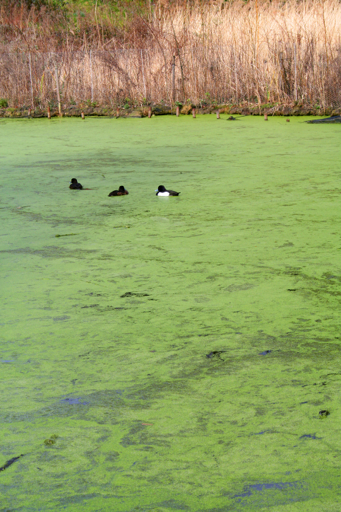
Health Challenges
Analyze emerging health challenges such as the spread of disease, mercury in fish, blue-green algae and E. coli in drinking water that result from changes to the condition of aquatic systems. ((STSE, K)
What are some of the health-related issues concerning water quality? (what are some health-related issues we’ve already discussed?)
Flint, Michigan, neurological damage due to lead in water supply.
Blue-green algae – neurological damage to pets (and humans).
E. coli – causes stomach-related illness (diarrhea, nausea, vomiting)
What caused these issues? Ultimately, human activity.
E. coli – is caused by human sewage and animal waste.
Blue-green algae’s cause is eutrophication and fertilizer runoff.
Flint, Michigan – the decomposition of the pipes that transport water
How do we manage issues like this?
Better waste management (specifically of sewage). Policies or legislation can make certain guidelines mandatory.
Creation of technology to better manage issues.

Slide 6
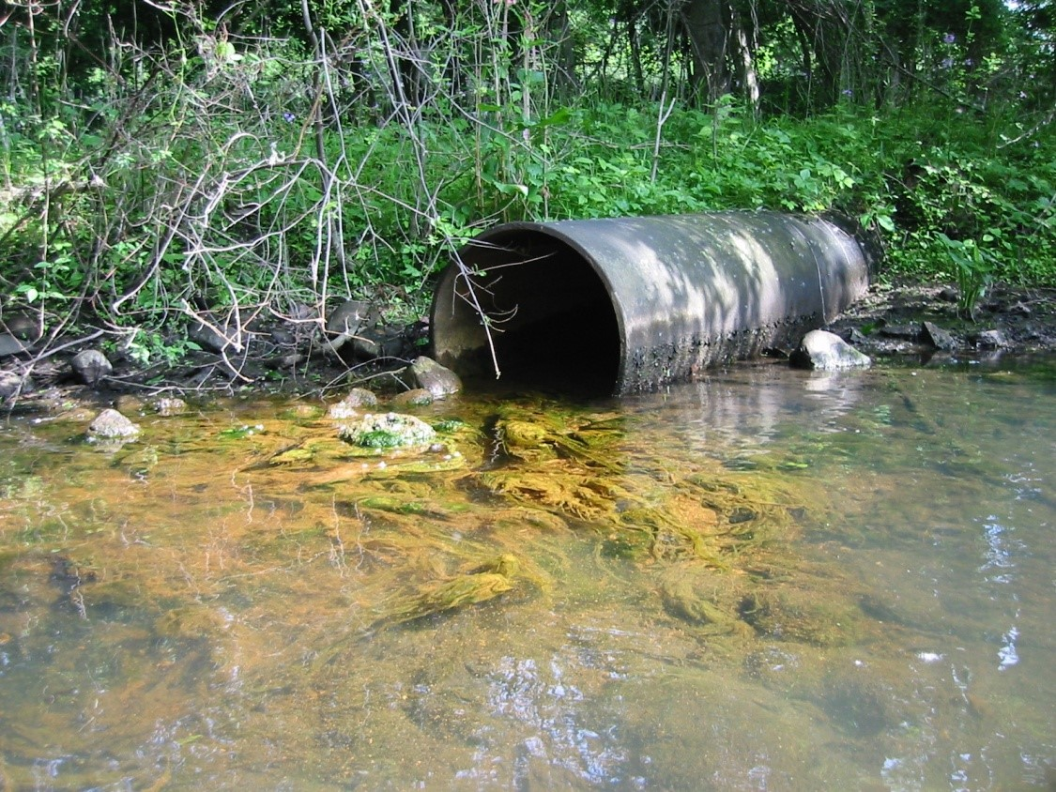
Identifying Pollution Sources
Analyze the impacts of point source and non-point source pollution on humans and aquatic systems. ((STSE, K, A)
To create strategies to reduce pollution that contributes to these problems, it helps to identify what causes the pollution.
___________________________ – “is a single identifiable source of air, water, thermal, noise or light pollution.” We can see specifically where it comes from.
Example:
_____________________________ - generally results from land runoff, precipitation, atmospheric deposition, drainage, seepage, or hydrological modification (rainfall or snowmelt) where tracing the pollution back to a single source is difficult.
Example:

Slide 7
Identifying Pollution Sources
Analyze the impacts of point source and non-point source pollution on humans and aquatic systems. ((STSE, K, A)
To create strategies to reduce pollution that contributes to these problems, it helps to identify what causes the pollution.
Point-Source Pollution – “is a single identifiable source of air, water, thermal, noise or light pollution.” We can see specifically where it comes from.
Example: Sewage runoff.
Non-Point Source Pollution - generally results from land runoff, precipitation, atmospheric deposition, drainage, seepage, or hydrological modification (rainfall or snowmelt) where tracing the pollution back to a single source is difficult.
Example: rainfall that carries fertilizer to B-pound (eutrophication)

Slide 8
Exploring Local Water Management Groups
Analyze the rationale for developing and enforcing water quality standards such as the Saskatchewan Surface Water Quality Objectives and the Canadian Water Quality Index and legislation such as the Canada Water Act and the International River Improvements Act. ((STSE, K)
Water Security Agency
How are they funded?
Moose Jaw River Watershed Stewards
How are they funded?
About WSA: What do they do?
What watershed(s) do we belong to?
What are two “key actions” of the Moose Jaw Watershed Source Water Protection Plan?
About Us: What are two projects they are pursuing (have pursued)?
Programs: What industry do they seem most focused on?

Slide 9
Exploring Local Water Management Groups
Analyze the rationale for developing and enforcing water quality standards such as the Saskatchewan Surface Water Quality Objectives and the Canadian Water Quality Index and legislation such as the Canada Water Act and the International River Improvements Act. ((STSE, K)
Water Security Agency
How are they funded? Government-Funded
Moose Jaw River Watershed Stewards
How are they funded? Non-profit
About WSA: What do they do?
Responsible for water (resources, drinking water, supplies) and all aspects of it in Saskatchewan.
What watershed(s) do we belong to?
MJ River Watershed, Hudson Bay Watershed, Qu’Appelle River Watershed
What are two “key actions” of the Moose Jaw Watershed Source Water Protection Plan?
Providing Watershed Education
Legislation, Policy and Program Changes
About Us: What are two projects they are pursuing (have pursued)?
Weed Management (Leafy Spurge)
Farm and Ranch Water
Programs: What industry do they seem most focused on?
Agricultural

Slide 10
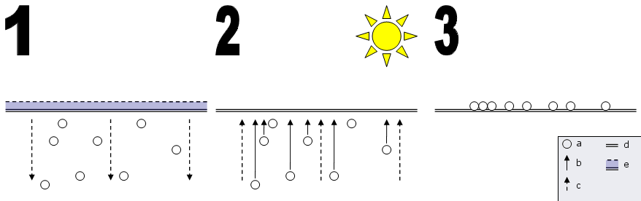
Pollution from Irrigation
Assess how irrigation projects affect food production, water availability, soil salinization and groundwater. ((STSE)
Irrigation affects ______________________ if there isn’t good drainage in the soil.
Water can actually ______________________, making the soil ______________________.
Less plants ultimately means _________________ and also impacts the land’s ability to _________________ – potentially _______________________________ in the soil.

Slide 11
Pollution from Irrigation
Assess how irrigation projects affect food production, water availability, soil salinization and groundwater. ((STSE)
Irrigation affects soil salinity if there isn’t good drainage in the soil.
Water can actually pull salt up in the soil, making the soil harder for plants to grow.
Less plants ultimately means less food and also impacts the land’s ability to hold water over time – potentially decreasing overall water availability in the soil.

Slide 12
Marine Industry Effects
Investigate how human activities (e.g., overfishing, photo- degradation of plastic waste, shipping, coastal development and offshore extraction of oil and minerals) impact marine ecosystems (e.g., coral reef degradation, introduction of invasive species and reduced fish populations). ((STSE, A)
Look up two of these activities, what are the negative effects of these activities (likely is coral reef degradation, reducing fish populations, or introduction of invasive species). Then explain how this activity contributes to it.
Marine-Related Industry Activity | Major Negative Effect | How?
Overfishing
Photo-degradation of Plastic Waste
Shipping (of goods)
Coastal Development (housing)
Offshore Oil/Mineral Extraction

Slide 13
Marine Industry Effects
Investigate how human activities (e.g., overfishing, photo- degradation of plastic waste, shipping, coastal development and offshore extraction of oil and minerals) impact marine ecosystems (e.g., coral reef degradation, introduction of invasive species and reduced fish populations). ((STSE, A)
Look up two of these activities, what are the negative effects of these activities (likely is coral reef degradation, reducing fish populations, or introduction of invasive species). Then explain how this activity contributes to it.
Marine-Related Industry Activity | Major Negative Effect | How?
Overfishing | reduction in fish populations via resource depletion. | Reduction of “food” fish leads to an imbalance of other species in the food chain.
Photo-degradation of Plastic Waste | Coral reef damage/fish population decline. | Plastic break down and are ingested by microorganisms, this plastic bioaccumulation can have negative effects on fish health.
Shipping (of goods) | Direct pollution (oil spills) or introduction of invasive species. | The hulls of ships may be transporting species that are invasive to other locations – disrupting ecosystems.
Coastal Development (housing) | Destruction of ecosystems – reducing of fish population | Pollutants and sediment released in construction or the damaging of coastal environments to make beaches
Offshore Oil/Mineral Extraction | Disruption of ecosystems. | Oil spills release pollution but some of the tools actually may affect sensory processes in surrounding organisms.

Slide 14
Drinking Water
Describe the operation and effectiveness of technologies and processes developed to protect drinking water sources locally and globally. ((K, STSE)
Many different forms of tech and processes associated with drinking water exist.
What are some examples?
Filters – carbon-based compounds

Slide 15
Drinking Water
Describe the operation and effectiveness of technologies and processes developed to protect drinking water sources locally and globally. ((K, STSE)
Many different forms of tech and processes associated with drinking water exist.
What are some examples?
LifeStraw
Bill Gates and Poop Water -Janicki Omnipressor
How to make filthy water drinkable.
How water is processed (typically).

Slide 16
Water Quality Technology
Research advances in technologies such as desalinization plants, water treatment plants and home water filtrations systems, which are designed to maintain and improve water quality. ((K, STSE, A)
Desalinization plants remove salt from water!
If freshwater sources are declining though, why don’t we just use that for bottled water? – Article
What may be a solution for this? How does this connect into socio-political issues?
BC and the Nestle Water Controversy – Article
What may be a solution for this? How does this connect into socio-political issues?

Slide 17
Water Quality Technology
Research advances in technologies such as desalinization plants, water treatment plants and home water filtrations systems, which are designed to maintain and improve water quality. ((K, STSE, A)
Desalinization plants remove salt from water!
If freshwater sources are declining though, why don’t we just use that for bottled water? – Article
What may be a solution for this? How does this connect into socio-political issues?
BC and the Nestle Water Controversy – Article
What may be a solution for this? How does this connect into socio-political issues?

Slide 18
Natural Solutions: Muskeg and Moss
Investigate the role of muskeg and moss in water filtration and food preservation for First Nations and Métis and other communities. ((K, STSE, A)
Muskeg is a type of acidic soil that typically has high concentrations of wood fragments in it. It acts as filter and buffer of certain dissolved particles in water – also contributing to growth of a variety of organisms.
When comparing this to how we treat our water (using clay, sand and rock) it’s important to note how different processes exist and were practiced in non-Western methods.
These natural solutions represent that connected of systems that we see as well as provide perspective and information on more potentially-sustainable forms of living and water management.

Slide 19
Implementing Change
Design a system of source water protection for a community`s drinking water recognizing the precautionary principle ((STSE, A, S)
Using targets identified by local water management groups, our information on how connected water bodies are, the biotic and abiotic contents of water and technology available to us – what do we focus on for preserving water quality? Point source pollution is typically something we can actually target.
What is a perceived need that justifiably stands above others? (This will be different for each of us)
How does this include the precautionary principle+?
+precautionary measures should be taken in the implementation of potentially harmful (health or environmental) industries or policies if the scientific evidence surrounding the topic isn’t definitive

