Slide 1
Genetics and Biotechnology
Outcome BI30-GB2: Investigate how genetic information is stored, transmitted and expressed at the molecular level.

Slide 2
Discovery of DNA
Appreciate how the discovery of the DNA molecule as the chemical basis of inheritance has fundamentally transformed the field of biology. (A, STSE)
Research the nature of the predominant scientific culture when scientists such as Erwin Chargaff, Rosalind Franklin, Maurice Wilkins, James Watson and Francis Crick were investigating the chemical basis of inheritance. (A, STSE, S)
Compilation of ideas and research lead to our understanding of DNA.
Friedrich Miescher (1869) –
Phoebus Levine (early 1900s) –
Erwan Chargaff (late 1940s) –
Rosalind Franklin and Maurice Wilkins studied
James Watson and Francis Crick built on

Slide 3
Discovery of DNA
Appreciate how the discovery of the DNA molecule as the chemical basis of inheritance has fundamentally transformed the field of biology. (A, STSE)
Research the nature of the predominant scientific culture when scientists such as Erwin Chargaff, Rosalind Franklin, Maurice Wilkins, James Watson and Francis Crick were investigating the chemical basis of inheritance. (A, STSE, S)
Compilation of ideas and research lead to our understanding of DNA.
Friedrich Miescher (1869) isolated nuclei from cell nuclei – but then incorrectly hypothesized the structure of DNA.
Phoebus Levine (early 1900s) performed tests using compounds that indicated the presence of nucleotides, but then incorrectly hypothesized the distribution of these nucleotides (specific numbers).
Erwan Chargaff (late 1940s) – a cytosine for every guanine, a thymine for every adenine.
Rosalind Franklin and Maurice Wilkins studied it using X-Rays, and were able to generate images of what they saw.
James Watson and Francis Crick built on their work to figure out the 3-Dimensional Structure of DNA as a double-helix, spiral staircase.

Slide 4
Discovery of DNA
Appreciate how the discovery of the DNA molecule as the chemical basis of inheritance has fundamentally transformed the field of biology. (A, STSE)
Research the nature of the predominant scientific culture when scientists such as Erwin Chargaff, Rosalind Franklin, Maurice Wilkins, James Watson and Francis Crick were investigating the chemical basis of inheritance. (A, STSE, S)
Historical context of scientific discoveries. (discuss with in small groups)
What events in history were happening at the time of these discoveries?
What inventions or things becoming more prevalent contributed to the growth/spread of ideas?
Why is asking these questions important to science?
What can we infer about these scientists about the potential root of their beliefs?
When considering this in our current context, what are barriers or benefits to discovery?

Slide 5
Discovery of DNA
Appreciate how the discovery of the DNA molecule as the chemical basis of inheritance has fundamentally transformed the field of biology. (A, STSE)
Research the nature of the predominant scientific culture when scientists such as Erwin Chargaff, Rosalind Franklin, Maurice Wilkins, James Watson and Francis Crick were investigating the chemical basis of inheritance. (A, STSE, S)
Historical context of scientific discoveries.
What events in history were happening at the time of these discoveries?
Rise of Nazism in Germany (1920s-30s)
Anti-Semitism in Russia (late 1800s)
Rise of Nationalism (1800s-1900s)
Rise of globalization (Post WW2)
Women’s rights (right to vote in Canada, 1916) *Rosalind did not win the Nobel prize – before you react – how come?
What inventions or things becoming more prevalent contributed to the growth/spread of ideas?
Transportation! Mail/media! Trade! Decline in war.

Slide 6
Discovery of DNA
Appreciate how the discovery of the DNA molecule as the chemical basis of inheritance has fundamentally transformed the field of biology. (A, STSE)
Research the nature of the predominant scientific culture when scientists such as Erwin Chargaff, Rosalind Franklin, Maurice Wilkins, James Watson and Francis Crick were investigating the chemical basis of inheritance. (A, STSE, S)
Why is asking these questions important to science?
What can we infer about these scientists about the potential root of their beliefs?
When considering this in our current context, what are barriers or benefits of these discovery?

Slide 7
Discovery of DNA
Appreciate how the discovery of the DNA molecule as the chemical basis of inheritance has fundamentally transformed the field of biology. (A, STSE)
Research the nature of the predominant scientific culture when scientists such as Erwin Chargaff, Rosalind Franklin, Maurice Wilkins, James Watson and Francis Crick were investigating the chemical basis of inheritance. (A, STSE, S)
Why is asking these questions important to science?
No discoveries occur in a vacuum. Every fabric of your being is influenced by every aspect of the universe. The oxygen you breathe, the beliefs of your grandparents, the French Revolution. When you consider scope and ask yourself, “could this have influenced things and can it technically influence me”?
What can we infer about these scientists about the potential root of their beliefs?
Many of these scientists are less inclined to engage in politics – yet are at the mercy of it – why might this be?
Despite contributions to the discovery of DNA – Franklin was snubbed, why (they don’t give post-humous Nobels)? How does our developing understanding shift our views?
When considering this in our current context, what are barriers or benefits of these discovery?
Politics determines funding of science and discovery. We dictate politics. Prevailing notions may benefit some things at the expense of others (or vice versa).

Slide 8
Why do I want to emphasize this, personally?
The more I question my understanding of the world and the implications of my actions I grow.
Your brain should hurt when you think about everything. Be okay with that. What do you really value, and what are the implications of that value? Don’t be passive – if you can’t question and challenge what you believe, why believe in it?
Am I comfortable with the way the world works? Is “that’s just the way it is”, okay with me? What can I realistically change? What’s within my power? How does the system limit my power to make change? How do I perpetuate the system? Apply this to every aspect of your life (relationships, life goals, etc).

Slide 9
Why do I want to emphasize this, personally?
The more I question my understanding of the world and the implications of my actions I grow.
Humans have genetic differences between them, but environmental factors shift how these genes are expressed. As a teacher/individual believing that everyone is capable of learning, or is constantly learning, that’s what keeps me patient and rarely getting angry.
I value all life, but to make a specific emphasis on who I care about seems too short-sighted, so widespread change needs to be an emphasis because to value some lives more technically diminishes the value of other lives.
If I truly value all life then I am less inclined to believe that I deserve “more” than others so what is an income cap I think is just for myself to maintain comfort of living and maximize my capacity for change but not further perpetuate a wealth gap? Is having kids selfish when I’m aware that the world is overpopulated, and is my thoughts about this evolutionarily disadvantageous?
Your brain should hurt when you think about everything. Be okay with that. What do you really value, and what are the implications of that value? Don’t be passive – if you can’t question and challenge what you believe, why believe in it?
Am I comfortable with the way the world works? Is “that’s just the way it is”, okay with me? What can I realistically change? What’s within my power? How does the system limit my power to make change? How do I perpetuate the system? Apply this to every aspect of your life (relationships, life goals, etc).

Slide 10
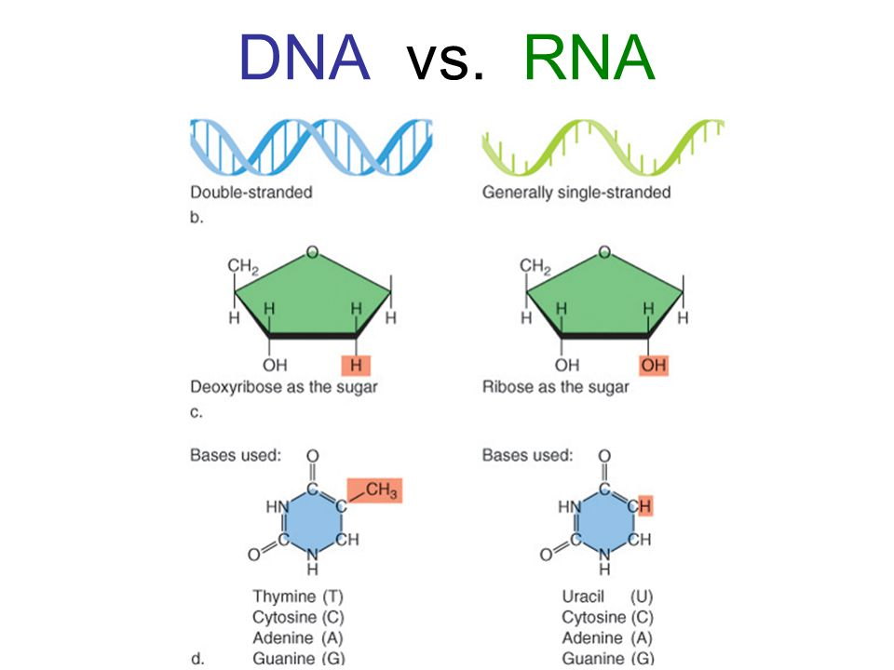
DNA
Assess the importance of the structure of the DNA molecule to its ability to store, transmit and express genetic information. (K)
DNA:
RNA:
Composed of sugar, phosphate
and nitrogenous bases
Four (five) different types of bases:
__________ (__________ for RNA),
__________, __________, __________

Slide 11
DNA
Assess the importance of the structure of the DNA molecule to its ability to store, transmit and express genetic information. (K)
DNA: deoxyribonucleic acid
RNA: ribonucleic acid
Composed of sugar, phosphate
and nitrogenous bases
Four (five) different types of bases:
Thymine (Uracil for RNA),
Cytosine, Adenine, Guanine
RNA typically is the form in which DNA information is transmitted, why might it be beneficial to be single-stranded than double-stranded?

Slide 12
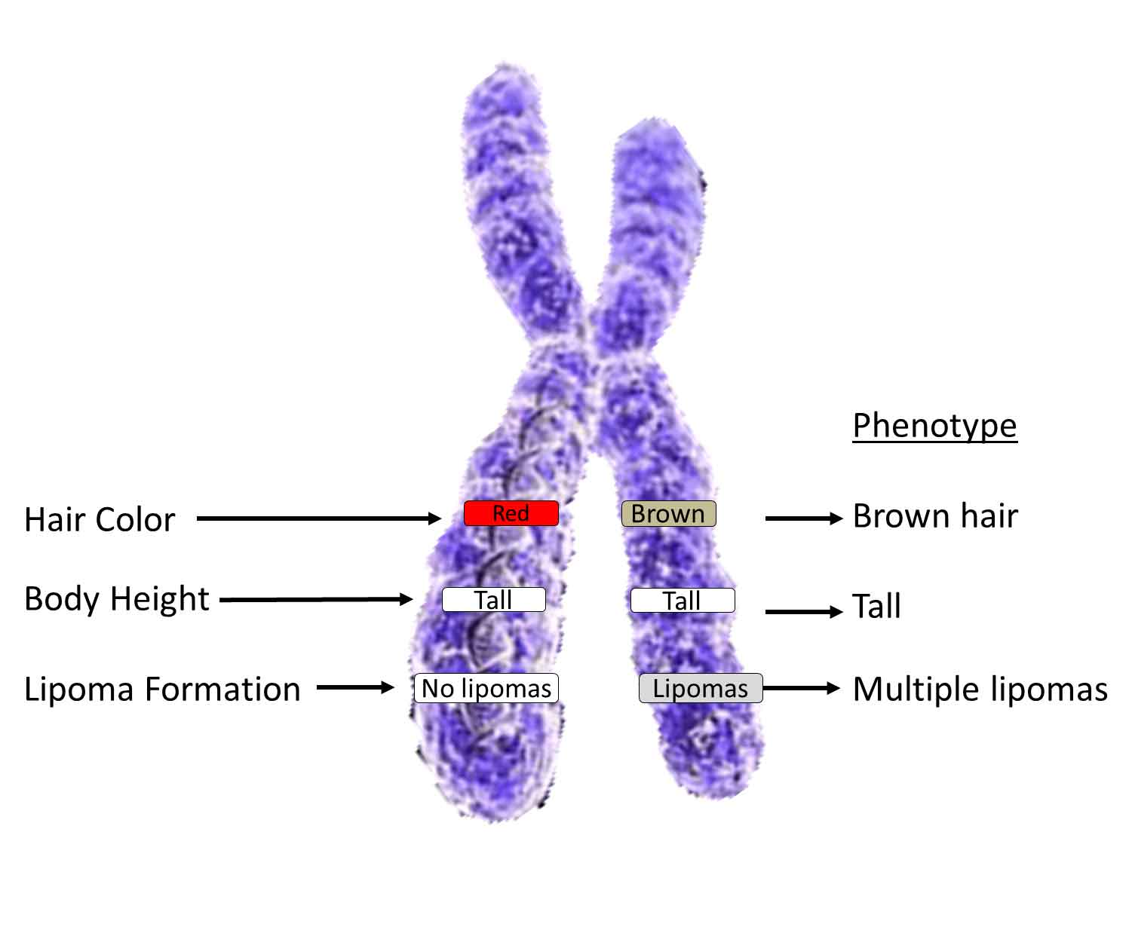
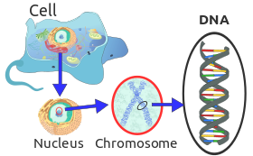
DNA
When crossing over occurs, certain traits are likely to transfer together because they are right beside each other on the genome!
Build DNA activity.
Each strand of DNA represents a chromosome!
Double-helix structure of DNA _____________ (bends and winds in many ways). This allows it to condense into a very small area.
DNA wraps around a protein called a ____________!

Slide 13
DNA
When crossing over occurs, certain traits are likely to transfer together because they are right beside each other on the genome!
Build DNA activity.
Each strand of DNA represents a chromosome!
Double-helix structure of DNA supercoils (bends and winds in many ways). This allows it to condense into a very small area.
DNA wraps around a protein called a histone! Different molecules cause the DNA to unwind from this histone.

Slide 14
Importance of DNA (shape)
What is its shape again?
Why doesn’t a chromosome look like that?

Slide 15
Importance of DNA (shape)
What is its shape again?
Double helix
Why doesn’t a chromosome look like that?
DNA bends and folds on itself and around histones (a certain protein). Some molecules cause DNA to unwind from these histones… this can induce transcription!
Molecules that are introduced to the cell (ingested, for example) cause DNA to detach from histones to be read to make proteins.

Slide 16
DNA is a molecule!
This is incredibly important when considering how things work in our body.
All of this needs to be kept in mind when considering gene expression and behaviour of our cells/body.

Slide 17
DNA is a molecule!
This is incredibly important when considering how things work in our body.
Everything we are composed of is molecules.
Molecules react and combine with one another.
Certain molecules bond together easily.
All of this needs to be kept in mind when considering gene expression and behaviour of our cells/body.

Slide 18
How do drugs work?
If you drink caffeine, what happens to you?
In our cells’ nuclei, when certain molecules are present, certain parts of DNA are stimulated and those areas are “read” and “promote” growth of particular proteins that perform specific tasks, much like when we drink caffeine, it tells our body to “increase energy output”, but even that is a series of molecular interactions with one molecule “promoting” the activity of another, ultimately increasing ATP usage.

Slide 19
How do drugs work?
If you drink caffeine, what happens to you?
In our cells’ nuclei, when certain molecules are present, certain parts of DNA are stimulated and those areas are “read” and “promoted” growth of particular proteins that perform specific tasks, much like when we drink caffeine, it tells our body to “increase energy output”, but even that is a series of molecular interactions with one molecule “promoting” the activity of another, ultimately increasing ATP usage.
This isn’t exactly what happens, but illustrates the previous point.
This can trigger the synthesis of proteins like enzymes or hormones in our body.

Slide 20
DNA Replication and Protein Synthesis
Model molecular genetic processes of DNA replication and protein synthesis (i.e., transcription and translation), including the roles of DNA, mRNA, tRNA and rRNA. (K, S)
Vocab
mRNA –
tRNA –
rRNA –
Helicase –
DNA Polymerase –
RNA Polymerase –
Codon –

Slide 21
DNA Replication and Protein Synthesis
Model molecular genetic processes of DNA replication and protein synthesis (i.e., transcription and translation), including the roles of DNA, mRNA, tRNA and rRNA. (K, S)
Vocab
mRNA – messenger RNA (carries messages from nucleus)
tRNA – transfer RNA (transfers amino acids to ribosome)
rRNA – what ribosomes are mostly composed of – allows mRNA to “fit” into it.
Helicase – DNA-splitting enzyme
DNA Polymerase – creates new DNA strands
RNA Polymerase – creates RNA strands (like mRNA)
Codon – three-nucleotide “code” for a particular amino acid.

Slide 22
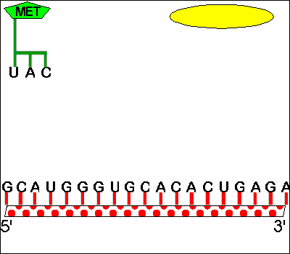
DNA Replication vs Protein Synthesis
__________ → ___________ → ___________
Replication creates new copies of DNA (perhaps to create a new cell). DNA Polymerase reads and creates a new strand of DNA from an unzipped DNA.
Transcription takes the information encoded in DNA and encodes it into mRNA, which heads out of the cell's nucleus and into the cytoplasm. During translation, the mRNA works with a ribosome and tRNA to synthesize proteins.

Slide 23
DNA Replication vs Protein Synthesis
Replication → Transcription → Translation
Replication creates new copies of DNA (perhaps to create a new cell). DNA Polymerase reads and creates a new strand of DNA from an unzipped DNA.
Transcription takes the information encoded in DNA and encodes it into mRNA, which heads out of the cell's nucleus and into the cytoplasm. During translation, the mRNA works with a ribosome and tRNA to synthesize proteins.

Slide 24
Transcription
Transcription (_____________________________________________)
Helicase (_____________), unzips the DNA inside the nucleus. DNA or RNA Polymerase (________________________________), binds to the DNA and “rides” along it, adding complementary base pairs until it reaches a stop. This complementary new strand (for RNA Polymerase) is called mRNA or messenger RNA and will exit the nucleus.
Remember:
The _______ then ventures from the ___________ to a __________ in the cell’s ____________.

Slide 25
Transcription
Transcription (creation of a “transcript” of DNA information)
Helicase (an enzyme), unzips the DNA inside the nucleus. DNA or RNA Polymerase (other enzymes depending on the product), binds to the DNA and “rides” along it, adding complementary base pairs until it reaches a stop. This complementary new strand (for RNA Polymerase) is called mRNA or messenger RNA and will exit the nucleus.
Remember: In RNA, Thymine = Uracil (Why? It’s less energy-intensive than Thymine and makes it easier to create)
The mRNA then ventures from the nucleus to a ribosome in the cell’s cytoplasm.

Slide 26
Translation
Translation (_______________________________________________________):
The mRNA meets with a corresponding ribosome and awaits a tRNA (_____________________________) to bond with/compliment its code (example: ___________________________________). The code, or ______, is a sequence of three DNA or RNA nucleotides that corresponds with a specific amino acid or stop signal during protein synthesis. When bonded with the mRNA in the ribosome, it allows a certain amino acid to be added to the chain (___________________________________________).
Note:

Slide 27
Translation
Translation (translation of mRNA into a combination of amino acids – polypeptide chain):
The mRNA meets with a corresponding ribosome and awaits a tRNA (transfer RNA – which transfers amino acids) to bond with/compliment its code (example: if the mRNA is CAG, the tRNA would be GUC). The code, or codon, is a sequence of three DNA or RNA nucleotides that corresponds with a specific amino acid or stop signal during protein synthesis. When bonded with the mRNA in the ribosome, it allows a certain amino acid to be added to the chain (the amino acid provided corresponds to the code).
Note: certain amino acids are considered “start codons” amino acids which will start the amino acid, and some are called “stop codons” which will end the amino acid chain.

Slide 28
(1) The DNA transcribes its message into mRNA in the nucleus
(2) mRNA leaves the nucleus
A U G U A U C G A U C G U
DNA
mRNA
(3) The mRNA moves to find the appropriate ribosome.
nucleus
(8) The released amino acids bond together to form a protein.
(7) The exposed codon of the tRNA matches with exposed bases of the template, which causes the tRNA to release the amino acid. The free tRNA returns to get another amino acid
cytoplasm
AA₁
AA₂
AA₄
(5) The tRNA found in the cytoplasm finds its specific amino acid (AA)
AA₂
(6) The tRNA carries the amino acid over to the ribosome
AA₁
C A U
A U G U A U C G A U C G U
tRNA
A U C
AA₁
G A C
AA₂
ribosome
AA₃
(9) When the protein is finished the mRNA and ribosome disassemble so that the ribosome is free to be a protein synthesis site again. The mRNA may return to the nucleus to be broken apart to form more mRNA
(4) The mRNA attaches to the ribosome to make a template
A U G

Slide 29
Protein Sequencing Practice
What codes for what?
Each three-letter codon codes for an amino acid. These amino acids are assembled at a ribosome to make a protein. Different combinations of amino acids make different proteins!
mRNA = the type of amino acid.

Slide 30
Different types of codons
Different amino acids may be start or stop codons. Therefore, if damage happened to the DNA (or mRNA), the wrong amino acid may be brought, the wrong protein made, and a large, useless organic molecule may be created.
DNA has a proofreading system to cope with this in addition to the complimentary base pairing!

Slide 31
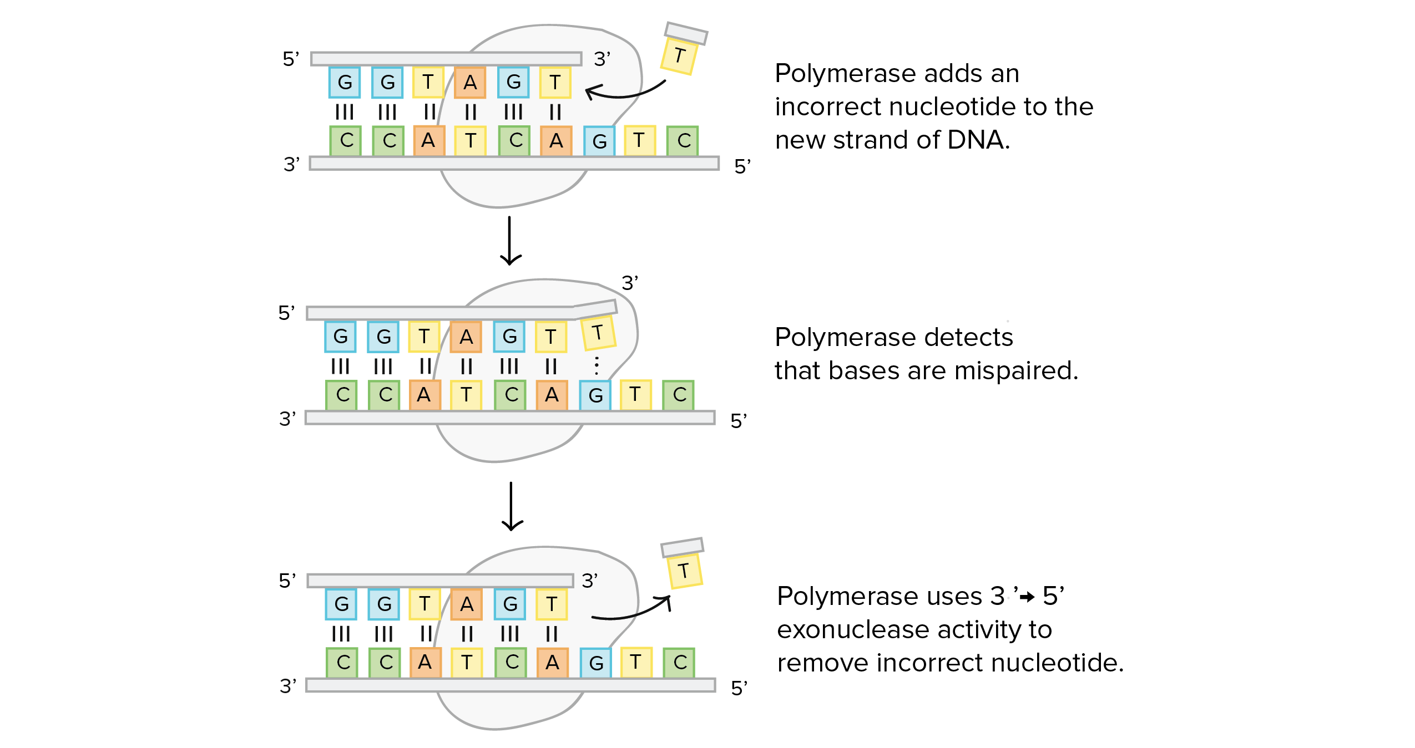
DNA Proofreading and Repair
Discuss the value of DNA proofreading and repair and its role in preventing genetic mutations. (K)
DNA Polymerase attaches nucleotides (but sometimes it attaches the wrong ones.
Exonuclease is an enzyme that disconnects incorrect nitrogenous bases.

Slide 32
What happens if these mistakes are missed?
On the first amino acid sequence in your last assignment, change the last letter… what happens to the product (amino acid produced)?
Pick another amino acid sequence and change the middle letter… what happens to the product (amino acid produced)?
When there are changes, some of these amino acids build faulty proteins that may be responsible for continuously creating new proteins (this overgrowth can lead to cancer).

Slide 33
What happens if these mistakes are missed?
On the first amino acid sequence in your last assignment, change the last letter… what happens to the product (amino acid produced)?
You don’t get a different amino acid! So we’re still okay!
Pick another amino acid sequence and change the middle letter… what happens to the product (amino acid produced)?
If we change this, this may also change the amino acid (it changed a stop to a serine) and therefore, the protein.
However, changing the last letter of some codons may still produce the same amino acid – another means of a self-check or error avoidance.
When there are changes, some of these amino acids build faulty proteins that may be responsible for continuously creating new proteins (this overgrowth can lead to cancer).

Slide 34
Genetic Abnormalities
Recognize how various types of gene mutations (e.g., deletion, insertion, point and frameshift) may lead to genetic disorders. (K)
Deletion –
Insertion –
Point –
Frameshift –
Inversion –
Translocation –
Replication Slippage –

Slide 35
Genetic Abnormalities
Recognize how various types of gene mutations (e.g., deletion, insertion, point and frameshift) may lead to genetic disorders. (K)
Deletion – we lose a base pair in the chromosome/DNA code (can happen with mistakes in crossing over).
Insertion - we gain a base pair in the chromosome/DNA code (can happen with mistakes in crossing over).
Point – change in a nucleotide at a specific point on the DNA (substitution).
Frameshift – deletions that occur in an entire codon (can lead to the creation of a wrong protein).
Inversion – chromosome flips and is read in the opposite order.
Translocation – non-homologues rearrange.
Replication Slippage – when base units repeat, the polymerase can slip past it or repeat by accident.

Slide 36
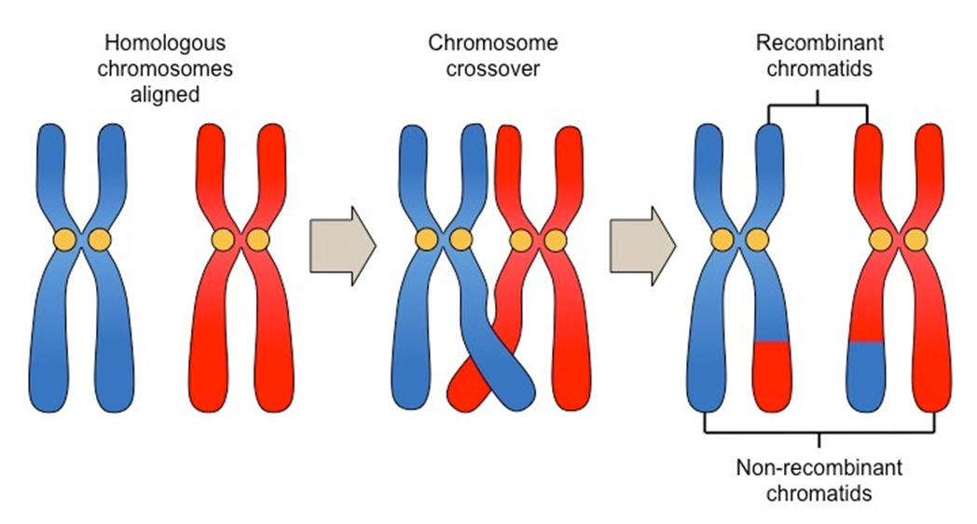
Meiosis and Crossing Over
What is meiosis?
What are gametes?
What is crossing over?
What is non-disjunction?

Slide 37
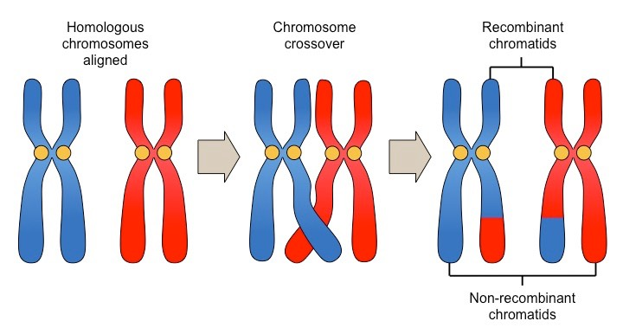
Meiosis and Crossing Over
What is meiosis?
Process of producing gametes! PMAT
What are gametes?
Sex cells, haploid copies of our DNA (chromosomes) transferred to sperm and egg cells.
What is crossing over/recombination?
exchange of genetic material between homologous chromosomes that results in recombinant chromosomes during sexual reproduction.
THIS IS IMPORTANT BECAUSE IT ALLOWS FOR NEW COMBINATIONS OF GENES
What is non-disjunction?
is the failure of homologous chromosomes or sister chromatids to separate properly during cell division.

Slide 38
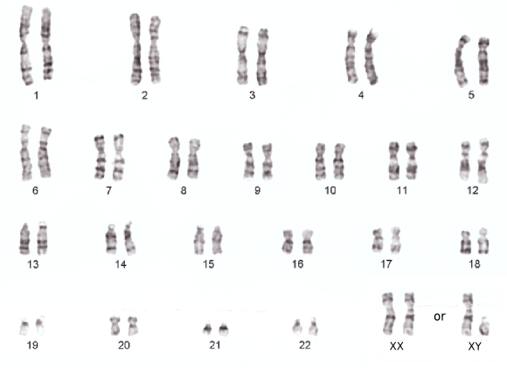
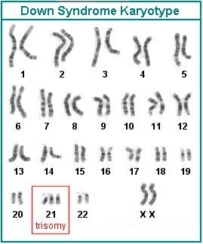
Karyotypes
A karyotype is…
Extra or missing chromosomes, or abnormal positions of chromosome pieces, can cause problems with a person's growth, development, and body functions.

Slide 39
Karyotypes
A karyotype is…
a test to identify and evaluate the size, shape, and number of chromosomes in a sample of body cells.
Extra or missing chromosomes, or abnormal positions of chromosome pieces, can cause problems with a person's growth, development, and body functions.

Slide 40
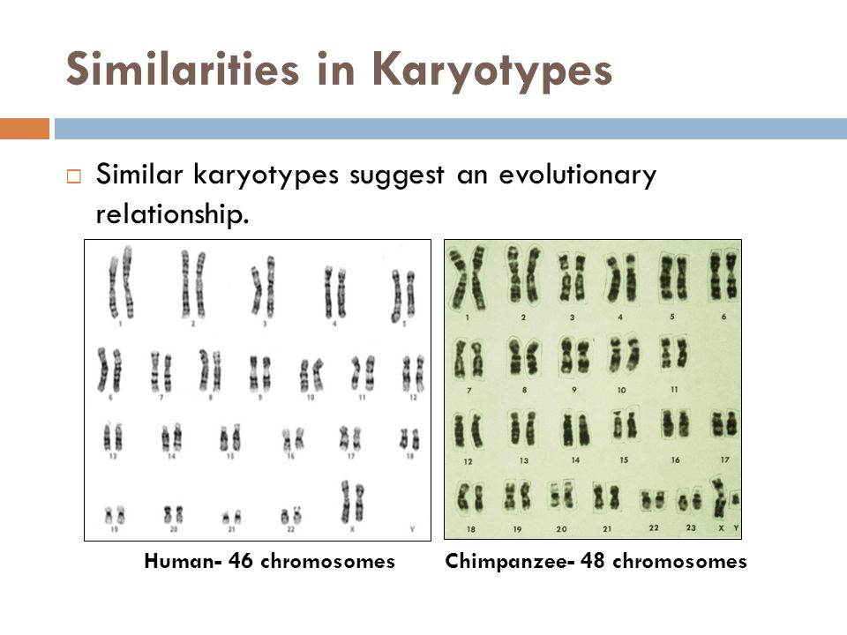
Karyotype Activity

Slide 41
Mutations
Assess the role of genetic mutation in the process of evolution. (K)
How does a change in a codon/amino acid change an organism?
Can overproduction of a particular protein be a good thing, how? What do proteins do?
How does this connect to evolution?

Slide 42
Mutations
Assess the role of genetic mutation in the process of evolution. (K)
How does a change in a codon/amino acid change an organism?
It can change the type of protein created or the amount of a protein created.
Can under/overproduction of a particular protein be a good thing, how? What do proteins do?
Proteins make up muscles, they code for hormones, and other structural tissue in the body. Overproduction or underproduction of certain proteins can change the phenotype of the organism.
How does this connect to evolution?
A change in the production of a certain protein may change the phenotype of an organism – this can be beneficial to their survival and be passed on!

Slide 43
Genetic Expression
Certain genes only become activated at certain times in the presence of environmental factors – this is called epigenetics. Why wouldn’t they be “on” all the time?
Different proteins can stop or induce the transcription or translation of certain proteins, however.
If I stopped the transcription of an mRNA that makes a protein that codes for brown hair, what might happen?

Slide 44
Genetic Expression
Certain genes only become activated at certain times in the presence of environmental factors – this is called epigenetics. Why wouldn’t they be “on” all the time?
It would be a waste of energy. May not need more of the protein in question.
Different proteins can stop or induce the transcription or translation of certain proteins, however.
If I stopped the transcription of an mRNA that makes a protein that codes for brown hair, what might happen?

Slide 45
Genetic Expression
___________ – proteins that suppress transcription of a gene in response to an external stimulus.
___________ – proteins that increases transcription of a gene in response to an external stimulus.
___________ – activate or repress transcription depending on needs of cell and availability of the substrate.

Slide 46
Genetic Expression
Repressors – proteins that suppress transcription of a gene in response to an external stimulus.
Activators – proteins that increases transcription of a gene in response to an external stimulus.
Inducers – activate or repress transcription depending on needs of cell and availability of the substrate.

Slide 47
Epigenetics – Altering of Genetic Material
“Epigenetics is the reason why a skin cell looks different from a brain cell or a muscle cell. All three cells contain the same DNA, but their genes are expressed differently (turned "on" or "off"), which creates the different cell types.” LiveScience
Modifications or adjustments are made all the time without changing our genes.
______________ through DNA Methylation.
Histone modification –

Slide 48
Epigenetics – Altering of Genetic Material
“Epigenetics is the reason why a skin cell looks different from a brain cell or a muscle cell. All three cells contain the same DNA, but their genes are expressed differently (turned "on" or "off"), which creates the different cell types.” LiveScience
Modifications or adjustments are made all the time without changing our genes.
Capping through DNA Methylation.
Basically, a molecule (a methyl group), bonds with a particular location on the DNA effectively blocking it from being expressed (or read).
Histone modification – relaxes the bond between DNA and histone and allows that DNA to be read.

Slide 49
Epigenetics and Cancer
(we have all been affected by someone we know or a friend knows who has or had it).
What is cancer?
Many environmental factors help contribute to the risk of cancer. However, when considering treatment then, we need to determine how to inhibit tumour growth by suppressing a “faulty” gene causing uncontrolled growth. Lots of groups that say “__________ helps cancer growth”, when in reality it helps lots of different types of cell growth.

Slide 50
Epigenetics and Cancer
(we have all been affected by someone we know or a friend knows who has or had it).
What is cancer?
Cancer is an uncontrolled growth in cells. The stop codon could be altered (due to deletion or insertion).
When this change occurs in the DNA of a cell, but the cell keeps mitosing, this makes more of the cancer cell.
If that cancer cell enters the bloodstream (the tumour gets big enough and breaks off), that’s when it “metastasizes”.
When considering the implications of this however, it helps in our potential curing of cancer. Some substances damage cells → DNA. Some induce more growth!
Many environmental factors help contribute to the risk of cancer. However, when considering treatment then, we need to determine how to inhibit tumour growth by suppressing a “faulty” gene causing uncontrolled growth. Lots of groups that say “__________ helps cancer growth”, when in reality it helps lots of different types of cell growth.

Slide 51
Inquiry Questioning about Genetics
Using your devices – try to answer one of the following questions.
People with orange/red hair normally have blue/green eyes?
What genetic mutation led to __________ types of dog?
Is there a genetic cause to ____________?
Genetics and procedural memory (or innate behaviour) – does my dad pass me learned skills?
Why does it seem like everything can cause cancer?
Can marijuana cure cancer?
Why does alcohol and smoking cause cancer?
Can CRISPR cure Cancer?
What are benign and malignant (tumours)

Slide 52
Designer Babies (12) or GMOs (4) – Bill Nye Netflix
Critique these. I personally have grown to like Bill Nye a little bit less in recent years given his approach at times.
If you have a question, we can pause and discuss!
What are three points that stood out?

Slide 53
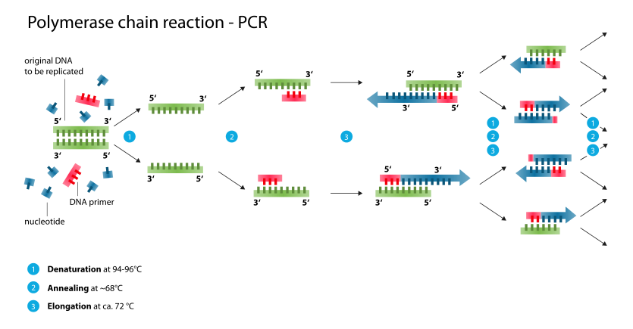
Common Genetic Techniques
Model or simulate common techniques (e.g., agarose gel electrophoresis, polymerase chain reaction, DNA sequencing and DNA fingerprinting) used by molecular geneticists. (S, K, A, STSE)
Our understanding of Genetics/DNA allows for technologies to analyze/adjust it.
Polymerase chain reaction facilitates the replication of certain segments of DNA.
DNA Fingerprinting (or Profiling)
Agarose Gel Electrophoresis (use of a medium and electricity separate molecules based on size – DNA is a molecule, can separate it).

Slide 54
Virtual Lab – Agarose Gel Electrophoresis
http://learn.genetics.utah.edu/content/labs/gel/
Pre-Lab Questions
How is the DNA moved through the gel? How does this connect to our basic understandings of chemistry?
Which strands make it further through the gel, why might this be?
Lab Questions
In 5 points – outline the process to sample the DNA (what do you need, what do you do with the materials)?
Post-Lab
What are some applications of this technology?

Slide 55
Virtual Lab – Agarose Gel Electrophoresis
http://learn.genetics.utah.edu/content/labs/gel/
Pre-Lab Questions
How is the DNA moved through the gel? How does this connect to our basic understandings of chemistry?
Which strands make it further through the gel, why might this be?
Lab Questions
In 5 points – outline the process to sample the DNA (what do you need, what do you do with the materials)?
Post-Lab
What are some applications of this technology?

